Slide 1





Write the date: 14 April 2025
Write the Title and Golden Thread
Title – Water and Bike Safety
Golden Thread – Secure Your Wellbeing
Underline both using your ruler & take out your oracy helpsheet
Complete the following questions:
What is being described: “a mistaken idea or belief many people think about a thing or group that is based upon how they look on the outside, which may be untrue or only partly true.”
True or False – “cyberbullying is not as harmful as in-person bullying
Give an example of when an online friendship is not safe
Stereotypes
False
Do not know them offline, they ask for personal information, ask for the friendship to be kept a secret, what they say and do online makes people scared or anxious

Slide 2
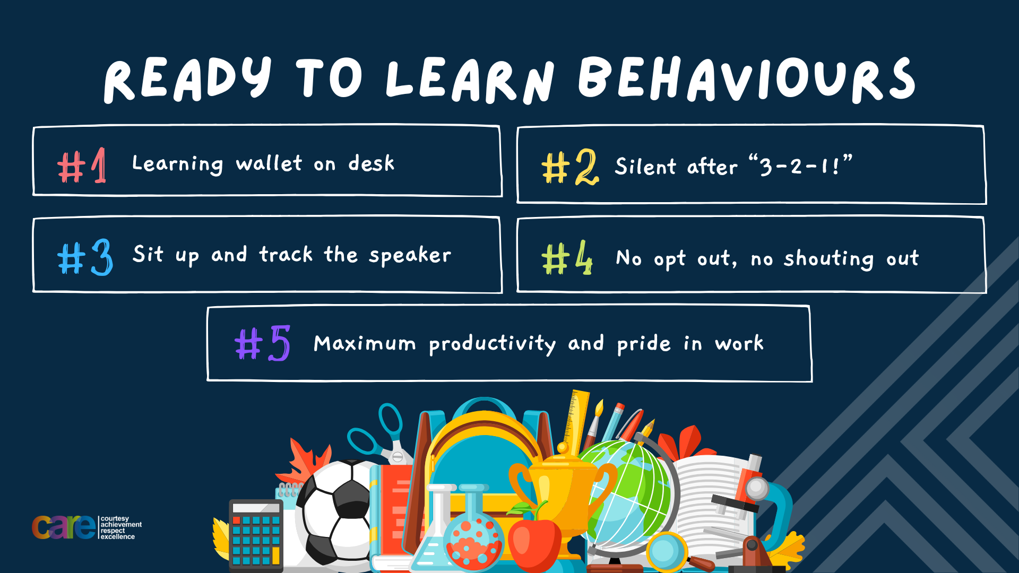

Slide 3


Secure your Wellbeing: Learning Journey
Staying safe – rail, bike and water
What is oral health
What is personal hygiene?
What is mental health?
What is social and physical health?
What does puberty mean?
Today we will look at:
Staying safe around water and using a bike
This includes:
How to stay safe around water
How to stay safe when using a bike
Please remember that during the lesson we should not be asking any pupil or teacher personal questions.
Your teacher can ask you questions but this will be to check your knowledge in the lesson.

Slide 4
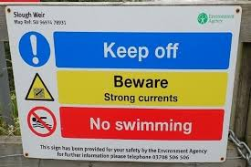
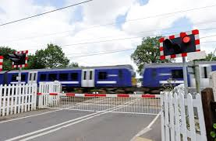
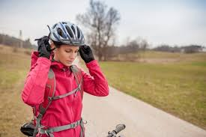
Tutor Time Recap
In your Personal Development Tutor Time activity, you looked at railway safety
In your books answer the following question:
“How can you stay safe around railway tracks?”
Sentence starter – You can stay safe around railway tracks by…

Slide 5
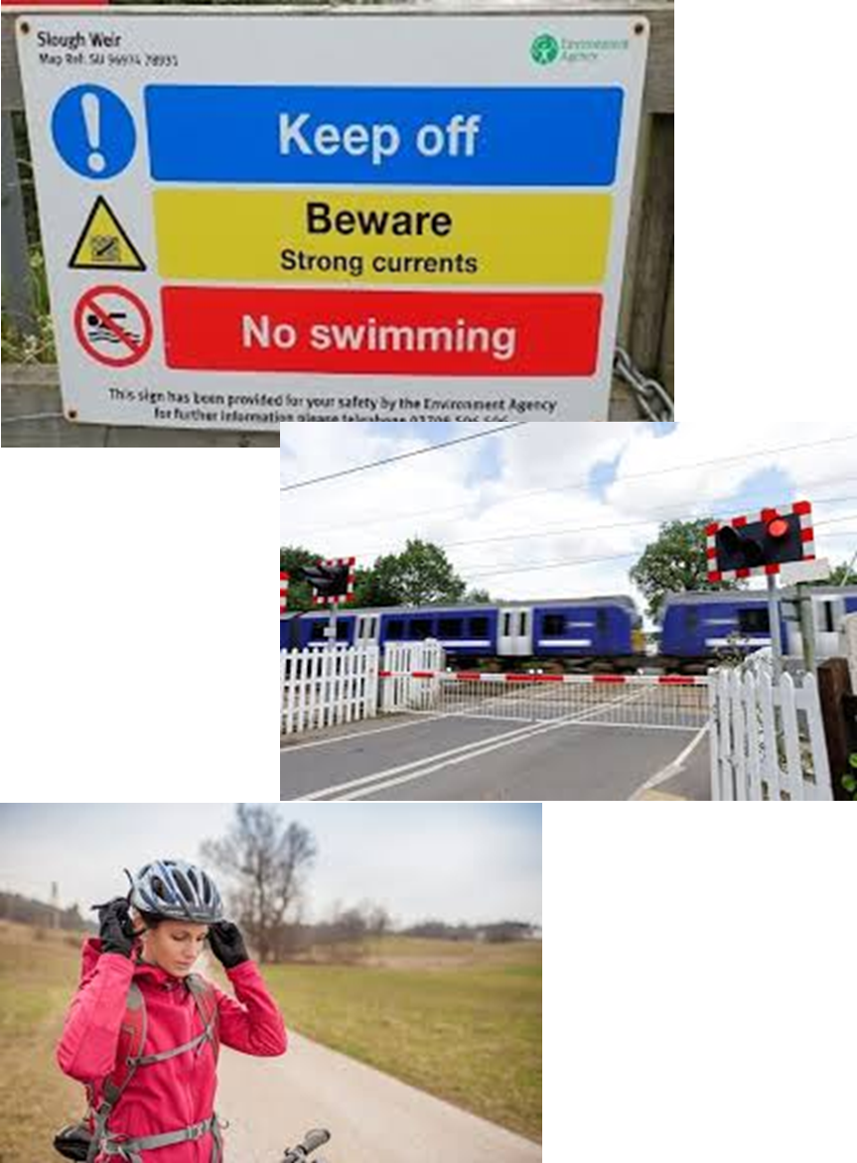
Tutor Time Recap
Ways of staying safe around railway tracks are:
Stay off the tracks
Use proper crossings
Obey warning signs and signals
Stay behind yellow line on platforms
Task – use your red pen to add to what you had written down.

Slide 6

Why are we learning about this?
This video shows why you are learning about staying safe around water
Notes:
https://www.youtube.com/watch?v=3mfgHki4aqw

Slide 7
Water Safety
There are lots of dangers around swimming in open waters such as rivers, lakes and canals.
Every year several young people drown in water incidents across the UK.
In many cases, young people did not have the knowledge and understanding of the dangers of swimming in open water.

Slide 8
Water Safety
One danger is cold water shock.
Open water is much colder than you think.
Cold water shock is the body’s involuntary response to being suddenly immersed into cold water around 15 degrees or lower.

Slide 9
Water Safety
Any water under 15 degrees can seriously affect a person’s breathing and capability to move.
This is because the body may be in muscle spasms and/or hyperventilation.
These stop a person from being able to control their movements.

Slide 10
Water Safety
Another danger is hidden dangers under the water.
People are used to jumping into a swimming pool where the water is clean and they are able to see the bottom.
They then assume they can then do the same in open waters. However there are a number of hidden dangers under the water.

Slide 11
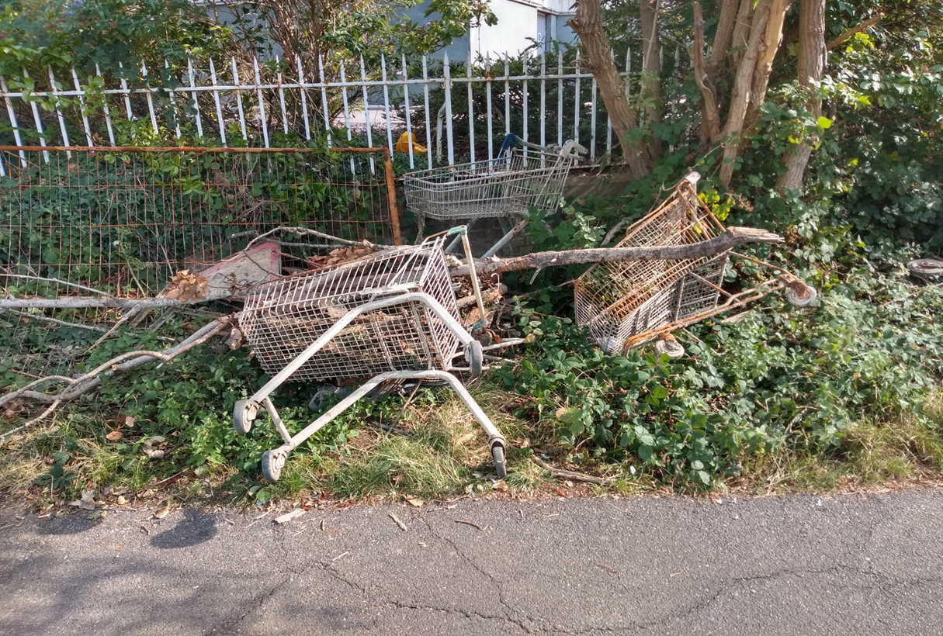
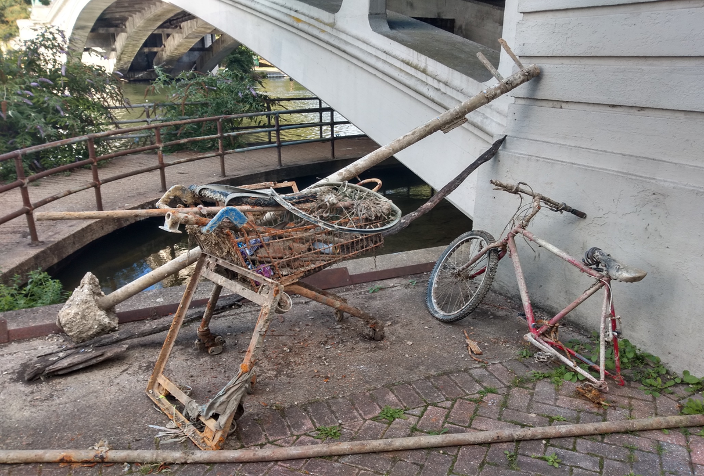
Water Safety
The following are pictures of what was taken out of rivers in the UK.

Slide 12
Water Safety
In addition to these objects, there is also weeds, mud or under currents.
Weeds and mud can make people stuck and not able to move as freely as they think they could.
Under currents are fast flowing water even if the surface looks calm. These can pull people under the water

Slide 13

Hinge Questions – whiteboard activity
3
Rules!
I will ask the question and give you some thinking time. (no more than 10 seconds)
Write the answer and turn your whiteboard over so nobody can see it.
When I am ready I will put on the 3 to 1 counter.
When ‘Show me’ appears on the board you must hold up your whiteboard (even if you don’t know the answer and there is nothing on your board)
2
1
Show me!
(even if your whiteboard is blank)

Slide 14
Hinge Questions – whiteboard activity
What is being described?
“the body’s involuntary response to being suddenly immersed into cold water around 15 degrees or lower.”
Cold water shock

Slide 15

Hinge Questions – whiteboard activity
What golden thread does this topic relate to?
A – Secure your Future
B – Secure your Wellbeing
C – Secure your Relationships
D – Secure your Voice

Slide 16
Hinge Questions – whiteboard activity
True or False
“Cold water shock just makes people get out of the water quicker”
A – True
B – False

Slide 17
Hinge Questions – whiteboard activity
Cold water shock happens in water under…
A – 20 degrees
B – 15 degrees
C – 10 degrees
D – 5 degrees

Slide 18
Hinge Questions – whiteboard activity
True or False:
“it is safe to get into water even if you cannot see the bottom”
A – True
B - False

Slide 19
Hinge Questions – whiteboard activity
True or False:
“in rivers and lakes there can be things like shopping trolleys and metal poles. The mud and weeds can impair your movement and the water might flow faster than you think”
A – True
B - False

Slide 20
Water Safety
Complete the following sentences
Cold water shock is…
Cold water shock happens in water that is…..
Some hidden dangers under water are….

Slide 21
Water Safety - scenario
It’s a warm, sunny afternoon, and Liam and Sam are riding their bikes along a path that runs beside a river.
Liam: “Hey, look at this! A rope swing! This is gonna be awesome!”
(He drops his bike and runs over to the edge of the river.)
Sam: “I don’t know, Liam… The water looks pretty deep. Are you sure it’s safe?”
(Sam glances around, noticing there are no adults or signs about swimming.)
Liam: “Come on, don’t be such a chicken! It’s hot, and we’ve got this place all to ourselves. What could go wrong?”
(Liam grabs the rope and starts testing it with his weight.)
In the margin write “SYV” – This stands for “Secure Your Voice”
Highlight “SYV”
Answer the questions below:
“What could Sam say to Liam to warn him of the dangers?”
Sentence starter – Sam could say…

Slide 22

Water Safety
Using your oracy helpsheet, discuss with the person next to you discuss:
“What could Sam say to Liam to warn him of the dangers?”
Remember to use the sentence starters to add, build or challenge what your partner has said.
Be ready to share your discussion with the class

Slide 23
Bike Safety
This is important as in 2022:
91 people were killed while using a bike
4,056 people were seriously injured
11,546 people were slightly injured

Slide 24
Bike Safety
The most important piece of equipment that can limit injuries is a helmet.
Helmets protect the brain and reduces the risk of serious head injuries by 85%
Even a very minor fall can let to a serious brain injury.

Slide 25
Bike Safety
In the margin write “SYV” – This stands for “Secure Your Voice”
Highlight “SYV”
Write down the 4 ways a person can be safe on a bike in order of most importance
Things a person can do to be safe are:
- Wear a helmet
Check their bike before every ride – do the brakes work? Are the tires pumped up correctly?
Be Visible – wear bright clothing or reflective gear
Stay alert – do not listen to music through headphones when cycling or look at your phone

Slide 26
Bike Safety
Using your oracy helpsheet, discuss with the person next to you discuss:
“What order did you put the things people can do to be safe on a bike?”
Remember to use the sentence starters to add, build or challenge what your partner has said.
Be ready to share your discussion with the class

Slide 27
Bike Safety
In the margin write “SYV” – This stands for “Secure Your Voice”
Highlight “SYV”
What advice would you give to Jake to be more safe on his bike?
Jake and Mia are riding their bikes home from school. Jake decides to take a shortcut through a busy car park. He’s wearing his school hoodie with the hood up and is listening to music with his headphones.

Slide 28
Bike Safety
Using your oracy helpsheet, discuss with the person next to you discuss:
“What advice would you give Jake to be more safe on his bike?”
Remember to use the sentence starters to add, build or challenge what your partner has said.
Be ready to share your discussion with the class

Slide 29
Bike Safety
In the margin write “SYV” – This stands for “Secure Your Voice”
Highlight “SYV”
What advice would you give to Liam and Ava to be more safe on their bikes?
Liam and Ava decide to go for a bike ride in the evening as the sun is setting. Liam’s bike has no lights or reflectors, and he’s wearing dark clothes. Ava is riding close behind Liam and keeps looking at her phone to check messages.

Slide 30
Bike Safety
Using your oracy helpsheet, discuss with the person next to you discuss:
“What advice would you give to Liam and Ava to be more safe on their bikes?”
Remember to use the sentence starters to add, build or challenge what your partner has said.
Be ready to share your discussion with the class

Slide 31
Bike Safety
In the margin write “SYV” – This stands for “Secure Your Voice”
Highlight “SYV”
What advice would you give to Ethan and Sophie to be more safe on their bikes?
Ethan and Sophie plan a weekend bike ride to the park. Before leaving, Ethan doesn’t bother checking his bike, even though his brakes felt loose the last time he rode. Sophie wears her helmet, but Ethan says it looks “uncool” and leaves his at home. On their way, they speed down a steep hill without using their brakes properly, and Ethan struggles to stop at the bottom. They also ignore a “Caution: Uneven Path” sign and ride through a construction area.

Slide 32
Bike Safety
Using your oracy helpsheet, discuss with the person next to you discuss:
“What advice would you give to Ethan and Sophie to be more safe on their bikes?”
Remember to use the sentence starters to add, build or challenge what your partner has said.
Be ready to share your discussion with the class

Slide 33


