Slide 1





Write the date: 14 April 2025
Write the Title and Golden Thread
Title – What are stereotypes?
Golden Thread – Secure Your Relationships
Underline both using your ruler & take out your oracy helpsheet
Complete the following questions:
What is being described: “bullying with the use of digital technologies that has the aim of scaring, angering or shaming another person”
Give an example of an unsafe characteristic of an online friendship
What are the 3 types of bullying?
cyberbullying
Do not know each other offline, they ask for personal information, the want the friendship to be a secret, make others feel uncomfortable/scared/anxious in what they say and share
Verbal, indirect, physical

Slide 2
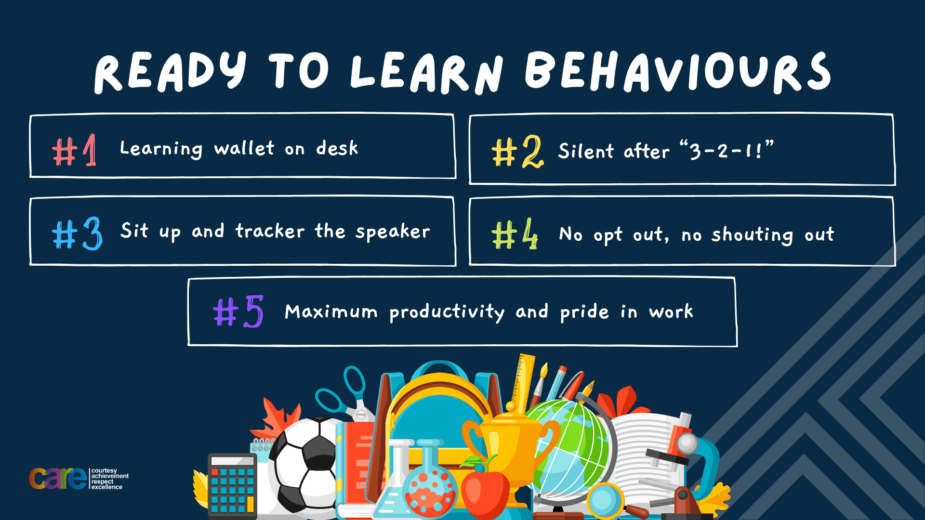

Slide 3


Secure your Relationships: Learning Journey
What makes a good friend?
What is peer pressure?
What is the difference between bullying and banter?
Are online friendship safe?
What is cyberbullying?
What are stereotypes?
Today we will look at:
What are stereotypes?
This includes:
Definition of stereotypes
How likely are you to stereotype?
How to challenge stereotypes?
Please remember that during the lesson we should not be asking any pupil or teacher personal questions.
Your teacher can ask you questions but this will be to check your knowledge in the lesson.

Slide 4

Tutor Time Recap
In your Personal Development Tutor Time activity, you started to look at stereotypes
In your books answer the following question:
“What is the definition of stereotypes?”
Sentence starter – stereotypes are…

Slide 5
Tutor Time Recap
Stereotypes are:
“a mistaken idea or belief many people think about a thing or group that is based upon how they look on the outside, which may be untrue or only partly true.”
Task – use your red pen to add to the definition you had written down.

Slide 6
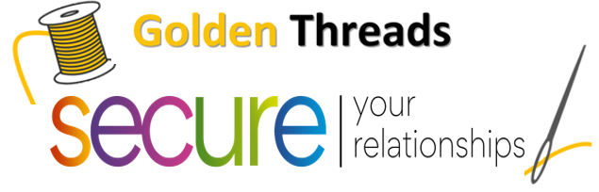

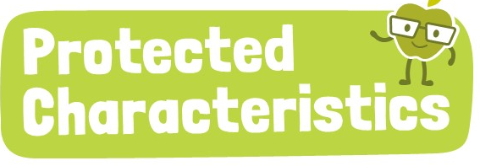
Tutor Time Recap
We are learning this because:
Links to the Golden Thread of “Secure your relationships”. It is important to get to know people and not instantly judge them
Individual Liberty is a British Value that allows people to express and act freely. No one should be stereotyped for their actions.
Article 2 of the UN Rights of a Child state children have the right to not be discriminated against. Stereotypes can lead to discrimination
No one should be treated differently for identifying with one or more of the protected characteristics. This is law called “The Equality Act (2010).”
UN Rights
of a Child

Slide 7
Stereotyping Task
For this next task you are the boss of a company that needs an engineer to work on a new space project to help the UK get to the moon.
It needs the right person for the job. Someone with resilience, determination, engineering expertise and great people skills.

Slide 8
Stereotyping Task
Over the next few slides you are going to find out some information about the 7 candidates for the role.
On each slide you are going to have to choose one person to remove from the process. Eventually you will be left with the person you will hire for the position.

Slide 9
Stereotyping Task
The 7 candidates are:
Ali
Patrick
Jamie
David
Adriana
Hannah
Delroy
One your whiteboard write down all 7 names.
Put a line through the name of the person you want to fire based on this information.

Slide 10
Stereotyping Task
The 7 candidates are:
Ali Abdul
Patrick Murphy
Jamie Small
David Campbell
Adriana Carboni
Hannah Mann
Delroy Bailey
Put a line through the name of the person you want to fire based on this information.

Slide 11
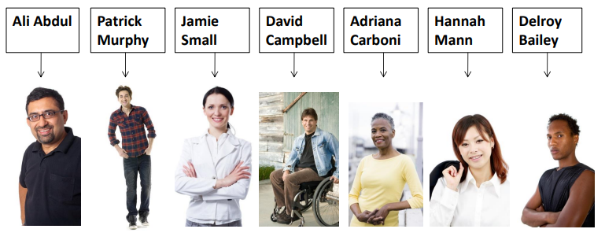
Stereotyping Task
The 7 candidates are:
Put a line through the name of the person you want to fire based on this information.

Slide 12
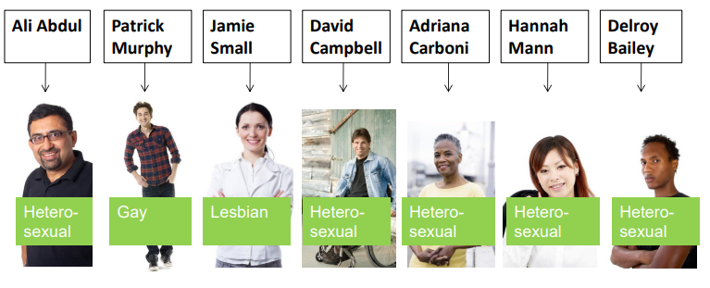
Stereotyping Task
The 7 candidates are:
Put a line through the name of the person you want to fire based on this information.

Slide 13
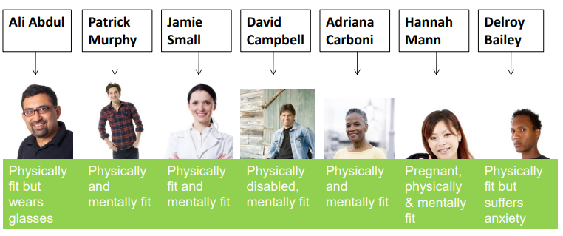
Stereotyping Task
The 7 candidates are:
Put a line through the name of the person you want to fire based on this information.

Slide 14
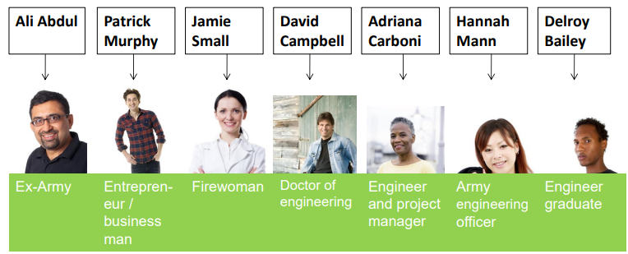
Stereotyping Task
The 7 candidates are:
Put a line through the name of the person you want to fire based on this information. You should now have one person remaining. This is who you have hired for the role

Slide 15
Stereotype task
Task
In the margin write “SYV” – This stands for “Secure Your Voice”
Highlight “SYV”
Answer the questions below:
  Who was your choice for the job?
  Would your choice had changed if you had all the information at the beginning?
  Were you swayed by any stereotypes? What do you think these were?

Slide 16

Stereotyping task
Using your oracy helpsheet, discuss with the person next to you discuss your answers to the questions you have just answered.
Remember to use the sentence starters to add, build or challenge what your partner has said.
Be ready to share your discussion with the class

Slide 17

Hinge Questions – whiteboard activity
3
Rules!
I will ask the question and give you some thinking time. (no more than 10 seconds)
Write the answer and turn your whiteboard over so nobody can see it.
When I am ready I will put on the 3 to 1 counter.
When ‘Show me’ appears on the board you must hold up your whiteboard (even if you don’t know the answer and there is nothing on your board)
2
1
Show me!
(even if your whiteboard is blank)

Slide 18
Hinge Questions – whiteboard activity
What is being described?
“a mistaken idea or belief many people think about a thing or group that is based upon how they look on the outside, which may be untrue or only partly true.”
stereotypes

Slide 19

Hinge Questions – whiteboard activity
What golden thread does this topic relate to?
A – Secure your Future
B – Secure your Wellbeing
C – Secure your Relationships
D – Secure your Voice

Slide 20
Hinge Questions – whiteboard activity
Stereotypes can lead to…
Discrimination

Slide 21
Hinge Questions – whiteboard activity
What law protects people from stereotypes/discrimination?
A – The Inequality Act 2010
B – The Equality Act 2010
C – The Stereotype Act 2010
D – The Anti-Stereotype Act 2010

Slide 22
Hinge Questions – whiteboard activity
True or False:
“all stereotypes are true”
A – True
B - False

Slide 23
Challenging Stereotypes
It is important that stereotypes are challenged.
Some ways this can be done are:
Asking questions such as “is this really true for everyone?”
Getting to know people as individuals
Becoming more educated on different cultures and perspectives
Promoting stories and role models that break stereotypes

Slide 24
Challenging stereotypes
In the margin write “SYV” – This stands for “Secure Your Voice”
Highlight “SYV”
Answer the questions below:
“Why is it important to speak up to challenge a stereotype?”
Sentence starter – It is important to challenge stereotypes because…

Slide 25
Challenging Stereotypes
Using your oracy helpsheet, discuss with the person next to you discuss:
“Why is it important to speak up to challenge a stereotype?”
Remember to use the sentence starters to add, build or challenge what your partner has said.
Be ready to share your discussion with the class

Slide 26
Scenario
A new pupil has joined the class. The teacher explains that the new pupil has just moved to the UK. Someone in the class assumes that the new pupil in the class does not speak English and tells their friends not to waste their time speaking to them. One of the friend goes over to talk to the friend and finds out they are fluent in English. They invite them over to get to know the group
In the margin write “SYV” – This stands for “Secure Your Voice”
Highlight “SYV”
Answer the questions below:
  What stereotype is evident in the scenario?
  How was the stereotype challenged?

Slide 27
Stereotyping task
Using your oracy helpsheet, discuss with the person next to you discuss:
“What was the stereotype in the scenario? How was the stereotype challenged?”
Remember to use the sentence starters to add, build or challenge what your partner has said.
Be ready to share your discussion with the class

Slide 28
Scenario
During a PE lesson involving both male and female pupils, the teacher wants to find out who is the fastest in the class. One pupil says “that’s easy, it is obviously a boy as boys are faster than girls” One of the pupils friends tell them “actually one of the girls represents West Midlands in 100m sprint.” The class have a race and the girl wins. The pupil who said the comment, goes over to the girl to ask about her experience as a sprinter and how they could get involved.
In the margin write “SYV” – This stands for “Secure Your Voice”
Highlight “SYV”
Answer the questions below:
  What stereotype is evident in the scenario?
  How was the stereotype challenged?

Slide 29
Stereotyping task
Using your oracy helpsheet, discuss with the person next to you discuss:
“What was the stereotype in the scenario? How was the stereotype challenged?”
Remember to use the sentence starters to add, build or challenge what your partner has said.
Be ready to share your discussion with the class

Slide 30
Reflection
Stereotypes lead to discrimination as they are often untrue.
This means that people are judged before people actually get to know them.
What will you do to avoid believing stereotypes?

Slide 31



Support
If you ever need support about stereotypes/discrimination for yourself, a friend or family member you can find it here:
Childline.org.uk
Call – 08001111
Email or chat online for support
Themix.org.uk
You can email or have one-to-chat online.
There is also a crisis messenger which is available 24/7

Slide 32


