Slide 1
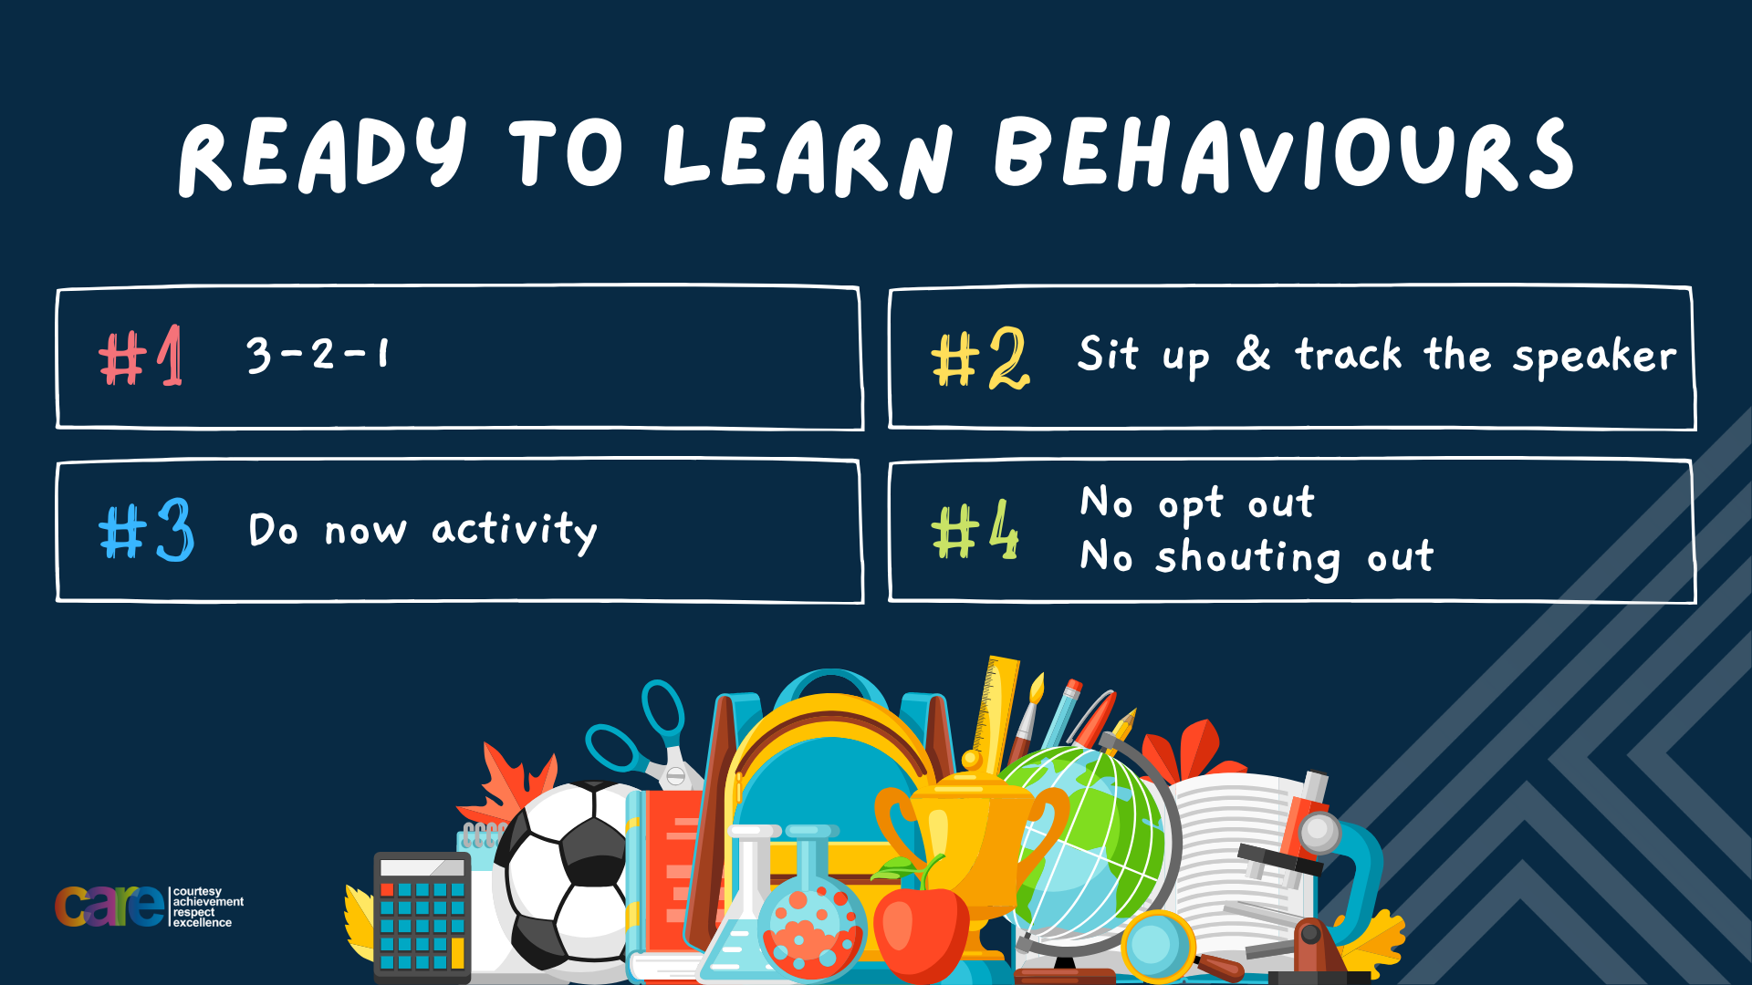

Slide 2








Write the date: 14 April 2025
Write the title: Who is in the UK Government?
Underline both using your ruler in your learning wallet. Take out your oracy helpsheet too.
Complete the following questions:
If a person wants to speak to their MP where do they have to go?
What political party came 2nd in the last General Election?
Name one UK Political Party that is not Labour or Conservative
MP Surgery
Conservatives
Reform UK, Liberal Democrats, SNP, Sinn Fein, DUP, Plaid Cymru, Green Party

Slide 3


Secure your Voice: Learning Journey
What is democracy?
Political Parties in the UK
How did the UK General Election work?
What does a MP do?
Who is in the UK Government?
What would you do as a MP?
Today we will look at:
Who is in the UK Government
This includes:
What departments are there in the UK Government
What do these departments do?
What would you do if you worked in one of the departments?
Please remember that during the lesson we should not be asking any pupil or teacher personal questions.
Your teacher can ask you questions but this will be to check your knowledge in the lesson.

Slide 4
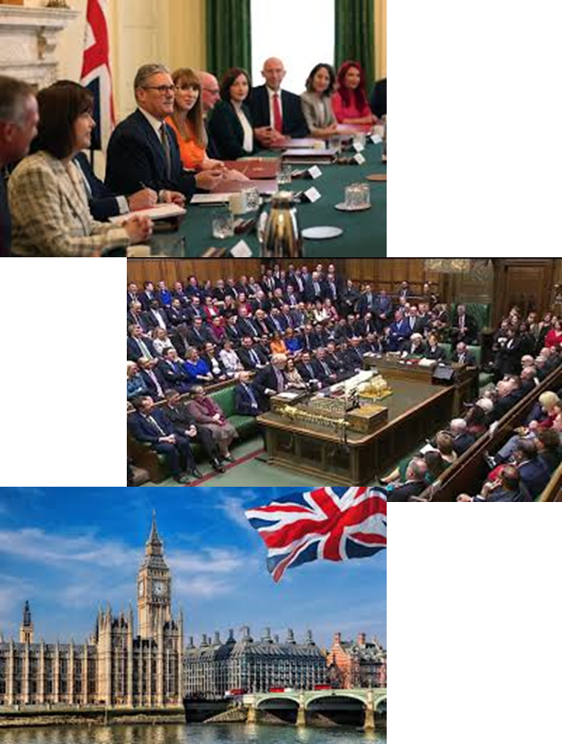
Tutor Time Recap
The UK Government is responsible for making decisions that affect everyone in the UK.
It creates and enforces law, manages public services (schools, hospitals) and ensures the safety and welfare of it’s citizens.

Slide 5
Tutor Time Recap
The structure of the UK Government is:
The Monarch
The Prime Minister
Cabinet Ministers/Secretaries of State
Ministers

Slide 6
Tutor Time Recap
Learning about this secures your voice in the future as you will be more knowledgeable about the government so when you are old enough to vote you can make a more informed decision on who to vote for.
Democracy is a British Value and is shown by all people within government have been elected by people living in the UK

Slide 7
Tutor Time Recap
Article 17 of the UN Rights of a Child state that governments should ensure children have a right to information. Learning about the UK Government and how they impact your life is an example of this.
All decisions made by the government have to ensure that the 9 protected characteristics are not discriminated against so everyone is treated fairly and equally.

Slide 8

UK Government departments
Take out your oracy helpsheet from your learning wallet.
You have 1 minute to think about the following question:
“What departments do you think there are within the UK Government?”

Slide 9

UK Government departments
Using your oracy helpsheet, discuss with the person next to you:
“What departments do you think there are within the UK Government?”
Remember to use the sentence starters to add, build or challenge what your partner has said.
Be ready to share your discussion with the class

Slide 10
UK Government departments
There are many departments in the UK. However some you may have heard of before are:
HM Treasury
Home Office
Foreign, Commonwealth & Development Office
Department for Education

Slide 11
UK Government departments
There are many departments in the UK. However some you may have heard of before are:
5. Department of Health and Social Care
6. Ministry of Defence
7. Department for Environment, Food & Rural Affairs
8. Department for Transport
9. Department for Digital, Culture, Media & Sport

Slide 12
UK Government departments
With the person next to you, now you have to use the matching cards to match up the name of the UK government department with a description of their role.
For example – Department for Education matches to “Responsible for schools, universities, apprenticeships and child services”

Slide 13
UK Government departments
HM Treasury matches to:
Manages the country’s finances, including taxes, spending and the national budget

Slide 14
UK Government departments
Home Office matches to:
Oversees police forces, immigration, counter-terrorism and public safety

Slide 15
UK Government departments
Foreign, Commonwealth & Development Office matches to:
Manages the UK’s relationships with other countries, including foreign aid and diplomacy

Slide 16
UK Government departments
Department for Education matches to:
Responsible for schools, universities, apprenticeships and child services

Slide 17
UK Government departments
Department of Health and Social Care matches to:
Oversees the NHS and all aspects of public health and social care.

Slide 18
UK Government departments
Ministry of Defence matches to:
Handles national security and the armed forces, including the army, navy and air force

Slide 19
UK Government departments
Department for Environment, Food & Rural Affairs matches to:
Looks after the environment, agriculture, rural communities and animal welfare

Slide 20
UK Government departments
Department for Transport matches to:
Manages roads, railways, aviation and public transport systems

Slide 21
UK Government departments
Department for Digital, Culture, Media & Sport matches to:
Promotes culture, arts, sports and digital innovation

Slide 22

Hinge Questions – whiteboard activity
3
Rules!
I will ask the question and give you some thinking time. (no more than 10 seconds)
Write the answer and turn your whiteboard over so nobody can see it.
When I am ready I will put on the 3 to 1 counter.
When ‘Show me’ appears on the board you must hold up your whiteboard (even if you don’t know the answer and there is nothing on your board)
2
1
Show me!
(even if your whiteboard is blank)

Slide 23

Hinge Questions – whiteboard activity
Who is responsible for all major decisions in government
A – Prime Minister’s Office
B – HM Treasury
C- Department for Education

Slide 24
Hinge Questions – whiteboard activity
Who is responsible for schools and universities in the government?
A – Department of Digital, Culture, Media & Sport
B – Department for Transport
C- Department for Education

Slide 25
Hinge Questions – whiteboard activity
Who is responsible for the NHS in the government?
A – Prime Minister’s Office
B – Department for Health and Social Care
C- Department for Transport

Slide 26
Hinge Questions – whiteboard activity
Who is responsible for the army in the government?
A – Prime Minister’s Office
B – Ministry of Defence
C- Department for Environment, Food & Rural Affairs

Slide 27
Hinge Questions – whiteboard activity
Who is responsible for the environment in the government?
A – HM Treasury
B – Home Office
C- Department for Environment, Food & Rural Affairs

Slide 28
UK Government departments
UK Government departments:
Prime Minister’s Office
HM Treasury
Home Office
Foreign, Commonwealth & Development Office
Department for Education
Department of Health and Social Care
Ministry of Defence
Department for Environment, Food and Rural Affairs
Department for Transport
Department for Digital, Culture, Media and Sport
In your books write down:
The government department that you think is most important
At least 1 reason why you think this department is the most important
The UK Government that I think is most important is…
The reason I think this is…

Slide 29
UK Government departments
Take out your oracy helpsheet from your learning wallet.
You have 1 minute to think about the following question:
“If you were in charge of the Department for Education what is the first change you would make to schools?”
Write your ideas in your book

Slide 30
UK Government departments
Using your oracy helpsheet, discuss with the person next to you:
“If you were in charge of the Department for Education what is the first change you would make to schools?”
Remember to use the sentence starters to add, build or challenge what your partner has said.
Be ready to share your discussion with the class

Slide 31
UK Government departments
Take out your oracy helpsheet from your learning wallet.
You have 1 minute to think about the following question:
“If you were the Prime Minister for 1 day, what would you do to make the lives of everyone in the UK better?”
Write your ideas in your book

Slide 32
UK Government departments
Using your oracy helpsheet, discuss with the person next to you:
“If you were the Prime Minister for 1 day, what would you do to make the lives of everyone in the UK better?”
Remember to use the sentence starters to add, build or challenge what your partner has said.
Be ready to share your discussion with the class

Slide 33
UK Government departments
Take out your oracy helpsheet from your learning wallet.
You have 1 minute to think about the following question:
“If you were in charge of the Department for Environment, Food and Rural Affairs, what would you do to improve the environment in the UK?”
Write your ideas in your book

Slide 34
UK Government departments
Using your oracy helpsheet, discuss with the person next to you:
“If you were in charge of the Department for Environment, Food and Rural Affairs, what would you do to improve the environment in the UK?”
Remember to use the sentence starters to add, build or challenge what your partner has said.
Be ready to share your discussion with the class

Slide 35


