Slide 1
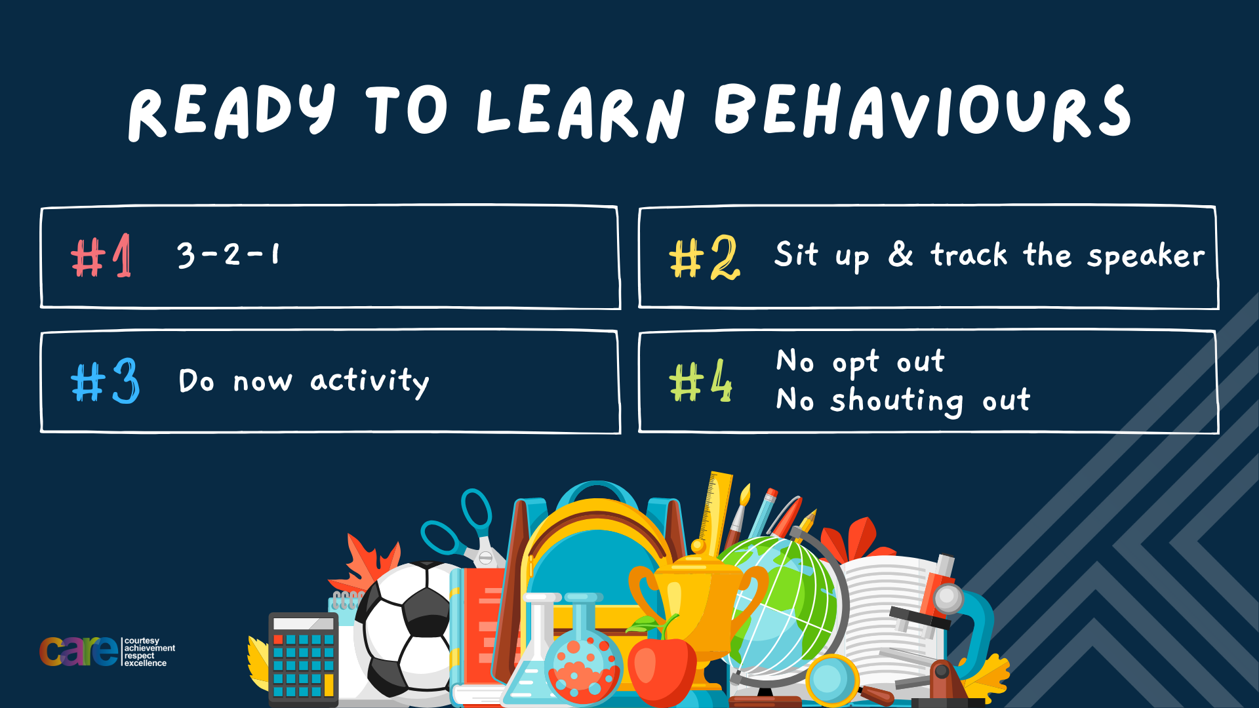

Slide 2








Write the date: 14 April 2025
Write the title: How did the UK General Election work?
Underline both using your ruler in your learning wallet. Take out your oracy helpsheet too.
Complete the following questions:
Name one political party in the UK
True or False – people have the right to protest as long as it remains peaceful
What does E stand for in BED to help sleep?
Labour, Conservatives, Reform UK, Liberal Democrats, SNP, Sinn Fein, DUP, Plaid Cymru, Green Party
True
Bedroom environment

Slide 3


Secure your Voice: Learning Journey
What is democracy?
Political Parties in the UK
How did the UK General Election work?
What is a MP?
What do MP’s do everyday?
What would you do as a MP?
Today we will look at:
How did the UK General Election work?
This includes:
Who can vote in the General Election
Results of the General Election
How the votes are counted
When will the next election be?
Please remember that during the lesson we should not be asking any pupil or teacher personal questions.
Your teacher can ask you questions but this will be to check your knowledge in the lesson.

Slide 4

Tutor Time Recap
In tutor time this week you started to learn about the political parties in the UK
You have 1 minute to write down 3 things you can remember from your Personal Development tutor time activity on Monday

Slide 5
Tutor Time Recap
Using your oracy helpsheet, discuss with the person next to you the things you remember from your Personal Development tutor time activity.
Remember to use the sentence starters to add, build or challenge what your partner has said.
Be ready to share your discussion with the class

Slide 6
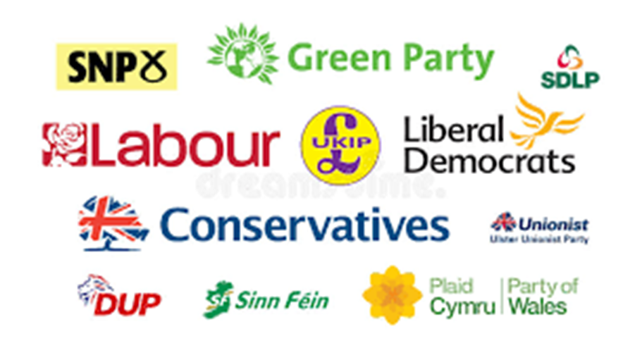
Tutor Time Recap
People in local areas are known as constituents.
Local areas are known as constituencies
Hodge Hill College falls under the Hodge Hill and North Solihull constituency. This was the first General Election for this constituency
The candidate that won the vote in the Hodge Hill and North Solihull constituency was Liam Byrne from the Labour Party

Slide 7
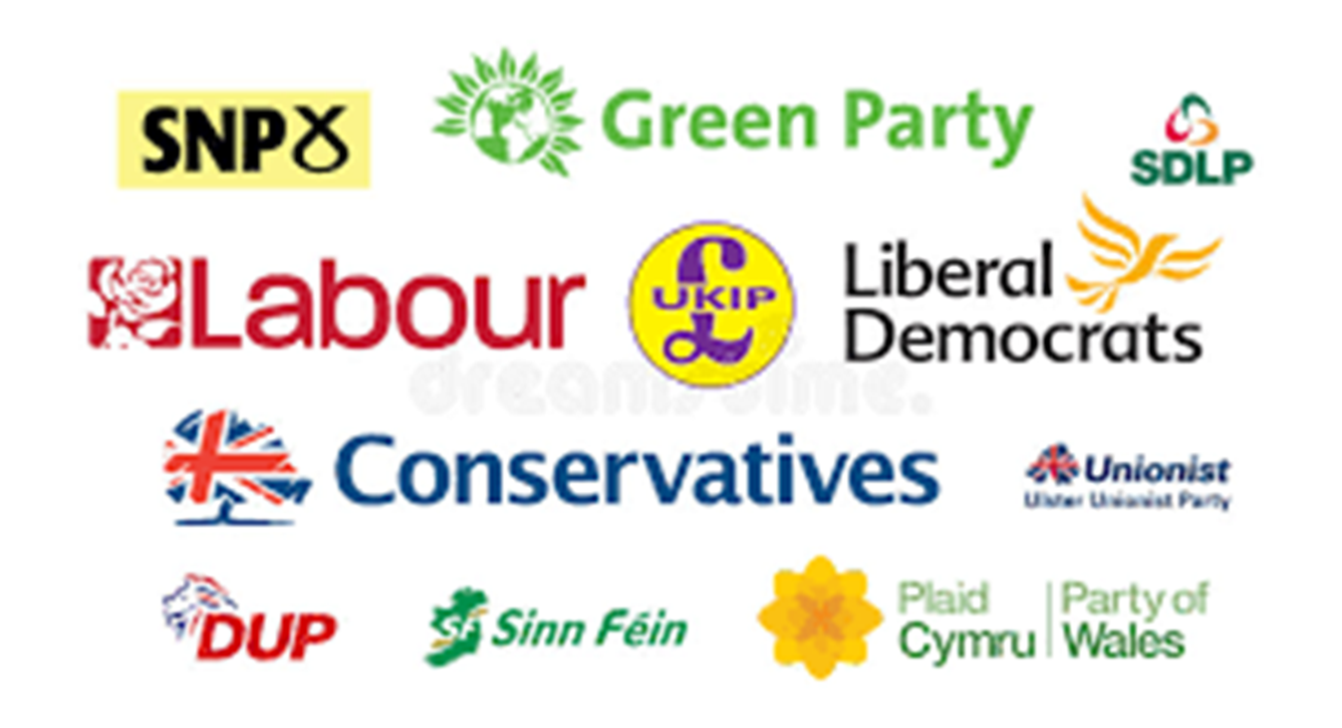
Tutor Time Recap
You are learning about this because:
-Democracy is a British Value that allows rule by the people. People are free to vote for whichever political party they wish
Article 12 of the UN Rights of a Child says that governments should have respect for children’s views. Although children can’t vote, political parties still make decisions that impact children
It will also help you secure your voice by making sure you know more about the political parties ready for when you can vote at 18 years old

Slide 8
Voting in the election
You now have 1 minute to think about the question:
“Could everyone vote in the UK General Election?”
Write your ideas down in your book.

Slide 9
Voting in the election
Using your oracy helpsheet, discuss with the person next to you the question:
“Could everyone vote in the UK General Election?”
Remember to use the sentence starters to add, build or challenge what your partner has said.
Be ready to share your discussion with the class

Slide 10


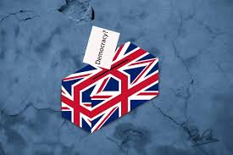
Could everyone vote in the UK General Election?
Although the UK is democratic country there are still some rules around who is allowed to vote in a General Election.

Slide 11
Could everyone vote in the UK General Election?
These rules are:
1. You must be a British, qualifying Commonwealth or Republic of Ireland citizen

Slide 12
Could everyone vote in the UK General Election?
These rules are:
2. You must not be legally excluded. An example of why people may be legally excluded is prisoners who have been found guilty of an offence and are detained in prison or a mental health hospital due to their offence.

Slide 13
Could everyone vote in the UK General Election?
These rules are:
3. Be 18 years old or older on the day of the general election

Slide 14
Could everyone vote in the UK General Election?
These rules are:
4. Have registered to vote. This date is different than the election day. The deadline for registering to vote for this General Election was Tuesday 18th June. In the previous General Election, approximately 8 million people did not register to vote.

Slide 15
Could everyone vote in the UK General Election?
These rules are:
5. Have photographic ID with you when voting.
This is the first General Election with this rule. This rule was implemented in 2023 after a Government policy paper said that having photographic ID is an effective system for preventing election fraud

Slide 16

Hinge Questions – whiteboard activity
3
Rules!
I will ask the question and give you some thinking time. (no more than 10 seconds)
Write the answer and turn your whiteboard over so nobody can see it.
When I am ready I will put on the 3 to 1 counter.
When ‘Show me’ appears on the board you must hold up your whiteboard (even if you don’t know the answer and there is nothing on your board)
2
1
Show me!
(even if your whiteboard is blank)

Slide 17

Hinge Questions – whiteboard activity
What are local areas known as during elections?
A – Neighbourhoods
B – The Hood
C- Constituency

Slide 18
Hinge Questions – whiteboard activity
What are voters known as during elections?
A – voters
B – constituents
C- people

Slide 19
Hinge Questions – whiteboard activity
True or False
We are learning about this because Democracy is a British Value?
True

Slide 20
Hinge Questions – whiteboard activity
True or False
Children cannot vote so there are no human rights for children
False – Article 12 of the UN Rights of a Child says that children’s views and opinion have a right to be heard and taken seriously. Many UK Political parties listen to children so their voices can be heard

Slide 21
Hinge Questions – whiteboard activity
True or False
You have to be 18 or over on election day to vote
True

Slide 22
Hinge Questions – whiteboard activity
True or False
“You have to a British, qualifying Commonwealth or Republic of Ireland citizen to vote”
True

Slide 23
Hinge Questions – whiteboard activity
True or False
“People in prison can vote”
False

Slide 24
Hinge Questions – whiteboard activity
True or False
“People must be registered to vote even if they already live in the UK”
True

Slide 25
Hinge Questions – whiteboard activity
True or False
“You have to shown photographic ID in order to vote”
True

Slide 26
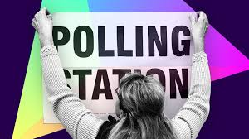

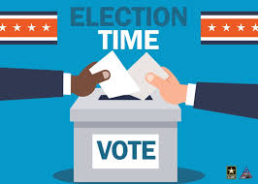
How did voting happen on election day
Look at where the local polling station is
A polling station is a public building that is used as a location for people to vote. Examples of Polling Stations are some school, libraries, town halls and community centres.
The location of the polling station is on a polling card. This is received in the post by all those who have registered to vote.

Slide 27
How did voting happen on election day
2. Go to the polling station
This might sound silly but lots of people either forget to vote on the day or they go before or after the polling station is open.
All polling stations are open from 7am to 10pm to allow all people a chance to attend around their work schedules.

Slide 28
How did voting happen on election day
3. Complete a voting slip
Voters must mark their choice with a “x” in the box beside their chosen candidate.
When completing the voting slip you must not mark multiple candidates or write anything else on the voting slip. This is called a “spoiled vote” and the vote will not be counted.
Once the voting slip is completed this is put into the ballot box for counting after the polling station has closed.

Slide 29
Other ways to vote
Many people may not be able to attend their polling station on voting day.
This could be because they are:
On holiday
Working away from home
Not physically capable of attending the polling station
In hospital for planned surgery

Slide 30
Other ways to vote
For people who cannot vote on the election day there are 2 other ways to vote:
Postal Vote
In order to vote by post you must be registered to vote and also apply to vote by post. All instructions must be followed or the vote will not count. All postal votes must be at the allocated polling station before 10pm on election day

Slide 31
Other ways to vote
For people who cannot vote on the election day there are 2 other ways to vote:
2. Proxy vote
This means that someone else can vote on your behalf. This could mean that you are away on election day, have a medical issue or disability. The person must also apply for a proxy vote 6 days before the general election

Slide 32
How were the results counted?
Once polling stations were closed, counting of the votes began.
The voting system used in the UK is “first past the post”
This means that voters selected their preferred candidate and the candidate with the most votes won.
For example – Liam Byrne got the highest percentage of votes in the Hodge Hill and North Solihill constituency so we won the vote in that constituency.

Slide 33
Hinge Questions – whiteboard activity
3
Rules!
I will ask the question and give you some thinking time. (no more than 10 seconds)
Write the answer and turn your whiteboard over so nobody can see it.
When I am ready I will put on the 3 to 1 counter.
When ‘Show me’ appears on the board you must hold up your whiteboard (even if you don’t know the answer and there is nothing on your board)
2
1
Show me!
(even if your whiteboard is blank)

Slide 34
Hinge Questions – whiteboard activity
True or False
“People could vote from their homes using their phones”
False

Slide 35
Hinge Questions – whiteboard activity
True or False
“When completing the ballot paper a voter can only chose one candidate”
True

Slide 36
Hinge Questions – whiteboard activity
People could complete a proxy vote. What one other way could a person vote if they could not make it to a polling station
A – Vote online
B - Postal vote
C – Send an email

Slide 37
Hinge Questions – whiteboard activity
What voting system is used to decide who wins the vote
A – first past the post
B – winner takes all

Slide 38
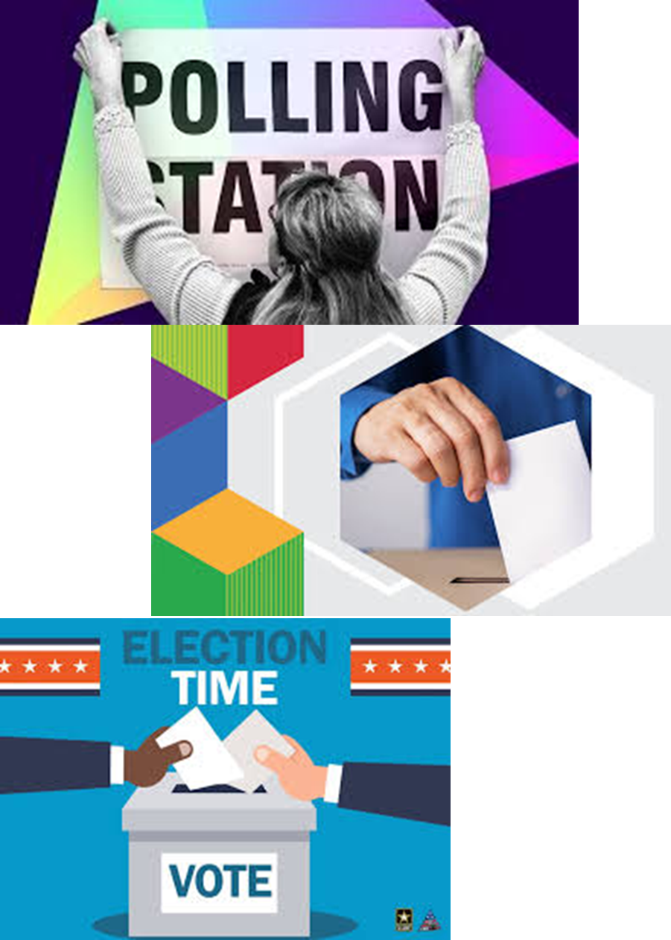
What were the General Election results
During Tutor Time you found out that Liam Byrne from the Labour party won the vote in the Hodge Hill and North Solihull constituency.
But what were the results across the whole UK?

Slide 39
What were the General Election results
Labour won the vote in 412 constituencies.
This meant that they won the majority of seats available in Parliament so they now have 412 MP’s.
This also meant that the Labour Party Leader, Sir Keir Starmer, became Prime Minister and replaced Rishi Sunak.

Slide 40
What were the General Election results
Of the 238 remaining constituencies the results were:
Conservatives – won 121
Liberal Democrats – won 72
SNP – won 9
Sinn Fein – won 7
Independents (people who do not represent a Political Party) – won 6
Reform UK – won 5
DUP – won 5
Green Party – 4
Plaid Cymru – won 4
SDLP – won 2
Alliance – won 1
UUP – won 1
TUV – won 1

Slide 41
What were the General Election results
If results are looked at differently, Labour won 33.7% of all votes made in the General Election.
Conservatives won 23.7% of all the votes made in the General Election.
Despite this Labour won over 3 times as many constituencies and therefore have over 3 times the amount of MP’s in Parliament

Slide 42
Election result
You now have 1 minute to think about the question:
“Do you think this is a fair system to count the votes?”
Write your reasons down in your book.

Slide 43
Election results
Using your oracy helpsheet, discuss with the person next to you the question:
“Do you think this is a fair system to count the votes?”
Remember to use the sentence starters to add, build or challenge what your partner has said.
Be ready to share your discussion with the class

Slide 44
When is the next General Election?
There is a law called Dissolution and Calling of Parliament Act 2022.
This law states that the Prime Minister has the power to ask The King to call an election at any time during the 5 year length of Parliament.
If the Prime Minister does not do this then Parliament is automatically dissolved 5 years after the day it first met.
This means the latest an election could be held is 15th August 2029.

Slide 45
When is the next election
You now have 1 minute to think about the question:
“Should people have to wait this long for a new General Election?”
Write your reasons down in your book.

Slide 46
Election results
Using your oracy helpsheet, discuss with the person next to you the question:
“Should people have to wait this long for a new General Election?”
Remember to use the sentence starters to add, build or challenge what your partner has said.
Be ready to share your discussion with the class

Slide 47


