Slide 1
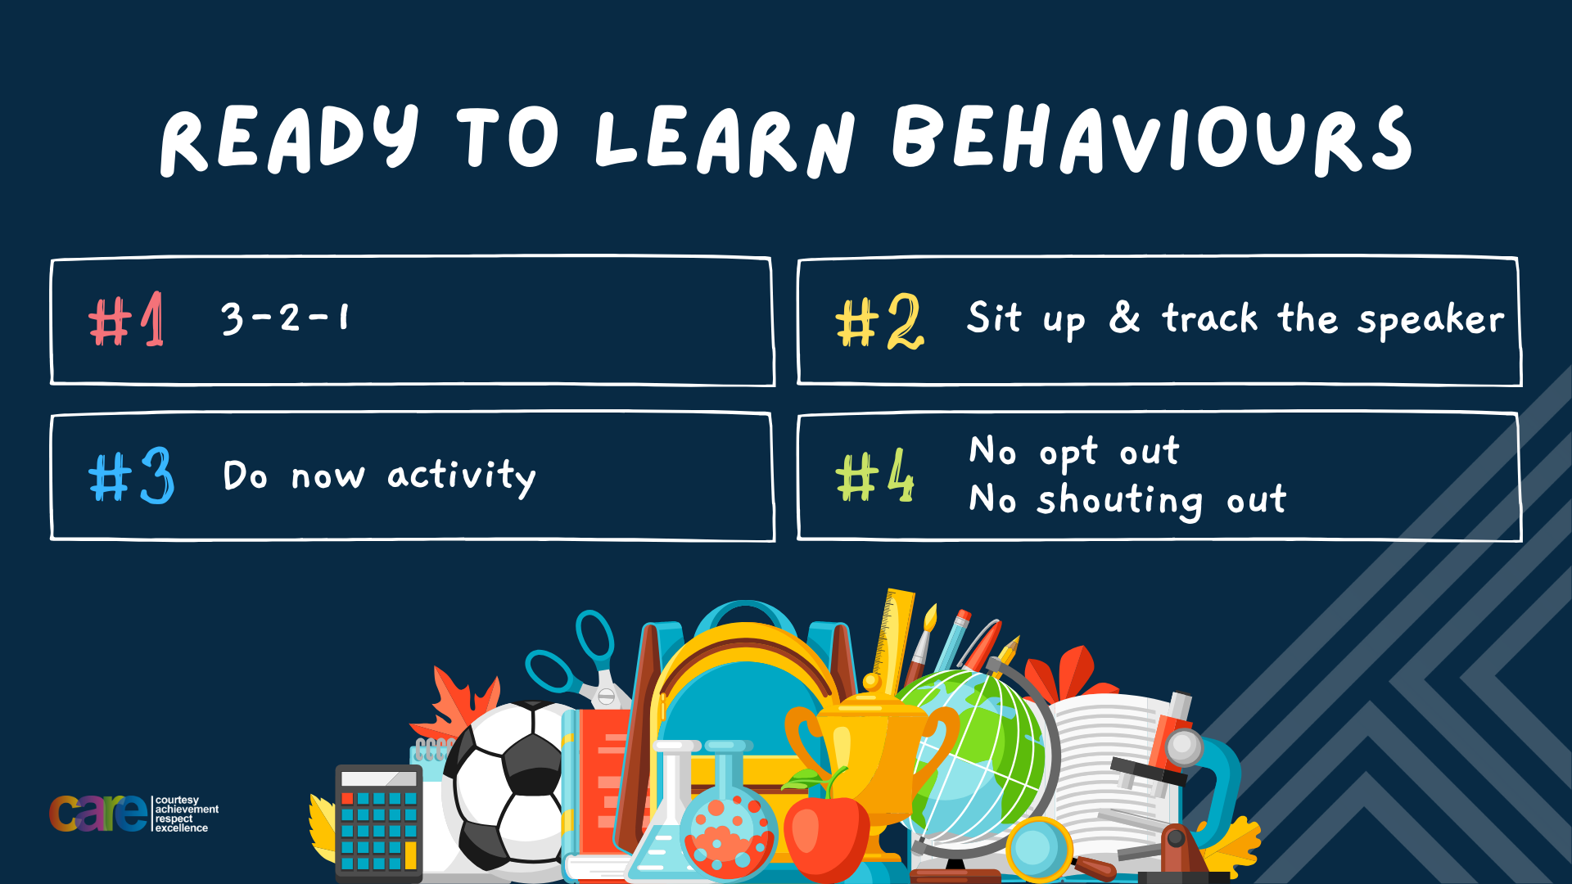

Slide 2








Write the date: 14 April 2025
Write the title: What makes a good friend?
Underline both using your ruler in your learning wallet. Take out your oracy helpsheet too.
Complete the following questions:
What is being described: “a system of rules that a country have agreed to follow.” “
Give an example of a Government Department
What is a local area called when it refers to elections?
Laws
HM Treasury, Home Office, Foreign Commonwealth & Development Office, Department for Education, Department for Health & Social Care, Ministry of Defence, Department for Environment Food & Rural Affairs, Department for Transport, Department for Digital Culture Media & Sport
Constituency

Slide 3


Secure your Relationships: Learning Journey
What makes a good friend?
What is peer pressure?
What is the difference between bullying and banter?
Are online friendship safe?
What is cyberbullying?
What are stereotypes?
Today we will look at:
What makes a good friend
This includes:
Qualities of a good friend
Why friendship matters
Are friendships always perfect?
Please remember that during the lesson we should not be asking any pupil or teacher personal questions.
Your teacher can ask you questions but this will be to check your knowledge in the lesson.

Slide 4
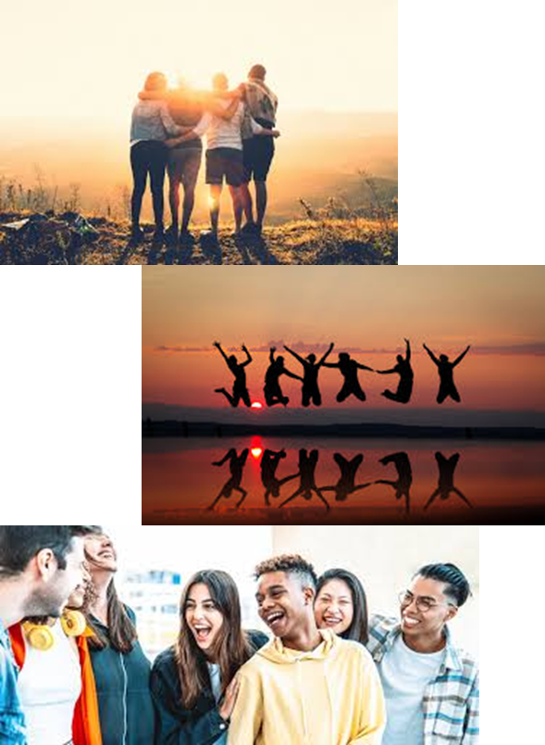
Tutor Time Recap
Friendship is “a close relationship between 2 or more people who care about and support each other”
Friendships matter as it provides an opportunity to feel connected and supported by other people than family members.
Friendships improve physical and mental health.

Slide 5
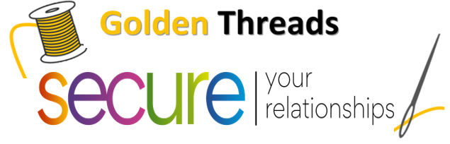
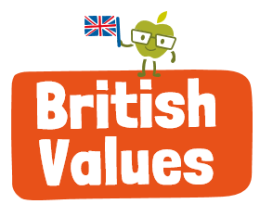
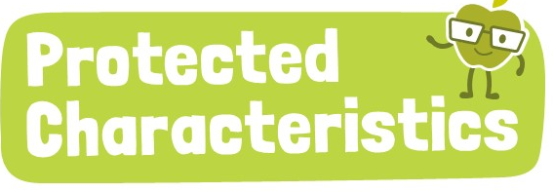
Tutor Time Recap
We are learning this because:
It helps to secure your relationships” friendship is an important aspect of life.
Individual Liberty is a British Value and a good friend will respect who you are as a person and not force you to be someone you are not.
Article 15 of the UN Rights of a Child state children have the right to meet with and choose their own friends
A good friend will celebrate their differences such as those outlined as protected characteristics
UN Rights
of a Child

Slide 6

What makes a good friend?
A good friend has many characteristics.
A characteristic in this context is a feature or quality of a person.
An example of a characteristic could be:
Funny
Kind

Slide 7
What makes a good friend?
In your books draw an outline of a person (like in the picture) or a stick person.
Inside your outline or around the outside of your stick person write as many characteristics of a good friend you can.

Slide 8
What makes a good friend?
In your books, you now need to identify the most important characteristic that you think are important for a good friend.
Complete the sentence:
I think the most important characteristic is…
The reason I think this is…

Slide 9
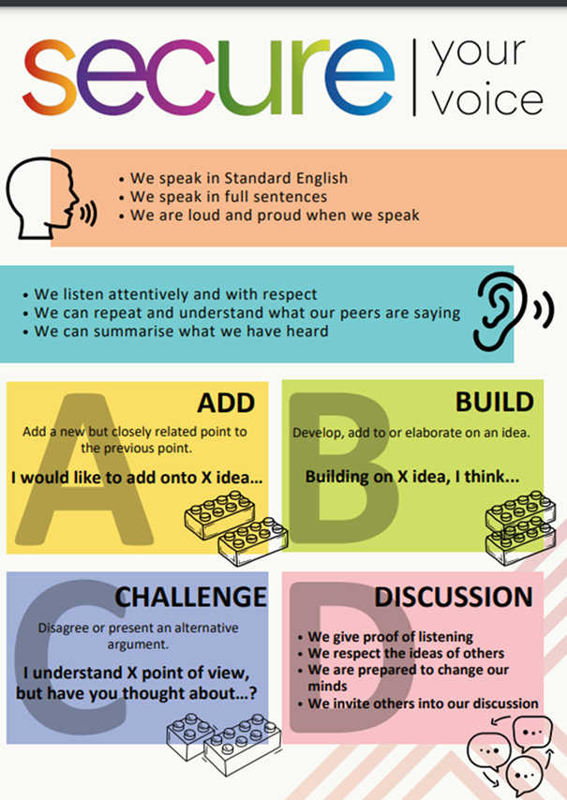
What makes a good friend?
Using your oracy helpsheet, discuss with the person next to you:
“What was your most important characteristic?”
Remember to use the sentence starters to add, build or challenge what your partner has said.
Be ready to share your discussion with the class

Slide 10
Why friendship matter
There are many reasons why friendship matter. Some of these reasons are:
1. Emotional support – Friends can help when people are feeling sad, stressed or worried. An example of the this is when a friend makes you feel better after an argument with your parents/carers.

Slide 11
Why friendship matter
There are many reasons why friendship matter. Some of these reasons are:
2. Encourages personal growth – friends can challenge others to try new things which they would never choose to do if they were alone. An example of this is trying a new food that is from a different culture

Slide 12
Why friendship matter
There are many reasons why friendship matter. Some of these reasons are:
3. Helps handle challenges – Good friends can make big challenges feel small and easy to overcome. An example of this is explaining a difficult topic for an upcoming assessment.

Slide 13

Hinge Questions – whiteboard activity
3
Rules!
I will ask the question and give you some thinking time. (no more than 10 seconds)
Write the answer and turn your whiteboard over so nobody can see it.
When I am ready I will put on the 3 to 1 counter.
When ‘Show me’ appears on the board you must hold up your whiteboard (even if you don’t know the answer and there is nothing on your board)
2
1
Show me!
(even if your whiteboard is blank)

Slide 14
Hinge Questions – whiteboard activity
What is being described?
“a close relationship between 2 or more people who care about and support each other”
Friendship

Slide 15

Hinge Questions – whiteboard activity
What golden thread does this topic relate to?
A – Secure your Future
B – Secure your Wellbeing
C – Secure your Relationships
D – Secure your Voice

Slide 16
Hinge Questions – whiteboard activity
Write down a characteristic of a good friend.
Kind, funny, loyal, smart, caring, trustworthy

Slide 17
Hinge Questions – whiteboard activity
Which statement below is not a reason why friendship matter
A – Emotional Support
B – Encourages Personal Development
C – Helps handle challenges
D – Makes you be more like them

Slide 18
Are friendships always perfect?
Friendships are never perfect and there will always be ups and downs.
However working through tough times in a friendships will ultimately makes the friendship stronger.
Good friends will do their best to limit the number of times a friendship goes through a tough time.

Slide 19
Are friendships always perfect?
One way to ensure people do not put strain onto a friendship is to not as a friend to do anything they are not comfortable with.
Another way is not thinking about a friends’ feeling or potential consequences on them when making a decision

Slide 20
Are friendships always perfect? - Scenario
“Your friend asks to copy your homework answers on SAM learning because they forgot to do it and they do not want to get a detention the next day.”
On your whiteboards choose 1 of the following statements:
I would let them copy
I would not let them copy

Slide 21
Are friendships always perfect? - Scenario
For those who chose “I would let them copy” lets now consider this…
“You let your friend copy your SAM Learning homework but the teacher realises that you and your friend copied each other. You and your friend both get a detention.”

Slide 22

Are friendships always perfect?
Take out your oracy helpsheet from your learning wallet.
You have 1 minute to discuss the following question with the person next to you:
“Would a good friend ask to copy your homework even though they know the other person could also end up in trouble?”
Be ready to share your discussion with the class.

Slide 23
Are friendships always perfect?
In your books complete the following sentences:
Friendships are not always…
One way to not put strain on a friendship is…

Slide 24
Honesty in friendships
Another important aspect of a good friendship is honesty.
Honesty means telling a friend the truth even if doing so is difficult.
Although, it can be difficult and could initially make a friend upset or angry, in the long run the friend will really appreciate it.

Slide 25
Honesty in friendships - Scenario
“You hear a friend say a mean comment to another person. You are shocked that they said it. Other people around laugh at the mean comment but you don’t find it funny”
In your books write down 1 way that you could be honest with your friend in this scenario.

Slide 26
Are friendships always perfect?
Take out your oracy helpsheet from your learning wallet.
You have 1 minute to discuss the following question with the person next to you:
“How could a person be honest with a friend in the scenario?”
Be ready to share your discussion with the class.

Slide 27
Honesty in friendships - Scenario
In this scenario an honest friend could:
Tell their friend privately that they didn’t find it funny
Ask the friend how they think the mean comment made the other person feel
Ask them why they said the comment. Did they really mean it or were they trying to impress other people?

Slide 28
Honesty in friendships - Scenario
“You overhear someone spreading a rumour about your friend. You know if they find out about it they will be really upset.”
In your books write down how a good friend could be honest in this scenario.

Slide 29
Are friendships always perfect?
Take out your oracy helpsheet from your learning wallet.
You have 1 minute to discuss the following question with the person next to you:
“How could a person be honest with a friend in the scenario?”
Be ready to share your discussion with the class.

Slide 30
Honesty in friendships - Scenario
In this scenario an honest friend could:
Report the rumour to a trusted adult so they can do something about it
Tell the friend about the rumour so they hear it from a friend and not find out another way

Slide 31
Friendship - reflection
Friendship are a really important part of life. Friendships are one of the most important relationships people make and can last a very long time.
How will you make sure you will be a good friend?
Write down 3 things in your book that you can do as a good friend this week.

Slide 32
