Slide 1
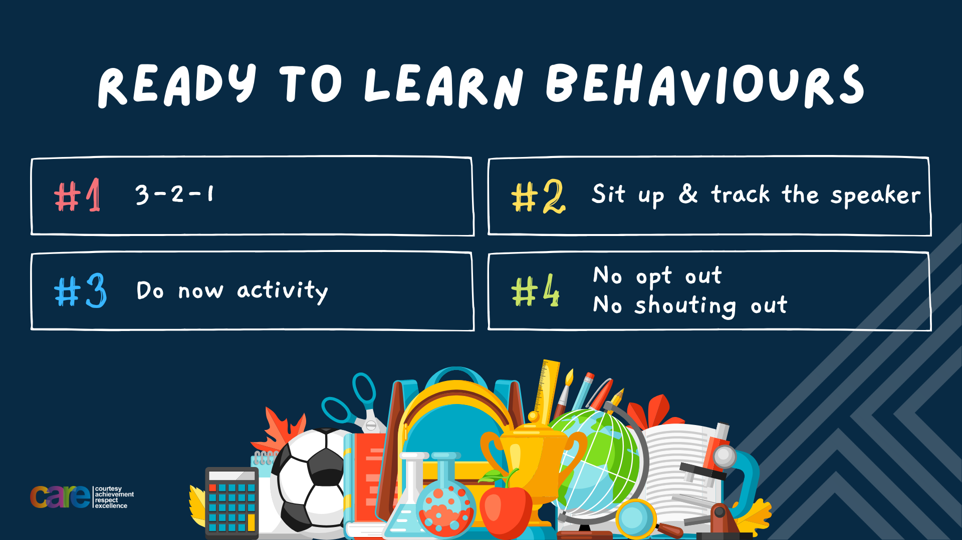

Slide 2








Write the date: 11 October 2024
Write the title: importance of sleep
Underline both!
Complete the following questions:
Name 2 food groups
Why should a person not cross in between parked cars
What is the difference between helpful and unhelpful thinking
Fruit and vegetables, protein, diary (and alternatives), oils and spreads, carbohydrates
It is more difficult to see and drivers can also not see them
Helpful thinking is thinking positively to overcome a challenge whereas unhelpful thinking is negative and can stop a challenge being overcome

Slide 3


Slide 4


Secure your Future: Learning Journey
Making new friends
Road Safety
What is resilience
Healthy food choices
Importance of sleep
Importance of physical activity
Today we will look at:
Importance of Sleep
This includes:
How long people should sleep for
Benefits of getting a good sleep
Identify how to help improve your sleep
Please remember that during the lesson we should not be asking any pupil or teacher personal questions.
Your teacher can ask you questions but this will be to check your knowledge in the lesson.

Slide 5


Tutor Time Recap
In tutor time this week you started to discuss the importance of sleep.
With the person next to you, what can you remember from tutor time?
Remember to listen to what your partner says and be ready to share answers with the class

Slide 6
Tutor Time Recap
Sleep is “a natural state that gives the body and brain time to relax”
Young people need 9-10 hours of sleep every night
There are 2 types of sleep:
  REM sleep (Rapid eye movement) – when dreams happen
  Non REM Sleep (deep sleep) – when the body repairs and grows
Some myths including that lying in at the weekend does not make up for sleep lost during the week

Slide 7
Your sleep
With your partner discuss the following questions:
How long did you sleep for last night?
What time did you go to bed at? Is this a normal time for you?
Did you fall asleep straight away? Did anything stop you from falling asleep?
What time did you get up at? How did you feel?
Remember to listen carefully to you partners answers as you will have to share them with the class

Slide 8
How much sleep do we need?
As you learnt in tutor time, young people need about 9-10 hours of sleep every night.
With our school gate opening at 8.30am and giving 1 hour to get ready in the morning, means you wake up at 7.30am. This means you need to be sleeping at 9.30-10.30pm.

Slide 9
How much sleep do we need?
However…
The teenage body naturally wants to go to bed later and also wake up later.
Due to this only 3% of teenagers get enough sleep per night

Slide 10

Benefits of sleep
While watching the video write down at least 2 benefits of getting enough sleep every night.
Notes:
https://www.youtube.com/watch?v=eaeIOvmjfVQ watch from the start until 1.43

Slide 11
Benefits of getting enough sleep?
Task
Think – in your book write out your top 3 benefits.
Pair – share your top 3 benefits with the person next to you and your reasons why.
Share – be ready to share your partners order. This means you should be listening to them
The benefits of getting enough sleep are:
Better long term memory = better grades
Better mood
Less stress
More energy
Better immune system to fight against illness
Make better food choices
Better athletic ability

Slide 12
Hinge Questions – whiteboard activity
3
Rules!
I will ask the question and give you some thinking time. (no more than 10 seconds)
Write the answer and turn your whiteboard over so nobody can see it.
When I am ready I will put on the 3 to 1 counter.
When ‘Show me’ appears on the board you must hold up your whiteboard (even if you don’t know the answer and there is nothing on your board)
2
1
Show me!
(even if your whiteboard is blank)

Slide 13
Hinge Questions – whiteboard activity
True or False:
“Young people need 9-10 hours of sleep per night”
True

Slide 14
Hinge Questions – whiteboard activity
True or False:
“Most young people get enough sleep per night”
False – only 3% of young people get enough sleep per night

Slide 15
Hinge Questions – whiteboard activity
True or False:
“Getting enough sleep will improve your grades at school”
True

Slide 16
Hinge Questions – whiteboard activity
True or False:
“People who are tired make poor food choices”
True

Slide 17
Hinge Questions – whiteboard activity
True or False:
“Getting enough sleep helps prevent illness”
True

Slide 18
Hinge Questions – whiteboard activity
True or False:
“Getting enough sleep makes people grumpy”
False

Slide 19
Tips for getting enough sleep
If a person is not getting enough sleep, they can use the BED principle to increase their amount of sleep.
BED stands for:
B – bedtime routine
E – bedroom environment
D – daytime routine

Slide 20

Bedtime Routine
A good bedtime routine has the following characteristics:
You go to bed at a similar time every night – including weekends
You avoid watching tv/playing video games at least 30 minutes before getting into bed
Avoid looking at your phone when you are in bed

Slide 21

Bedroom Environment
A good bedroom environment has the following characteristics:
Make your sure you have a comfy space
Make sure the room is dark – you can wear an eye mask to help this
Make sure the room is quiet – you can wear ear plugs to help this
It is better when the room is slightly cooler than being to warm

Slide 22
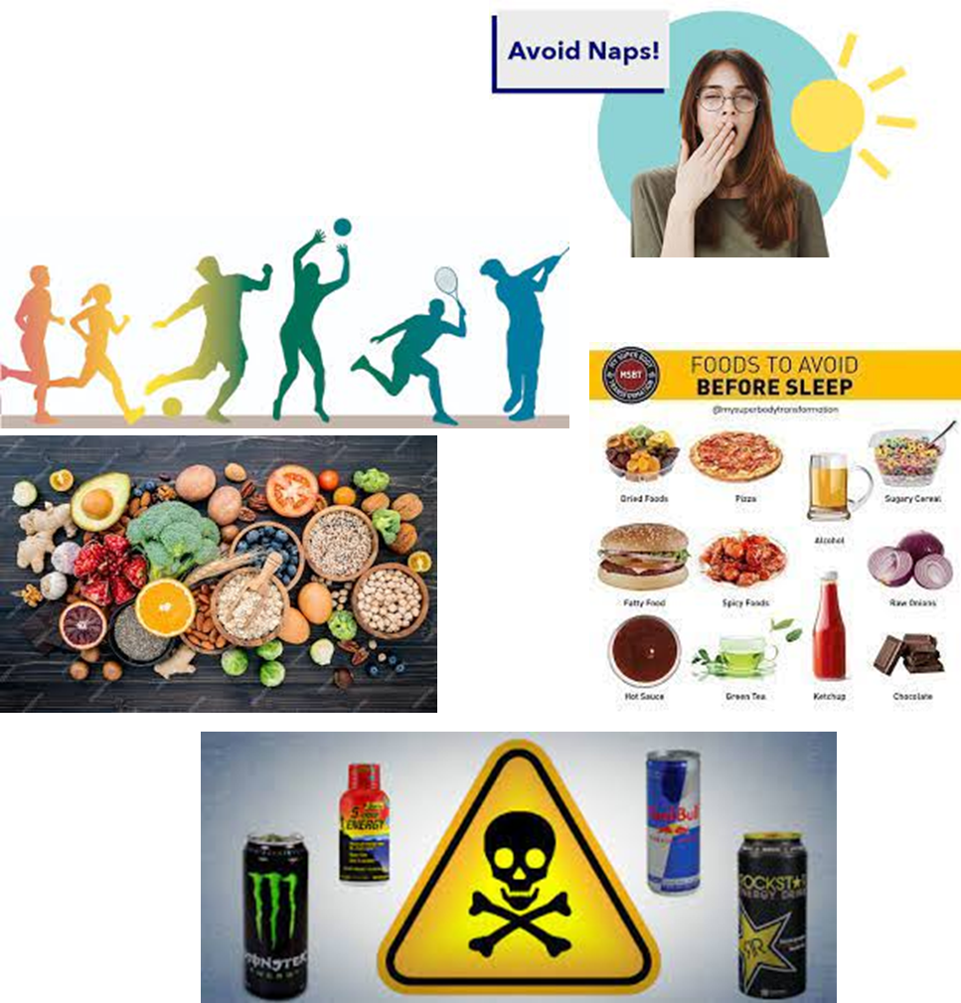
Daytime Routine
A good daytime routine has the following characteristics:
Avoid having naps
Make sure you are active everyday
Make good food choices
Avoid snacking before you go to sleep
Avoid things like coffee, sweets and energy drinks in the afternoon

Slide 23
Scenario
Benji feels tired all the time. He finds it really difficult to wake up in the morning so gets into an argument with his parents most mornings and gets blamed for making everyone late. He often gets into trouble for being late to school, too. He drinks a caffeine drink on the way into school to help him wake up and usually has three or four more during the day. He sometimes finds himself falling asleep during lessons, and most days he has a nap when he gets home from school, between about 4.30pm and 6pm. The only time he feels energetic or awake is in the evening, and doesn’t feel tired when he tries to go to bed! At the weekend he usually has a lie in until 1pm to catch up on sleep, but stays out late with friends on Friday and Saturday nights.
What element of BED does Benji need to improve the most?
Daytime Routine

Slide 24
Scenario
Benji feels tired all the time. He finds it really difficult to wake up in the morning so gets into an argument with his parents most mornings and gets blamed for making everyone late. He often gets into trouble for being late to school, too. He drinks a caffeine drink on the way into school to help him wake up and usually has three or four more during the day. He sometimes finds himself falling asleep during lessons, and most days he has a nap when he gets home from school, between about 4.30pm and 6pm. The only time he feels energetic or awake is in the evening, and doesn’t feel tired when he tries to go to bed! At the weekend he usually has a lie in until 1pm to catch up on sleep, but stays out late with friends on Friday and Saturday nights.
What can Benji do to improve his daytime routine?
Avoid caffeine drinks in the afternoon and having a nap

Slide 25
Scenario
Benji feels tired all the time. He finds it really difficult to wake up in the morning so gets into an argument with his parents most mornings and gets blamed for making everyone late. He often gets into trouble for being late to school, too. He drinks a caffeine drink on the way into school to help him wake up and usually has three or four more during the day. He sometimes finds himself falling asleep during lessons, and most days he has a nap when he gets home from school, between about 4.30pm and 6pm. The only time he feels energetic or awake is in the evening, and doesn’t feel tired when he tries to go to bed! At the weekend he usually has a lie in until 1pm to catch up on sleep, but stays out late with friends on Friday and Saturday nights.
How else can Benji get better sleep?
Improve his bedtime routine by going to bed at a similar time each night including weekends

Slide 26
Scenario
Benji feels tired all the time. He finds it really difficult to wake up in the morning so gets into an argument with his parents most mornings and gets blamed for making everyone late. He often gets into trouble for being late to school, too. He drinks a caffeine drink on the way into school to help him wake up and usually has three or four more during the day. He sometimes finds himself falling asleep during lessons, and most days he has a nap when he gets home from school, between about 4.30pm and 6pm. The only time he feels energetic or awake is in the evening, and doesn’t feel tired when he tries to go to bed! At the weekend he usually has a lie in until 1pm to catch up on sleep, but stays out late with friends on Friday and Saturday nights.
What benefits will Benji see after improving his sleep?
Wake up not feeling tired, not argue with parents for being late, not be in trouble at school for being late, more alert in lessons which will improve his grades

Slide 27
Scenario
Benji feels tired all the time. He finds it really difficult to wake up in the morning so gets into an argument with his parents most mornings and gets blamed for making everyone late. He often gets into trouble for being late to school, too. He drinks a caffeine drink on the way into school to help him wake up and usually has three or four more during the day. He sometimes finds himself falling asleep during lessons, and most days he has a nap when he gets home from school, between about 4.30pm and 6pm. The only time he feels energetic or awake is in the evening, and doesn’t feel tired when he tries to go to bed! At the weekend he usually has a lie in until 1pm to catch up on sleep, but stays out late with friends on Friday and Saturday nights.
What benefits will Benji see after improving his sleep?
Wake up not feeling tired, not argue with parents for being late, not be in trouble at school for being late, more alert in lessons which will improve his grades

Slide 28
Hinge Questions – whiteboard activity
What does B stand for in the BED principle?
Bedtime routine

Slide 29
Hinge Questions – whiteboard activity
Write down 1 thing for a good bedtime routine
Go to bed at a similar time every night including weekends, avoid watching TV/playing video games at least 30 minutes before getting into bed, avoid looking at a phone while in bed

Slide 30
Hinge Questions – whiteboard activity
What does E stand for in BED principle?
Bedroom Environment

Slide 31
Hinge Questions – whiteboard activity
Write down 1 thing for a good bedroom environment
Have a comfy space, make sure the room is dark, make sure the room is quiet, temperature of the room is slightly cooler than being too warm

Slide 32
Hinge Questions – whiteboard activity
What does D stand for in BED principle?
Daytime Routine

Slide 33
Hinge Questions – whiteboard activity
Write down 1 thing for a good daytime routine
Avoid naps, be active everyday, make good food choices, avoid snacking before going to bed, avoid caffeine drinks in the afternoon

Slide 34
Scenario
Shaznay has just got her first smartphone for her 12th birthday. She has started using her mobile phone as an alarm clock, so sleeps with it on her bedside table. She doesn’t think it disturbs her sleep much, but she does use it for an hour or so before she goes to bed, and sometimes that means she stays up later than she meant to. Her phone often goes off during the night and it is hard to resist checking the notifications, but she only looks at it for a second or to in case it’s important. She doesn’t understand why some of her friends are still posting at 2 or 3am. Checking her phone is the first thing she does when she wakes up. Sometimes, she listens to a podcast or a relaxation app to help her fall asleep.
Questions
Answer the following questions in your book
What part of BED does Shaznay need to improve?
What is one way she can improve this?
Why does she need to improve this?
What are the benefits for Shaznay getting enough sleep?

Slide 35

Reflection
Reflect on your bedroom routine, bedroom environment and daytime routine.
Are you doing everything you could do to ensure you get enough sleep every night?
Is there something you will change tonight to try to get more sleep?

Slide 36


