Slide 1
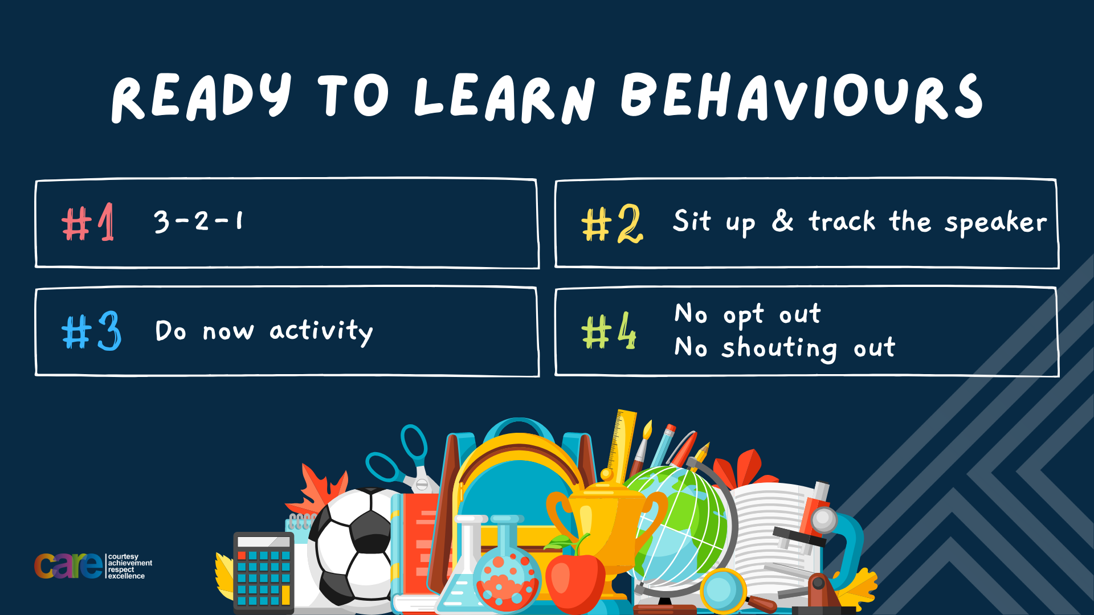

Slide 2








Write the date: 14 April 2025
Write the title: What does a MP do?
Underline both using your ruler in your learning wallet. Take out your oracy helpsheet too.
Complete the following questions:
What political party won the most seats during the last General Election?
Name one UK Political Party that is not Labour or Conservative
True or False – For a petition to be consider by the Government it requires 100,000 signatures?
Labour
Reform UK, Liberal Democrats, SNP, Sinn Fein, DUP, Plaid Cymru, Green Party
True

Slide 3


Secure your Voice: Learning Journey
What is democracy?
Political Parties in the UK
How did the UK General Election work?
What does a MP do?
Who is in the UK Government?
What would you do as a MP?
Today we will look at:
What does a MP do?
This includes:
What happens during a MP surgery?
What happens in a Government debate?
Please remember that during the lesson we should not be asking any pupil or teacher personal questions.
Your teacher can ask you questions but this will be to check your knowledge in the lesson.

Slide 4
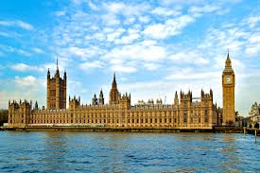
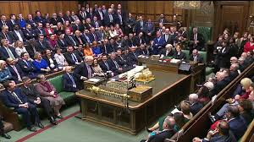
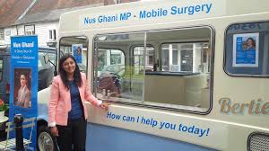
Tutor Time Recap
MP stands for “Member of Parliament”
There are 650 MP’s which all get a “seat” in Parliament which is called the House of Commons.
The House of Commons is in the Houses of Parliament in Westminster, London
The political party with the most MP’s forms the UK Government. This is currently Labour

Slide 5
Tutor Time Recap
MP’s have lots of different roles that include:
Represent their constituents
Support the work of a Government department such as Education, Health, Defence
Meet constituents to discuss issues they are facing
Campaign during elections for their party
Support the law making process
Ask questions and challenge the Prime Minister and other Government representatives in the House of Commons
Visit places of interest in their constituency such as schools, hospitals and businesses

Slide 6
Tutor Time Recap
We are learning about this because:
It is important to know about how politics work as even though you cannot vote, your MP still represents you and you have the right to know if you are being represented correctly and be empowered to challenge your MP. This links to Article 12 of the UN Rights of a Child which states that Government’s should have respect for children’s views.
This is another example of how democracy works in the UK. Democracy is also a British Value.

Slide 7
What is a MP Surgery?
One of the main roles of a MP is to represent their constituency so it is important that MP’s create opportunities to meet local people.
Meeting local people in this manner is called a MP Surgery.
This is where people can meet their MP to discuss matters of concern. This may result in the MP taking the concern to Parliament (in the House of Commons) to try to instigate action to resolve the matter.

Slide 8
What is a MP Surgery?
The concerns discussed can be about anything that impacts an individual in that constituency.
Examples of concerns discussed in MP Surgeries are:
  Housing problems (not enough houses, problems with landlords etc)
  Lack of facilities or run down facilities for the public to use
  The amount of the litter in the area
  Illegal fly tipping
  Potholes in the road
  The cost of living crisis

Slide 9
What is a MP Surgery?
if we use Hodge Hill College as a constituency, Mrs Herrmann would be our MP since she is the Head Teacher.
If Mrs Herrmann ran a “Pupil Surgery” to hear about your concerns what would you say?
In your books write down your concern. You should include the following in your concern:
  A description of your concern
  Why this is a concern
  What would you like Mrs Herrmann to do about it

Slide 10

Voting in the election
Using your oracy helpsheet, discuss with the person next to you:
“What you say to Mrs Herrmann during a ‘Pupil Surgery’?”
Remember to use the sentence starters to add, build or challenge what your partner has said.
Be ready to share your discussion with the class

Slide 11
Debating in House of Commons
A debate in the the House of Commons is a “formal discussion of a particular proposal”
Proposals range from national issues, such as the environment and climate change to more community based issues like school funding or local healthcare
Debating is essential to the work MP’s do as it allows them to discuss different ideas and perspectives on issues.

Slide 12
Debating in House of Commons
Debating is not just about the MP’s talking.
An important element of the debate is listening to other MP’s.
This allows them to understand multiple sides of an issues.
This allows MP’s to make an informed decision on the issue being debated that will benefit their constituents and the wider UK population.

Slide 13

Hinge Questions – whiteboard activity
3
Rules!
I will ask the question and give you some thinking time. (no more than 10 seconds)
Write the answer and turn your whiteboard over so nobody can see it.
When I am ready I will put on the 3 to 1 counter.
When ‘Show me’ appears on the board you must hold up your whiteboard (even if you don’t know the answer and there is nothing on your board)
2
1
Show me!
(even if your whiteboard is blank)

Slide 14

Hinge Questions – whiteboard activity
What does MP stand for?
A – Member of Politics
B – Member of Police
C- Member of Parliament

Slide 15
Hinge Questions – whiteboard activity
True or False
We are learning about this because Democracy is a British Value?
True

Slide 16
Hinge Questions – whiteboard activity
True or False
We are learning about this because MP’s represent children in their constituency as well as adults.
True

Slide 17
Hinge Questions – whiteboard activity
True or False
UN Rights of a Child states that Government do not need to respect the rights of children as they cannot vote.
False

Slide 18
Hinge Questions – whiteboard activity
What is being described?
“where people can meet their MP to discuss matters of concern.”
A – MP Surgery
B – MP Dentist
C- MP Hospital

Slide 19
Hinge Questions – whiteboard activity
True or False
A MP debate is MP’s just saying their opinions and not listening to other MP’s?
False

Slide 20
Debating in House of Commons
We are going to have our own debate about various issues.
You are either going to be “for” the proposal. This means you agree with the proposal.
Or you will be “against” the proposal. This means you disagree with the proposal.
Notes:
Teachers need to split pupils up into for and against

Slide 21
Debating in House of Commons
You now have 1-2 minutes to write down at least 3 reasons either “for/against” the following proposal
“schools should get rid of school uniforms”

Slide 22
Rules of the debates
Before we debate the proposal, it is important to go over debating rules that exist in the House of Commons.
These are designed to highlight the importance of respect. It is important that MP’s respect each other even when they disagree.
This ensures the debate is constructive and professional at all times

Slide 23
Rules of the debates
The rules are:
If you want to speak you must stand up. If you are not chosen to speak, you must sit down. You repeat this process until you are chosen to speak. This is called “bobbing”
You only speak if you are selected to speak.
If you agree with what is said you can cheer or shout “here, here” You cannot say or do anything else such as clap. Clapping is not allowed in the House of Commons
If you disagree with what is said you can boo or jeer. You cannot shout anything out to oppose what has just been said
Language such as “shut up” or “you’re talking rubbish” or name calling is not allowed.

Slide 24
Debate
Using your oracy helpsheet, you are now going to debate the following proposal
“Schools should get rid of school uniforms”
You must follow the rules of a debate and let the teacher chair the debate.
A vote will be taken after to see if the proposal is agreed or dismissed

Slide 25
Debating in House of Commons
You now have 1-2 minutes to write down at least 3 reasons either “for/against” the following proposal
“pupils should be allowed to use their mobile phones during break times”

Slide 26
Debate
Using your oracy helpsheet, you are now going to debate the following proposal
“pupils should be allowed to use their mobile phones during break times”
You must follow the rules of a debate and let the teacher chair the debate.
A vote will be taken after to see if the proposal is agreed or dismissed

Slide 27
Debating in House of Commons
You now have 1-2 minutes to write down at least 3 reasons either “for/against” the following proposal
“The school day should be made longer to help pupils learn more”

Slide 28
Debate
Using your oracy helpsheet, you are now going to debate the following proposal
“The school day should be made longer to help pupils learn more”
You must follow the rules of a debate and let the teacher chair the debate.
A vote will be taken after to see if the proposal is agreed or dismissed

Slide 29
Hinge Questions – whiteboard activity
3
Rules!
I will ask the question and give you some thinking time. (no more than 10 seconds)
Write the answer and turn your whiteboard over so nobody can see it.
When I am ready I will put on the 3 to 1 counter.
When ‘Show me’ appears on the board you must hold up your whiteboard (even if you don’t know the answer and there is nothing on your board)
2
1
Show me!
(even if your whiteboard is blank)

Slide 30
Hinge Questions – whiteboard activity
True or False
During a debate you are allowed to clap when you agree with what has been said
False

Slide 31
Hinge Questions – whiteboard activity
True or False
If a MP wants to speak during a debate they must stand up
True

Slide 32
Hinge Questions – whiteboard activity
True or False
If a MP wants to speak during a debate but they were not selected to speak, they can shout out what they wanted to say anyway
False

Slide 33
Hinge Questions – whiteboard activity
True or False
During a debate, MP’s must be respectful and not use language such as “shut up” or “you’re talking rubbish”
True

Slide 34
Hinge Questions – whiteboard activity
True or False
During a debate, if a MP disagrees with what has been said they can boo or jeer. However they must not shout out why they disagree
True

Slide 35

Extension - What else does a MP do?
While watching the video answer the following questions in your book.
What other roles does a MP have that we have not already discussed?
Where does the MP complete these roles?
Notes:
https://www.youtube.com/watch?v=fpyc_I4q6DA

Slide 36


