Slide 1
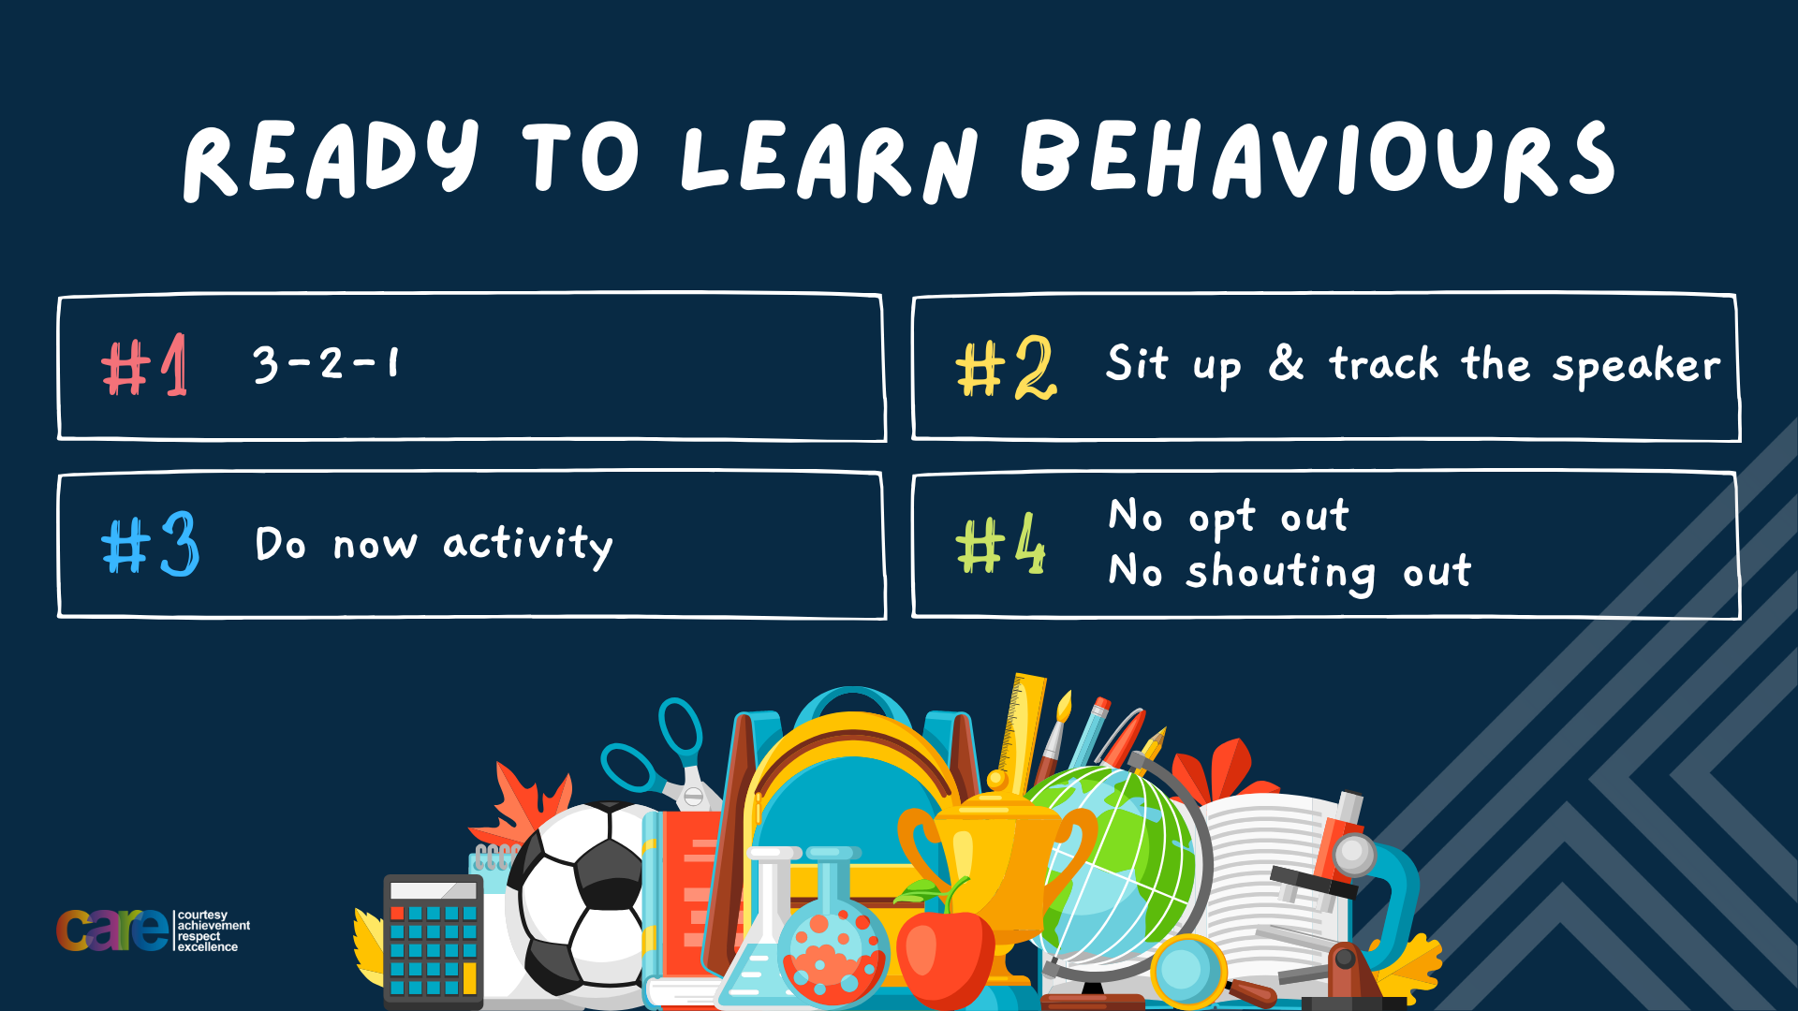

Slide 2








Write the date: 11 October 2024
Write the title: Healthy food choices
Underline both!
Complete the following questions:
What word is being described? - never giving up, working hard and going through tough times and coming out the other side
Where should you cross Bromford Road when arriving and leaving school?
True or False – if you fall out with a friend you should bring up old issues?
resilience
At the pedestrian crossing
False – you should not bring up old issues as this will make the fallout worse

Slide 3


Slide 4


Secure your Future: Learning Journey
Making new friends
Road Safety
What is resilience
Healthy food choices
Importance of sleep
Importance of physical activity
Today we will look at:
Healthy food choices
This includes:
Identify the different food groups
Identify examples of each food group
Identify how to know if a food is healthy or not based on labelling
Please remember that during the lesson we should not be asking any pupil or teacher personal questions.
Your teacher can ask you questions but this will be to check your knowledge in the lesson.

Slide 5

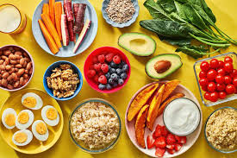
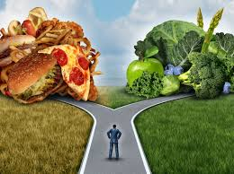
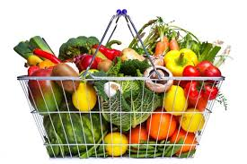
Healthy Food Choices
With the person next to you discuss the following statement:
“It doesn’t matter what food I eat as long as I am full afterwards”
Do you agree or disagree with this statement? Why?
Be ready to share your discussion with the class.

Slide 6
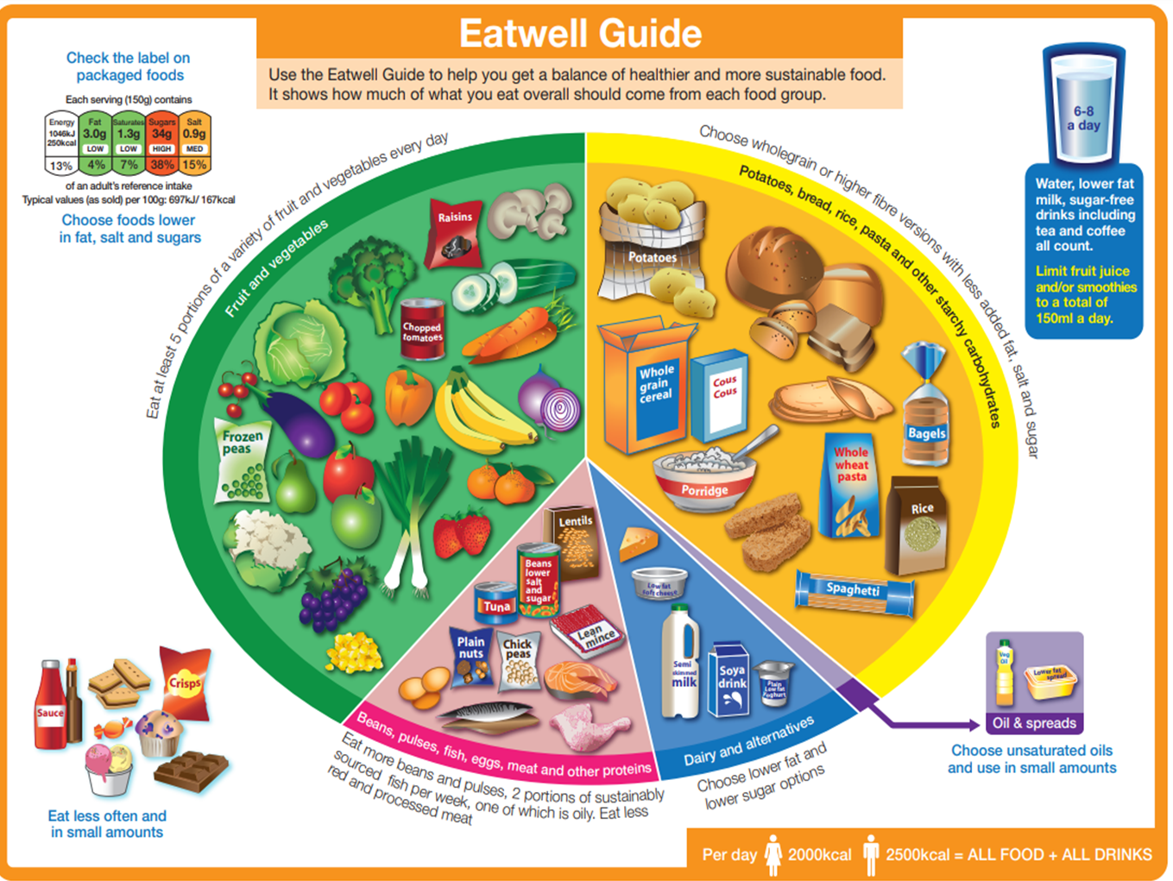
Eatwell Guide
UK Government has developed the “Eatwell Guide” to help people make healthy choices regarding their food choices
It shows the following information:
  The different food groups required to have a well balanced and healthy diet
  The proportions of each food group that we should eat in one day, not necessarily at each meal

Slide 7

Eatwell Guide
While watching the video write down 2 key points you think are important.
Be ready to share these with the class
Notes:
https://www.youtube.com/watch?v=xtFx55a-j0Y watch from the beginning to 1.31

Slide 8
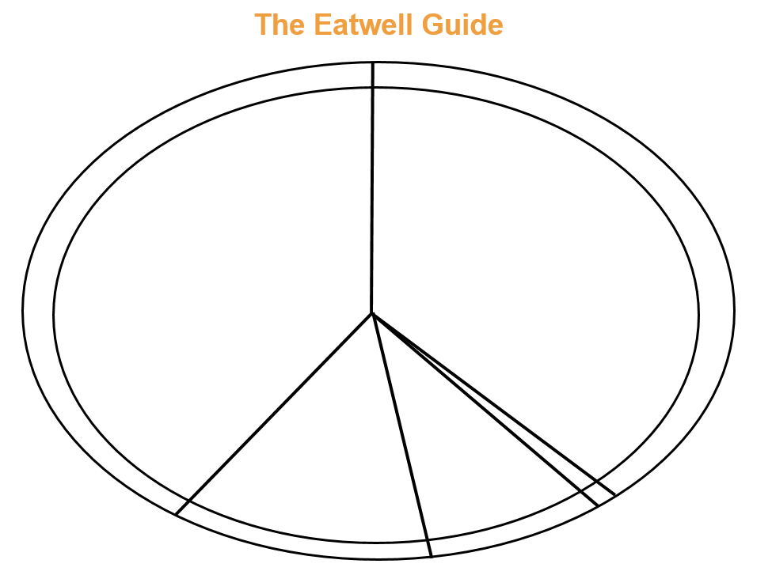
Fruit and Vegetables
Eat 5 portions per day.
Contain vitamins
Carbohydrates e.g. potatoes, bread, rice and pasta
Provides energy
Which foods could we put in each section?
Oil and spreads. Used as an energy store and for warmth.
Protein e.g. beans, pulses, fish and meat. Used for muscle growth and repair
Dairy and alternatives
Contain minerals e.g. calcium for healthy bones and teeth

Slide 9
Hinge Questions – whiteboard activity
3
Rules!
I will ask the question and give you some thinking time. (no more than 10 seconds)
Write the answer and turn your whiteboard over so nobody can see it.
When I am ready I will put on the 3 to 1 counter.
When ‘Show me’ appears on the board you must hold up your whiteboard (even if you don’t know the answer and there is nothing on your board)
2
1
Show me!
(even if your whiteboard is blank)

Slide 10

Hinge Questions – whiteboard activity
Which food group contains fish, beans and eggs?
Protein
Carbohydrates
Fruit and Vegetables

Slide 11

Hinge Questions – whiteboard activity
Which food group contains rice and pasta?
Oils and Spreads
Carbohydrates
Dairy and spreads

Slide 12
Hinge Questions – whiteboard activity
What does fruit and vegetables contain?
protein
fat
vitamins

Slide 13
Hinge Questions – whiteboard activity
What does the body use carbohydrates for?
energy
Getting enough vitamins
Growing muscles

Slide 14
Hinge Questions – whiteboard activity
What does the body use protein for?
Getting enough vitamins
Storing fat
Muscle growth and repair

Slide 15
Hinge Questions – whiteboard activity
What does the body use oils and spreads for?
Energy store and for warmth
Muscle growth and repair
Getting vitamins

Slide 16
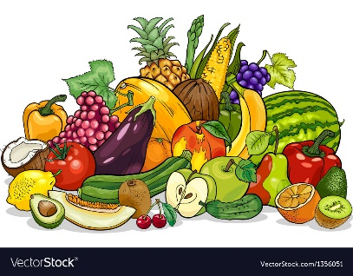
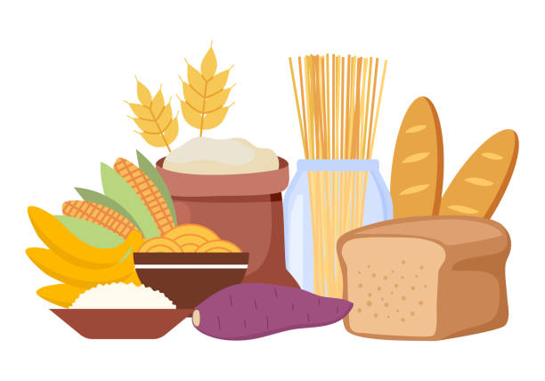
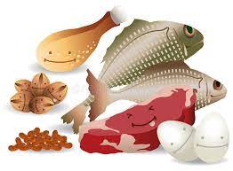
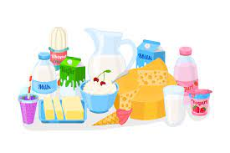
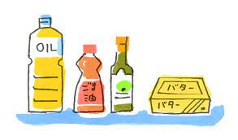
Independent Practice
Food Group
Example
Key Fact
Eat ____ portions per day. Contains v___________.
Fruit and vegetables
Bananas, apples, peppers
5
itamins
Provides e_________.
Potatoes. Bread, rice, pasta and other carbohydrates
Bread, rice, pasta, potatoes
nergy
Beans, pulses, fish, eggs, meat and other proteins
Used for muscle g_______ and r_______.
Fish, steak, chicken, fish
rowth
epair
inerals
Diary and alternatives
Milk, yogurt, cheese
Contains m________ e.g. c________ for healthy bones and teeth.
alcium
Used as an e_______ store and for w_______.
Oils and spreads
Butter, olive oil, vegetable oil
nergy
armth

Slide 17
Other food choices
With the person next to you discuss the following question:
“What foods are not included in the Eatwell guide that we all enjoy eating?
Be ready to share your answers with the class

Slide 18

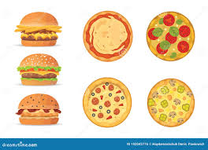
Food high in fat, salt and sugar
These foods include:
  Chocolate
  Cakes
  Biscuits
  Soft drinks
  Ice cream
These foods are not needed in a healthy but if they are going to be eaten, they should be eaten infrequently and in small amounts

Slide 19
Food high in fat, salt and sugar
With the person next to you discuss the following statement:
“Foods that are high in fat, salt and sugar are bad foods”
Remember to listen to your partners opinion and then respond. Be ready to share your discussion with the class.

Slide 20

Bad food myth
There is no such thing as a “bad food”
Too much of any food even if it is classed as a “good food” is unhealthy.
A person should be aiming to enjoy food, eat when they are hungry and make healthy food choices.
Foods high in fat, salt and sugar, if eat to frequently or in eaten in place of one of the other food groups, is unhealthy

Slide 21
Food Labelling
The UK Government have designed a food labelling system to help people pick the healthiest option they can
While watching the video answer the following questions:
What are the 5 different categories labelled?
What colours show the most healthy choices?
What must be taken into consideration when using the labels?
Notes:
https://www.youtube.com/watch?v=bLKoAsikD-Q – please watch full video

Slide 22
Hinge Questions – whiteboard activity
3
Rules!
I will ask the question and give you some thinking time. (no more than 10 seconds)
Write the answer and turn your whiteboard over so nobody can see it.
When I am ready I will put on the 3 to 1 counter.
When ‘Show me’ appears on the board you must hold up your whiteboard (even if you don’t know the answer and there is nothing on your board)
2
1
Show me!
(even if your whiteboard is blank)

Slide 23
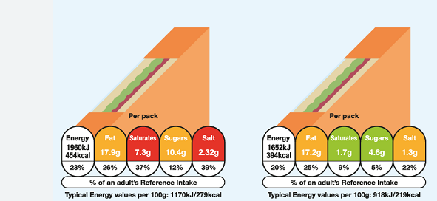
Hinge Questions – whiteboard activity
Why sandwich would you choose and why?
A
B

Slide 24
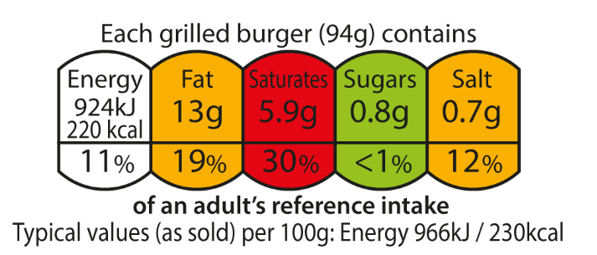
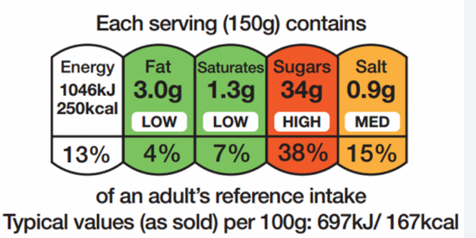
Independent practice
Complete the following sentences in your book:
Crisps are examples of the food group…
If crisps are going to be eaten they should….
I would choose the eat the _______ burger because….
Beef burger
Chicken burger

Slide 25
Reflection
At the start of the lesson we discussed the statement:
“It doesn’t matter what food I eat as long as I am full afterwards”
With the person next to you discuss if your answer is still the same or have you changed your mind. You must explain your answer.
Be ready to give your response to the rest of the class.

Slide 26


Slide 28
Food Group
Example
Key Fact
Eat ____ portions per day. Contains v___________.
Provides e_________.
Used for muscle g_______ and r_______.
Contains m________ e.g. c________ for healthy bones and teeth.
Used as an e_______ store and for w_______.

