Slide 1
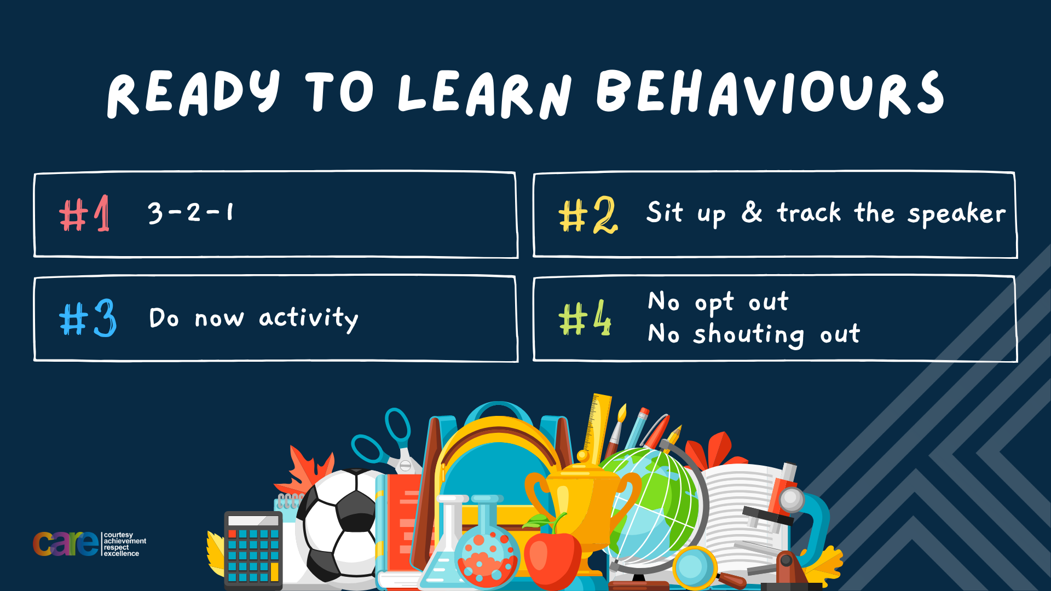

Slide 2








Write the date: 14 April 2025
Write the title: What are laws?
Underline both using your ruler in your learning wallet. Take out your oracy helpsheet too.
Complete the following questions:
Give an example of a Government Department
What does MP stand for?
Name one UK Political Party that is not Labour or Conservative
HM Treasury, Home Office, Foreign Commonwealth & Development Office, Department for Education, Department for Health & Social Care, Ministry of Defence, Department for Environment Food & Rural Affairs, Department for Transport, Department for Digital Culture Media & Sport
Member of Parliament
Reform UK, Liberal Democrats, SNP, Sinn Fein, DUP, Plaid Cymru, Green Party

Slide 3


Secure your Voice: Learning Journey
What is democracy?
Political Parties in the UK
How did the UK General Election work?
What does a MP do?
Who is in the UK Government?
What are laws?
Today we will look at:
What are laws?
This includes:
How are laws made?
What happens if laws are broken?
Please remember that during the lesson we should not be asking any pupil or teacher personal questions.
Your teacher can ask you questions but this will be to check your knowledge in the lesson.

Slide 4

Tutor Time Recap
Laws are “a system of rules that a country have agreed to follow.”
Laws are necessary because they:
Keep everyone safe
Ensure everyone is treated fairly
Ensure everyone’s property is protected

Slide 5
Tutor Time Recap
We are learning this because:
It helps to secure your future as breaking the law can lead to criminal records which can negatively impact job opportunities.
Rule of law is a British Value which means everyone living in the UK is required to follow the law
UN Rights of the Child is an example of international law which is designed to keep all children safe
Protected characteristics is an example of a law in the UK called the Equality Act (2010) which stops people being discriminated against due to any of the characteristics.

Slide 6
How laws are made
In the UK it is up to the Government to make the laws.
However it is not as simple as the Prime Minister deciding that something is now a law.
There is a process that has to be followed

Slide 7

How laws are made
You have been given a worksheet with each step of the law making process. While watching the video you should write a number beside each step.
Example – The first step is “a bill is put forward” beside this is “1”
Label the next steps using numbers between 2 and 7
Notes:
https://www.youtube.com/watch?v=iM4CKYCrW7Y

Slide 8
How laws are made
The first step is
“A bill is put forward”
This can be by a range of people or groups. The bill could be to propose a new law or to amend an existing law

Slide 9
How laws are made
The second step is
“A green paper is published”
This presents the Governments ideas for the bill and it is open to the public to discuss. This is called a public consultation.

Slide 10
How laws are made
The 3rd step is
“A white paper is published”
This includes finding from the public consultation and outlines the proposed bill in more detail than the green paper

Slide 11
How laws are made
The 4th step is
“Government ministers must agree if the proposal is taken forward”
Government ministers are MP’s who are part of the Prime Ministers closest team. An easy way to think about this is SLT teachers support Mrs Herrmann. Government ministers have the same role for the Prime Minister.
These Government ministers have to agree that the proposal should be taken forward

Slide 12
How laws are made
The 5th step is
“The bill is presented to Parliament”
The Government Minister responsible for the area that will be impacted by the new or changed law presents it to all MP’s in the House of Commons

Slide 13
How laws are made
The 6th step is
“MPs in the House of Commons and the House of Lords debate the bill”
This can happen multiple times as both the House of Commons and House of Lords can make changes to the proposal. Before it goes any further both the House of Commons and House of Lords have to agree on all changes.

Slide 14
How laws are made
The 7th step is
“Passed to Monarch for formal approval”
The King is given a copy of the bill. Once they have approved it this is now law which is called an Act of Parliament

Slide 15

Hinge Questions – whiteboard activity
3
Rules!
I will ask the question and give you some thinking time. (no more than 10 seconds)
Write the answer and turn your whiteboard over so nobody can see it.
When I am ready I will put on the 3 to 1 counter.
When ‘Show me’ appears on the board you must hold up your whiteboard (even if you don’t know the answer and there is nothing on your board)
2
1
Show me!
(even if your whiteboard is blank)

Slide 16
Hinge Questions – whiteboard activity
What is being described?
“a system of laws that a country have agreed to follow”
Laws

Slide 17

Hinge Questions – whiteboard activity
True or False
Breaking the law can lead to a criminal record that may affect future employment
A – True
B – False

Slide 18
Hinge Questions – whiteboard activity
True or False
Rule of Law is a British Value
A – True
B – False

Slide 19
Hinge Questions – whiteboard activity
True or False
Laws are unnecessary and they do not keep people safe
A – True
B – False

Slide 20
Hinge Questions – whiteboard activity
True or False
The Prime Minister can immediately decide a law?
A – True
B – False

Slide 21
Hinge Questions – whiteboard activity
True or False
There are 7 steps to a something becoming law. The final step is the Monarch (The King) giving approval
A – True
B – False

Slide 22

What are laws?
Take out your oracy helpsheet from your learning wallet.
You have 1 minute to think about the following question:
“If you could put forward a bill as the first step to making a new law in the UK, what would you suggest?”
Write your ideas in your book

Slide 23

What are laws?
Using your oracy helpsheet, discuss with the person next to you:
““If you could put forward a bill as the first step to making a new law in the UK, what would you suggest?”
Remember to use the sentence starters to add, build or challenge what your partner has said.
Be ready to share your discussion with the class

Slide 24
What happens when laws are broken?
When someone breaks the law, they may face consequences based on the severity of their actions.
Consequences can include:
1. Cautions – this is warning. If a person gets too many cautions then the consequence is escalated.

Slide 25
What happens when laws are broken?
When someone breaks the law, they may face consequences based on the severity of their actions.
Consequences can include:
2. Fines – a person is required to pay a fine. These are for minor offences such as parking tickets or littering

Slide 26
What happens when laws are broken?
When someone breaks the law, they may face consequences based on the severity of their actions.
Consequences can include:
3. Community service. A person will have to help out in the community (litter picking, cleaning graffiti). This is normally given for vandalism offences

Slide 27
What happens when laws are broken?
When someone breaks the law, they may face consequences based on the severity of their actions.
Consequences can include:
4. Prison. A person can go to prison for committing very serious crimes such as robbery, assault or murder.

Slide 28
Consequences for breaking the law
Take out your oracy helpsheet from your learning wallet.
You have 1 minute to think about the following question:
“After the summer riots, people have been sent to prison for things they posted online. Do you think people should go to prison for something posted on social media?”
Write your ideas in your book

Slide 29
Consequences of breaking the law
Using your oracy helpsheet, discuss with the person next to you:
“After the summer riots, people have been sent to prison for things they posted online. Do you think people should go to prison for something posted on social media?”
Remember to use the sentence starters to add, build or challenge what your partner has said.
Be ready to share your discussion with the class

Slide 30
What happens when laws are broken?
It is everyone’s responsibility to know what the law says and to obey it.
Ignorance (saying “I didn’t know”) of the law is not regarded as a valid excuse if a person is found breaking the law.

Slide 31
Scenarios
In your books answer the following questions:
Has a law been broken?
What consequence could the person face?
A student is at a park and leaves their phone on a bench while playing football. Another person walking by notices the phone and decides to take it home, knowing it doesn’t belong to them.

Slide 32
Scenarios
Using your oracy card, discuss with your partner your answers to the questions below.
Has a law been broken?
What consequence could the person face?
Remember to add, build or challenge.
A student is at a park and leaves their phone on a bench while playing football. Another person walking by notices the phone and decides to take it home, knowing it doesn’t belong to them.

Slide 33
Scenarios
In your books answer the following questions:
Has a law been broken?
What consequence could the person face?
A car is driving through a school zone where the speed limit is 20 mph. The driver is in a rush and drives at 40 mph. They are pulled over by the police before anyone gets hurt.

Slide 34
Scenarios
Using your oracy card, discuss with your partner your answers to the questions below.
Has a law been broken?
What consequence could the person face?
Remember to add, build or challenge.
A car is driving through a school zone where the speed limit is 20 mph. The driver is in a rush and drives at 40 mph. They are pulled over by the police before anyone gets hurt.

Slide 35


