Slide 1
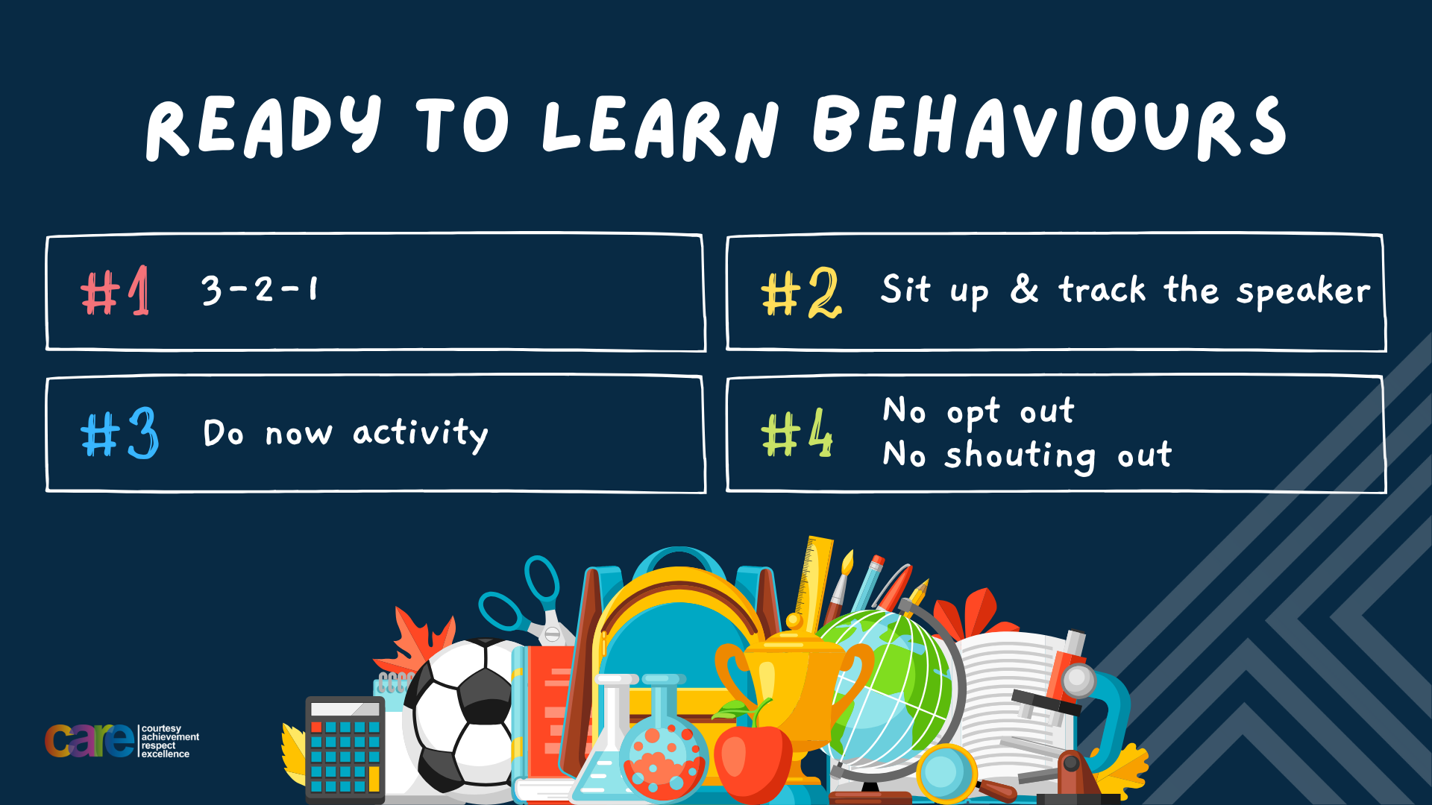

Slide 2








Write the date: 11 October 2024
Write the title: Resilience
Underline both!
Complete the following questions:
True or False – You should cross the road anywhere you want?
Where should you stand when crossing the road?
True or False – if you fall out with a friend you should complain about that friend on a group chat?
False – you should cross at pedestrian crossings/zebra crossing
Away from the kerb, not right at the edge
False – you should not broadcast your feelings to other people or online

Slide 3


Slide 4


Secure your Future: Learning Journey
Making new friends
Road Safety
What is resilience
Healthy food choices
Importance of sleep
Importance of physical activity
Today we will look at:
Resilience
This includes:
Recap of resilience
Examples of resilience
Helpful vs unhelpful thinking
Please remember that during the lesson we should not be asking any pupil or teacher personal questions.
Your teacher can ask you questions but this will be to check your knowledge in the lesson.

Slide 5


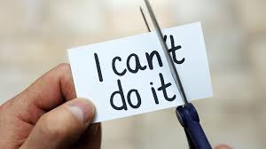

What is resilience?
In tutor time this week you looked at the definition of resilience.
What can you remember about resilience? What is the definition? What is the importance of resilience?

Slide 6
What is resilience?
The definition of resilience is…
“never giving up, working hard and going through tough times and coming out the other side”

Slide 7
Why is resilience important?
Resilience helps people deal with challenges that they face in everyday life. This could be their school work, their friendships/relationships or just if they are having a tough day.

Slide 8
Why is resilience important?
Being resilient over a long period of time builds confidence and makes people mentally stronger when faced with a challenge.
This means that resilient people do not give up easily.

Slide 9
Resilience example – Harry Kane
While watching the video, answer:
1. How did Harry Kane show resilience in his career?

Slide 10
Resilience example – Harry Kane
Harry Kane showed resilience throughout his career. From being released by Arsenal at 8 years old he has become England Mens Football captain.
In September 2024 he won his 100th England Mens cap and is currently the Englans Mens record goalscorer.

Slide 11
Resilience example – Harry Kane
Ultimately Harry Kane showed resilience by working hard and believing in himself despite numerous setbacks and challenges.
This is an example of helpful thinking.

Slide 12
Helpful vs Unhelpful thinking
Helpful thinking can make a person feel better about a setback or challenge. This is what helps you build resilience.
Unhelpful thinking can make a setback seem worse than it is and can stop a person from bouncing back positively

Slide 13
Helpful vs Unhelpful thinking
For each sentence write on your whiteboard either “helpful” or “unhelpful”
“everything always goes wrong for me”
This is an example of unhelpful thinking

Slide 14
Helpful vs Unhelpful thinking
For each sentence write on your whiteboard either “helpful” or “unhelpful”
“Everyone else gets it right. Why can’t I?”
This is an example of unhelpful thinking

Slide 15
Helpful vs Unhelpful thinking
For each sentence write on your whiteboard either “helpful” or “unhelpful”
“We didn’t win but everyone tried their best”
This is an example of helpful thinking

Slide 16
Helpful vs Unhelpful thinking
For each sentence write on your whiteboard either “helpful” or “unhelpful”
“I want to be healthier so I’m going to find out how I can do that”
This is an example of helpful thinking

Slide 17
Helpful vs Unhelpful thinking
For each sentence write on your whiteboard either “helpful” or “unhelpful”
“I’m really nervous about this but at least I’m brave enough to try it”
This is an example of helpful thinking

Slide 18
Scenario
Emily has always found Maths difficult. This year she is finding even more difficult and gets frustrated in every lesson that she can’t get the right answer no matter how hard she tries. Needless to say Emily failed her first maths test that year.
Instead of quitting, Emily decided to ask her teacher for extra help and if there was a Maths club she could join. At first things didn’t get much easier and she still struggled but little by little she began to improve.
On her next test, Emily still didn’t do particularly well but much better than she did in her first test.
Questions
Did Emily show an example of helpful or unhelp thinking?]
What did Emily do when she faced a challenge?
What was the result of Emily showing resilience?

Slide 19
Can you show resilience?
In your books write the following sentence as neat as you can
“The five boxing wizards jump quickly”
Now you have 5 attempts at rewriting the sentence as neat as possible but with other hand.
Try to improve with each attempt. How close can you get your 5th attempt to the sentence with your dominant hand?

Slide 20
Hinge Questions – whiteboard activity
3
Rules!
I will ask the question and give you some thinking time. (no more than 10 seconds)
Write the answer and turn your whiteboard over so nobody can see it.
When I am ready I will put on the 3 to 1 counter.
When ‘Show me’ appears on the board you must hold up your whiteboard (even if you don’t know the answer and there is nothing on your board)
2
1
Show me!
(even if your whiteboard is blank)

Slide 21
Hinge Questions – whiteboard activity
What is being described?
“never giving up, working hard and going through tough times and coming out the other side”
Resilience

Slide 22
Hinge Questions – whiteboard activity
True or False
You are resilient if you can think of excuses not to do something that is difficult
False

Slide 23
Hinge Questions – whiteboard activity
What is being described?
Thoughts that can make a person feel better about a setback or challenge. This is what helps you build resilience.
Helpful thinking

Slide 24
Developing Resilience
Setbacks and challenges can also come in the form of making mistakes.
Learning from mistakes can help build resilience

Slide 25

Developing Resilience
While watching the video write down the 3 top tips for when a mistake is made
Notes:
https://www.youtube.com/watch?v=34U2K_c-s3k

Slide 26
Developing resilience
The top 3 tips for when a mistake is made are:
Recognising that making mistakes is the normal process for learning
Question what went wrong when a mistake was made
Try not to make the same mistake again and again

Slide 27
Reflection
Write yourself a promise for the next time you find something difficult.
Example – The next time I find a question hard in Maths I am not going to give up. I will try my best and if I get the answer wrong that is ok. I can ask the teacher to show me what I did wrong and I can try again on a different question.

Slide 28


