Slide 1
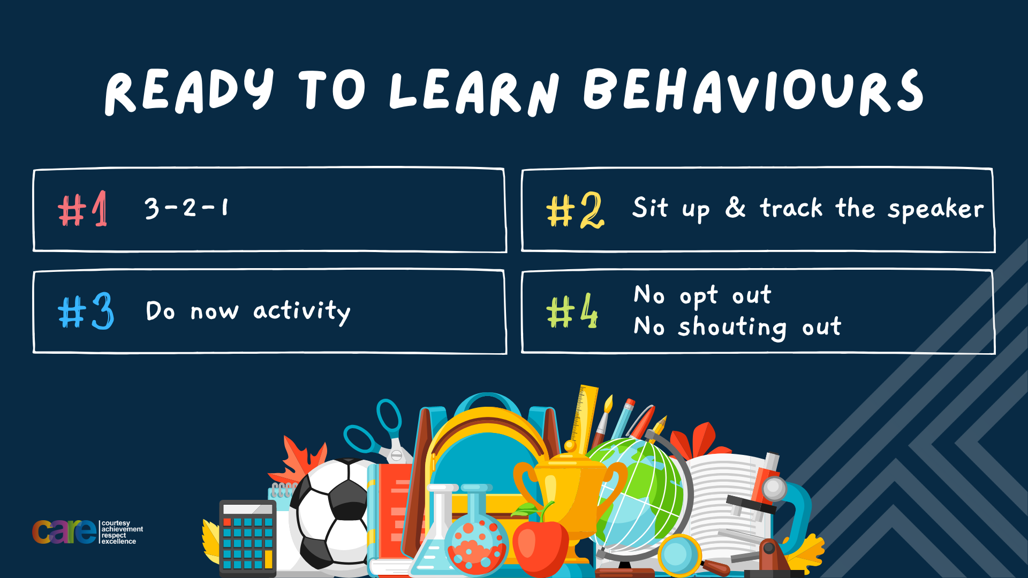

Slide 2








Write the date: 25 September 2024
Write the title: Making Friends
Underline both!
Complete the following questions:
Name 1 quality of a good friend
Name 1 tip to making friendships last
Name 1 thing you should not do if you fall out with a friend
Honesty. Loyalty kindness, respect, support, trust, communication, individuality, growth, humour
Communicate regularly, be authentic, find common interests/activities, show appreciation, embrace each others differences
Never call friends names or behave in a threatening way, never broadcast feeling to other people/online, always stay calm and walk away if angry/put phone or tablet away, don’t bring up old issues

Slide 3


Slide 4


Secure your Future: Learning Journey
Making new friends
Road Safety
What is resilience
Healthy food choices
Importance of sleep
Importance of physical activity
Today we will look at:
Road Safety
This includes:
What road skills you need to walk to school
How to plan a safer journey to school
Apply knowledge to different scenarios
Please remember that during the lesson we should not be asking any pupil or teacher personal questions.
Your teacher can ask you questions but this will be to check your knowledge in the lesson.

Slide 5


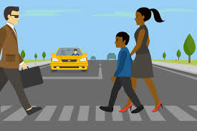
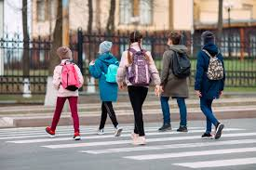
Road Safety – what can you remember?
You started looking at road safety during tutor time this week.
In your books write down 2 things you remember.
Be ready to share your answers with the class

Slide 6
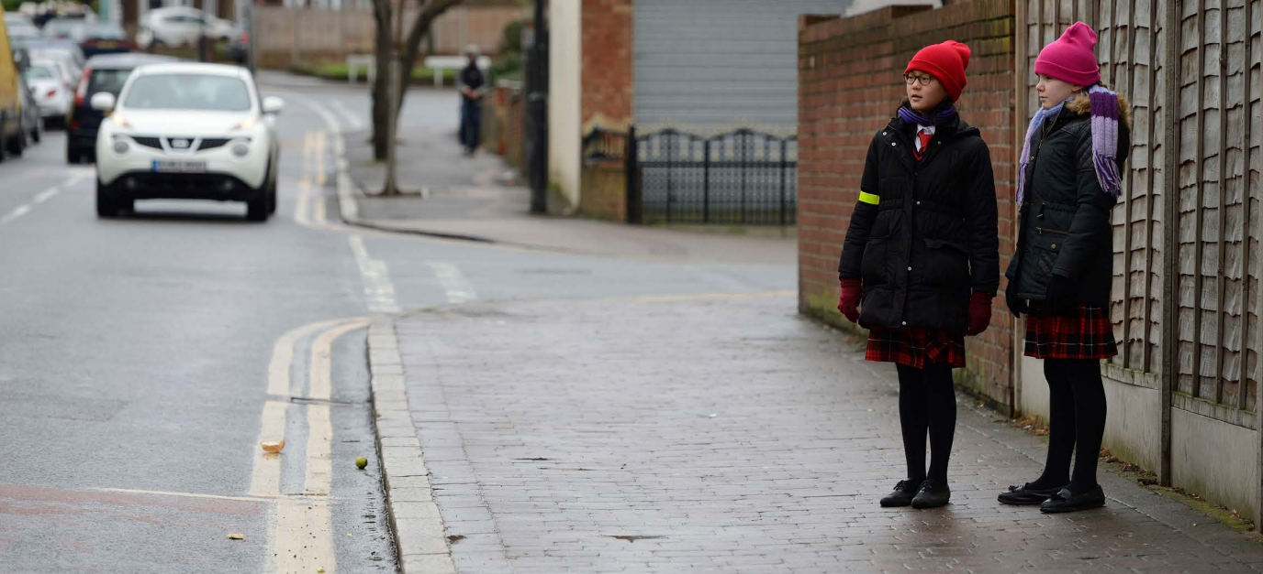
Road Safety – Step 1
Step 1 of road safety is:
Find the safest place to cross
Where possible cross the road at pedestrian crosses such as zebra crossing and traffic lights or where there is a crossing point controlled by an adult.
If you need to cross a road with no crossing, choose a place where you can see clearly in all directions and drivers can see you

Slide 7
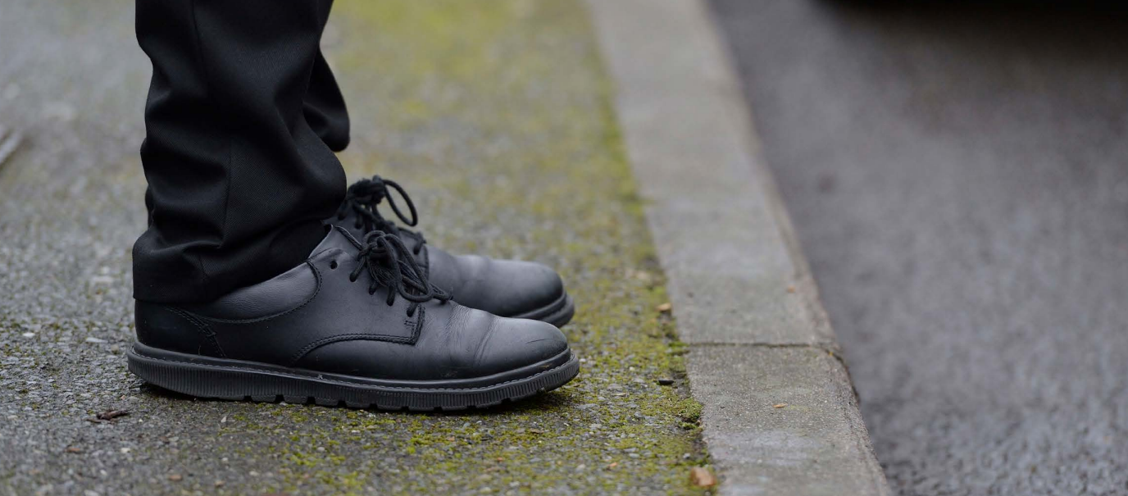
Road Safety – Step 2
Step 2 of road safety is:
Before crossing, stop just before you get to the kerb
This means you can keep back from the edge of the road to ensure you can see all traffic and drivers can see you.
You do not need to rush, give yourself time to look all around for traffic and listen

Slide 8
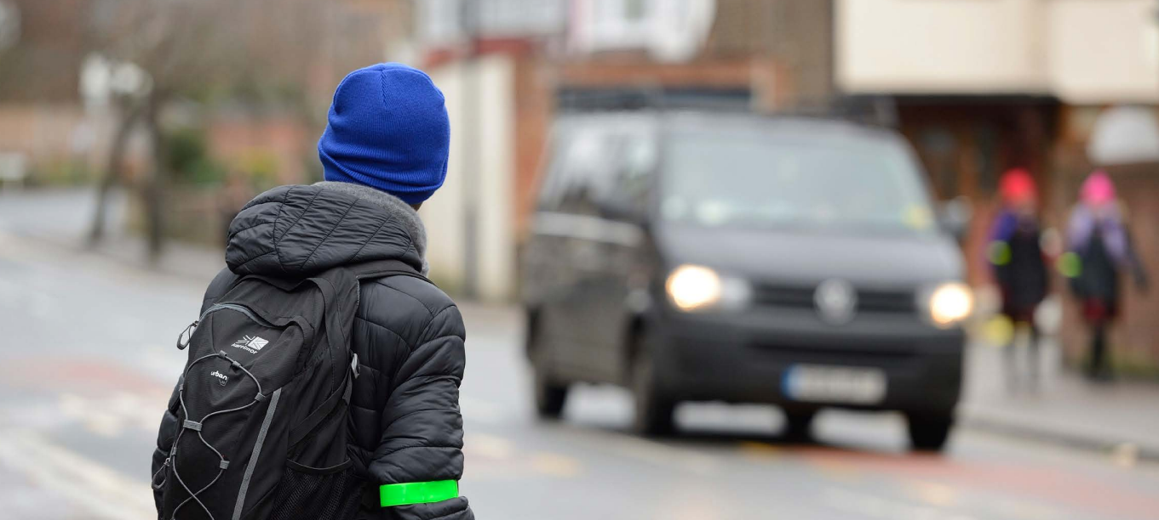
Road Safety – Step 3
Step 3 of road safety is:
If traffic is coming, let it pass
Do not cross the road until there is a safe gap in the traffic and you are certain that there is plenty of time

Slide 9
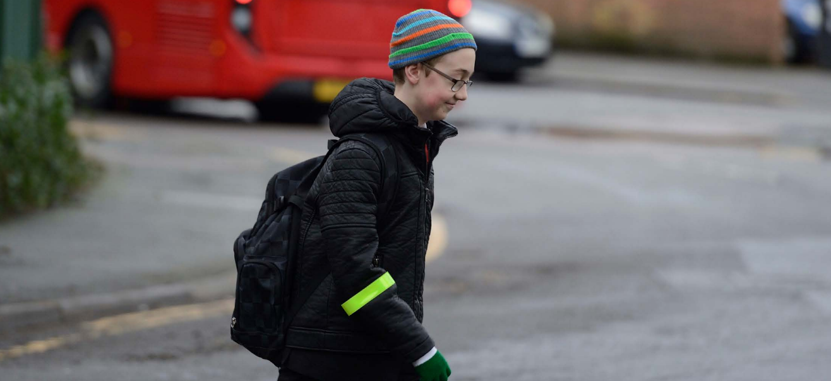
Road Safety – Step 4
Step 4 of road safety is:
When it is safe, go straight across the road but do not run
Do not cross the road until there is a safe gap in the traffic and you are certain that there is plenty of time

Slide 10
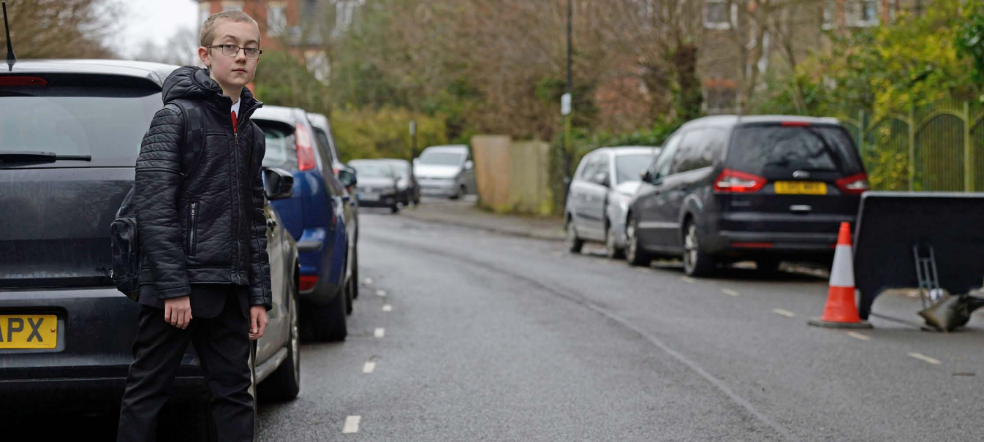
Road Safety – Step 5
Step 5 of road safety is:
Do not cross between parked cars
Unless necessary do not cross between parked cars.
Instead choose a place where there is a big space to cross or where there is a big space between parked cars (make sure they are not about to drive off)

Slide 11
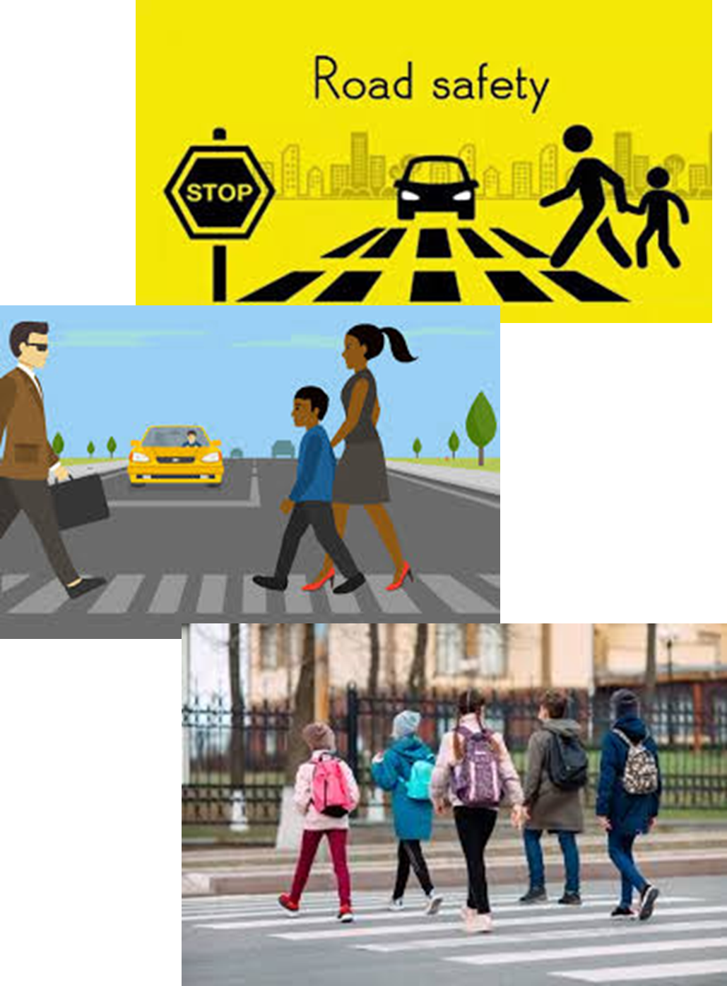
Road Safety Recap
The 5 steps to road safety are:
Find a safe place to cross
Before crossing, stop before you get to the kerb
If traffic is coming let it pass
When it is safe, go straight across the road but do not run
Do not cross between parked cars

Slide 12
First Journeys
While watching the video, answer:
Which types of journeys were children looking forward to making?
What advice was there about taking your first journey?
There was one journey that nearly went wrong, what happened?
Notes:
Link to video can be sent on request.

Slide 13
First Journeys - recap
Which types of journeys were children looking forward to making?
Answers were:
“going to secondary school, going shopping and going to buy a milkshake”

Slide 14
First Journeys - recap
2. What advice was there about taking your first journey?
Answers were
“talk with family, practice the route with someone else, make sure you wait for the green man and that traffic has stopped, don’t play with a ball or anything, take out your headphones before crossing the road”

Slide 15
First Journeys - recap
3. There was one journey that nearly went wrong, what happened?
Answer were
“a girl was waiting to cross the road with her friends when her friends decided to cross on a red man. The girl waited for the green man to cross and told her friends about the risks of not crossing the road safely.”

Slide 16
Hinge Questions – whiteboard activity
3
Rules!
I will ask the question and give you some thinking time. (no more than 10 seconds)
Write the answer and turn your whiteboard over so nobody can see it.
When I am ready I will put on the 3 to 1 counter.
When ‘Show me’ appears on the board you must hold up your whiteboard (even if you don’t know the answer and there is nothing on your board)
2
1
Show me!
(even if your whiteboard is blank)

Slide 17
Hinge Questions – whiteboard activity
True or False
To be safe on the road you should walk when crossing the road?
True

Slide 18
Hinge Questions – whiteboard activity
True or False
To be safe on the road you should cross wherever you want too?
False

Slide 19
Hinge Questions – whiteboard activity
True or False
To be safe on the road you should stand right on the edge of kerb before crossing
False

Slide 20
Hinge Questions – whiteboard activity
True or False
To be safe on the road you should try to always use a pedestrian crossing or where a crossing is controlled by an adult
True

Slide 21
Road Safety Scenarios
Read the scenario below and write down what advice you have. Remember you will be asked to give your answers to the class
“a group of friends are walking down a really busy road. One dares another to run across the road as quickly as they can. Everyone is watching and giving encouragement”

Slide 22
Road Safety Scenarios
Read the scenario below and write down what advice you have. Remember you will be asked to give your answers to the class
“Outside the school gates lots of parents have parked their cars. A Year 7 is standing between the cars waiting to cross. 50 metres down the street there is a pedestrian crossing”

Slide 23
Road Safety Scenarios
Read the scenario below and write down what advice you have. Remember you will be asked to give your answers to the class
“A year 7 is wearing headphones and selecting music on their phone as they are walking to school”

Slide 24
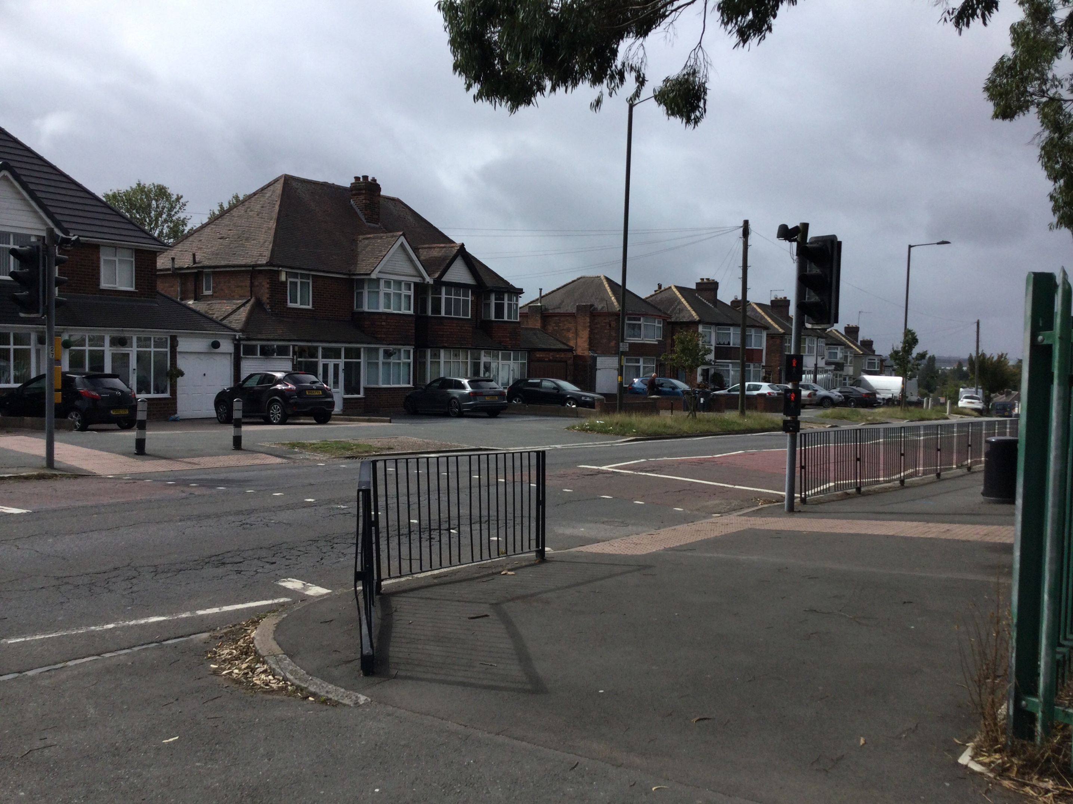
Road Safety at Hodge Hill College
Remember when you are crossing Bromford Road to enter school or when leaving school you should always be using the pedestrian crossing.
There are lots of cars around the school in the mornings and afternoons. Using the pedestrian crossing will keep you safe

Slide 25
Road Safety Game
Using your whiteboards choose option A or B in the game your teacher will now put on the board.
The choice with the biggest majority will decide what option the teacher chooses on the game
https://www.think.gov.uk/resource/take-the-lead-game/

Slide 26


