Slide 1
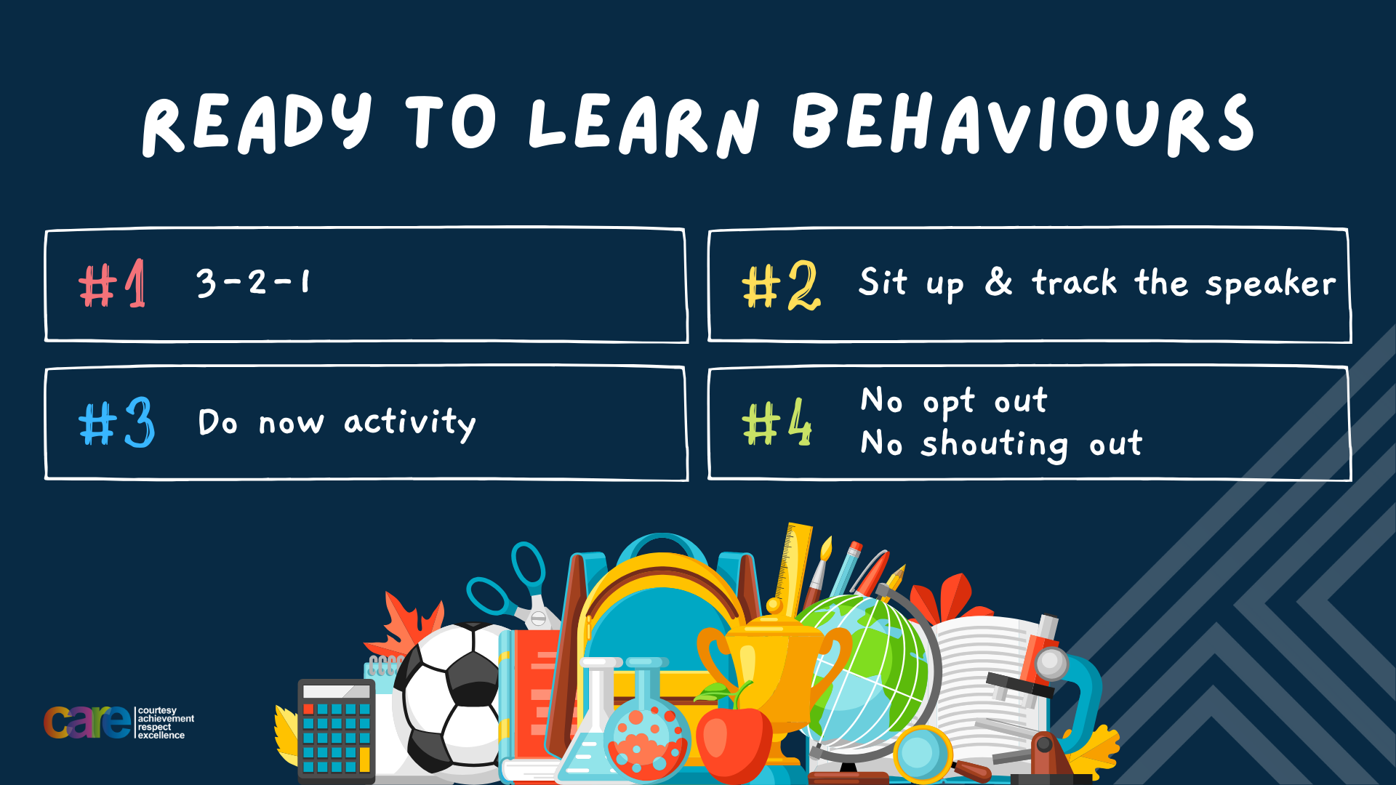

Slide 2








Write the date: 14 April 2025
Write the title: What is peer pressure?
Underline both using your ruler in your learning wallet. Take out your oracy helpsheet too.
Complete the following questions:
What is being described: “a close relationship between 2 or more people who care about and support each other”
True or False – “The Prime Minister decides all laws”
What political party won 412 seats in the last General Election?
Friendship
False
Labour

Slide 3


Secure your Relationships: Learning Journey
What makes a good friend?
What is peer pressure?
What is the difference between bullying and banter?
Are online friendship safe?
What is cyberbullying?
What are stereotypes?
Today we will look at:
What is peer pressure?
This includes:
Types of peer pressure
Positive and negative peer pressure
How to avoid negative peer pressure
Please remember that during the lesson we should not be asking any pupil or teacher personal questions.
Your teacher can ask you questions but this will be to check your knowledge in the lesson.

Slide 4
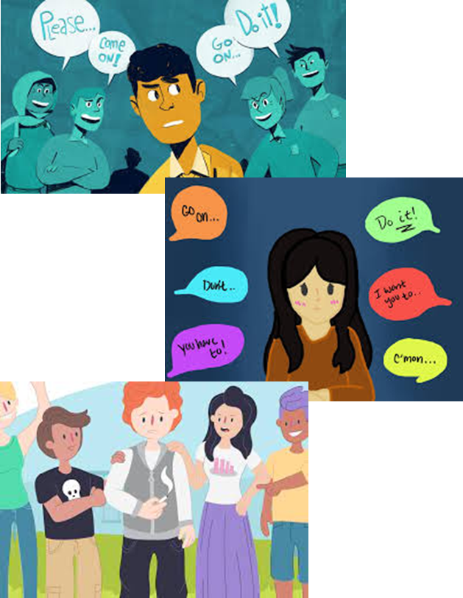
Tutor Time Recap
Peer pressure is “being influenced by other people (peers) to act in a certain way”
Peer pressure can only happen between people of the same or similar age

Slide 5
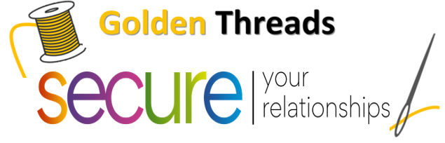

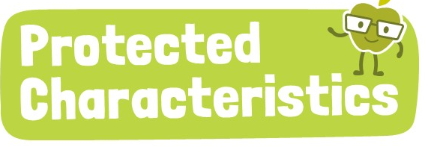
Tutor Time Recap
We are learning this because:
Links to the Golden Thread of “Secure your relationships”. Being part of a group is important but it is equally important to retain your individuality and not start acting in a way that is not in line with your values
Individual Liberty is a British Value and no one should be forced or feel under pressure to act in a way they are not comfortable with
Article 15 of the UN Rights of a Child state children have the right to meet with friends and form groups as long as it does not harm others. Negative peer pressure can do this which means children’s rights are not being respected.
UN Rights
of a Child

Slide 6
Type of Peer Pressure
There are different types of peer pressure. These are:
Direct Peer Pressure
Indirect Peer Pressure
Positive Peer Pressure
Negative Peer Pressure

Slide 7
Type of Peer Pressure
With the person next to you discuss which definition links to each type of peer pressure
Direct Peer Pressure
Encouraging good habits
Indirect Peer Pressure
Encouraging risky behaviours
Positive Peer Pressure
A more subtle way of influence such as wanting to wear the same clothes or listen to the same music as someone
Negative Peer Pressure
Someone explicitly asking you to do something

Slide 8
Type of Peer Pressure
It is important to know that direct and indirect peer pressure can also be positive or negative peer pressure.
Example – direct & positive peer pressure – a good friend telling you to turn off the playstation to revise for your assessment the next day

Slide 9
Type of Peer Pressure
It is important to know that direct and indirect peer pressure can also be positive or negative peer pressure.
Example – indirect & negative peer pressure – seeing a pupil in the year above being rude and disrespectful to a teacher then copying this behaviour in your next lesson

Slide 10
Type of Peer Pressure - scenario
“Your friend tells you to try out for the football team even though you are nervous”
In your books answer the following questions:
Is this direct or indirect peer pressure?
Is this positive or negative peer pressure?
What would you do if you were in this scenario?

Slide 11

What is peer pressure
Using your oracy helpsheet, discuss with the person next to you:
“Your 3 answers to the scenario. Do you agree on how you would both react?”
Remember to use the sentence starters to add, build or challenge what your partner has said.
Be ready to share your discussion with the class

Slide 12
Type of Peer Pressure - scenario
“You are meeting your friend after school. You know they have lied to their parents about where they are going. You decide to do the same.”
In your books answer the following questions:
Is this direct or indirect peer pressure?
Is this positive or negative peer pressure?
What would you do if you were in this scenario?

Slide 13
What is peer pressure
Using your oracy helpsheet, discuss with the person next to you:
“Your 3 answers to the scenario. Do you agree on how you would both react?”
Remember to use the sentence starters to add, build or challenge what your partner has said.
Be ready to share your discussion with the class

Slide 14

Hinge Questions – whiteboard activity
3
Rules!
I will ask the question and give you some thinking time. (no more than 10 seconds)
Write the answer and turn your whiteboard over so nobody can see it.
When I am ready I will put on the 3 to 1 counter.
When ‘Show me’ appears on the board you must hold up your whiteboard (even if you don’t know the answer and there is nothing on your board)
2
1
Show me!
(even if your whiteboard is blank)

Slide 15
Hinge Questions – whiteboard activity
What is being described?
“being influenced by other people (peers) to act in a certain way”
Peer Pressure

Slide 16

Hinge Questions – whiteboard activity
What golden thread does this topic relate to?
A – Secure your Future
B – Secure your Wellbeing
C – Secure your Relationships
D – Secure your Voice

Slide 17
Hinge Questions – whiteboard activity
What type of peer pressure is being described?
“someone explicitly telling you to do something”
A – Direct Peer Pressure
B – Indirect Peer Pressure
C – Positive Peer Pressure
D – Negative Peer Pressure

Slide 18
Hinge Questions – whiteboard activity
What type of peer pressure is being described?
“encouraging risky behaviour”
A – Direct Peer Pressure
B – Indirect Peer Pressure
C – Positive Peer Pressure
D – Negative Peer Pressure

Slide 19
Hinge Questions – whiteboard activity
What type of peer pressure is being described?
“a subtle way of being influenced”
A – Direct Peer Pressure
B – Indirect Peer Pressure
C – Positive Peer Pressure
D – Negative Peer Pressure

Slide 20
Hinge Questions – whiteboard activity
Which statement below is not a reason why friendship matter
A – Emotional Support
B – Encourages Personal Development
C – Helps handle challenges
D – Makes you be more like them

Slide 21

Peer Pressure
You have 1 minute to answer the following question in your book:
“Is peer pressure normally positive or negative?”

Slide 22
Peer Pressure
Take out your oracy helpsheet from your learning wallet.
You have 1 minute to discuss the following question with the person next to you:
“Is peer pressure normally positive or negative?”
Be ready to share your discussion with the class.

Slide 23
Negative Peer Pressure
When peer pressure is referred to it is normally in a negative context.
This means that a person has been influenced directly or indirectly to do something or behave in a way that is not normally like them.
This is the type of peer pressure that should be avoided. However it is easier said than done.

Slide 24
Negative Peer Pressure
To avoid negative peer pressure there are 3 things that should be considered before acting on the influences of others:
1. Problem – what does your friend want you to do? Is it a good or a bad thing? Is kind or mean? Is healthy or unhealthy? Is it legal or illegal? Is it something you would do in front of parents/carers?

Slide 25
Negative Peer Pressure
To avoid negative peer pressure there are 3 things that should be considered before acting on the influences of others:
2. Consequences – What will happen if you do what your friend has asked? Is there anything positive that can happen? Will it help someone? Is there anything negative that can happen? Could you or others be hurt? Could you or others get into trouble?

Slide 26
Negative Peer Pressure
To avoid negative peer pressure there are 3 things that should be considered before acting on the influences of others:
3. Action – Should you do what your friend has asked? Would you be proud of your choice afterwards? Would your parents/carers be proud of your choice?

Slide 27
Negative Peer Pressure
To avoid negative peer pressure there are 3 things that should be considered before acting on the influences of others:
3. Action – Should you do what your friend has asked? Would you be proud of your choice afterwards? Would your parents/carers be proud of your choice?

Slide 28

Negative peer pressure - example
Notes:
https://www.youtube.com/watch?v=Fl3RPRvI5JE

Slide 29
Negative Peer Pressure
Having watched the video complete the following sentences in your book.
The problem faced by the person facing peer pressure was…
The consequences of doing what was asked of them was…
The action I would suggest they do is…

Slide 30
Negative peer pressure
Take out your oracy helpsheet from your learning wallet.
You have 1 minute to discuss the answers you have written about the video we have just watched.
Be ready to share your discussion with the class.

Slide 31
Reflection
Think carefully before acting on something a friend has asked you to do. Only respond to something that will have a positive impact and matches the values you have as a person.
The same can be said for if you ask a friend to do something. Does your request result in a positive or negative consequence for everyone involved.

Slide 32
Peer Pressure scenario – extension task
Tatiana invites Lisa, a new friend, home after school. Nobody else is home. They decide to play some games on the computer, which is okay, but Tatiana is not supposed to use the internet without permission. If she does, she will lose computer privileges and probably get grounded. Lisa wants to visit some websites. Tatiana says, “Nah, let’s play some more.” But Lisa says, “So what’s the big deal? Everybody does it. My other friends and I do it all the time.”
In your books answer the following questions:
What is the problem faced by Tatiana?
What are the consequences if she does what Lisa suggests?
What action would you suggest Tatiana takes?

Slide 33
Peer pressure extension task
Take out your oracy helpsheet from your learning wallet.
You have 1 minute to discuss your answers to the previous scenario.
Remember to add, build and challenge what your partner says.
Be ready to share your discussion with the class.

Slide 34


