Slide 2
Write the date: 01 May 2024
Write the title: Understanding the local elections
Underline both!
Complete the do now task:
What are the 3 key principles of an unhealthy relationship?
2. What are the 3 key principles of a healthy relationship?
3. True or False – your identity can change as you get older?
Disrespect, neglect and control
Respect, equity and communication
True - your values may change as you get older and values help shape your identity

Slide 4
You may have heard that there are local elections this week to decide the next West Midlands Mayor.
Today we will look at:
What is democracy?
How do Mayor’s get elected
Who people can vote for in the election
Conduct your own class election
Please remember that during this lesson you should not be asking your teacher any personal questions.
This means in this lesson you should not ask the teacher who they would be/will be voting for in the election.

Slide 5
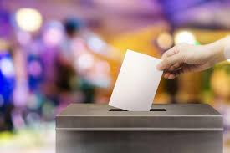
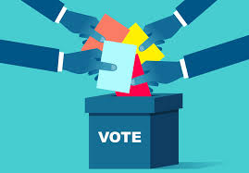
What is an election?
The definition of an election is:
“The selection by vote of a person from among candidates for a position. This is normally for a political position”

Slide 6
Elections and Democracy
The UK is a democratic country and democracy is the foundation of the political system in the UK.
This means that everyone in the UK has an equal say in how their country is run and that any elected political person should be accountable to the people.
This is shown in the UK through voting system allowing all adults to vote (if they have registered to do so). The result of this vote is respected.

Slide 7
What elections are happening this week?
Across the UK, there are local elections.
The local elections do not decide the Prime Minister or the political party in charge of the UK Government.
The local elections can decide on numerous positons:
Local councilors
Mayor
This week there is an election for both a councilor in Birmingham City Council and a West Midlands Mayor.
Today we will focus on the election for a West Midlands Mayor

Slide 8
How do Mayors get elected?
While watching the video answer the following questions in your books:
How often do mayoral elections happen?
What will the Mayor be head of if elected?
True or False – You need a polling card to vote?
Notes:
https://www.youtube.com/watch?v=BH5IEfBTj24

Slide 9
How do Mayors get elected?
You should now mark your answers with red pen. If you got the wrong answer, you should write the correct answer.
1. How often do mayoral elections happen?
Every 4 years

Slide 10
How do Mayors get elected?
You should now mark your answers with red pen. If you got the wrong answer, you should write the correct answer.
2. What will the Mayor be head of if elected?
The West Midlands Combined Authority
This means they are a direct representative of people who live in Birmingham, Coventry, Dudley, Sandwell, Solihull, Walsall and Wolverhampton.

Slide 11
How do Mayors get elected?
You should now mark your answers with red pen. If you got the wrong answer, you should write the correct answer.
3. True or False – You need a polling card to vote?
True – you receive this in the post (if you have registered to vote) and you must show this when voting.

Slide 12
What is the role of a Mayor?
While watching the video answer the following questions in your books:
True or False – Mayors can make their own laws?
What does Mayor’s do with Government money?
Notes:
https://www.youtube.com/watch?v=atQWFlsTTDM

Slide 13
What is the role of a mayor?
You should now mark your answers with red pen. If you got the wrong answer, you should write the correct answer.
1. True or False – Mayors can make their own laws?
False

Slide 14
What is the role of a mayor?
You should now mark your answers with red pen. If you got the wrong answer, you should write the correct answer.
2. What do Mayors do with Government money?
Improve transport networks
Develop housing initiatives
Address unemployment
Tackle Homelessness
Improve air quality
Build relationships across different groups in the community
Which of these 6 things do you think is the most important?
Why do you think this?

Slide 15
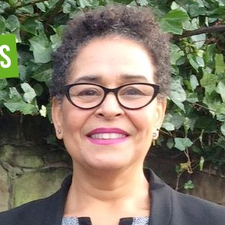
Who wants to be West Midlands Mayor?
Siobhan Haper-Nunes from the Green Party.
Siobhan says as mayor they will:
Invest more in left behind communities by creating jobs and business opportunities
Insulate homes, bring down energy bills, reduce emissions and create green jobs.
Give communities a stronger says on how government money is spent

Slide 16
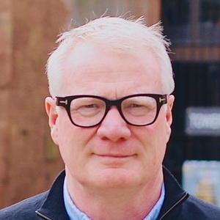
Who wants to be West Midlands Mayor?
Richard Parker from the Labour and Co-operative Party
Richard says as Mayor they will:
Create 150,000 job and training opportunities
Revitalise high streets
Tackle crime and anti-social behaviour
Bring buses back into public control
Fix the housing crisis

Slide 17
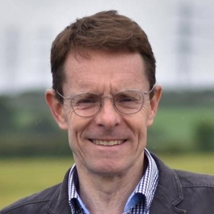
Who wants to be West Midlands Mayor?
Andy Street from the Conservative and Unionist Party. Andy Street is the current West Midlands Mayor
Andy says as Mayor they will:
Keep transport fares low
Get West Midlands economy growing faster than London’s through increasing employment
Triple the number of social rental homes being built

Slide 18
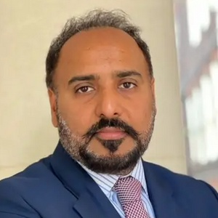
Who wants to be West Midlands Mayor?
Sunny Virk from the Liberal Democrats.
Sunny says as Mayor they will:
Give people in the West Midlands:
Quality affordable homes
Investment to grow the regional economy
Provide a reliable public transport network

Slide 19
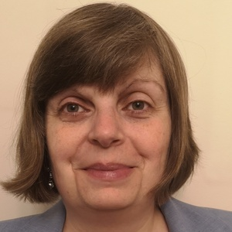
Who wants to be West Midlands Mayor?
Elaine Ruth Williams from Reform UK
Elaine says as Mayor they will:
Invest in town centres to help businesses to grow
Money invested to reduce leaks and pollution in the water infrastructure
Rethink the transport network system
Bid for more funding to tackle crime
Ensure that everyone can access the health services they need

Slide 20
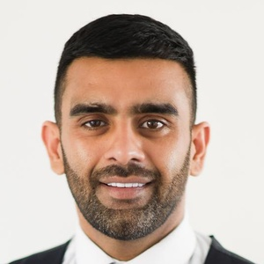
Who wants to be West Midlands Mayor?
Akhmed Yakoob. Akhmed is an Independent candidate. This means they are not part of a political party.
Akhmed says as Mayor they will:
Work with partners to build new homes and increase social housing
Ensure burial services meet religious requirements
Improve public transport but reducing fares and congestion, moving transport to public ownership and slowing private hire taxis to use bus lanes
Create more green jobs initiatives and apprenticeships

Slide 21
Time to Vote
Now we have learnt what candidates there are for the West Midlands Mayoral Election it is time to vote.
You have a voting slip. You must put a “x” in the box beside the candidate you wish to vote for. You can only vote for 1 candidate.
The candidate who has the majority of votes (for example if there are 20 people in your class, a candidate will need at least 11 votes) wins. This is called “first past the post”

Slide 22
Reflection
While your teacher is counting the votes. Complete the following sentences in your book.
I voted for….
The reason I voted for them was…
(in this sentence you should say what policy you think was best)

Slide 23
Hinge Questions – whiteboard activity
3
Rules!
I will ask the question and give you some thinking time. (no more than 10 seconds)
Write the answer and turn your whiteboard over so nobody can see it.
When I am ready I will put on the 3 to 1 counter.
When ‘Show me’ appears on the board you must hold up your whiteboard (even if you don’t know the answer and there is nothing on your board)
2
1
Show me!
(even if your whiteboard is blank)

Slide 24
Hinge Questions – whiteboard activity
What is being described?
“that everyone in the UK has an equal say in how their country is run and that any elected political person should be accountable to the people.”
A – Respect
B – Tolerance
C - Democracy

Slide 25
Hinge Questions – whiteboard activity
Is the following statement true or false?
West Midlands Mayoral Elections happen every 5 years
A – True
B – False

Slide 26
Hinge Questions – whiteboard activity
Is the following statement true or false?
“West Midlands Mayor are the head of the West Midlands Combined Authority”
A – True
B – False

Slide 27
Hinge Questions – whiteboard activity
State one thing that the West Midlands Mayor can spend Government money on
Improve transport network, develop housing initiatives, address unemployment, tackle homelessness, improve air quality, build relationships across different groups in the community

Slide 28
Hinge Questions – whiteboard activity
How many candidates can you vote for in an election?
A – 1
B – 2
C – 3
D - 4

Slide 29
Hinge Questions – whiteboard activity
If 100 people vote, how many votes does a candidate need to win?
A – 100
B – 50
C – 51
D - 75

