Slide 1
Thought of the Day
“Influencers shape our self-esteem, our goals, and our values. The trick is to follow those who make you feel good about yourself, not bad”
Emma Gannon, Podcaster

Slide 2


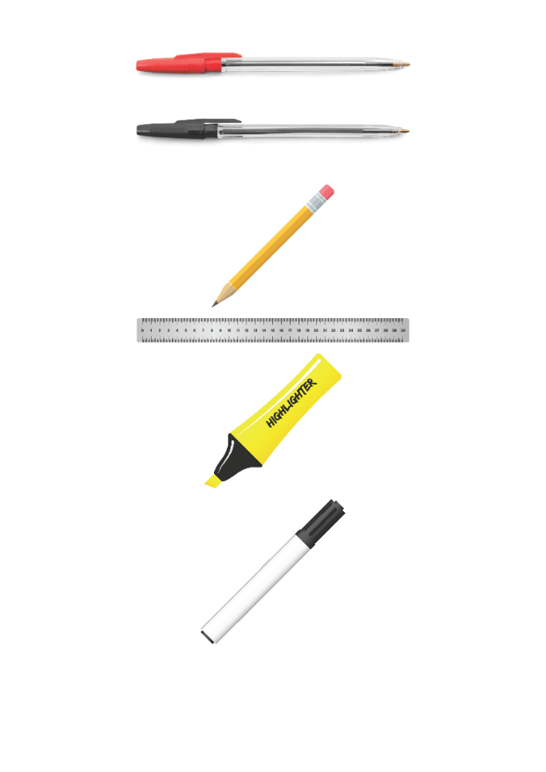


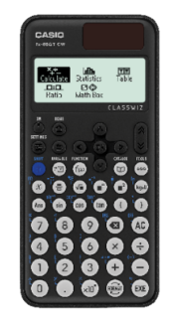


Replacement equipment for your learning wallet can be purchased at the following locations/times:
The following items can be purchased for 10p each (cash only) from West Canteen, East Canteen, the Library, and
LRC (next to W214):
Day | West Canteen | East Canteen | Library or LRC | Library
Monday | 08:00–08:35 | 08:30–08:35 | 10:10– 10:30 11:10–11:30 12:40–13:00 13:40–14:00 | 16:10–16:30
Tuesday | 08:00–08:35 | 08:30–08:35 | 10:10– 10:30 11:10–11:30 12:40–13:00 13:40–14:00 | 15:10–15:30
Wednesday | 08:00–08:35 | 08:30–08:35 | 10:10– 10:30 11:10–11:30 12:40–13:00 13:40–14:00 | 15:10–15:30
Thursday | 08:00–08:35 | 08:30–08:35 | 10:10– 10:30 11:10–11:30 12:40–13:00 13:40–14:00 | 15:10–15:30
Friday | 08:00–08:35 | 08:30–08:35 | 11:10–11:30 12:40–12:30 | 13:40–14:00
The following items can be purchased from West Office using money on your ParentPay:
£1.70
£15.00

Slide 3


Homework has been set for this week.
Remember to log in and complete your set tasks.
MATHS
SCIENCE
ALL OTHER SUBJECTS
Have you completed and shown your Maths Teacher your booklet
Have you completed and shown your Science Teacher your booklet
Notes:
Please give time for the students to produce answers for themselves before showing answers.

Slide 4

Secure your Wellbeing: Learning Journey
Impact of harmful content on young people
How to report inappropriate online content
What is online harassment?
What influence does social media have on body image
What impact can social media influencers have
What does a positive online presence look like?
Today we will look at:
What impact can social media influencers have
This includes:
Definition of social media influencers
Examples of people who are classed as social media influencers
Please remember that during the lesson we should not be asking any pupil or teacher personal questions.
Your teacher can ask you questions but this will be to check your knowledge in the lesson.

Slide 5
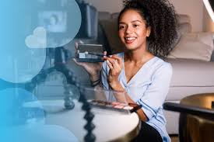


What are social media influencers
Social media influencers are…
“people who have gained a large following on social media platforms and influences the opinions, behaviours and buying decision of others”

Slide 6

Why are we learning about this?
This links to the Golden Thread of “Secure your Wellbeing”
As you begin to use social media, it is important to understand that influencers may not show their real lives. This will stop you comparing your life to something that is fake. This can protect your mental health and wellbeing

Slide 7

Why are we learning about this?
Rule of Law is a British Value. This means people are expected to follow laws to keep everyone safe. Online laws state that influencers have to follow certain rules when promoting products so their followers know they are looking at an advert

Slide 8
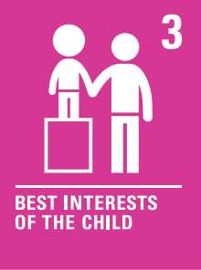
Why are we learning about this?
Article 3 of the UN Rights of a Child state that governments and all adults should do what is best for children. Although this may mean that children disagree with the decisions, the government have laws around what age social media can be used. This is ultimately to protect children.
UN Rights
of a Child

Slide 9
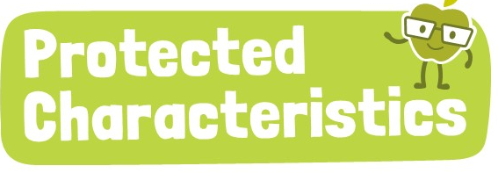
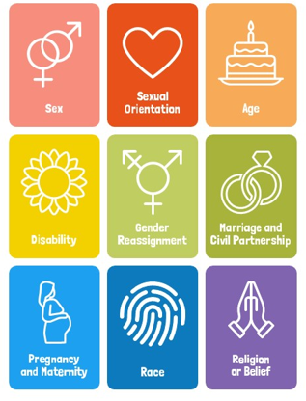
Why are we learning about this?
The Equality Act (2010) sets out 9 Protected Characteristics. No one should be treated differently due to identifying with one or more of the characteristics. This applies online over social media too.

Slide 10

Social Media Influencers
You have 1 minute to think about the following question:
“What social media influencers do you know about? What do they show on social media?”

Slide 11
Social Media Influencers
Using your oracy helpsheet, with the person next to you, discuss your response to the question:
“What social media influencers do you know about? What do they show on social media?”
Remember to use the sentence starters to add, build or challenge what your partner has said.
Be ready to share your discussion with the class

Slide 12
Examples of Social Media Influencers
Mr Beast – 65 million Instagram followers – content is based around elaborate challenges to complete
Kylie Jenner – 395 million Instagram followers – content is around fashion and beauty products
Joanna Gaines – 13.5 million Instagram followers – content is all about creating a good lifestyle through fashion

Slide 13

Impact of Social Media influencers

Slide 14
Social Media Influencers
You have 1 minute to think about the following question:
“What negative influence did the people in the video say social media influencers can have?”

Slide 15
Social Media Influencers
Using your oracy helpsheet, with the person next to you, discuss your response to the question:
“What negative influence did the people in the video say social media influencers can have?”
Remember to use the sentence starters to add, build or challenge what your partner has said.
Be ready to share your discussion with the class

Slide 16



Support
If you ever need support about content posted by social media influencers for yourself, a friend or family member you can find it here:
Childline.org.uk
Call – 08001111
Email or chat online for support
Themix.org.uk
You can email or have one-to-chat online.
There is also a crisis messenger which is available 24/7

