Slide 1
Thought of the Day
“It's essential that we all take some responsibility in reporting bad content when we see it – even if we're just quickly scrolling through our social media feeds.”

Slide 2


Homework has been set for this week.
Remember to log in and complete your set tasks.
We still use Classcharts for announcements, surveys and revision material
Homework Club every morning in West Canteen from 8am
Library is open before school and at break times
Students on the following slides have not completed ALL tasks
Make sure you are completing the SET TASKS! These are the tasks your teachers have set.
Notes:
Please give time for the students to produce answers for themselves before showing answers.

Slide 3








Replacement equipment for your learning wallet can be purchased at the following locations/times:
The following items can be purchased for 10p each (cash only) from West Canteen, East Canteen, the Library, and
LRC (next to W214):
Day | West Canteen | East Canteen | Library or LRC | Library
Monday | 08:00–08:35 | 08:30–08:35 | 10:10– 10:30 11:10–11:30 12:40–13:00 13:40–14:00 | 16:10–16:30
Tuesday | 08:00–08:35 | 08:30–08:35 | 10:10– 10:30 11:10–11:30 12:40–13:00 13:40–14:00 | 15:10–15:30
Wednesday | 08:00–08:35 | 08:30–08:35 | 10:10– 10:30 11:10–11:30 12:40–13:00 13:40–14:00 | 15:10–15:30
Thursday | 08:00–08:35 | 08:30–08:35 | 10:10– 10:30 11:10–11:30 12:40–13:00 13:40–14:00 | 15:10–15:30
Friday | 08:00–08:35 | 08:30–08:35 | 11:10–11:30 12:40–12:30 | 13:40–14:00
The following items can be purchased from West Office using money on your ParentPay:
£1.70
£15.00

Slide 4

Secure your Wellbeing: Learning Journey
Impact of harmful content on young people
How to report inappropriate online content
What is online harassment?
What influence does social media have on body image
What impact can social media influencers have
What does a positive online presence look like?
Today we will look at:
Reporting inappropriate online content
This includes:
What is inappropriate online content
How to report on different platforms
What happens after you report
Please remember that during the lesson we should not be asking any pupil or teacher personal questions.
Your teacher can ask you questions but this will be to check your knowledge in the lesson.

Slide 5



What is inappropriate content?
Inappropriate content is…
“content that refers to any material that is harmful, offensive or violates platform policies”

Slide 6

Why are we learning about this?
This links to the Golden Thread of “Secure your Wellbeing”
Harmful online content can impact a person’s mental health as it can be very distressing. It can also have other negative consequences that can lead to other physical and mental wellbeing dangers

Slide 7

Why are we learning about this?
Rule of Law is a British Value that means everyone is expected to follow the laws. There are age restrictions on what content can be seen by children. This is to protect children for seeing content they do not yet understand or be easily influenced by

Slide 8

Why are we learning about this?
Article 17 of the UN Rights of a Child states that children have the right to get information from the internet. It also states that this information should not be harmful and it is up to adults to enforce this. This is why there are parental controls over what can be accessed online
UN Rights
of a Child

Slide 9
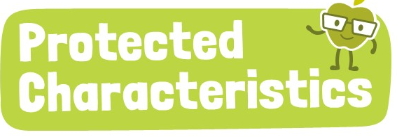
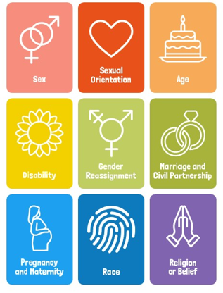
Why are we learning about this?
The Equality Act (2010) sets out 9 Protected Characteristics. Unfortunately content online can be harmful against people who identify with one or more of these characteristics. This content is illegal and should not be viewed by children

Slide 10
What is inappropriate content?
Examples of inappropriate content are:
Hate speech – content that targets individuals or groups based on one of the Protected Characteristics
Cyberbullying/Harassment – Threats, trolling or repeated abuse
Explicit/Sexual Content – Sharing of explicit material such as pornography, grooming
Violence/Graphic Content – content of real-life violence, self harm encouragement or gore
Illegal or harmful content – drug promotion, scams, child exploitation or extremist views

Slide 11

How to report on Instagram
Notes:
https://www.youtube.com/watch?v=2jWqPLDGN34

Slide 12
How to report on Snapchat
Notes:
https://www.youtube.com/watch?v=puKpLESKLHk

Slide 13
How to report on PlayStation Network

Slide 14
What happens after you report?
Each platform has its own individual process for reported content. Generally the following happens:
Content is reviewed either by human moderators or AI
If the content violates platform policy, the content is removed and the user is issued a warning, suspended or banned
If this does not happen, users can still continue to report the content. It is also recommended to block/mute the user who posted the content

Slide 15

Reporting Content
You have 1 minute to think about the following question:
“Should online platforms do more to stop inappropriate content from being uploaded in the first place?”

Slide 16
Reporting Content
Using your oracy helpsheet, with the person next to you, discuss your response to the question:
“Should online platforms do more to stop inappropriate content from being uploaded in the first place?”
Remember to use the sentence starters to add, build or challenge what your partner has said.
Be ready to share your discussion with the class

Slide 17



Support
If you ever need support about harmful online content for yourself, a friend or family member you can find it here:
Childline.org.uk
Call – 08001111
Email or chat online for support
Themix.org.uk
You can email or have one-to-chat online.
There is also a crisis messenger which is available 24/7

