Slide 1
Thought of the Day
“It's essential that we all take some responsibility in reporting bad content when we see it – even if we're just quickly scrolling through our social media feeds.”

Slide 2


Homework has been set for this week.
Remember to log in and complete your set tasks.
MATHS
SCIENCE
ALL OTHER SUBJECTS
Have you completed and shown your Maths Teacher your booklet
Have you completed and shown your Science Teacher your booklet
Notes:
Please give time for the students to produce answers for themselves before showing answers.

Slide 3





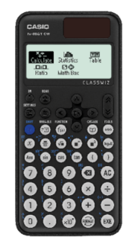


Replacement equipment for your learning wallet can be purchased at the following locations/times:
The following items can be purchased for 10p each (cash only) from West Canteen, East Canteen, the Library, and
LRC (next to W214):
Day | West Canteen | East Canteen | Library or LRC | Library
Monday | 08:00–08:35 | 08:30–08:35 | 10:10– 10:30 11:10–11:30 12:40–13:00 13:40–14:00 | 16:10–16:30
Tuesday | 08:00–08:35 | 08:30–08:35 | 10:10– 10:30 11:10–11:30 12:40–13:00 13:40–14:00 | 15:10–15:30
Wednesday | 08:00–08:35 | 08:30–08:35 | 10:10– 10:30 11:10–11:30 12:40–13:00 13:40–14:00 | 15:10–15:30
Thursday | 08:00–08:35 | 08:30–08:35 | 10:10– 10:30 11:10–11:30 12:40–13:00 13:40–14:00 | 15:10–15:30
Friday | 08:00–08:35 | 08:30–08:35 | 11:10–11:30 12:40–12:30 | 13:40–14:00
The following items can be purchased from West Office using money on your ParentPay:
£1.70
£15.00

Slide 4



Food Bank Collection for Ramadan
"Do not withhold good from those to whom it is due, when it is in your power to act." – Proverbs 3:27
During March, many Muslims will be observing Ramadan by fasting.
As a school, we aim to come together to share food and support those who may have limited resources to break their fast.
So for a whole week (from Monday 3rd March 2025 until Friday 7th March), all students will have the opportunity to bring food items from home in to school to donate to their form tutor.
On Friday our Pupil Leaders will collect all donations, which will be recorded on the Secure Tracker, and there will be a prize for the best form!
Thank you for your kindness and generosity in supporting our community
Mrs Sajed and Miss Reid
"The believer’s shade on the Day of Resurrection will be his charity." – Prophet Muhammad (Tirmidhi 604)
Notes:
Form tutors please keep all collected food items with you in your rooms until Friday 7th when our Pupil Leaders will come and take these all from you during form/period 1.
And if you could make sure the secure tracker is being filled also if students bring donations in under Charity contribution.

Slide 5
Food Bank Collection for Ramadan
"Do not withhold good from those to whom it is due, when it is in your power to act." – Proverbs 3:27
What items could you bring to donate?
Dried food such as rice and pasta
Tinned food such as beans, soup, and canned vegetables
Tinned desserts such as custard, rice pudding
Boxes of cereal
Packet food such as noodles, ramen
Bottles of squash
Please do not bring fresh fruit or vegetables, or frozen food, as these will spoil.
"The believer’s shade on the Day of Resurrection will be his charity." – Prophet Muhammad (Tirmidhi 604)
Notes:
Form tutors please keep all collected food items with you in your rooms until Friday 7th when our Pupil Leaders will come and take these all from you during form/period 1.
And if you could make sure the secure tracker is being filled also if students bring donations in under Charity contribution.

Slide 6

Secure your Wellbeing: Learning Journey
Impact of harmful content on young people
How to report inappropriate online content
What is online harassment?
What influence does social media have on body image
What impact can social media influencers have
What does a positive online presence look like?
Today we will look at:
What is online harassment
This includes:
Define of online harassment
Please remember that during the lesson we should not be asking any pupil or teacher personal questions.
Your teacher can ask you questions but this will be to check your knowledge in the lesson.

Slide 7
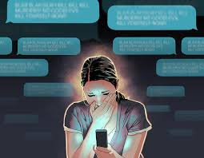
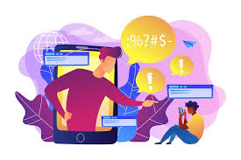
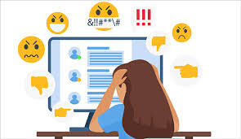
What is online harassment?
Online Harassment is…
“the use of digital technology to repeatedly intimidate, threaten, humiliate or manipulate someone”

Slide 8
What is online harassment?
Online Harassment can occur through various platforms including social media, messaging apps, gaming platforms, chat forums and emails

Slide 9

Why are we learning about this?
This links to the Golden Thread of “Secure your Wellbeing”
Online harassment can have very serious negative wellbeing consequences. It is important to know that online harassment is wrong so you can get help to stop it in order to protect your physical and mental wellbeing

Slide 10

Why are we learning about this?
Rule of Law is a British Value that means everyone is expected to follow the laws. These laws also apply online. Harassment is illegal offline, this means it is also illegal online

Slide 11

Why are we learning about this?
Article 2 states that no child should be treated unfairly for any reason. Online harassment can stem from discrimination. This means that not only is the law being broken, it is also affecting a person’s rights.
UN Rights
of a Child

Slide 12
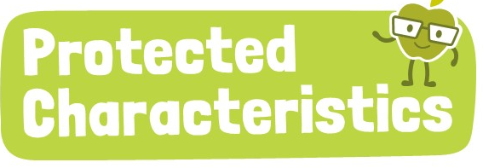
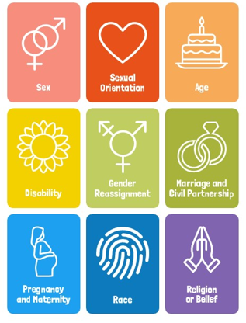
Why are we learning about this?
The Equality Act (2010) sets out 9 Protected Characteristics. No one should be treated online due to identifying with one or more of these characteristics

Slide 13
What is online harassment?
Types of online harassment include:
1. Cyberbullying – sending repeated harm messages, name calling and spreading rumours

Slide 14
What is online harassment?
Types of online harassment include:
2. Doxxing – publishing someone’s private or identifying information without their consent

Slide 15
What is online harassment?
Types of online harassment include:
3. Impersonation – pretending to be someone else online to harm their reputation or manipulate others

Slide 16
What is online harassment?
Types of online harassment include:
4. Stalking - repeatedly sending unwanted messages, tracking a person’s location or excessive checking of their online activity

Slide 17
What is online harassment?
Types of online harassment include:
5. Threats - sending violent threats, pressuring someone to send inappropriate content or using personal content against them.

Slide 18

What is online harassment?
Notes:
https://www.youtube.com/watch?v=seEQUACd9Jg

Slide 19

Impact of online harassment
You have 1 minute to think about the following question:
“What impact can online harassment have on people?”

Slide 20
Impact of online harassment
Using your oracy helpsheet, with the person next to you, discuss your response to the question:
“What impact can online harassment have on people?”
Remember to use the sentence starters to add, build or challenge what your partner has said.
Be ready to share your discussion with the class

Slide 21
Impacts of online harassment
Impacts include:
Increase risk of becoming anxious, depressed having low self esteem and in extreme cases, suicidal thoughts
Strained relationships with others due to feeling isolated or having a lack of trust

Slide 22
Impacts of online harassment
There are also impacts for the perpetrators. These include:
Legal consequences as online harassment is illegal, just as harassment offline is illegal
This could harm future college, university and job applications if a social media search is completed or if that person has been reported to the police

Slide 23



Support
If you ever need support about online harassment for yourself, a friend or family member you can find it here:
Childline.org.uk
Call – 08001111
Email or chat online for support
Themix.org.uk
You can email or have one-to-chat online.
There is also a crisis messenger which is available 24/7

