Slide 1
Thought of the Day
“You are what you share.”
Charles Leadbeater

Slide 2








Replacement equipment for your learning wallet can be purchased at the following locations/times:
The following items can be purchased for 10p each (cash only) from West Canteen, East Canteen, the Library, and
LRC (next to W214):
Day | West Canteen | East Canteen | Library or LRC | Library
Monday | 08:00–08:35 | 08:30–08:35 | 10:10– 10:30 11:10–11:30 12:40–13:00 13:40–14:00 | 16:10–16:30
Tuesday | 08:00–08:35 | 08:30–08:35 | 10:10– 10:30 11:10–11:30 12:40–13:00 13:40–14:00 | 15:10–15:30
Wednesday | 08:00–08:35 | 08:30–08:35 | 10:10– 10:30 11:10–11:30 12:40–13:00 13:40–14:00 | 15:10–15:30
Thursday | 08:00–08:35 | 08:30–08:35 | 10:10– 10:30 11:10–11:30 12:40–13:00 13:40–14:00 | 15:10–15:30
Friday | 08:00–08:35 | 08:30–08:35 | 11:10–11:30 12:40–12:30 | 13:40–14:00
The following items can be purchased from West Office using money on your ParentPay:
£1.70
£15.00

Slide 3


Homework has been set for this week.
Remember to log in and complete your set tasks.
MATHS
SCIENCE
ALL OTHER SUBJECTS
Have you completed and shown your Maths Teacher your booklet
Have you completed and shown your Science Teacher your booklet
Notes:
Please give time for the students to produce answers for themselves before showing answers.

Slide 4

Secure your Wellbeing: Learning Journey
Impact of harmful content on young people
How to report inappropriate online content
What is online harassment?
What influence does social media have on body image
What impact can social media influencers have
What does online footprint mean?
Today we will look at:
What does online footprint mean?
This includes:
Definition of online footprint
Types of online footprints
Examples of online footprints
Please remember that during the lesson we should not be asking any pupil or teacher personal questions.
Your teacher can ask you questions but this will be to check your knowledge in the lesson.

Slide 5

What is a online footprint
Online footprint is…
“the trail of data a person leaves behind when using the internet”

Slide 6

Why are we learning about this?
This links to the Golden Thread of “Secure your Wellbeing”
Understanding that what you do on the internet leaves a footprint, can make you think twice about what you access. This can help your wellbeing as it will make you less anxious if a college, university or employer ever wants to search you online or asks about what you post/share/like online.

Slide 7

Why are we learning about this?
Rule of Law is a British Value that means everyone is expected to follow the laws. There are laws around what data companies can collect from people. Although it is easy to just click a button to consent to data collection to get to the webpage you want, it is important to read the terms and conditions about what is happening with your data.

Slide 8

Why are we learning about this?
Article 3 of the UN Rights of a Child state that governments and all adults should do what is best for children. Although this may mean that children disagree with the decisions, the government have laws around what age social media can be used. This is based around data collection that happens on social media platforms
UN Rights
of a Child

Slide 9
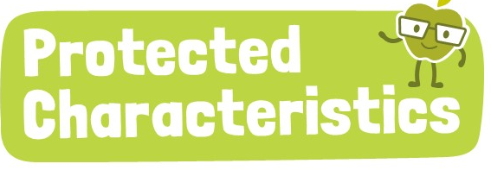
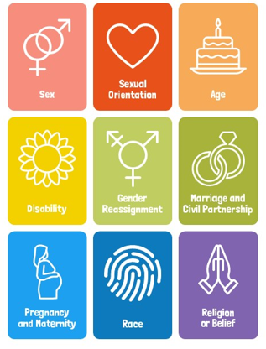
Why are we learning about this?
The Equality Act (2010) sets out 9 Protected Characteristics. No one should be treated differently due to identifying with one or more of the characteristics. This applies online over social media too. You do not want your online footprint to show you do not respect these characteristics as this could impact your future.

Slide 10

What is an online footprint?
Notes:
https://www.youtube.com/watch?v=ottnH427Fr8

Slide 11



What is an online footprint?
There are different types of online footprints
Active Footprint – information you intentionally share such as posts of social media
Passive footprint – information collected about you without your direct input. This includes browsing habits, cookies and location tracking

Slide 12
What is an online footprint?
There are different types of online footprints
Active Footprint – information you intentionally share such as posts of social media
Passive footprint – information collected about you without your direct input. This includes browsing habits, cookies and location tracking

Slide 13

Importance of Online Footprints
You have 1 minute to think about the following question:
“Why do you think your online footprint matters?”

Slide 14
Importance of online footprints
Using your oracy helpsheet, with the person next to you, discuss your response to the question:
“Why do you think your online footprint matters?”
Remember to use the sentence starters to add, build or challenge what your partner has said.
Be ready to share your discussion with the class

Slide 15
Importance of online footprints
Online footprints can affect a person’s future.
Over 70% of employers check social media before hiring someone. This is also now happening more and more at universities.
There are examples of people being rejected a university scholarship due to posting an offensive tweet years before applying to university.

Slide 16
Importance of Online Footprints
You have 1 minute to think about the following question:
“Should universities and employers be allowed to check online activity before accepting or hiring someone?”

Slide 17
Importance of online footprints
Using your oracy helpsheet, with the person next to you, discuss your response to the question:
“Should universities and employers be allowed to check online activity before accepting or hiring someone?”
Remember to use the sentence starters to add, build or challenge what your partner has said.
Be ready to share your discussion with the class

Slide 18
Managing online footprints
The most important way to manage a online footprint is to think before posting, liking or sharing something.
Think about what possible impact this could have on other people. If there is any chance it could have a negative impact, then there is a chance it could have a negative impact on you in the future

Slide 19
Managing online footprints
When you are online next take a minute to look at your previous posts.
Do these posts reflect you as a person?
What would someone else think if they seen those posts?

Slide 20



Support
If you ever need support about online footprint for yourself, a friend or family member you can find it here:
Childline.org.uk
Call – 08001111
Email or chat online for support
Themix.org.uk
You can email or have one-to-chat online.
There is also a crisis messenger which is available 24/7

