Slide 1
Thought of the Day
“When we compare ourselves to highly edited and curated images online, we are measuring ourselves against an unrealistic standard”
Dr Phillippa Diedrichs

Slide 2


Homework has been set for this week.
Remember to log in and complete your set tasks.
MATHS
SCIENCE
ALL OTHER SUBJECTS
Have you completed and shown your Maths Teacher your booklet
Have you completed and shown your Science Teacher your booklet
Notes:
Please give time for the students to produce answers for themselves before showing answers.

Slide 3


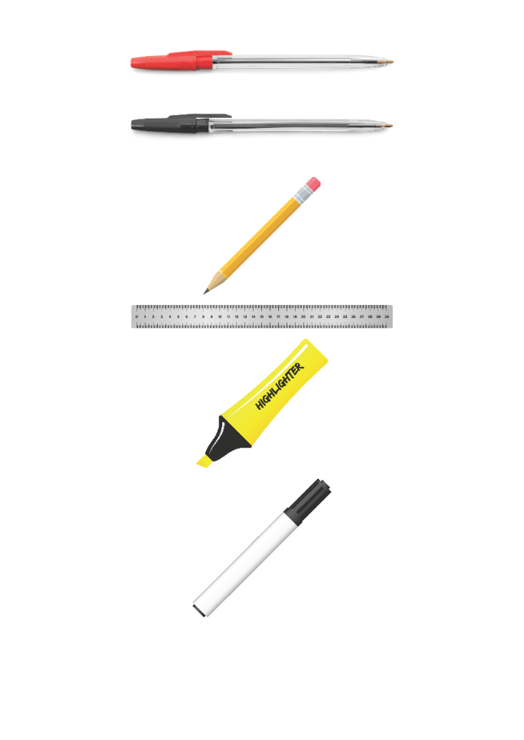





Replacement equipment for your learning wallet can be purchased at the following locations/times:
The following items can be purchased for 10p each (cash only) from West Canteen, East Canteen, the Library, and
LRC (next to W214):
Day | West Canteen | East Canteen | Library or LRC | Library
Monday | 08:00–08:35 | 08:30–08:35 | 10:10– 10:30 11:10–11:30 12:40–13:00 13:40–14:00 | 16:10–16:30
Tuesday | 08:00–08:35 | 08:30–08:35 | 10:10– 10:30 11:10–11:30 12:40–13:00 13:40–14:00 | 15:10–15:30
Wednesday | 08:00–08:35 | 08:30–08:35 | 10:10– 10:30 11:10–11:30 12:40–13:00 13:40–14:00 | 15:10–15:30
Thursday | 08:00–08:35 | 08:30–08:35 | 10:10– 10:30 11:10–11:30 12:40–13:00 13:40–14:00 | 15:10–15:30
Friday | 08:00–08:35 | 08:30–08:35 | 11:10–11:30 12:40–12:30 | 13:40–14:00
The following items can be purchased from West Office using money on your ParentPay:
£1.70
£15.00

Slide 4

Secure your Wellbeing: Learning Journey
Impact of harmful content on young people
How to report inappropriate online content
What is online harassment?
What influence does social media have on body image
What impact can social media influencers have
What does a positive online presence look like?
Today we will look at:
How social media influences body image
This includes:
Definition of body image
How social media leads to unrealistic comparisons
Ways to build a healthy body image
Please remember that during the lesson we should not be asking any pupil or teacher personal questions.
Your teacher can ask you questions but this will be to check your knowledge in the lesson.

Slide 5
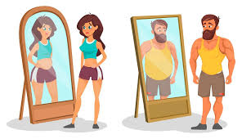
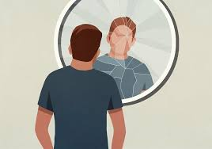
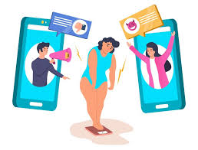
What is body image?
Body image is…
“how a person sees, thinks and feels about their body”

Slide 6

Why are we learning about this?
This links to the Golden Thread of “Secure your Wellbeing”
Body image is directly linked to mental health/wellbeing. Studies show that heavy social media use is linked to lower self-esteem and body dissatisfaction

Slide 7

Why are we learning about this?
Article 17 states that children have the right to access information. This can be accessed online which is most likely through social media. It is important to know that images seen on social media are not always real. They make have been majorly edited to make people look differently than what they do in offline
UN Rights
of a Child

Slide 8
Body Image and Social Media
Social media sets unrealistic beauty standards. It shows that people always have the “ideal” look:
Perfect skin
Thin bodies
Muscular physiques

Slide 9
Body Image and Social Media
However, on many occasions this look is achieved through photo editing.
There are many filters and editing apps available for people to change photos/selfies to make themselves the “ideal” body image they see posted by social media influencers.
This can negatively impact a person’s mental health as they are comparing themselves to an unrealistic expectation.

Slide 10

Body Image and Social Media
Notes:
https://www.youtube.com/watch?v=z2T-Rh838GA

Slide 11

Social media and body image
You have 1 minute to think about the following question:
“Are you surprised by anything in this video? Why?”

Slide 12
Social Media and Body Image
Using your oracy helpsheet, with the person next to you, discuss your response to the question:
“Are you surprised by anything in this video? Why?”
Remember to use the sentence starters to add, build or challenge what your partner has said.
Be ready to share your discussion with the class

Slide 13
Social Media and Body Image
Notes:
https://www.youtube.com/watch?v=7a86-qRtxuo

Slide 14
Social media and body image
You have 1 minute to think about the following question:
“How are the images different in this video? What did the young people think about the images?”

Slide 15
Social Media and Body Image
Using your oracy helpsheet, with the person next to you, discuss your response to the question:
“How are the images different in this video? What did the young people think about the images?”
Remember to use the sentence starters to add, build or challenge what your partner has said.
Be ready to share your discussion with the class

Slide 16
Body Image and Social Media
To avoid negative comparisons on social media people can:
Follow accounts that promote realistic and positive body image
Unfollow accounts that make them start to make comparisons
Unfollow accounts that look like they post edited content
Limit screen time to reduce endless scrolling
Remember that social media is not real life

Slide 17
Body Image and Social Media
Remember:
Social media can distort reality
A person’s worth is not based on the number of likes on a photo
Everyone is more than their appearance. Being a kind and honest person is even more important than that “ideal” body image.

Slide 18



Support
If you ever need support about body image for yourself, a friend or family member you can find it here:
Childline.org.uk
Call – 08001111
Email or chat online for support
Themix.org.uk
You can email or have one-to-chat online.
There is also a crisis messenger which is available 24/7

