Slide 1
Thought of the Day
“You are what you share.”
Charles Leadbeater

Slide 2


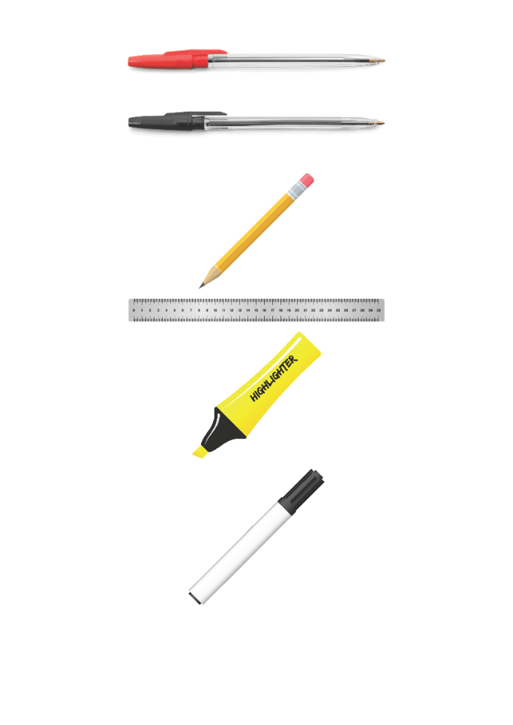


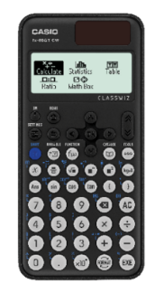


Replacement equipment for your learning wallet can be purchased at the following locations/times:
The following items can be purchased for 10p each (cash only) from West Canteen, East Canteen, the Library, and
LRC (next to W214):
Day | West Canteen | East Canteen | Library or LRC | Library
Monday | 08:00–08:35 | 08:30–08:35 | 10:10– 10:30 11:10–11:30 12:40–13:00 13:40–14:00 | 16:10–16:30
Tuesday | 08:00–08:35 | 08:30–08:35 | 10:10– 10:30 11:10–11:30 12:40–13:00 13:40–14:00 | 15:10–15:30
Wednesday | 08:00–08:35 | 08:30–08:35 | 10:10– 10:30 11:10–11:30 12:40–13:00 13:40–14:00 | 15:10–15:30
Thursday | 08:00–08:35 | 08:30–08:35 | 10:10– 10:30 11:10–11:30 12:40–13:00 13:40–14:00 | 15:10–15:30
Friday | 08:00–08:35 | 08:30–08:35 | 11:10–11:30 12:40–12:30 | 13:40–14:00
The following items can be purchased from West Office using money on your ParentPay:
£1.70
£15.00

Slide 3


Homework has been set for this week.
Remember to log in and complete your set tasks.
MATHS
SCIENCE
ALL OTHER SUBJECTS
Have you completed and shown your Maths Teacher your booklet
Have you completed and shown your Science Teacher your booklet
Notes:
Please give time for the students to produce answers for themselves before showing answers.

Slide 4

Secure your Wellbeing: Learning Journey
How to stay safe now you are more independent
Is it safe to donate blood and organs?
How people become involved in gang culture?
What impact can gang culture have on relationships?
What impact does gang culture have on the community?
How can I be a good role model in my community?
Today we will look at:
How to stay safe now you are more independent
This includes:
Definition of independence
What risks there are in different settings
Please remember that during the lesson we should not be asking any pupil or teacher personal questions.
Your teacher can ask you questions but this will be to check your knowledge in the lesson.

Slide 5
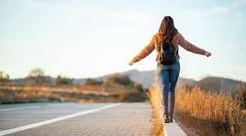

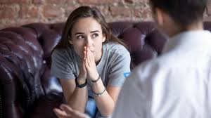
What is independence?
Independence is…
“being able to make your own decisions and take responsibility for your actions without needing constant help from others”

Slide 6
What is independence?
Independence at the age of 15-16 years old might be:
Going out without adult supervision
Travelling to town alone
Making choices about friends, free time or online behaviour
Staying home alone for short periods

Slide 7

Independence
You have 1 minute to think about the following question:
“How do you feel more independent now than you did at 12 or 13 years old?”

Slide 8
Independence
Using your oracy helpsheet, with the person next to you, discuss your response to the question:
“How do you feel more independent now than you did at 12 or 13 years old?”
Remember to use the sentence starters to add, build or challenge what your partner has said.
Be ready to share your discussion with the class

Slide 9
Independence and safety
Even with more independence, safety is essential.
Becoming more responsible and independent means learning how to keep yourself safe without adult guidance all the time.
Independence does not mean taking risks. It means knowing how to avoid them.

Slide 10
Independence and safety
When in public some risks are:
Walking alone at night
Being approached by strangers
Getting lost or stranded

Slide 11
Independence and safety
To limit these risks you should:
Always let someone know where you are going and what time you will be back
Plan your route and avoid shortcuts through alleyways or parks
Keep phone charged
Trust your instincts – if something feel off, remove yourself from the situation

Slide 12
Independence and safety
Peer pressure and finding yourself in risky situations may lead to the following behaviours which are wrong/illegal or not safe. These include:
smoking/vaping
Taking/carrying drugs
Carrying a weapon

Slide 13
Independence and safety
To limit these risks you should:
Practice saying “no” confidently – this is a valuable skill
Think about who your real friends are – do they respect your safety and choices?
Consider long term impact of one reckless decision
Remember you do not need to prove anything to anyone

Slide 14
Independence and safety
Read the scenario below:
Liam, age 16, stays late at a friend’s house. It’s dark and buses have stopped. He decides to walk home alone, taking a shortcut through a park. He doesn’t tell anyone
Questions
Is Liam making safe choices?
What risks is he opening himself up too?
What could he have done differently?

Slide 15
Independence and safety
Read the scenario below:
Josh, age 15, is at a party. His friends dare him to climb onto the garage roof to take a funny video. Everyone’s watching. He doesn’t want to back down and be teased.
Questions
Is Josh making safe choices?
What risks is he opening himself up too?
What advice would you give Josh in this scenario?

Slide 16



Support
If you ever need support about your independence you can find it here:
Childline.org.uk
Call – 08001111
Email or chat online for support
Themix.org.uk
You can email or have one-to-chat online.
There is also a crisis messenger which is available 24/7

