Slide 1
Thought of the Day
“Knowledge about fertility helps us make informed choices about our bodies and our futures, empowering us to take control of our reproductive health.”
Natalie Silverman – host of The Fertility Podcast

Slide 2


HWK Detentions will be held afterschool on Friday
We still use Classcharts for announcements, surveys and revision material
Homework Club every morning in West Canteen from 8am
Library is open before school and at break times
Students on the following slides have not completed ALL tasks
Make sure you are completing the SET TASKS! These are the tasks your teachers have set.
Notes:
Please give time for the students to produce answers for themselves before showing answers.

Slide 3


Slide 4


Secure your Relationships: Learning Journey
What is consent in a sexual relationship?
What is safe sex?
Impact of alcohol and drugs on sexual behaviours
What does fertility mean?
Pregnancy safety
Difference between stillborn, miscarriage and adoption
Today we will look at:
What does fertility mean?
This includes:
What does this mean for males and females
Factors affecting fertility
Facts and myths about fertility
Please remember that during the lesson we should not be asking any pupil or teacher personal questions.
Your teacher can ask you questions but this will be to check your knowledge in the lesson.

Slide 5
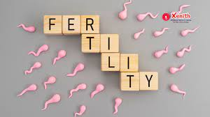

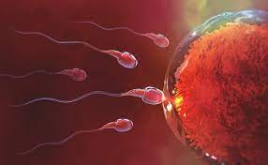
What is fertility
Fertility is…
“the ability to conceive children”
Fertility is a natural biological process involving both males and females and it can be included by a number of factors.

Slide 6




Why are we learning about this?
This links to the Golden Thread of “Secure your Relationships“
Although this may not seem relevant to you right now, but if you ever choose to have children understanding fertility is very important. Understanding what it means for both males and females will enable you to be understanding and reassuring if fertility is ever a problem.

Slide 7
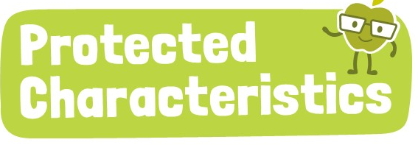

Why are we learning about this?
Pregnancy and maternity is a Protected Characteristic. This means that a pregnant woman should not be treated any differently during their pregnancy or when they are maternity leave. There are laws around this which protect women.

Slide 8
Male fertility
Male fertility is the role of sperm production.
The rate of sperm production is different for every male and changes depending on age.
Males with a high sperm count will rarely encounter fertility issues whereas males with a lower sperm count may face fertility issues.

Slide 9
Female fertility
Female fertility is the menstrual cycle, ovulation and the lifespan of an egg after release.
Females are more fertile on the day an egg is released from the ovary and the 5 days beforehand. However, this can be different for many women and is dependent on the length of the menstrual cycle.

Slide 10
Factors affecting fertility
There are different factors that affect fertility for both males and females.
These include:

Slide 11
Factors affecting fertility
Age:
As women get older, their fertility decreases significantly after the mid-30’s. This happens due to the reduced quantity and quality of eggs
As men get older there is a gradual decrease in sperm quality and motility (how the sperm moves through the female reproductive organs). This is especially true after 40 years old.

Slide 12
Factors affecting fertility
Lifestyle:
For both males and females, fertility can be affected by diet and exercise. A healthy diet and regular moderate exercise enhances fertility.

Slide 13

Factors affecting fertility
You have one minute to think about the following question:
“What lifestyle factors do you think would negatively impact fertility?”

Slide 14
Scenario
Using your oracy helpsheet, with the person next to you, discuss your response to the question:
“What lifestyle factors do you think would negatively impact fertility?”
Remember to use the sentence starters to add, build or challenge what your partner has said.
Be ready to share your discussion with the class

Slide 15
Factors affecting fertility
Lifestyle:
For both males and females, fertility can be negatively affected through:
smoking/vaping
Excessive alcohol consumption
Drug use

Slide 16
Factors affecting fertility
Psychological factors
Both male and female fertility can be impacted by mental health. Higher stress levels, depression and anxiety can lead to hormonal imbalances which can impact sperm count and ovulation.

Slide 17
Myth busting fertility
Is the following statement a fact or myth regarding fertility?
“Fertility is only a female issue”
This is a myth. We have just covered how fertility can affect males too.

Slide 18
Myth busting fertility
Is the following statement a fact or myth regarding fertility?
“Using contraception, particularly the contraceptive pill or implant for a long time can make a female infertile”
This is a myth. Contraception does not impact fertility when it is no longer used.

Slide 19
Myth busting fertility
Is the following statement a fact or myth regarding fertility?
“Fertility issues are always permanent”
This is a myth. Fertility can be impacted by stress and other mental health issues. If these issues are resolved, fertility levels can increase.

Slide 20
Myth busting fertility
Is the following statement a fact or myth regarding fertility?
“Smoking or vaping reduces fertility is both males and females”
This is a fact. Smoking and vaping can impact fertility.

Slide 21
Myth busting fertility
Is the following statement a fact or myth regarding fertility?
“All men are fertile because they produce sperm”
This is technically a fact. However every male’s sperm count is different. Males with a low sperm count are still fertile, they may just face more challenges compared to a male with a high sperm count.

Slide 22



Support
Support around anything discussed today support is available:
Umbrellahealth.co.uk
This provides a safe way to find the closest sexual health in Birmingham
Themix.org.uk
You can email or have one-to-chat online.
There is also a crisis messenger which is available 24/7

