Slide 1
Thought of the Day
“A healthy pregnancy sets the foundation for a healthy life—for both the baby and the mother.”
Dr. Ranj Singh

Slide 2


HWK Detentions will be held afterschool on Friday
We still use Classcharts for announcements, surveys and revision material
Homework Club every morning in West Canteen from 8am
Library is open before school and at break times
Students on the following slides have not completed ALL tasks
Make sure you are completing the SET TASKS! These are the tasks your teachers have set.
Notes:
Please give time for the students to produce answers for themselves before showing answers.

Slide 3
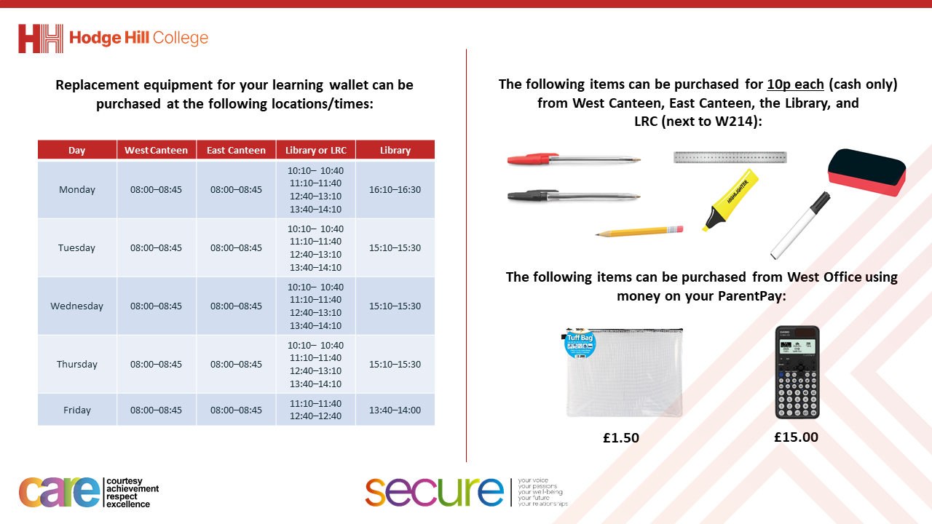

Slide 4


Secure your Relationships: Learning Journey
What is consent in a sexual relationship?
What is safe sex?
Impact of alcohol and drugs on sexual behaviours
What does fertility mean?
Pregnancy safety
Difference between stillborn, miscarriage and adoption
Today we will look at:
What is pregnancy safety?
This includes:
Lifestyle choices during pregnancy
Support required during pregnancy
Please remember that during the lesson we should not be asking any pupil or teacher personal questions.
Your teacher can ask you questions but this will be to check your knowledge in the lesson.

Slide 5



Pregnancy safety
Pregnancy safety is…
“the things to do or avoid during pregnancy to protect the wellbeing of the baby and mother”

Slide 6




Why are we learning about this?
This links to the Golden Thread of “Secure your Relationships“
Although this may not seem relevant to you right now, but if you ever choose to have children understanding how to keep your partner and unborn baby safe is important. Until then, you may have pregnant relatives that you can help.

Slide 7
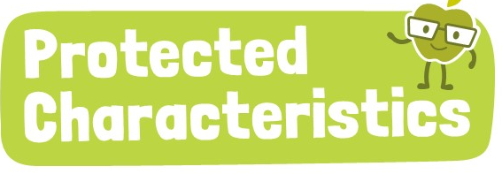
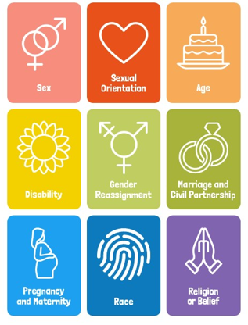
Why are we learning about this?
Pregnancy and maternity is a Protected Characteristic. This means that a pregnant woman should not be treated any differently during their pregnancy or when they are maternity leave. There are laws around this which protect women.

Slide 8
Pregnancy
A pregnancy is described a “full term” after 40 weeks.
Some babies are born after this.
Some babies are born before this. This is known as a premature baby.

Slide 9
Pregnancy Safety
There are 4 key areas that can help ensure the safety of both unborn baby and mother during pregnancy.
These are:
Avoiding smoking, vaping, drugs and alcohol
Checking medicine
Exercising
Eating a healthy and balanced diet

Slide 10
Pregnancy Safety – smoking, vaping, drugs and alcohol
Avoiding smoking, vaping, drugs and alcohol is vital for pregnancy safety.
Smoking and vaping can limit the amount of oxygen reaching the unborn baby which can cause serious harm.

Slide 11
Pregnancy Safety – smoking, vaping, drugs and alcohol
Illegal drug use in pregnancy can have serious harm to the unborn baby.
Drinking alcohol during pregnancy can lead to long term health issues for the baby. The more alcohol consumed the greater the risk

Slide 12
Pregnancy Safety – Medicine
Medicine will be important throughout a pregnancy.
However it is important that before taking any medicine, a check with a midwife, doctor or pharmacist is completed to ensure the medicine is safe for pregnant women to consume.

Slide 13
Pregnancy Safety – Exercise
Keeping active during pregnancy can help to reduce some problems later in pregnancy.
It is advised that regular physical activity is continued for as long as the mother feels comfortable. Some exercises may have to be adapted by a personal trainer can help with this.
Certain activities such as contact sports should be avoided.

Slide 14
Pregnancy Safety – Diet and Nutrition
There is no need for a pregnant woman to have a special diet.
It is important that they eat a variety of foods, especially fruit and vegetables for essential vitamins and minerals.

Slide 15

Pregnancy safety
You have one minute to think about the following question:
“What key area do you think is most important to ensure pregnancy safety? Why?”

Slide 16
Pregnancy Safety
Using your oracy helpsheet, with the person next to you, discuss your response to the question:
“What key area do you think is most important to ensure pregnancy safety? Why?”
Remember to use the sentence starters to add, build or challenge what your partner has said.
Be ready to share your discussion with the class

Slide 17
Pregnancy safety
You have one minute to think about the following question:
“What key area do you think pregnant women will find hardest to do? Why?”

Slide 18
Pregnancy Safety
Using your oracy helpsheet, with the person next to you, discuss your response to the question:
“What key area do you think pregnant women will find hardest to do? Why?”
Remember to use the sentence starters to add, build or challenge what your partner has said.
Be ready to share your discussion with the class

Slide 19



Support
Support around anything discussed today support is available:
Umbrellahealth.co.uk
This provides a safe way to find the closest sexual health in Birmingham
Themix.org.uk
You can email or have one-to-chat online.
There is also a crisis messenger which is available 24/7

