Slide 1
Thought of the Day
“Grief is the price we pay for love”
Queen Elizabeth II

Slide 2


HWK Detention will be held afterschool on Friday
We still use Classcharts for announcements, surveys and revision material
Homework Club every morning in West Canteen from 8am
Library is open before school and at break times
Students on the following slides have not completed ALL tasks
Make sure you are completing the SET TASKS! These are the tasks your teachers have set.
Notes:
Please give time for the students to produce answers for themselves before showing answers.

Slide 3
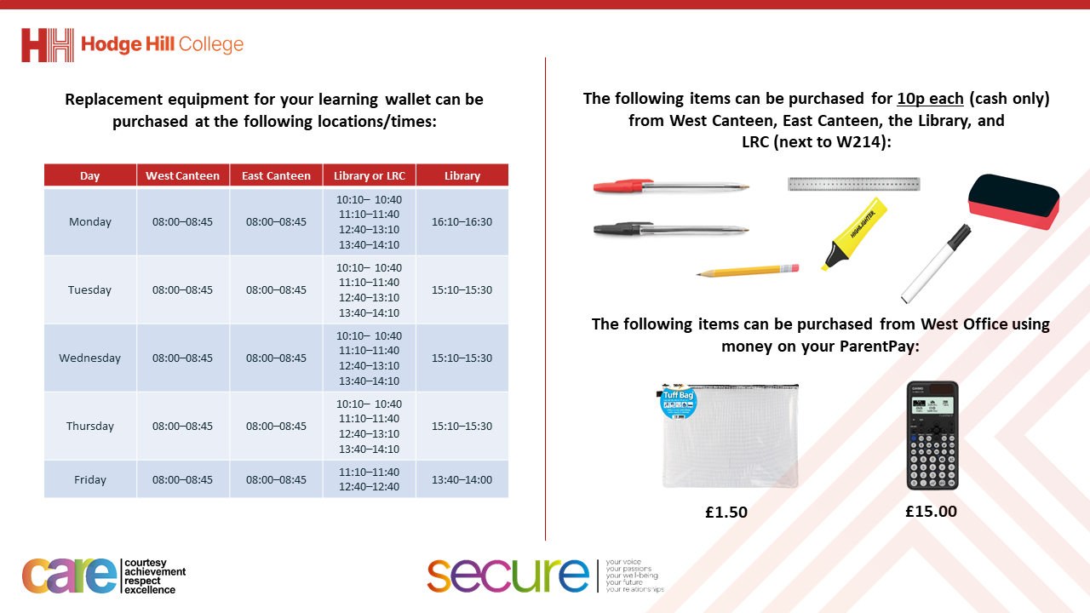

Slide 4


Secure your Wellbeing: Learning Journey
Impact of harmful content on young people
How to report inappropriate online content
What is online harassment?
What influence does social media have on body image
What impact can social media influencers have
What does a positive online presence look like?
Today we will look at:
The impact of harmful content online
This includes:
Definitions of harmful content
Example of harmful content
What to do if you see harmful content
Please remember that during the lesson we should not be asking any pupil or teacher personal questions.
Your teacher can ask you questions but this will be to check your knowledge in the lesson.

Slide 5
What is harmful content
Harmful content is...
“any material that could negatively affect a person’s well-being, mental health, safety, or beliefs.”

Slide 6

Why are we learning about this?
This links to the Golden Thread of “Secure your Wellbeing”
Harmful online content can impact a person’s mental health as it can be very distressing. It can also have other negative consequences that can lead to other physical and mental wellbeing dangers

Slide 7

Why are we learning about this?
Rule of Law is a British Value that means everyone is expected to follow the laws. There are age restrictions on what content can be seen by children. This is to protect children for seeing content they do not yet understand or be easily influenced by

Slide 8

Why are we learning about this?
Article 17 of the UN Rights of a Child states that children have the right to get information from the internet. It also states that this information should not be harmful and it is up to adults to enforce this. This is why there are parental controls over what can be accessed online
UN Rights
of a Child

Slide 9
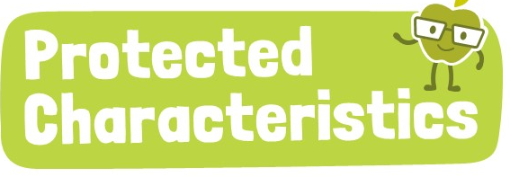
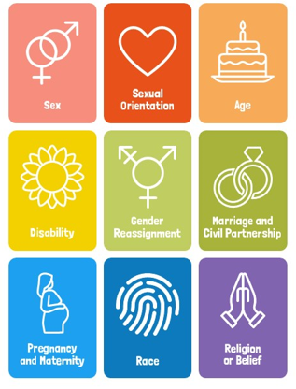
Why are we learning about this?
The Equality Act (2010) sets out 9 Protected Characteristics. Unfortunately content online can be harmful against people who identify with one or more of these characteristics. This content is illegal and should not be viewed by children

Slide 10
What is harmful content
Harmful content can be found all over the internet but in particular:
Social Media Platforms
Gaming communities
Website and forums
Messaging apps

Slide 11
What is harmful content
Harmful content can be found all over the internet but in particular:
Social Media Platforms
Gaming communities
Website and forums
Messaging apps

Slide 12
What is harmful content
Harmful content is dangerous as it can:
Shape a person’s beliefs and behaviours
Negatively impact a person’s mental health
Expose young people to illegal or dangerous activities
Make people feel pressured to engage in harmful trends

Slide 13
What is harmful content
Some types of harmful content include:
1. Violent and graphic content – This includes videos of real life violent, school fights and self harm content. This is dangerous as it can desensitize young people to violence, meaning that violence amongst young people can increase.

Slide 14
What is harmful content
Some types of harmful content include:
2. Pornography and inappropriate material – this is dangerous for young people as this content has been made for adults only. It can impact how a young person views relationships, consent and unrealistic portrayals of relationships

Slide 15
What is harmful content
Some types of harmful content include:
3. Radicalisation and extremism – this includes online groups promoting extremist views and terrorism recruitment. This is particularly dangerous for young people as they can be easily influenced into adopting harmful beliefs.

Slide 16

What is harmful content
There has been debate about how governments can combat harmful content online. There are currently draft UK laws about this. This video will tell you more
Notes:
https://www.youtube.com/watch?v=PVASKo131Gc

Slide 17

Harmful online content
You have 1 minute to think about the following question:
“Who do you think is responsible for harmful content – internet companies or the people posting it? Why?”

Slide 18
Harmful online content
Using your oracy helpsheet, with the person next to you, discuss your response to the question:
“Who do you think is responsible for harmful content – internet companies or the people posting it? Why?”
Remember to use the sentence starters to add, build or challenge what your partner has said.
Be ready to share your discussion with the class

Slide 19



Support
If you ever need support about harmful online content for yourself, a friend or family member you can find it here:
Childline.org.uk
Call – 08001111
Email or chat online for support
Themix.org.uk
You can email or have one-to-chat online.
There is also a crisis messenger which is available 24/7

