Slide 1
Thought of the Day
“The more we understand how substances affect our choices, the better we can protect ourselves from making risky decisions that change our lives forever”
Dr. Rachel Britton

Slide 2


HWK Detentions will be held afterschool on Friday
We still use Classcharts for announcements, surveys and revision material
Homework Club every morning in West Canteen from 8am
Library is open before school and at break times
Students on the following slides have not completed ALL tasks
Make sure you are completing the SET TASKS! These are the tasks your teachers have set.
Notes:
Please give time for the students to produce answers for themselves before showing answers.

Slide 3
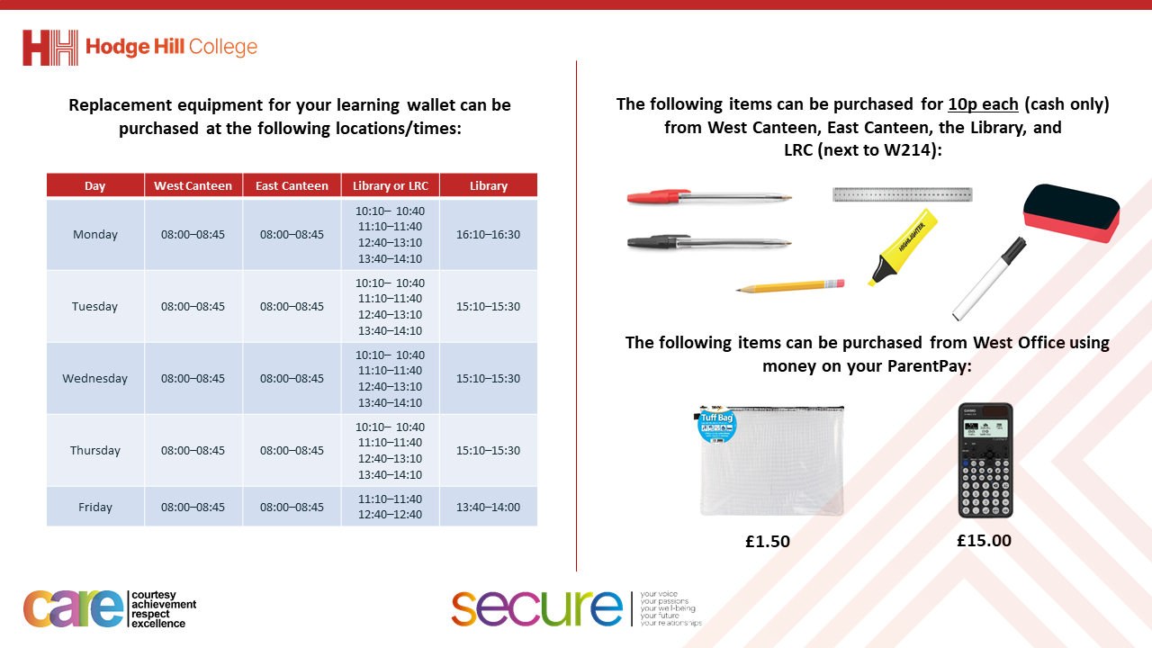

Slide 4


Secure your Relationships: Learning Journey
What is consent in a sexual relationship?
What is safe sex?
Impact of alcohol and drugs on sexual behaviours
What does fertility mean?
Pregnancy safety
Difference between stillborn, miscarriage and adoption
Today we will look at:
Impact of alcohol and drugs on sexual behaviours
This includes:
How do drugs and alcohol impair decision making
Consequences of risky behaviours
Scenarios
Please remember that during the lesson we should not be asking any pupil or teacher personal questions.
Your teacher can ask you questions but this will be to check your knowledge in the lesson.

Slide 5




Why are we learning about this?
This links to the Golden Thread of “Secure your Relationships“
Although this may not seem relevant to you right now, it is important to know how the impact drugs and alcohol can have on relationships. This shows respect to the people in the relationship by setting boundaries and keeping each other safe.

Slide 6

Why are we learning about this?
Rule of Law is a British Value. It is important to remember that consuming alcohol is illegal for U18’s and there are illegal drugs. The legal age of consent to sex in the UK is 16 years old.

Slide 7
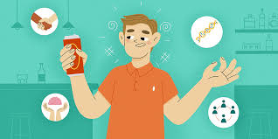
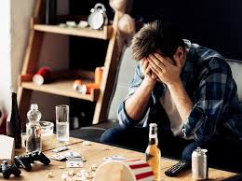
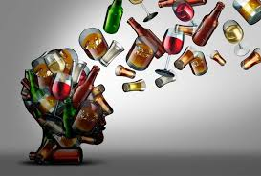
Impact of drugs and alcohol
Drugs and alcohol make it harder to make good decisions (including about sexual choices). They can “cloud” thinking, lower inhibitions (feeling of embarrassment or lack of confidence) and lead to risky behaviour (activities that have the potential to be harmful or dangerous)

Slide 8
Impact of drugs and alcohol
This happens due to drugs and alcohol changing the chemistry in the brain.
This means it changes the way people think, feel and their actions.

Slide 9
Impact of drugs and alcohol
Being under the influence of drugs and alcohol can lead to the pressurising of other to do things that they might not do when sober.

Slide 10
Impact of drugs and alcohol
If this is applied to sexual behaviours under the influence of drugs and alcohol, consent becomes an issue.
The law states that a person under the influence of drugs and alcohol may verbally consent at the time but because of their intake of drugs and alcohol, they did not have the capacity to provide consent.
This could lead to a person becoming a victim of sexual harassment or sexual assault.

Slide 11
Impact of drugs and alcohol
Taking part in sexual activity under the influence of drugs and alcohol can also have other consequences:
Doing things that people cannot remember
Taking part in unprotected sex. As we learnt before, this can lead to unwanted pregnancy and/or STI’s.

Slide 12
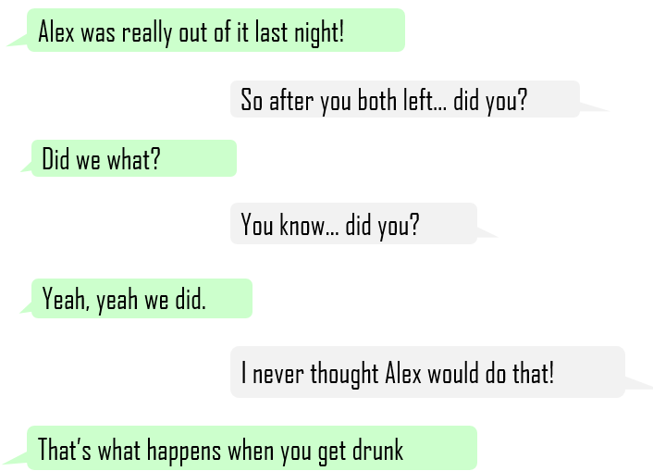
Scenario
Task
Think about the following questions:
Why do you think it means by “Alex was really out of it last night?”
Do you think Alex had the capacity to consent to whatever happened?
How do you think Alex feels now?
What would you suggest Alex does now?

Slide 13

Scenario
Using your oracy helpsheet, with the person next to you, discuss your response to the questions about the scenario.
Remember to use the sentence starters to add, build or challenge what your partner has said.
Be ready to share your discussion with the class

Slide 14



Support
If you ever need support about drugs, alcohol or risky behaviour for yourself, a friend or family member you can find it here:
Childline.org.uk
Call – 08001111
Email or chat online for support
Themix.org.uk
You can email or have one-to-chat online.
There is also a crisis messenger which is available 24/7

Slide 15

Support
Support around anything discussed today support is available:
Umbrellahealth.co.uk
This provides a safe way to find the closest sexual health in Birmingham
Themix.org.uk
You can email or have one-to-chat online.
There is also a crisis messenger which is available 24/7

