Slide 1


Homework Reminders:
We still use Classcharts for announcements, surveys and revision material
Homework Club every morning in West Canteen from 8am
Library is open before school and at break times
Make sure you are completing the SET TASKS! These are the tasks your teachers have set.
Complete all tasks with a due date of 18th November onwards!
Notes:
Please give time for the students to produce answers for themselves before showing answers.

Slide 2
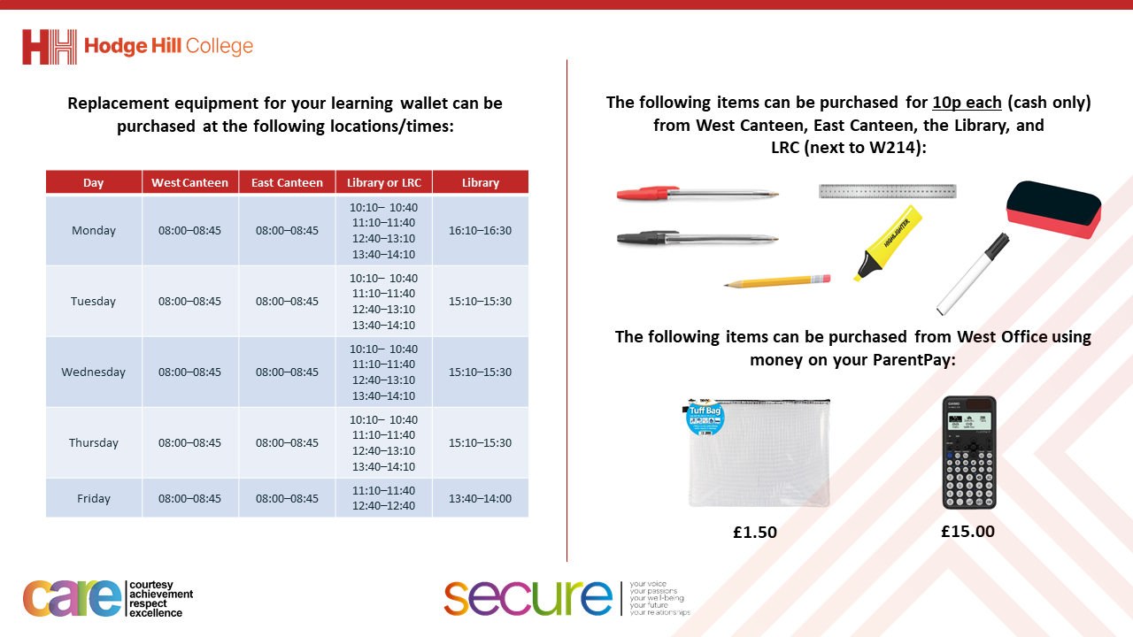

Slide 3
Thought of the Day
“our true destiny is a world built by nations who help each other in their hour of need”

Slide 4


Secure your Future: Learning Journey
What is democracy?
How are laws made in other countries?
How do elections work in other countries?
How does the UK work with other countries?
What is international law?
What are international human rights?
Today we will look at:
How does the UK work with other countries
This includes:
How an election works in a dictatorship
How an election works in a democracy
Please remember that during the lesson we should not be asking any pupil or teacher personal questions.
Your teacher can ask you questions but this will be to check your knowledge in the lesson.

Slide 5

Why are we learning about this?
The UK is a prominent global voice on issues such as peace, trade, environmental protection and humanitarian aid.
It is important to learn about how the UK works with other countries to achieve these things.
When you are old enough to vote, you can choose a political party that aligns with your beliefs and values as a global citizen

Slide 6

Democratic elections
You have 1 minute to think about the following question:
“why might countries work together on global issues?”

Slide 7
Democratic elections
Using your oracy helpsheet, with the person next to you, discuss your response to the question:
“why might countries work together on global issues?”
Remember to use the sentence starters to add, build or challenge what your partner has said.
Be ready to share your discussion with the class

Slide 8
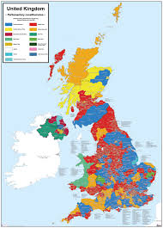
Why does the UK work with other countries
The UK works with other countries to:
1. Help ensure peace and security – The UK works with other countries to help prevent conflicts and promote stability

Slide 9
Why does the UK work with other countries
The UK works with other countries to:
2. Global Trade – The UK works with other countries through international trade which boosts the UK economy. This means more jobs are created and the UK have access to more goods

Slide 10
Why does the UK work with other countries
The UK works with other countries to:
3. Improving quality of life – Through sharing knowledge, technology and resources, countries can address poverty and health issues to improve their citizen’s quality of life.

Slide 11
Why does the UK work with other countries
The UK works with other countries to:
4. Tackling Global Challenges- The UK works with other countries over challenges that affect all countries such as climate change, terrorism and health pandemics

Slide 12
UK Humanitarian efforts
The UK plays a leading role in its global humanitarian efforts.
This means that the UK provides funding and resources to help countries in need especially during natural disasters or to fight poverty.

Slide 13
UK Humanitarian efforts
This is largely provided through a Government budget called “Foreign Aid”
With the funding and resources countries can:
Build schools
Provide clean water
Restock medical supplies

Slide 14

UK Humanitarian efforts
This video shows how UK Aid is provided
Notes:
https://www.youtube.com/watch?v=zG7JL7dbLkw

Slide 15
Democratic elections
People say that the UK should focus more on their own citizens more than spending money on foreign aid, considering that there are many issues that need to be resolved in the UK such as NHS waiting times.
You have 1 minute to decide if you agree or disagree with this viewpoint. You must have reasons why.

Slide 16
Democratic elections
Using your oracy helpsheet, with the person next to you, discuss your response to the viewpoint:
“People say that the UK should focus more on their own citizens more than spending money on foreign aid, considering that there are many issues that need to be resolved in the UK such as NHS waiting times.”
Remember to use the sentence starters to add, build or challenge what your partner has said.
Be ready to share your discussion with the class

