Slide 1


Remember to complete all homework tasks on SAM Learning
We still use Classcharts for announcements, surveys and revision material
Homework Club every morning in West Canteen from 8am
Library is open before school and at break times
Students on the following slides have incomplete Homework Tasks
Make sure you are completing the SET TASKS! These are the tasks your teachers have set.
Notes:
Please give time for the students to produce answers for themselves before showing answers.

Slide 2
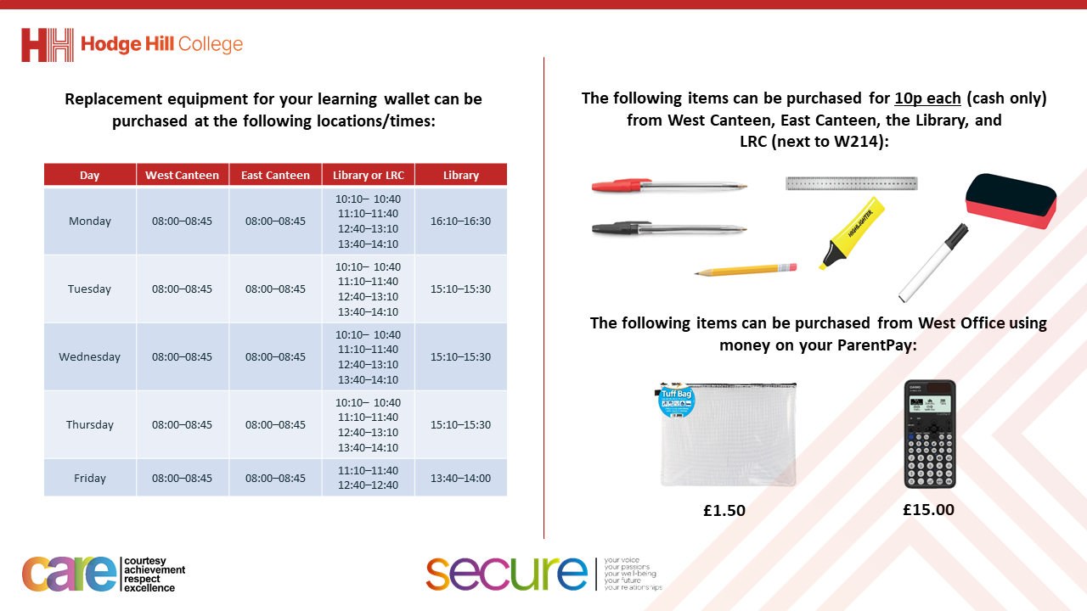

Slide 3
Thought of the Day
“Every election is determined by the people who show up”
Larry J. Sabato

Slide 4


Secure your Future: Learning Journey
What is democracy?
How are laws made in other countries?
How do elections work in other countries?
How does the UK work with other countries?
What is international law?
What are international human rights?
Today we will look at:
How do elections work in other countries
This includes:
How an election works in a dictatorship
How an election works in a democracy
Please remember that during the lesson we should not be asking any pupil or teacher personal questions.
Your teacher can ask you questions but this will be to check your knowledge in the lesson.

Slide 5

Why are we learning about this?
It is important to learn about how politics works around the world
Despite you not being old enough to vote and living in the UK, it is important to learn about this now so that when you are older you are confident in speaking about global events such as elections

Slide 6

Why are we learning about this?
Democracy is a British Value that we learn about before half term. This mean “rule by people” as this happens by people being able to freely vote for a political party to represent them in Government

Slide 7

Why are we learning about this?
Article 12 states that Governments should have respect for children’s views. Although children cannot vote, they still have the human right to have their opinions and voices heard and taken seriously. An example of how this happens in the UK is the UK Youth Parliament which gives young people access to the policy making process to be the voice of young people in the UK.
UN Rights
of a Child

Slide 8
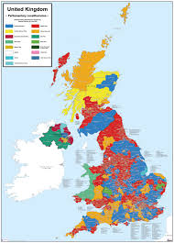
How did the election work in the UK?
As a reminder there was a General Election in the UK in July 2024.
This election worked by:
People who were legally allowed to vote, and registered, voted for their preferred candidate in their constituency
The candidate with the most votes in the constituency became the MP for that constituency
There are 650 constituencies. The Political Party who wins the most constituencies can form the UK Government
Labour won 412 constituencies, meaning they have 412 MP’s. The leader of the party, Sir Keir Starmer became Prime Minister for the UK
This is an example of an election in a democratic country.

Slide 9
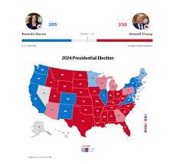
Another example of a democratic election
The USA have just voted for Donald Trump to be the new President.
This election worked differently to the UK General Election.
However it is another example of a democratic election

Slide 10
How did the US election work?
The US election uses an unique voting system called “Electoral College”
This means that each state has a certain number of “electoral votes”
This is based on the population of the state. For example California has a population of 38.9 million so it has 54 electoral votes whereas Alaska has a population of 730,000 so it has 3 electoral votes
This system aims to balance influence so that smaller states still have a voice. This means that highly populated and less populated states play a role in the election outcome.

Slide 11
How did the US election work?
Voting is based on a winner takes all system
This means that the candidate who wins the majority of the votes (50.1%) in each state takes all the electoral votes.
There are a total of 528 electoral votes so a candidate requires 270 electoral votes to win the election and become the next US President

Slide 12

Democratic elections
You have 1 minute to think about the following question:
“which democratic election system do you think works best? Why?”

Slide 13
Democratic elections
Using your oracy helpsheet, with the person next to you, discuss your response to the question:
“which democratic election system do you think works best? Why?”
Remember to use the sentence starters to add, build or challenge what your partner has said.
Be ready to share your discussion with the class

Slide 14
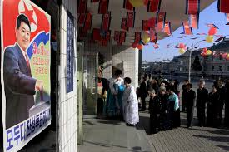
How do elections work in a dictatorship
In a dictatorship like North Korea elections still happen.
However in North Korea there is only 1 Political Party and therefore only 1 candidate for voters to choose.
This makes it impossible for other viewpoints to influence the leadership

Slide 15
How do elections work in a dictatorship
In addition, voting in North Korea is public. This means the government can see who each individual voted for.
This makes it difficult for people to vote against the regime or not to vote at all

Slide 16
How do elections work in a dictatorship
This poses the question, why do elections happen in North Korea?
The election is used to display control and loyalty. The election is not intended to introduce change but to confirm the regime’s rule.

Slide 17
Elections
You have 1 minute to think about the following question:
“why is it important that elections are completed democratically?”

Slide 18
Democratic elections
Using your oracy helpsheet, with the person next to you, discuss your response to the question:
“why is it important that elections are completed democratically?”
Remember to use the sentence starters to add, build or challenge what your partner has said.
Be ready to share your discussion with the class

