Slide 1


Remember to complete all homework tasks on SAM Learning
We still use Classcharts for announcements, surveys and revision material
Homework Club every morning in West Canteen from 8am
Library is open before school and at break times
Students on the following slides have incomplete Homework Tasks
Make sure you are completing the SET TASKS! These are the tasks your teachers have set.
Notes:
Please give time for the students to produce answers for themselves before showing answers.

Slide 2
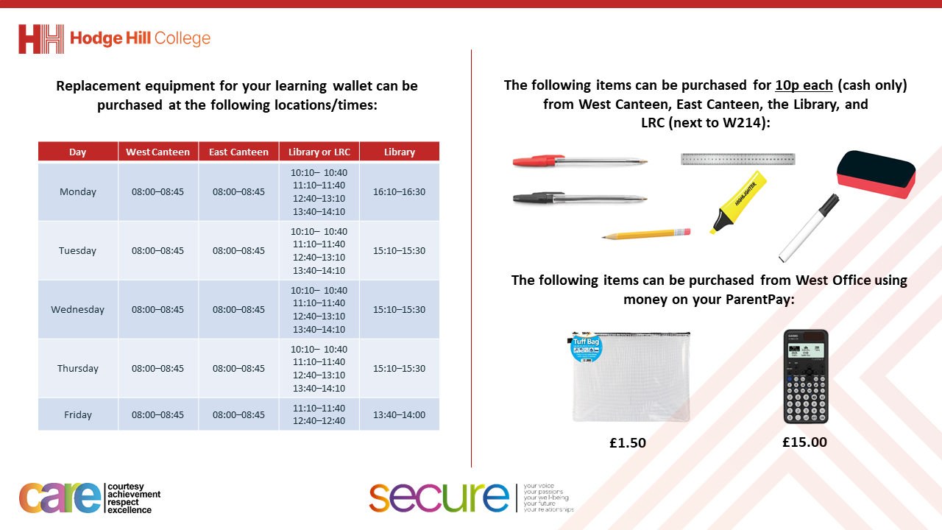

Slide 3
Thought of the Day
“Consent is a clear an enthusiastic ‘yes’. Anything less is a no”

Slide 4


Secure your Relationships: Learning Journey
What is consent in a sexual relationship?
What is safe sex?
Impact of alcohol and drugs on sexual behaviours
What does fertility mean?
Pregnancy safety
Difference between stillborn, miscarriage and adoption
Today we will look at:
What is consent in a sexual relationship?
This includes:
Definition of consent
Ways of providing consent
Please remember that during the lesson we should not be asking any pupil or teacher personal questions.
Your teacher can ask you questions but this will be to check your knowledge in the lesson.

Slide 5


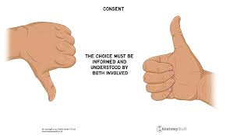
What is consent?
Consent is…
“an agreement by choice made by someone with the freedom and capacity to provide consent”

Slide 6




Why are we learning about this?
This links to the Golden Thread of “Secure your Relationships“
Consent means that permission is given by both people taking part in a sexual activity. Ensuring consent shows trust and respect in the relationship and will cement the relationship further.

Slide 7

Why are we learning about this?
Rule of Law is a British Value. The law states that if consent is not given for any sexual activity, this is classed as sexual harassment all the way up to sexual assault including rape.

Slide 8
What is consent?
Consent in a sexual relationship is when both parties agree to a sexual activity happening.
If one person gives consent but the other does not, this means consent is not given.

Slide 9
How to provide consent?
There are 2 ways to provide consent:
Verbally
Non-verbally (body language)

Slide 10
How to provide consent?
Verbal consent is:
Actually saying “yes” or “no” – a person is actually saying their decision orally.
A way to check for consent is through asking questions to check if there is an agreement before a sexual activity begins.
Examples of this is “is this ok?” “Are you happy to do this?”

Slide 11
How to provide consent?
Non verbal consent is using body language and actions to giving consent.
Non verbal consent is just as important as verbal consent. This is because people may be forced to verbally consent despite not wanting too. A person’s actions and behaviour can sometimes say more than their words.

Slide 12
How to provide consent?
Examples of non verbal consent are:
Regular eye contact between both people
Both people have a relaxed body language
Both people clearly responsive

Slide 13
How to provide consent?
Examples consent not being provided non verbally:
One person is avoiding eye contact
One person is tense/rigid. They may also be emotional
One person is not responsive or may flinch or recoil when touched by the other person.

Slide 14
Withdrawing consent
It is important to know that consent can be withdrawn at any time.
This includes during a sexual activity even if consent was given for the activity to begin.

Slide 15
Withdrawing consent
When consent has been withdrawn it is important that this is respected as this means one person does not want the sexual activity to continue.
If the other person does not stop at this point, they are breaking the law.
This may be classed as sexual harassment or depending on the activity, sexual assault including rape.

Slide 16

Consent
Notes:
https://www.youtube.com/watch?v=fGoWLWS4-kU

Slide 17



Support
If you ever need support about consent for either yourself or a friend/family member you can get support from the following places
Childline.org.uk
Call – 08001111
Email or chat online for support
Themix.org.uk
You can email or have one-to-chat online.
There is also a crisis messenger which is available 24/7

