Slide 1


Remember to complete all homework tasks on SAM Learning
We still use Classcharts for announcements, surveys and revision material
Homework Club every morning in West Canteen from 8am
Library is open before school and at break times
Students on the following slides have incomplete Homework Tasks
Make sure you are completing the SET TASKS! These are the tasks your teachers have set.
Notes:
Please give time for the students to produce answers for themselves before showing answers.

Slide 2


Slide 3
Thought of the Day
“International law is not merely a set of rules. It is the lifeblood of a civilised world”
Stephen Breyer
(Associate Justice of the U.S. Supreme Court)

Slide 4


Secure your Future: Learning Journey
What is democracy?
How are laws made in other countries?
How do elections work in other countries?
How does the UK work with other countries?
What is international law?
What are international human rights?
Today we will look at:
What is international law
This includes:
Definition of international law
Examples of international law
Please remember that during the lesson we should not be asking any pupil or teacher personal questions.
Your teacher can ask you questions but this will be to check your knowledge in the lesson.

Slide 5

Why are we learning about this?
Learning about International Law allows you to secure your voice by knowing what laws countries should be following.
We receive news about what is happening in other countries and having knowledge of how actions are bound by or break international law allows you to gain a more rounded opinion of global events.

Slide 6

Why are we learning about this?
Rule of Law is a British Value. It is important that the UK follows International Law in order to set a positive global example to other countries.

Slide 7
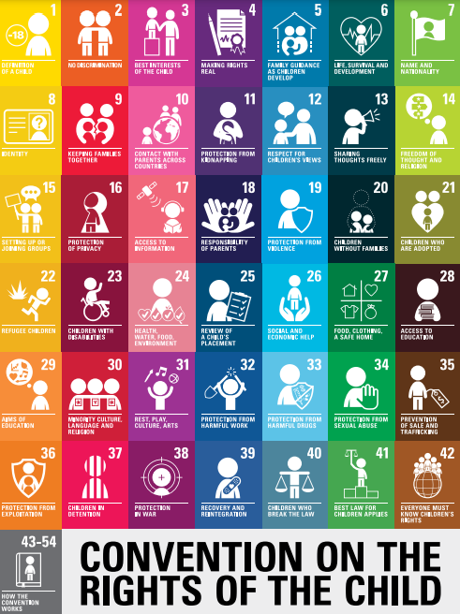
Why are we learning about this?
The most agreed part of international law is the UN Rights of a Child. This outlines 54 different rights all children are entitled too. The UK signed to agree that they will adhere to this international law
UN Rights
of a Child

Slide 8

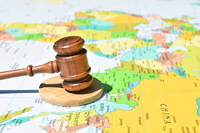
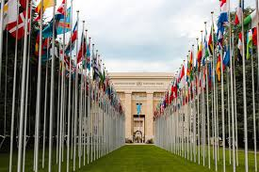
What is International Law
International law is…
“a set of rules and agreements that countries follow in their relations with one another”
It’s purpose is to maintain peace, protect human rights and to ensure fair trade and cooperation

Slide 9

What is International Law
Notes:
https://www.youtube.com/watch?v=jTzKgI68VLc

Slide 10
Examples of International Law
One example of international law is “the Geneva Convention”
This is a set of international treaties that establish standards for humanitarian treatment during war.

Slide 11
Examples of International Law
The Geneva Convention has existed since 1864 but was most recently updated in 1949 following the end of WW2.

Slide 12
Examples of International Law
The Geneva Convention is an important part of international law as it states during war or conflict countries should:
Protect non-combatants such as civilians, medical and aid workers
Torture and humiliating acts are forbidden
Care for the wounded/sick regardless of allegiance
Targeting hospitals or using civilians as shields is illegal

Slide 13
Examples of International Law
The Geneva Convention is enforced by the International Criminal Court (ICC).
However the ICC face challenges in ensuring that countries comply with the convention during war.
There are example of countries breaking the convention is many wars since the convention was last updated.

Slide 14
Examples of International Law
Another important piece of International Law is “The Paris Agreement”
This is an international treaty on climate change.
The goal of this to improve the global environment by reducing the rate of climate change

Slide 15
Examples of International Law
Key parts of the treaty are:
A global temperature goal of keeping temperature rise below 2 degrees compared to pre-industrial levels
Reduce emissions of greenhouse gases. Each country must submit a progress report every 5 years
Wealthier countries are required to support poorer nations in adapting to climate change and moving to green energy
Cooperation between countries in how technology, research and innovation is used to reduced climate change

Slide 16
Examples of International Law
However, unlike other elements of international law, The Paris Agreement is not legally binding.
This means that countries are not punished for missing targets.
Despite signing the agreement some countries have issues with the agreement. An example of this is shown when USA withdrew from the Paris Agreement under Donald Trump’s first Presidential term.

Slide 17

The Paris Agreement
You have 1 minute to think about the following question:
“Do you think the Paris Agreement should be legally binding? What impact do you think this would have?”

Slide 18
Democratic elections
Using your oracy helpsheet, with the person next to you, discuss your response to the question:
“Do you think the Paris Agreement should be legally binding? What impact do you think this would have?”
Remember to use the sentence starters to add, build or challenge what your partner has said.
Be ready to share your discussion with the class

