Slide 1


Remember to complete all homework tasks on SAM Learning
We still use Classcharts for announcements, surveys and revision material
Homework Club every morning in West Canteen from 8am
Library is open before school and at break times
Students on the following slides have incomplete Homework Tasks
Make sure you are completing the SET TASKS! These are the tasks your teachers have set.
Notes:
Please give time for the students to produce answers for themselves before showing answers.

Slide 2
Complete all tasks with a due date of 2nd December onwards.
Remember these tasks will aid with your mock revision!

Slide 3
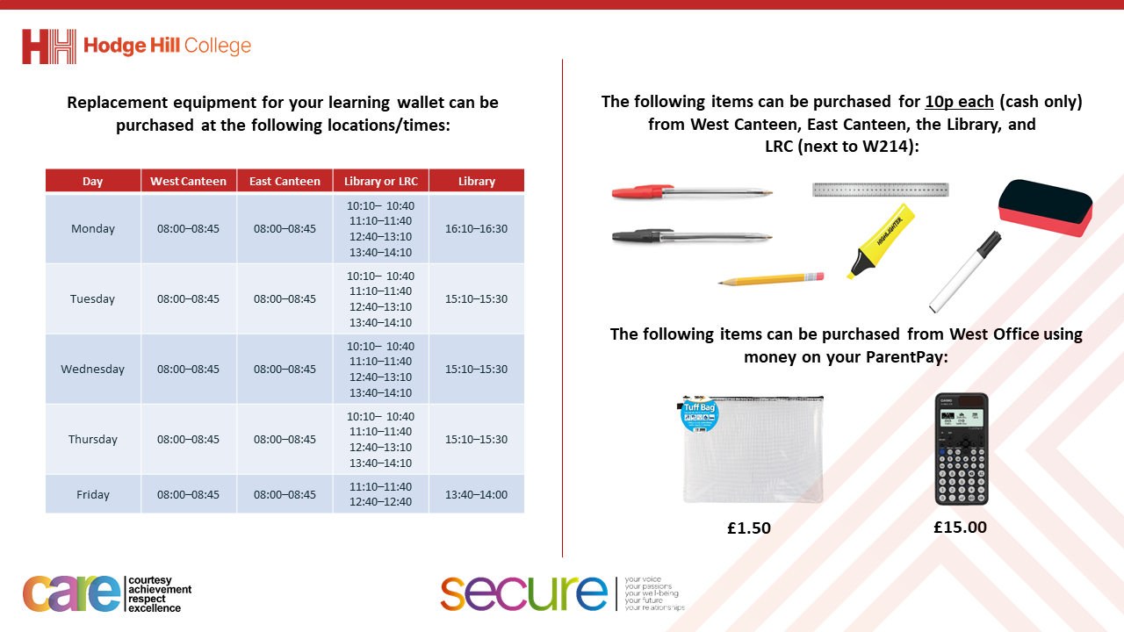

Slide 4
Thought of the Day
“To deny people their human rights is to challenge their very humanity”
Nelson Mandela

Slide 5


Secure your Future: Learning Journey
What is democracy?
How are laws made in other countries?
How do elections work in other countries?
How does the UK work with other countries?
What is international law?
What are international human rights?
Today we will look at:
What are international human rights?
This includes:
What are human rights
Examples of human rights with a focus on the UN Rights of a Child
Please remember that during the lesson we should not be asking any pupil or teacher personal questions.
Your teacher can ask you questions but this will be to check your knowledge in the lesson.

Slide 6

What are Human Rights?
You have 1 minute to think about the following question:
“What are human rights?”

Slide 7
What are Human Rights?
Using your oracy helpsheet, with the person next to you, discuss your response to the question:
“What are human rights?”
Remember to use the sentence starters to add, build or challenge what your partner has said.
Be ready to share your discussion with the class. You can check other people’s thoughts on the grid on the previous slides.

Slide 8



What are human rights?
Human rights are…
“universal, inherent and non-discriminating rights that everyone is entitled to regardless of age, gender, nationality or ethnicity.”

Slide 9

Why are we learning about this?
It is important that you know your rights.
Your rights give you protection if you are feeling discriminated against.

Slide 10

Why are we learning about this?
Rule of Law is a British Value. In the UK there is the Human Rights Act that ensures everyone in the UK is treated equally, with fairness, dignity and respect.

Slide 11
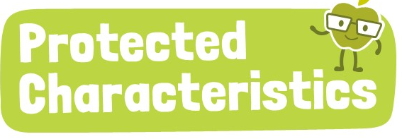
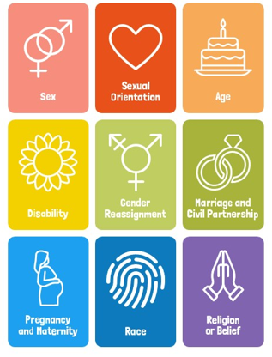
Why are we learning about this?
Another example of human rights in the UK is the Equality Act (2010) that outlines 9 protected characteristics. This means it is against the law to discriminate against someone based on one or more of these characteristics. This shows how the UK protects people’s human rights.

Slide 12
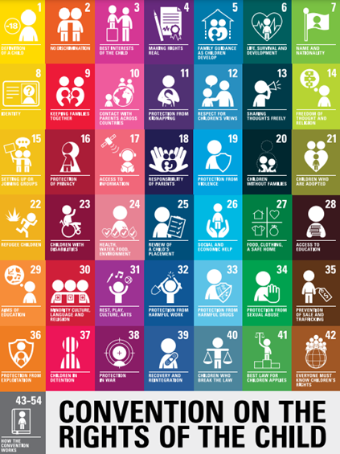
Example of human rights
An example of human rights is the “UN Convention on the Rights of the Child”
This is outlines the fundamental rights of every child globally.
It is separate to other human rights laws as children and more vulnerable and need extra protection compared to adults.

Slide 13
Example of human rights
There are 54 articles that cover the rights every child should have.
42 articles are specific rights and 12 articles outline how the rights should be available to all children

Slide 14
Example of human rights
The rights can be split into 4 categories:
Survival rights – access to food, shelter and healthcare
Protection rights – protection from abuse, exploitation and neglect
Development rights – education, play and cultural participation
Participation rights – freedom to express views and be heard in decisions affecting them

Slide 15
Example of human rights
Decide if the following right is either survival, protection, development or participation. You must have a reason why
“The right to set up or join groups”
Remember you can add or challenge other people’s opinion.

Slide 16
Example of human rights
“The right to set up or join groups”
This is an example of participation rights

Slide 17
Example of human rights
Decide if the following right is either survival, protection, development or participation. You must have a reason why
“The right to access education”
Remember you can add or challenge other people’s opinion.

Slide 18
Example of human rights
“The right to access education”
This is an example of a development right

Slide 19
Example of human rights
Decide if the following right is either survival, protection, development or participation. You must have a reason why
“The right to protection from harmful drugs”
Remember you can add or challenge other people’s opinion.

Slide 20
Example of human rights
“The right to protection from harmful drugs”
This is an example of a protection right

Slide 21
Example of human rights
Decide if the following right is either survival, protection, development or participation. You must have a reason why
“The right to be alive”
Remember you can add or challenge other people’s opinion.

Slide 22
Example of human rights
“The right to be alive”
This is an example of a survival right.

Slide 23
Example of human rights
Decide if the following right is either survival, protection, development or participation. You must have a reason why
“The right to access information”
Remember you can add or challenge other people’s opinion.

Slide 24
Example of human rights
“The right to access information”
This is an example of a development right.

Slide 25
Example of human rights
Decide if the following right is either survival, protection, development or participation. You must have a reason why
“The right to an identity and nationality”
Remember you can add or challenge other people’s opinion.

Slide 26
Example of human rights
“The right to an identity and nationality”
This is an example of a protection right.

Slide 27
Other rights?
You have 1 minute to think about the following question:
“What other rights do you think is on the UN Rights of a Child?”

Slide 28
Other rights?
Using your oracy helpsheet, with the person next to you, discuss your response to the question:
“What other rights do you think is on the UN Rights of a Child?”
Remember to use the sentence starters to add, build or challenge what your partner has said.
Be ready to share your discussion with the class. You can check other people’s thoughts on the grid on the previous slides.

Slide 29
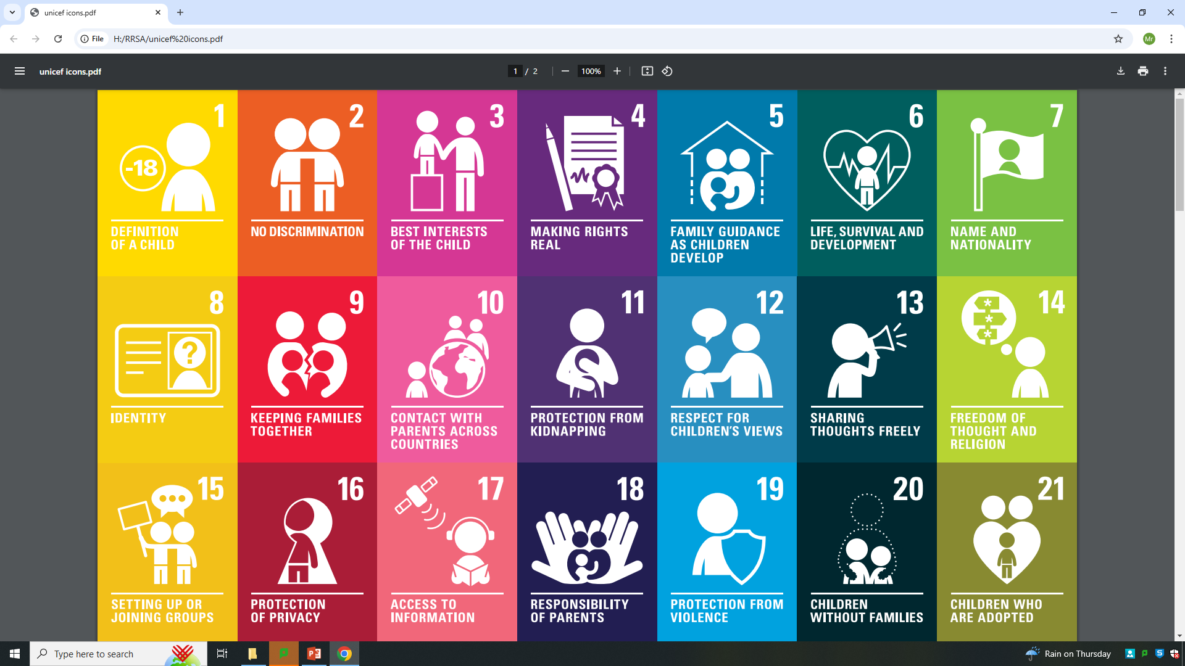
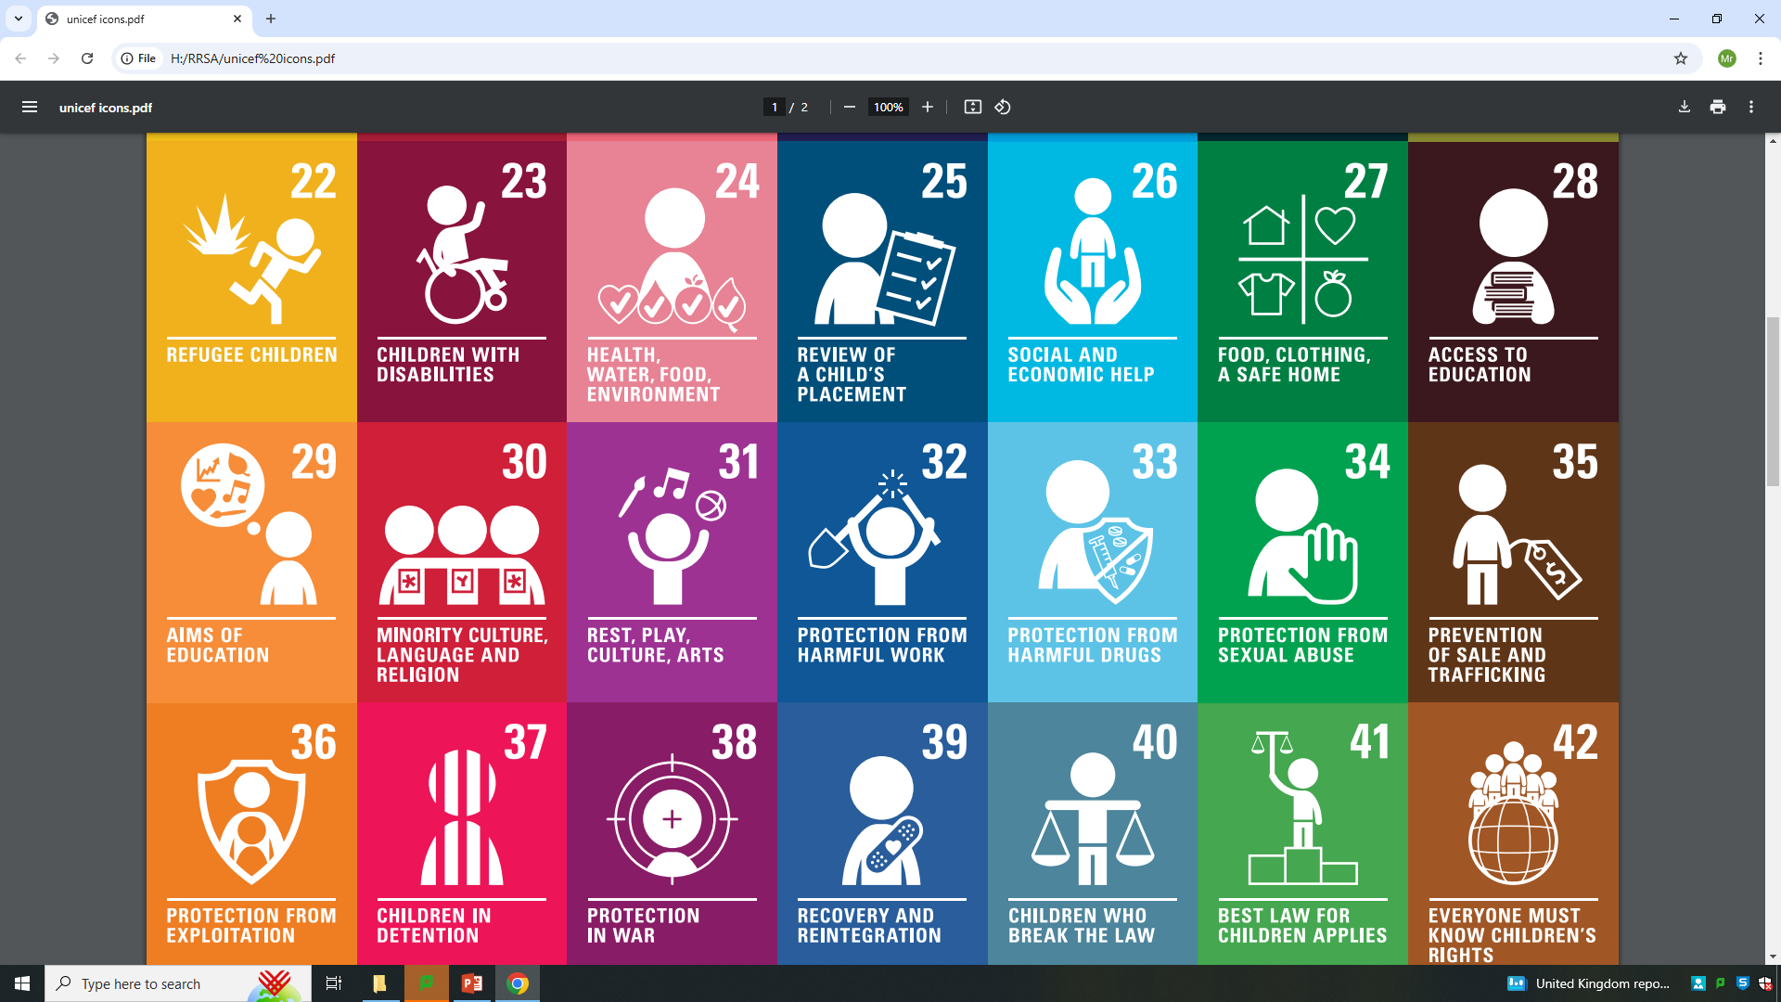
The UN Convention of The Rights of the Child
These are the 42 articles of the rights every child should have around the world.

