Slide 1
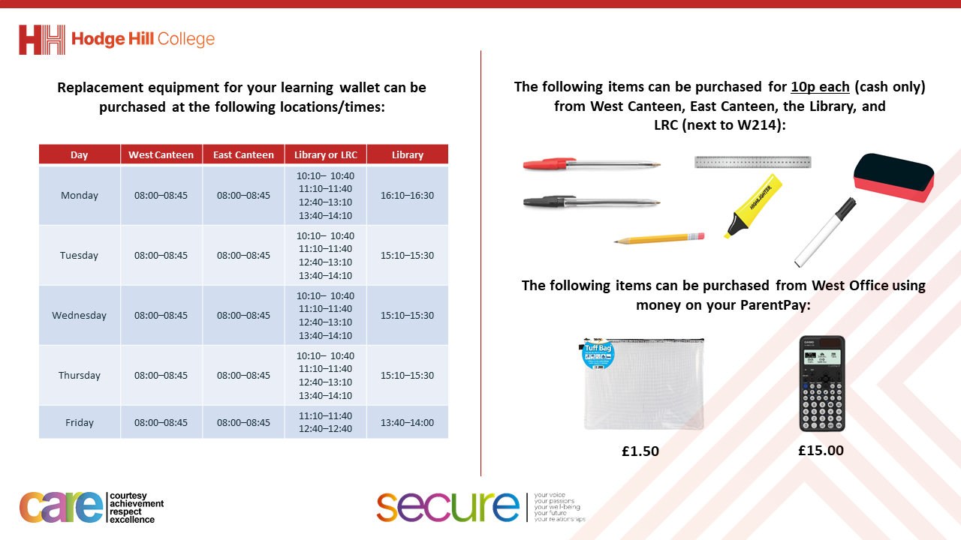

Slide 2
Thought for the Day
“Feelings are much like waves. We can’t stop them from coming, but we can choose which ones to surf”
Malcolm Gladwell

Slide 3


Slide 4


Secure your Future: Learning Journey
What is mental health?
What stress will I have this year?
What healthy habits should I start this year?
How do I manage my time effectively?
Should I have a revision timetable now?
How do I cope with different emotions?
Today we will look at:
How to cope with different emotions
This includes:
Emotions such as anger and grief
Please remember that during the lesson we should not be asking any pupil or teacher personal questions.
Your teacher can ask you questions but this will be to check your knowledge in the lesson.

Slide 5

What are emotions?
With the person next to you discuss the following question:
“What emotions have you seen other people display?”
Remember to use your oracy helpsheet and be ready to share your discussion with the class

Slide 6

What are emotions?
Notes:
https://www.youtube.com/watch?v=wmzy6fRLcCU

Slide 7
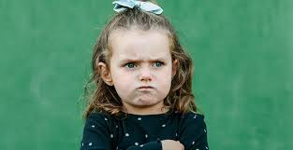

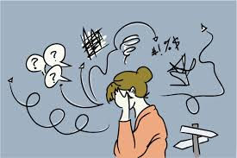
What are emotions?
Emotions are:
“responses to life experiences”
Despite people going through similar experiences, people feel and display emotions differently.
But it is important to know that all emotions are normal.

Slide 8
Why managing emotions is important?
Managing emotions is an important skill as it:
Helps to maintain healthy relationships
Contributes to mental wellbeing
Affect decision making and overall happiness

Slide 9
What is anger?
With the person next to you discuss the following question:
“What is anger?”
Remember to use your oracy helpsheet and be ready to share your discussion with the class

Slide 10
Anger
Anger is…
“a natural response to feeling threatened, frustrated or hurt”
Anger can be healthy or unhealthy.
Healthy anger – a person can display anger while remaining calm
Unhealthy anger – a person lashes out, becoming physically and/or verbally aggressive

Slide 11
How to deal with anger
Some tips to help deal with anger:
Recognise what make you angry – this can help to avoid these things/situations
Take a break before responding – easy way is to pause and count to 10
Channel anger into something positive – if you are angry for an extended period of time about something, doing some physical activity, drawing or talking to someone not involved in the thing that has made you angry will calm you donw
Use “I” statements – focus on how you feel instead of blaming others

Slide 12
What is grief?
With the person next to you discuss the following question:
“What is grief?”
Remember to use your oracy helpsheet and be ready to share your discussion with the class

Slide 13
What is grief
Grief is…
“a natural response to loss, such as losing a loved one, a friendship, or a life change”
Grief has many different stages. These include:
Denial
Anger
Sadness/depression
Acceptance
However not everyone experiences all of these stages and the stages will happen in different orders for everyone

Slide 14
Coping with Grief
Grief is a very difficult emotion and unfortunately it is something that everyone will experience at some time in their lives.
Tips to coping with grief are:
Give yourself time to heal
Talk about your feelings with people you trust
Think about the positive memories of the person you have lost
Accept that it is ok to feel happy again once grief starts to stop

Slide 15
Healthy expression of emotions
Talking it out - Sharing your feelings with others helps lighten the emotional load
Journaling - Writing down thoughts can help you process emotions. This is especially useful if you are not ready to talk about your feelings
Exercise - Physical activity releases endorphins, which improve mood. This may help anger go away and give you something different to focus on if you’re grieving
Art and Music – draw, paint, sing or playing music are all creative outlets to express emotions constructively.

Slide 16



Support
If you ever need support about emotions for either yourself or a friend/family member, you can get support from the following places
Childline.org.uk
Call – 08001111
Email or chat online for support
Themix.org.uk
You can email or have one-to-chat online.
There is also a crisis messenger which is available 24/7

