Slide 1




Pupil Leader Applications
Pupil Leader application form is on classcharts as an announcement and is available for anyone to apply
This is your opportunity to stand out in a positive way on your college/apprenticeship applications
Deadline is Friday 27th September at 8.30am
If you have any questions please speak to Mr Stewart

Slide 2
Thought for the Day
“Good habits are the key to all success. Bad habits are the unlocked door to failure”
Og Mandino, American author

Slide 3


Slide 4
Secure your Future: Learning Journey
What is mental health?
What stress will I have this year?
What healthy habits should I start this year?
How do I manage my time effectively?
Should I have a revision timetable now?
How do I cope with different emotions?
Today we will look at:
The importance of healthy habits
This includes:
What does healthy habits mean
Examples of healthy habits
How to form healthy habits
Please remember that during the lesson we should not be asking any pupil or teacher personal questions.
Your teacher can ask you questions but this will be to check your knowledge in the lesson.

Slide 5

What are healthy habits?
With the person next to you discuss the following questions:
What does the term “healthy habits” mean?
Give an example of a healthy habit
Remember to use your oracy helpsheet and be ready to share your discussion with the class

Slide 6
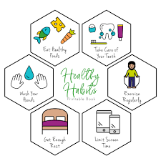
What are healthy habits?
Healthy habits can be defined as:
“behaviour or routine that benefits your physical, mental and emotional wellbeing, contributing to overall health and success”

Slide 7
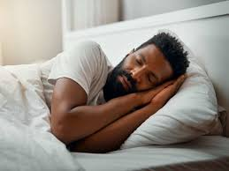

Getting enough sleep
Getting enough sleep is a healthy habit.
Teenagers should get between 9-10 hours of sleep every night
The benefits of this are:
Better mood
Less stress
More energy
Better long term memory – this is the most important benefit for you in Year 11. If you have a better long term memory you will recall facts during your exams and get better grades

Slide 8
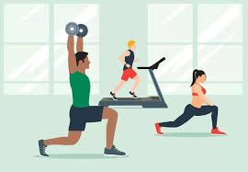
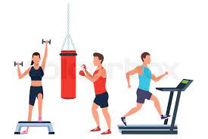
Exercise
Exercising is a healthy habit.
Teenagers should be physically active for 60 minutes at a moderate to vigorous level every day.
The benefits of this are:
Better mood
Less stress
Increased body confidence
More brain power – this is the most important benefit for you in Year 11. This means you will achieve more in your lessons and revisions. This can lead to you getting better grades in your exams

Slide 9
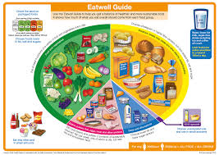
Balanced diet and hydration
Eating a balanced diet and staying hydrated is a healthy habit.
Everyone should aim to eat a balanced diet that covers all the major food groups and avoids high levels of fat and sugar. This means limiting the intake of junk food and fast food. Everyone should also aim to drink 8-10 cups of water every day.
The benefits of this are:
Better mood
Improved energy levels
Better immune system – this is important as it will improve your attendance at school so you do not miss lesson time
Enhance brain function – this is the most important benefit for you in Year 11. This means you will achieve more in your lessons and revisions. This can lead to you getting better grades in your exams

Slide 10

How to form healthy habits
This video shows how you can form healthy habits.
What are the 3 steps to achieving this?
Notes:
https://www.youtube.com/watch?v=9-jrkicgL3E

Slide 11
Reflection
Do you currently have any healthy habits? How do you know they are habits?
Is there any healthy habits that you could start today? What are the benefits of starting these habits?

