Slide 1


Slide 2


Secure your Future: Learning Journey
What is mental health?
What stress will I have this year?
What healthy habits should I start this year?
How do I manage my time effectively?
Should I have a revision timetable now?
How do I cope with different emotions?
Today we will look at:
What stress will I have this year?
This includes:
Definition of stress
What is exam stress
How to cope with exam stress
Please remember that during the lesson we should not be asking any pupil or teacher personal questions.
Your teacher can ask you questions but this will be to check your knowledge in the lesson.

Slide 3

What is stress?
With the person next to you discuss the following question
“what is stress? Where have you heard the term stress before?”
Be ready to share your discussion with the class

Slide 4
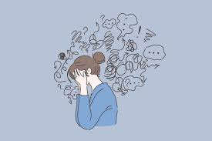
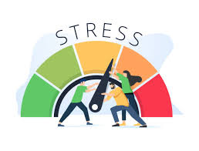
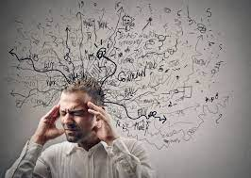
What is stress?
The definition of stress is…
“a normal reaction to the demands in our lives. It is a response to events in life when your brain releases hormones for the fight, flight or freeze response”

Slide 5
What is exam stress?
Exam stress is a stress specific to how a person feels in the lead up to important exams or tests
Discuss with the person next to you why you think people suffer from exam stress

Slide 6

Managing exam stress
What advice is there for managing exam stress?

Slide 7
Managing exam stress
The advice in the video included:
Talk to someone you trust about your stress levels
Don’t compare and compete – concentrate on you
Set realistic revision goals. Concentrate on one topic at a time and do not revise for longer than 45 minutes
Before going to bed relax
Don’t revise in your bedroom
Do some exercise
Try deep breathing when feeling stressed
Visualise finishing the exam and doing well
Have perspective – if you do not get the grade you want, there will still be options for you

Slide 8
Managing exam stress
Additionally, it may help to see exam stress as a positive stress.
Positive stress is a kind of stress that helps motivate people to do well, challenge themselves and become energized to accomplish the tasks they have been given.

Slide 9
Scenario
With the person next to you discuss what advice you would give in the scenario below.
Remember to use your oracy helpsheet and be ready to share your discussion with the class
“A friend has come to you for advice as they are feeling really stressed out about their exams. They ask you to help them”

Slide 10



Support
If you ever need support about stress for either yourself or a friend/family member, you can get support from the following places
Childline.org.uk
Call – 08001111
Email or chat online for support
Themix.org.uk
You can email or have one-to-chat online.
There is also a crisis messenger which is available 24/7

