Slide 1
Thought of the Day
“It is vital that the internet is safe for young people and we need to be confident they won’t experience any harm”
Carol Vorderman

Slide 2


Remember to log in and complete your set tasks.
We still use Classcharts for announcements, surveys and revision material
Homework Club every morning in West Canteen from 8am
Library is open before school and at break times
Students on the following slides have not completed ALL tasks
Make sure you are completing the SET TASKS! These are the tasks your teachers have set.
Notes:
Please give time for the students to produce answers for themselves before showing answers.

Slide 3


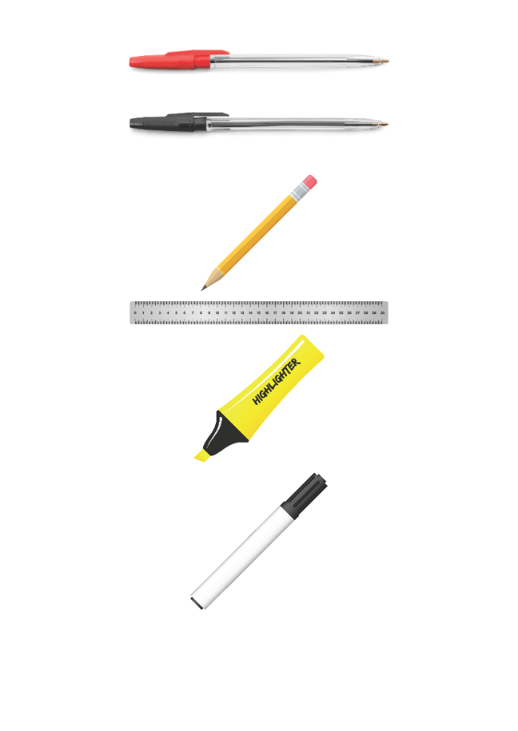


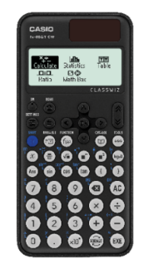


Replacement equipment for your learning wallet can be purchased at the following locations/times:
The following items can be purchased for 10p each (cash only) from West Canteen, East Canteen, the Library, and
LRC (next to W214):
Day | West Canteen | East Canteen | Library or LRC | Library
Monday | 08:00–08:35 | 08:30–08:35 | 10:10– 10:30 11:10–11:30 12:40–13:00 13:40–14:00 | 16:10–16:30
Tuesday | 08:00–08:35 | 08:30–08:35 | 10:10– 10:30 11:10–11:30 12:40–13:00 13:40–14:00 | 15:10–15:30
Wednesday | 08:00–08:35 | 08:30–08:35 | 10:10– 10:30 11:10–11:30 12:40–13:00 13:40–14:00 | 15:10–15:30
Thursday | 08:00–08:35 | 08:30–08:35 | 10:10– 10:30 11:10–11:30 12:40–13:00 13:40–14:00 | 15:10–15:30
Friday | 08:00–08:35 | 08:30–08:35 | 11:10–11:30 12:40–12:30 | 13:40–14:00
The following items can be purchased from West Office using money on your ParentPay:
£1.70
£15.00

Slide 4

Secure your Wellbeing: Learning Journey
What does online footprint mean
How is your data used online?
Does social media affect mental health?
How to manage screen time?
How can the internet be used professionally
What are online trends?
Today we will look at:
What is an online trend/challenge?
This includes:
Definition of online challenge
Example of positive online challenges
Please remember that during the lesson we should not be asking any pupil or teacher personal questions.
Your teacher can ask you questions but this will be to check your knowledge in the lesson.

Slide 5



What are online challenges?
Online challenges are…
“trends that encourage people to perform a task and share it online”

Slide 6

Why are we learning about this?
This links to the Golden Thread of “Secure your Wellbeing”
Online challenges are very common and many can be funny to take part in and watch. However, some are also very dangerous and can lead to serious injuries or death

Slide 7

Why are we learning about this?
Rule of Law is a British Value. This means people are expected to follow laws to keep everyone safe. Online laws state that children under 13 years old should not have access to social media.

Slide 8
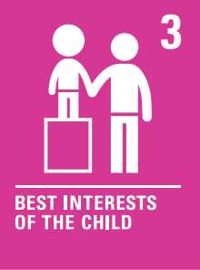
Why are we learning about this?
Article 3 of the UN Rights of a Child state that governments and all adults should do what is best for children. Although this may mean that children disagree with the decisions, the government have laws around what age social media can be used. This is ultimately to protect children.
UN Rights
of a Child

Slide 9
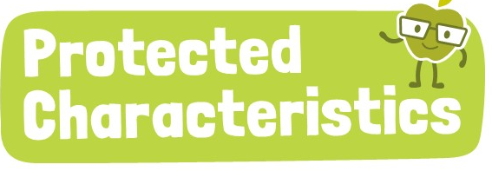
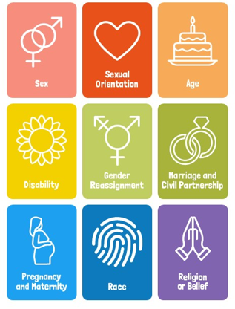
Why are we learning about this?
The Equality Act (2010) sets out 9 Protected Characteristics. No one should be treated differently due to identifying with one or more of the characteristics. This applies online over social media too.

Slide 10

Online Challenges
You have 1 minute to think about the following question:
“Have you ever seen or heard of an online challenge? What was it?”

Slide 11
Online Challenges
Using your oracy helpsheet, with the person next to you, discuss your response to the question:
“Have you ever seen or heard of an online challenge? What was it?”
Remember to use the sentence starters to add, build or challenge what your partner has said.
Be ready to share your discussion with the class

Slide 12
Online Challenges
Online challenges is one way that many charities raise money and awareness.
There have been many viral challenges that have successfully help people in need, spread importance messages and inspired millions worldwide

Slide 13
Online Challenges
This shows that online challenges can be positive if…
They raise money for charities
Do not involve any risky or dangerous behaviours
Promotes kindness, self care or a call to action to help someone/group of people
They are inclusive. Getting people to do something together can help feel people like they are part of something bigger

Slide 14

Online Challenges
Notes:
https://www.youtube.com/watch?v=AQvGtqDt670

Slide 15
Online Challenges
Other online challenges that have had a positive impact:
No make up selfie – raised £8 million in just one week for Cancer Research UK
#trashtag challenge – people cleaned up parks, beaches and streets. They posted before and after photos which encourage millions of people worldwide to join in
22 push up challenge – people did 22 push ups for 22 days to raise awareness about suicide prevention among Armed Forces veterans and encouraged donations to mental health charities

Slide 16
Online Challenges
You have 1 minute to think about the following question:
“Can you think of a positive online challenge?”

Slide 17
Online Challenges
Using your oracy helpsheet, with the person next to you, discuss your response to the question:
“Can you think of a positive online challenge?”
Remember to use the sentence starters to add, build or challenge what your partner has said.
Be ready to share your discussion with the class

Slide 18
Online Challenges
However not all online challenges are positive. You will be learning about how to remain safe around online challenges in your Personal Development lesson this week.
Before then, think about what online challenges you see. Do they look safe? Are they based around making a positive difference?

Slide 19



Support
If you ever need support about online challenges for yourself, a friend or family member you can find it here:
Childline.org.uk
Call – 08001111
Email or chat online for support
Themix.org.uk
You can email or have one-to-chat online.
There is also a crisis messenger which is available 24/7

