Slide 1
Thought of the Day
“Domestic violence is not a private matter. It’s everyone’s business”
Barbara Mikulski

Slide 2


Remember to log in and complete your set tasks.
We still use Classcharts for announcements, surveys and revision material
Homework Club every morning in West Canteen from 8am
Library is open before school and at break times
Students on the following slides have not completed ALL tasks
Make sure you are completing the SET TASKS! These are the tasks your teachers have set.
Notes:
Please give time for the students to produce answers for themselves before showing answers.

Slide 3


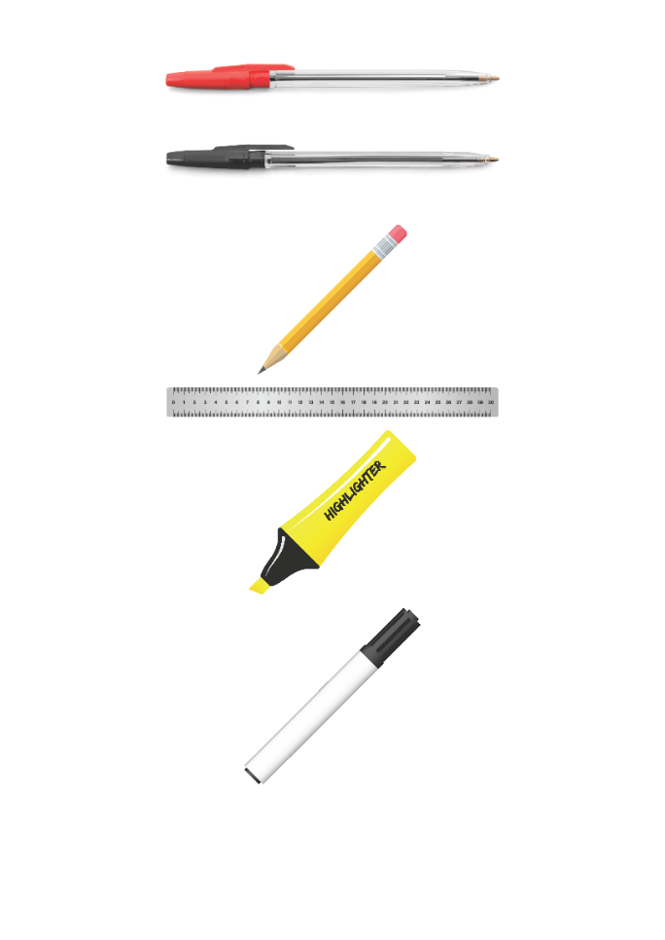


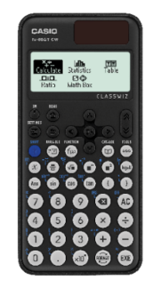


Replacement equipment for your learning wallet can be purchased at the following locations/times:
The following items can be purchased for 10p each (cash only) from West Canteen, East Canteen, the Library, and
LRC (next to W214):
Day | West Canteen | East Canteen | Library or LRC | Library
Monday | 08:00–08:35 | 08:30–08:35 | 10:10– 10:30 11:10–11:30 12:40–13:00 13:40–14:00 | 16:10–16:30
Tuesday | 08:00–08:35 | 08:30–08:35 | 10:10– 10:30 11:10–11:30 12:40–13:00 13:40–14:00 | 15:10–15:30
Wednesday | 08:00–08:35 | 08:30–08:35 | 10:10– 10:30 11:10–11:30 12:40–13:00 13:40–14:00 | 15:10–15:30
Thursday | 08:00–08:35 | 08:30–08:35 | 10:10– 10:30 11:10–11:30 12:40–13:00 13:40–14:00 | 15:10–15:30
Friday | 08:00–08:35 | 08:30–08:35 | 11:10–11:30 12:40–12:30 | 13:40–14:00
The following items can be purchased from West Office using money on your ParentPay:
£1.70
£15.00

Slide 4

Secure your Wellbeing: Learning Journey
Laws around marriage and civil partnerships
What is domestic violence?
How do people become involved in gang culture?
What impact can gang culture have on relationships?
What impact can gang culture have on the community?
How can I be a good role model in my community?
Today we will look at:
What is domestic violence
This includes:
Definition of domestic violence
What is classed as domestic violence
Impact of domestic violence
Please remember that during the lesson we should not be asking any pupil or teacher personal questions.
Your teacher can ask you questions but this will be to check your knowledge in the lesson.

Slide 5
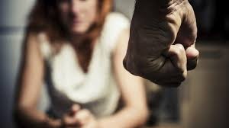
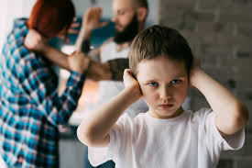
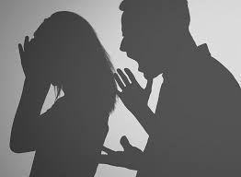
What is domestic violence?
Domestic violence is…
“violence or abusive behaviour within the home”

Slide 6

Why are we learning about this?
This links to the Golden Thread of “Secure your Relationships”
Being in a relationship that involves domestic violence/abuse is not a healthy relationship. It is important to know what domestic violence/abuse looks like to ensure you always have a healthy relationship or know how to get help if a relationship turns unhealthy.

Slide 7

Why are we learning about this?
Rule of Law is a British Value. This means people are expected to follow laws to keep everyone safe. Domestic violence is a criminal offence under the Domestic Violence, Crime and Victims Act (2004).

Slide 8

Why are we learning about this?
Article 19 of the UN Rights of a Child state that children must be protected from violence, abuse and neglect by anyone who looks after them.
UN Rights
of a Child

Slide 9
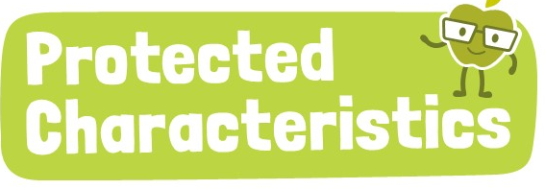
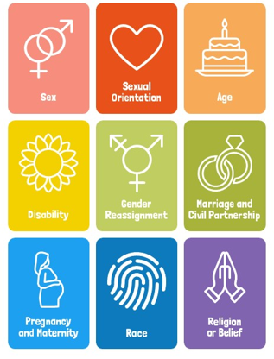
Why are we learning about this?
The Equality Act (2010) sets out 9 Protected Characteristics. No one should be a victim of domestic violence or abuse due to identifying with one or more of the protected characteristics.

Slide 10
What is domestic violence?
The law says that domestic violence or abuse can be:
Physical
Psychological/Emotional
Sexual
Financial

Slide 11
What is domestic violence?
Physical domestic violence/abuse would be when a person attacks another person in the home.
This could involve punching, pushing, slapping and kicking.

Slide 12
What is domestic violence?
Psychological/emotional domestic violence/abuse is when a person undermines another person’s self work through constant criticism and verbal abuse. It can also involve controlling behaviours including who another person can see or talk too.

Slide 13
What is domestic violence?
Sexual domestic violence/abuse includes a person forcing another person into sexual acts without their consent.
This can potentially mean that a person has been raped.

Slide 14
What is domestic violence?
Financial domestic violence/abuse can involve a person controlling all of the household income and not letting a person have any money despite them working. It can also involve stopping a person from being in work, education or training.

Slide 15
What is domestic violence?
It is important to know that domestic violence/abuse can happen between people who are married, people who are just going out together, people who live together.
Even though women are more often the victims of abuse, men can also be victims.
All victims of domestic violence/abuse can find it difficult to seek help from friends/family and support services. However, men often finder it harder to seek help

Slide 16
What is domestic violence?
It is also important to know that the abuser in the relationship is always responsible.
No one else is to blame, even though the abuser may say it was the other person’s fault.
An example of this is after hitting their partner an abuser may say “look what you made me do”

Slide 17

What is domestic violence
You have 1 minute to think about the following question:
“What are the impacts of domestic violence/abuse on the person being abused?”

Slide 18
What is domestic violence?
Using your oracy helpsheet, with the person next to you, discuss your response to the question:
“What are the impacts of domestic violence/abuse on the person being abused?”
Remember to use the sentence starters to add, build or challenge what your partner has said.
Be ready to share your discussion with the class

Slide 19
What is domestic violence?
Domestic violence/abuse can lead to people:
Experience loneliness and isolation
Negative impact on health and wellbeing
Depression
Low self confidence
Anxiety
Feelings of guilt and shame

Slide 20



Support
If you ever need support about domestic violence/abuse for you, a friend or family member you can find it here:
Childline.org.uk
Call – 08001111
Email or chat online for support
Call 999 if a person is in immediate danger

