Slide 1
Thought of the Day
“"Social media and excessive screen use can create a distorted reality—what you see online isn’t always real life.”
Dr. Cal Newport

Slide 2


Remember to log in and complete your set tasks.
We still use Classcharts for announcements, surveys and revision material
Homework Club every morning in West Canteen from 8am
Library is open before school and at break times
Students on the following slides have not completed ALL tasks
Make sure you are completing the SET TASKS! These are the tasks your teachers have set.
Notes:
Please give time for the students to produce answers for themselves before showing answers.

Slide 3


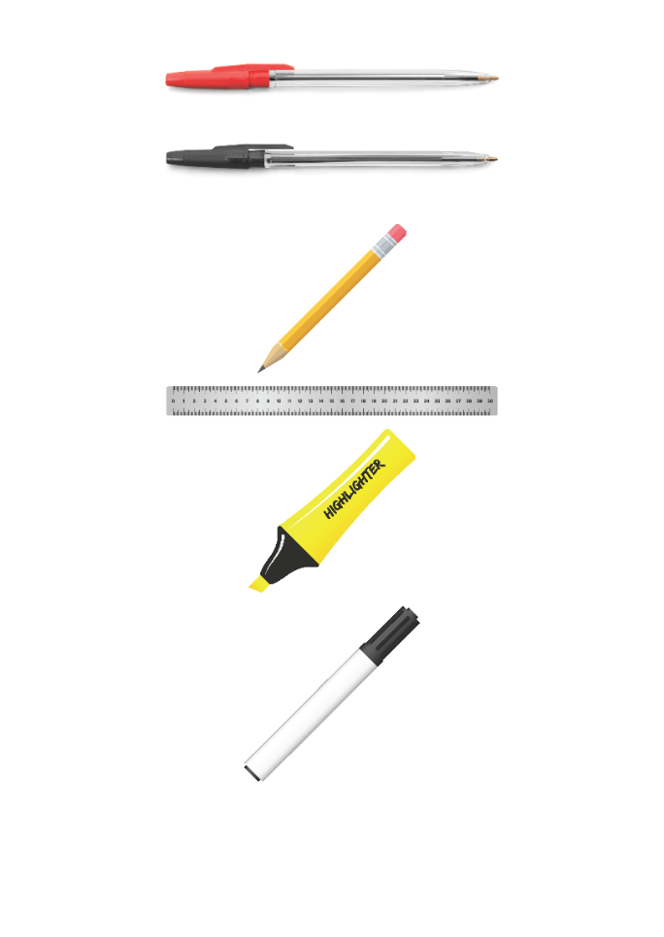


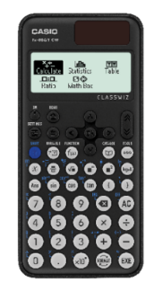


Replacement equipment for your learning wallet can be purchased at the following locations/times:
The following items can be purchased for 10p each (cash only) from West Canteen, East Canteen, the Library, and
LRC (next to W214):
Day | West Canteen | East Canteen | Library or LRC | Library
Monday | 08:00–08:35 | 08:30–08:35 | 10:10– 10:30 11:10–11:30 12:40–13:00 13:40–14:00 | 16:10–16:30
Tuesday | 08:00–08:35 | 08:30–08:35 | 10:10– 10:30 11:10–11:30 12:40–13:00 13:40–14:00 | 15:10–15:30
Wednesday | 08:00–08:35 | 08:30–08:35 | 10:10– 10:30 11:10–11:30 12:40–13:00 13:40–14:00 | 15:10–15:30
Thursday | 08:00–08:35 | 08:30–08:35 | 10:10– 10:30 11:10–11:30 12:40–13:00 13:40–14:00 | 15:10–15:30
Friday | 08:00–08:35 | 08:30–08:35 | 11:10–11:30 12:40–12:30 | 13:40–14:00
The following items can be purchased from West Office using money on your ParentPay:
£1.70
£15.00

Slide 4

Secure your Wellbeing: Learning Journey
What does online footprint mean
How is your data used online?
Does social media affect mental health?
How to manage screen time?
How can the internet be used professionally
What are online dangers?
Today we will look at:
Screen Time
This includes:
Definition of screen time
Impact on physical wellbeing
Impact on mental wellbeing
Please remember that during the lesson we should not be asking any pupil or teacher personal questions.
Your teacher can ask you questions but this will be to check your knowledge in the lesson.

Slide 5
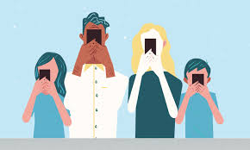

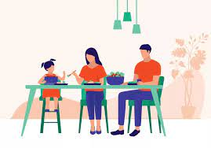
Screen Time
Screen time is…
“Any time spent using a device with a screen.”
This includes:
Mobile phones
Tablets
TV
Computer/laptops

Slide 6

Why are we learning about this?
This links to the Golden Thread of “Secure your Wellbeing”
Spending too much time inside looking at screens can have an impact on physical and mental wellbeing. It is important to put screens away and enjoy the outdoors too

Slide 7

Why are we learning about this?
Article 3 of the UN Rights of a Child state that governments and all adults should do what is best for children. Although this may mean that children disagree with the decision. An example of this is schools banning mobile phones however this allows pupils opportunities to enjoy interacting with each other in person and not through a device.
UN Rights
of a Child

Slide 8
Screen Time
Screen time exposes people to blue light.
Blue light has smaller wavelength than other lights on the spectrum. It also has higher energy.
This disturbs a sleep hormone called melatonin. If this hormone is disturbed it negatively impacts the person’s quality of sleep.

Slide 9

Screen Time
You have 1 minute to think about the following question:
“What other reasons have you heard of why extended screen time can be harmful?”

Slide 10
Social Media Use
Using your oracy helpsheet, with the person next to you, discuss your response to the question:
“What other reasons have you heard of why extended screen time can be harmful?”
Remember to use the sentence starters to add, build or challenge what your partner has said.
Be ready to share your discussion with the class

Slide 11
Screen Time
Screen time can impact physical wellbeing.
This is due to increased screen time meaning people are less active and eat a less healthy diet. This is made worse by lack of sleep.
One potential consequence of this is weight gain. This could eventually lead to obesity which is linked to lots of serious health issues such as diabetes, cardiovascular diseases and strokes.

Slide 12
Screen Time
Screen time can impact mental wellbeing.
Too much screen time can reduce a person’s self-esteem and self-worth. This is largely due to comparisons with unrealistic body images and lifestyle compared to their own lives.

Slide 13
Screen Time
Screen time can also impact mental wellbeing of young people by making them feeling more lonely, stressed, anxious, tense or angry.
This could be explained by young people being able to access too much information about current global issues or seeing graphic or violent content that is not appropriate for their age.

Slide 14
Screen Time
You have 1 minute to think about the following question:
“Do you think excessive screen time affects physical or mental wellbeing the most? Why?”

Slide 15
Social Media Use
Using your oracy helpsheet, with the person next to you, discuss your response to the question:
“Do you think excessive screen time affects physical or mental wellbeing the most? Why?”
Remember to use the sentence starters to add, build or challenge what your partner has said.
Be ready to share your discussion with the class

Slide 16
Screen Time
To stop these negative impacts people can:
Do not snack when using a screen
Dedicate time to physical activity and leave mobile phone at home when doing so
Turn screens off 1 hour before going to sleep
Spend more time talking to people in person and not online
Speak to someone you trust if you feel angry, stressed or tense after seeing something online
Download apps that limit use of social media or gaming on smartphones/tablets

Slide 17
Screen Time
You have 1 minute to think about the following question:
“Which piece of advice do you think is most realistic for young people to try? Why?”

Slide 18
Social Media Use
Using your oracy helpsheet, with the person next to you, discuss your response to the question:
“Which piece of advice do you think is most realistic for young people to try? Why?”
Remember to use the sentence starters to add, build or challenge what your partner has said.
Be ready to share your discussion with the class

Slide 19



Support
If you ever need support about excessive screen time for yourself, a friend or family member you can find it here:
Childline.org.uk
Call – 08001111
Email or chat online for support
Themix.org.uk
You can email or have one-to-chat online.
There is also a crisis messenger which is available 24/7

