Slide 1
Thought of the Day
“There is a lot of pressure on young people to look perfect on social media, but it’s important to remember that not everything online is real.”
Jameela Jamil

Slide 2


Remember to log in and complete your set tasks.
We still use Classcharts for announcements, surveys and revision material
Homework Club every morning in West Canteen from 8am
Library is open before school and at break times
Students on the following slides have not completed ALL tasks
Make sure you are completing the SET TASKS! These are the tasks your teachers have set.
Notes:
Please give time for the students to produce answers for themselves before showing answers.

Slide 3


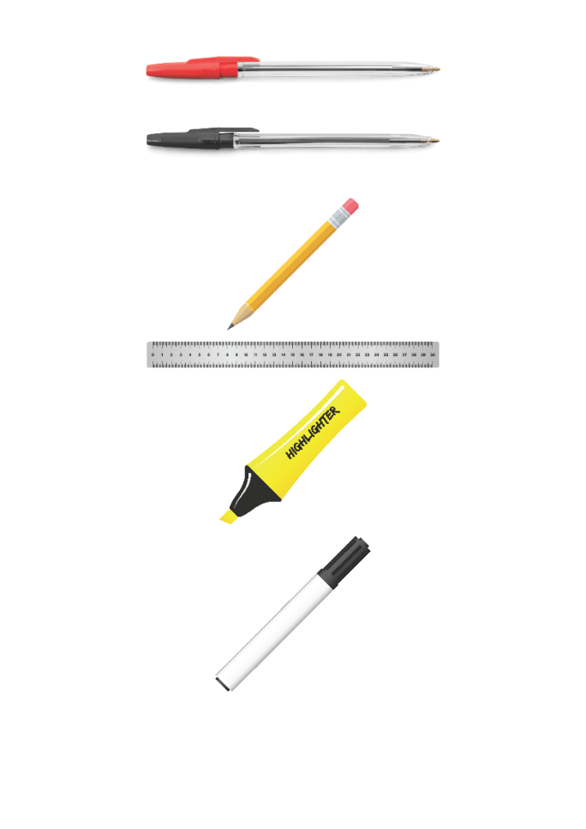


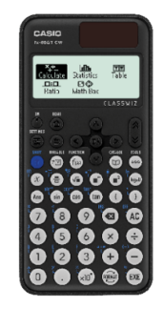


Replacement equipment for your learning wallet can be purchased at the following locations/times:
The following items can be purchased for 10p each (cash only) from West Canteen, East Canteen, the Library, and
LRC (next to W214):
Day | West Canteen | East Canteen | Library or LRC | Library
Monday | 08:00–08:35 | 08:30–08:35 | 10:10– 10:30 11:10–11:30 12:40–13:00 13:40–14:00 | 16:10–16:30
Tuesday | 08:00–08:35 | 08:30–08:35 | 10:10– 10:30 11:10–11:30 12:40–13:00 13:40–14:00 | 15:10–15:30
Wednesday | 08:00–08:35 | 08:30–08:35 | 10:10– 10:30 11:10–11:30 12:40–13:00 13:40–14:00 | 15:10–15:30
Thursday | 08:00–08:35 | 08:30–08:35 | 10:10– 10:30 11:10–11:30 12:40–13:00 13:40–14:00 | 15:10–15:30
Friday | 08:00–08:35 | 08:30–08:35 | 11:10–11:30 12:40–12:30 | 13:40–14:00
The following items can be purchased from West Office using money on your ParentPay:
£1.70
£15.00

Slide 4



Food Bank Collection for Ramadan
"Do not withhold good from those to whom it is due, when it is in your power to act." – Proverbs 3:27
During March, many Muslims will be observing Ramadan by fasting.
As a school, we aim to come together to share food and support those who may have limited resources to break their fast.
So for a whole week (from Monday 3rd March 2025 until Friday 7th March), all students will have the opportunity to bring food items from home in to school to donate to their form tutor.
On Friday our Pupil Leaders will collect all donations, which will be recorded on the Secure Tracker, and there will be a prize for the best form!
Thank you for your kindness and generosity in supporting our community
Mrs Sajed and Miss Reid
"The believer’s shade on the Day of Resurrection will be his charity." – Prophet Muhammad (Tirmidhi 604)
Notes:
Form tutors please keep all collected food items with you in your rooms until Friday 7th when our Pupil Leaders will come and take these all from you during form/period 1.
And if you could make sure the secure tracker is being filled also if students bring donations in under Charity contribution.

Slide 5
Food Bank Collection for Ramadan
"Do not withhold good from those to whom it is due, when it is in your power to act." – Proverbs 3:27
What items could you bring to donate?
Dried food such as rice and pasta
Tinned food such as beans, soup, and canned vegetables
Tinned desserts such as custard, rice pudding
Boxes of cereal
Packet food such as noodles, ramen
Bottles of squash
Please do not bring fresh fruit or vegetables, or frozen food, as these will spoil.
"The believer’s shade on the Day of Resurrection will be his charity." – Prophet Muhammad (Tirmidhi 604)
Notes:
Form tutors please keep all collected food items with you in your rooms until Friday 7th when our Pupil Leaders will come and take these all from you during form/period 1.
And if you could make sure the secure tracker is being filled also if students bring donations in under Charity contribution.

Slide 6

Secure your Wellbeing: Learning Journey
What does online footprint mean
How is your data used online?
Does social media affect mental health?
How to manage screen time?
How can the internet be used professionally
What are online dangers?
Today we will look at:
Does social media affect mental health?
This includes:
How long do young people spend on social media?
What science says about the impact of social media on young people
Debate around Australia banning social media for U16’s
Please remember that during the lesson we should not be asking any pupil or teacher personal questions.
Your teacher can ask you questions but this will be to check your knowledge in the lesson.

Slide 7

Social Media Use
You have 1 minute to think about the following question:
“How many hours do you think you spend looking at social media each day?”
Social media includes Instagram, Snapchat, YouTube etc

Slide 8
Social Media Use
Using your oracy helpsheet, with the person next to you, discuss your response to the question:
“How many hours do you think you spend looking at social media each day?”
Remember to use the sentence starters to add, build or challenge what your partner has said.
Be ready to share your discussion with the class

Slide 9

Social Media Use
Research completed in 2023 found that teenagers spend on average 4.8 hours on social media everyday.
37% of respondents said they spend 5 hours or more on social media every day

Slide 10
Social Media Use
The same research found that teenagers who reported spending the most time on social media rated their mental health as poor or very poor.
Worryingly, the research also showed that these young people were more likely to have thoughts about suicide and self harm.

Slide 11
Social Media Use
Reasons why social media can be bad for mental health are:
1. People generally post content that does not always show their true lifestyle. Content is idealised, filtered and edited to make it look better than it often is. This can lead to people making comparisons to their lifestyle which create low self esteem.

Slide 12
Social Media Use
Reasons why social media can be bad for mental health are:
2. Social media is often a place for online bullying to occur. This can be either leaving hurtful/threatening comments, or impersonating people online through fake profiles. It is widely recognised that people are more willing to be unpleasant behind a screen than in real life. This can lead to the victim having poor mental health due to being bullied online

Slide 13
Social Media Use
Reasons why social media can be bad for mental health are:
3. Social media can present a distorted view of the world. Influencers want as many views as possible to get paid more. This can lead to them exaggerating stories to make them more extreme and shocking. This often makes their version of the news false. However, unless their followers check the information they will not know this. This can lead to mental health becoming poor if fake news stories are particularly distressing

Slide 14

Why are we learning about this?
This links to the Golden Thread of “Secure your Wellbeing”
Social media is part of young people’s daily life. It is important to know that social media can be a cause of poor mental health, so you can take action to limit use to maintain good mental health

Slide 15

Why are we learning about this?
Rule of Law is a British Value that means everyone is expected to follow the laws. There are laws around what age young people can use social media. These laws are designed to protect young people

Slide 16

Why are we learning about this?
Article 3 of the UN Rights of a Child state that governments and all adults should do what is best for children. Although this may mean that children disagree with the decisions, the government have laws around what age social media can be used.
UN Rights
of a Child

Slide 17


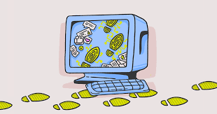
Social media ban
In 2024, Australia announced that children under 16 years old will be banned from using social media.
The Australian Prime Minister has said this action is needed in order to protect young people from the “harms” of social media

Slide 18
Social Media Use
You have 1 minute to think about the following question:
“Do you agree or disagree with Australia’s decision to ban under 16’s from social media? Why?”

Slide 19
Social Media Use
Using your oracy helpsheet, with the person next to you, discuss your response to the question:
“Do you agree or disagree with Australia’s decision to ban under 16’s from social media? Why?”
Remember to use the sentence starters to add, build or challenge what your partner has said.
Be ready to share your discussion with the class

Slide 20



Support
If you ever need support about social media use for yourself, a friend or family member you can find it here:
Childline.org.uk
Call – 08001111
Email or chat online for support
Themix.org.uk
You can email or have one-to-chat online.
There is also a crisis messenger which is available 24/7

