Slide 1
Thought of the Day
“Love is love. It knows no gender, it knows no boundaries”
Lance Bass

Slide 2


Remember to log in and complete your set tasks.
We still use Classcharts for announcements, surveys and revision material
Homework Club every morning in West Canteen from 8am
Library is open before school and at break times
Students on the following slides have not completed ALL tasks
Make sure you are completing the SET TASKS! These are the tasks your teachers have set.

Slide 3








Replacement equipment for your learning wallet can be purchased at the following locations/times:
The following items can be purchased for 10p each (cash only) from West Canteen, East Canteen, the Library, and
LRC (next to W214):
Day | West Canteen | East Canteen | Library or LRC | Library
Monday | 08:00–08:35 | 08:30–08:35 | 10:10– 10:30 11:10–11:30 12:40–13:00 13:40–14:00 | 16:10–16:30
Tuesday | 08:00–08:35 | 08:30–08:35 | 10:10– 10:30 11:10–11:30 12:40–13:00 13:40–14:00 | 15:10–15:30
Wednesday | 08:00–08:35 | 08:30–08:35 | 10:10– 10:30 11:10–11:30 12:40–13:00 13:40–14:00 | 15:10–15:30
Thursday | 08:00–08:35 | 08:30–08:35 | 10:10– 10:30 11:10–11:30 12:40–13:00 13:40–14:00 | 15:10–15:30
Friday | 08:00–08:35 | 08:30–08:35 | 11:10–11:30 12:40–12:30 | 13:40–14:00
The following items can be purchased from West Office using money on your ParentPay:
£1.70
£15.00

Slide 4

Secure your Wellbeing: Learning Journey
Laws around marriage and civil partnerships
What is domestic violence?
How do people become involved in gang culture?
What impact can gang culture have on relationships?
What impact can gang culture have on the community?
How can I be a good role model in my community?
Today we will look at:
Laws around marriage and civil partnerships
This includes:
Definition of marriage and civil partnerships
Differences between marriage and civil partnerships
Please remember that during the lesson we should not be asking any pupil or teacher personal questions.
Your teacher can ask you questions but this will be to check your knowledge in the lesson.

Slide 5



What does marriage mean?
Marriage is…
“a legally recognised union between two people as partners in a personal relationship”

Slide 6
What does civil partnership mean?
A civil partnership is…
“a legal relationship similar to marriage but without religious or ceremonial aspects”

Slide 7

Why are we learning about this?
This links to the Golden Thread of “Secure your Relationships”
When you are older and you wish to enter a legal relationship with another person, you will understand the different options and choose the option that suits the relationship best.

Slide 8

Why are we learning about this?
Rule of Law is a British Value. This means people are expected to follow laws to keep everyone safe. There are laws around marriage and civil partnerships. For example to enter a marriage or civil partnership, a person must be 18 years old or older.

Slide 9

Why are we learning about this?
Article 36 of the UN Rights of a Child state that children have the right to be protected from exploitation. In the UK this right is recognised by the legal age of marriage and civil partnerships being 18 years old. This means no child can be forced into a marriage or civil partnership
UN Rights
of a Child

Slide 10
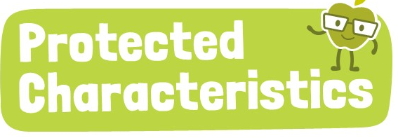
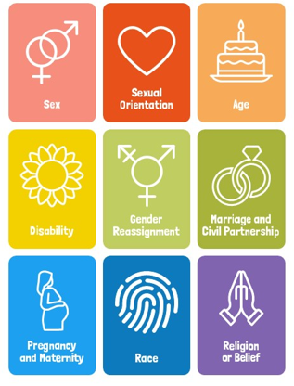
Why are we learning about this?
Marriage and Civil Partnership is a Protected Characteristic. This means that people should not be treated differently regardless of their choice of legal partnership or to not enter a marriage or civil partnership

Slide 11
Laws around marriage and civil partnership
In 2023, the legal age for marriage and civil partnership became 18 years old in England.
Previous to this it was 16 years old.

Slide 12
Laws around marriage and civil partnership
Civil partnerships were originally introduced in 2004.
They were introduced as a legal equivalent to marriage for same sex couples as at this time same sex marriage was illegal.
It was only in 2013, when same sex marriages became legal

Slide 13
Laws around marriage and civil partnership
However, it was not until 2019 when it became legal for opposite sex couples to choose to enter into a civil partnership rather a marriage.
Some people choose a civil partnership for non-religious or equality reasons.

Slide 14
Quiz
Is the following statement true or false
“People can get married when they are 17 years old”
This is false

Slide 15
Quiz
Is the following statement true or false
“A civil partnership is only for same sex couples and marriage is for opposite sex couples”
This is false

Slide 16
Quiz
Is the following statement true or false
“Civil partnerships and marriages have the same legal rights”
This is true

Slide 17
Rights and Responsibilities
There are many reasons why people choose to enter a marriage or civil partnership. These include:
Property rights – there are equal rights to shared property
Inheritance – a person automatically inherits if one partner dies without a will
Financial support – obligation to support each other financially
Parental rights - legal responsibilities toward children (depending on circumstances)

Slide 18
Rights and Responsibilities
An example of this is:
“Liam and Raj, a married couple, buy a house together. Unfortunately Liam dies suddenly and he did not have a will. This means that Raj automatically inherits Liam’s share of the house they bought together”

Slide 19
Ending a marriage or civil partnership
Marriages and civil partnerships can be legally terminated.
In terms of a marriage this is called divorce
In terms of civil partnerships this is called dissolution
Since 2022, couples can apply for a “no fault divorce/dissolution” Prior to this one person in the relationship had to take the blame for the ending of the marriage/civil partnership

Slide 20

Divorce/dissolution
You have 1 minute to think about the following question:
“Why might people get a divorce/dissolution?”

Slide 21
Divorce/dissolution
Using your oracy helpsheet, with the person next to you, discuss your response to the question:
“Why might people get a divorce/dissolution?”
Remember to use the sentence starters to add, build or challenge what your partner has said.
Be ready to share your discussion with the class

Slide 22
marriage or civil partnership
The key things to remember are:
The legal age for marriage and civil partnerships is 18 years old
Both are legal and are equal forms of relationship recognition
Rights in a marriage/civil partnership is property, inheritance, financial support and parental rights
Ending a marriage is called divorce
Ending a civil partnership is called dissolution

Slide 23



Support
If you ever need support about marriage/civil partnership for a friend or family member you can find it here:
Childline.org.uk
Call – 08001111
Email or chat online for support
Themix.org.uk
You can email or have one-to-chat online.
There is also a crisis messenger which is available 24/7

