Slide 1
Thought of the Day
“Watching pornography as a child can blur the lines between fantasy and reality, making it harder to form real, meaningful connections.”
Philippa Perry

Slide 2


HWK Detentions will be held afterschool on Friday
We still use Classcharts for announcements, surveys and revision material
Homework Club every morning in West Canteen from 8am
Library is open before school and at break times
Students on the following slides have not completed ALL tasks
Make sure you are completing the SET TASKS! These are the tasks your teachers have set.
Notes:
Please give time for the students to produce answers for themselves before showing answers.

Slide 3
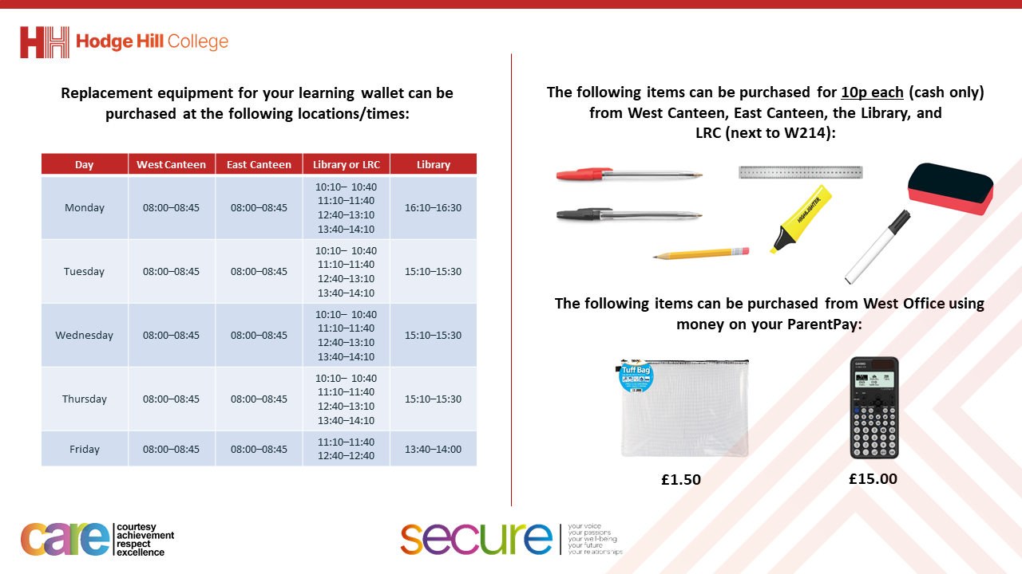

Slide 4


Secure your Relationships: Learning Journey
Risk of unprotected sex
What is intimacy without having sex?
What is sexual harassment and upskirting?
What is toxic masculinity?
Dangers of pornography
Dangers of sexting
Today we will look at:
The dangers of pornography
This includes:
Definition of pornography
Myths and reality of pornography
The law around pornography
Please remember that during the lesson we should not be asking any pupil or teacher personal questions.
Your teacher can ask you questions but this will be to check your knowledge in the lesson.

Slide 5
What is pornography?
Pornography is…
“material such as books, magazines, pictures and videos that depicts erotic behaviour that is intended to cause sexual excitement”

Slide 6




Why are we learning about this?
This links to the Golden Thread of “Secure your Relationships“
It is important to learn about the negative impact pornography as it can lead to unrealistic expectations in relationships when you are older

Slide 7

Why are we learning about this?
Rule of Law is a British Value that means everyone is expected to follow the laws. There are laws regarding the age limit of accessing pornographic material. The legal age of accessing pornography is 18 years old.

Slide 8

Why are we learning about this?
Article 3 of the UN Rights of a Child state that adults should make decisions that are in the best interests of the child. This is why there are age restrictions on accessing pornographic material as it is not age appropriate. This protects children from seeing content that might make them feel uneasy, unsafe or scared.
UN Rights
of a Child

Slide 9
Impact of pornography?
The NSPCC completed research about the impact of watching pornography between the ages of 11-16 years old.
This research found young people aged 11-16 who have seen pornography are at greater risk of developing:
Unrealistic attitudes about sex and consent
More negative attitudes towards roles and identities in relationships
More casual attitudes towards sex and sexual relationships
An increase in “risky” sexual behaviour
Unrealistic expectations of body image and performance

Slide 10
Impact of pornography?
The research also showed that males between 11-16 years old reported a higher frequency of viewing pornography.
Out of the people who were interviewed 56% of males compared to 40% of females viewed pornography.
Another revealing statistic is that 59% of males intentionally viewed pornography compared to 25% of females.
This means that males between 11-16 years old are more at risk of developing the attitudes described on the previous slide.

Slide 11
The law about pornography
Pornographic magazines and videos can be legally bought at 18 years old. The law states that any online pornographic services must have age verification tools to prevent children from seeing content that is not appropriate for them.
This means that is illegal for any adults to show pornographic material to children (anyone under 18 years old).

Slide 12
The law about pornography
Although viewing pornography is legal at 18 years old, there is pornographic content that is illegal to ever be seen, distributed or held even if you are over 18 years old.
This content includes:
Violent pornography that includes rape or abuse
Degrading pornographic content
Material showing anyone under 18 years old

Slide 13
True or False
Is the statement below true or false:
“Research showed that males between 11-16 years old intentionally viewed pornography more than females”
This is true. Research shows that 59% of males intentionally viewed pornography compared to 25% of females

Slide 14
True or False
Is the statement below true or false:
“Sex in pornography is the same as sex in real life”
This is false. Actors shown in pornographic material may have had surgery to have the “ideal” sexual body. This may alter the size and shape of normal body parts

Slide 15
True or False
Is the statement below true or false:
“Selling pornographic magazines or videos in a shop to someone under 18 is legal”
This is false. Pornographic material can only be purchased if you are 18 years old or older. Shops will normally ask for ID to check the age of the customer

Slide 16
True or False
Is the statement below true or false:
“It is illegal to watch violent pornographic material that causes harm to someone else”
This is true. Pornographic material that includes violence including rape or abuse is illegal if it is viewed by someone 18 years old or older.

Slide 17
True or False
Is the statement below true or false:
“it is legal to view pornography that includes consenting adults”
This is true. This is legal as long as the adults are consenting. If they have not consented this is called “revenge porn” and this is illegal. This tends to happen more with “home made” pornography material

Slide 18
True or False
Is the statement below true or false:
“it is legal for an adult to show a child pornographic material”
This is false. It is against the law for adults to show children any pornographic material.

Slide 19



Support
If you ever need support about anything raised in today’s lesson for yourself, a friend or family member you can find it here:
Childline.org.uk
Call – 08001111
Email or chat online for support
Themix.org.uk
You can email or have one-to-chat online.
There is also a crisis messenger which is available 24/7

