Slide 1
Thought of the Day
“Toxic masculinity is not just a personal issue; it perpetuates inequalities and sustains a culture of harm for everyone”

Slide 2


HWK Detentions will be held afterschool on Friday
We still use Classcharts for announcements, surveys and revision material
Homework Club every morning in West Canteen from 8am
Library is open before school and at break times
Students on the following slides have not completed ALL tasks
Make sure you are completing the SET TASKS! These are the tasks your teachers have set.
Notes:
Please give time for the students to produce answers for themselves before showing answers.

Slide 3
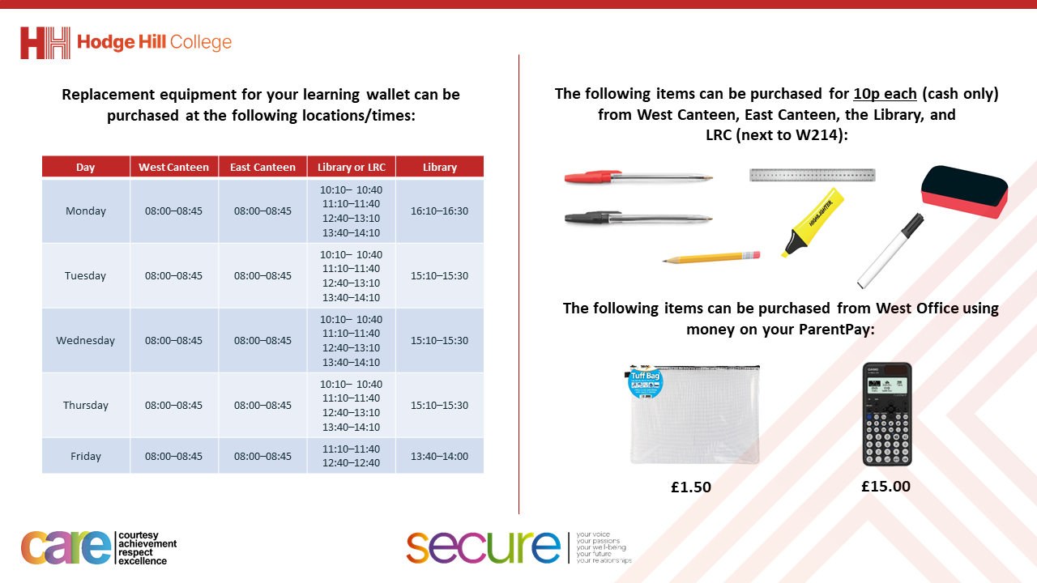

Slide 4


Secure your Relationships: Learning Journey
Risk of unprotected sex
What is intimacy without having sex?
What is sexual harassment and upskirting?
What is toxic masculinity?
Dangers of pornography
Dangers of sexting
Today we will look at:
What is toxic masculinity?
This includes:
Characteristics of toxic masculinity
Impact of toxic masculinity
Strategies to combat toxic masculinity
Please remember that during the lesson we should not be asking any pupil or teacher personal questions.
Your teacher can ask you questions but this will be to check your knowledge in the lesson.

Slide 5
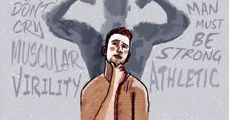
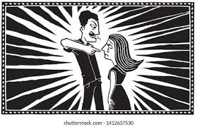
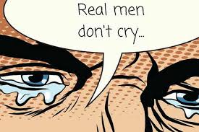
What is toxic masculinity?
Toxic Masculinity is…
“societal expectations and norms that pressure men to behave in certain restrictive ways.”

Slide 6
What is toxic masculinity?
The restrictive behaviours could be:
Suppressing emotions
Being overly aggressive
Following rigid gender roles/stereotypes

Slide 7




Why are we learning about this?
This links to the Golden Thread of “Secure your Relationships“
It is important to learn about toxic masculinity as it will improve relationships particularly with females as avoiding toxic masculinity behaviours will ensure that everyone feels safe and respected in the relationship.

Slide 8
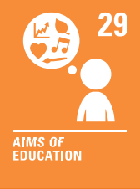
Why are we learning about this?
Article 29 states that education should help children fully develop to their best ability. Learning about and challenging toxic masculinity behaviours will help all children be the best young person they can be, and help everyone live peacefully alongside each other
UN Rights
of a Child

Slide 9
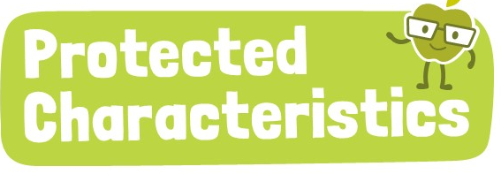
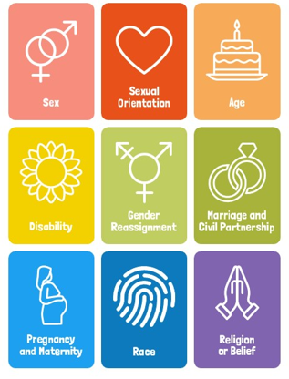
Why are we learning about this?
Sex is a protected characteristic. One example of a toxic masculinity behaviour is following rigid gender stereotypes. Regardless if a person is male, female or identifies as a different gender, they should not be treated any differently.

Slide 10
Characteristics of Toxic Masculinity
Some characteristics of toxic masculinity are:
Belief that men should suppress emotions like sadness or fear as showing emotion is seen as weak
Being overly dominant, aggressive and controlling
Men should not share their problems and instead “bottle up” their emotions
Not giving value to anything considered “feminine” or traditionally associated with women.

Slide 11

Characteristics of toxic masculinity
You have 1 minute to think about your response to the following question:
“which toxic masculinity characteristic do you think is most problematic? Why?”

Slide 12
Characteristics of toxic masculinity
Using your oracy helpsheet, with the person next to you, discuss your response to the question:
“which toxic masculinity characteristic do you think is most problematic? Why?”
Remember to use the sentence starters to add, build or challenge what your partner has said.
Be ready to share your discussion with the class

Slide 13
Impact of Toxic Masculinity
Toxic Masculinity can have a negative impact for:
Individuals
Wider society

Slide 14
Impact of Toxic Masculinity
Negative impacts on the individual include:
Mental Health Challenges – due to the pressure to bottle up feelings and to not show vulnerability, this can lead to mental health disorders such as depression and anxiety. Toxic masculinity is also linked to a higher male suicide rate compared to females
Difficulty forming healthy relationships with others due to their perceived anger, dominance and controlling behaviours
Reduced self-esteem due to the pressure to meet unattainable standards

Slide 15
Individual impact
You have 1 minute to think about your response to the following question:
“all of these reasons were male dominated. What do you think are negative impacts of toxic masculinity on females?”

Slide 16
Individual Impact
Using your oracy helpsheet, with the person next to you, discuss your response to the question:
“all of these reasons were male dominated. What do you think are negative impacts of toxic masculinity on females?”
Remember to use the sentence starters to add, build or challenge what your partner has said.
Be ready to share your discussion with the class

Slide 17
Impact of Toxic Masculinity
Negative impacts on females include:
Increased incidents of gender-based violence including domestic abuse
Females being dismissed or disrespected in professional and social settings
Stereotypes limit female’s opportunities and roles in society.

Slide 18
Impact of Toxic Masculinity
Negative impacts on wider society are:
Reinforces gender inequality by promoting male dominance and dismissing female contributions
Contributes to increase violence, including domestic violence
Limits opportunities for men to explore diverse interests and roles

Slide 19
Impact of Toxic Masculinity
Toxic masculinity is harmful to everyone.
Although it may seem difficult challenging toxic masculine behaviours will lead to healthier individuals, relationships and communities.

Slide 20

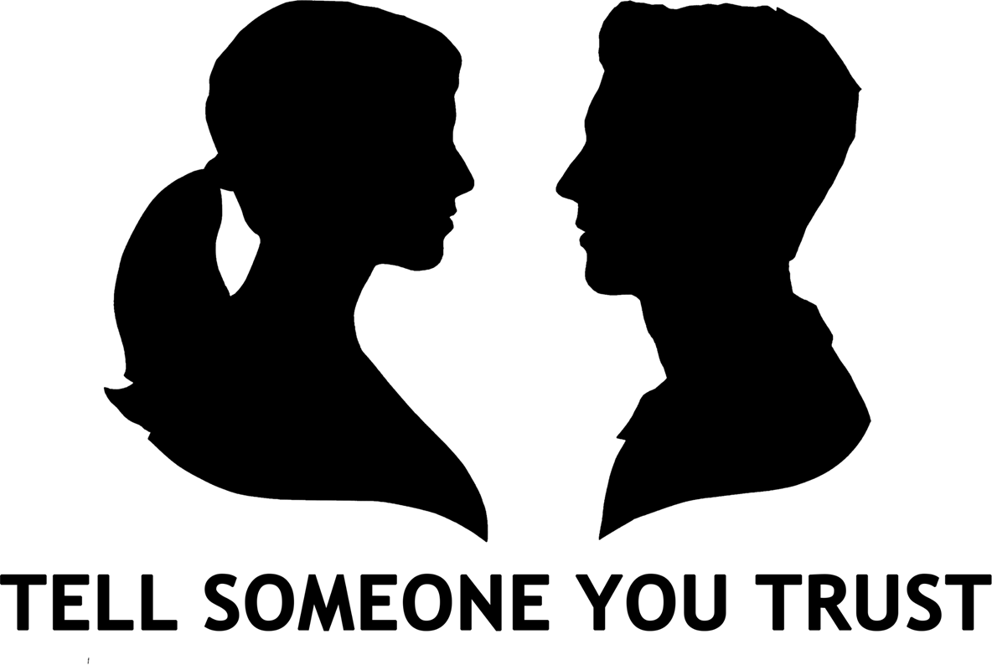

Support
If you ever need support about toxic masculinity behaviours for yourself, a friend or family member you can find it here:
Childline.org.uk
Call – 08001111
Email or chat online for support
Themix.org.uk
You can email or have one-to-chat online.
There is also a crisis messenger which is available 24/7

