Slide 1


Remember to complete all homework tasks on SAM Learning
We still use Classcharts for announcements, surveys and revision material
Homework Club every morning in West Canteen from 8am
Library is open before school and at break times
Students on the following slides have not completed ALL tasks
Make sure you are completing the SET TASKS! These are the tasks your teachers have set.

Slide 2
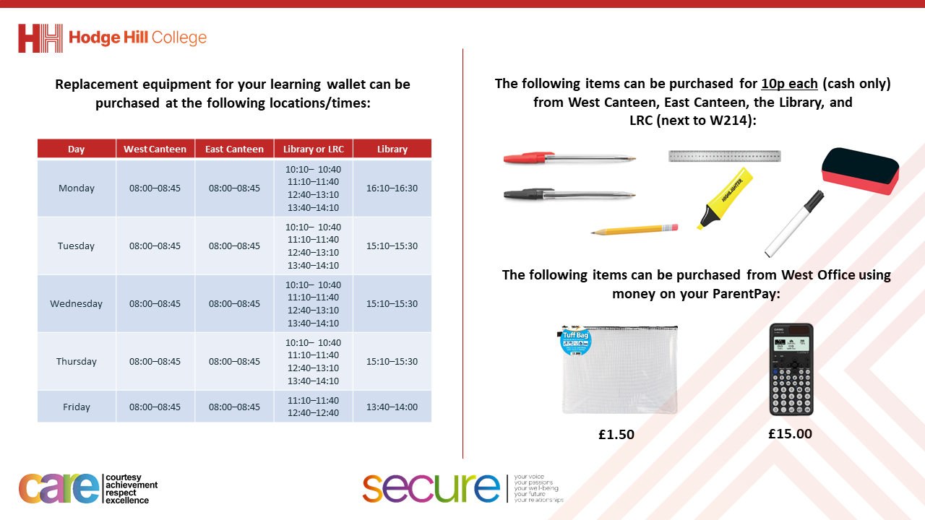

Slide 3
Thought of the Day
“Local councils are the backbone of our communities, ensuring that essential services are delivered and local voices are heard”

Slide 4


Secure your Future: Learning Journey
What is democracy?
What are laws?
How did the UK General Election work?
What does a MP do?
How does the UK Government work day to day?
What do local councils do?
Today we will look at:
What do local councils do?
This includes:
What are local councils?
Key responsibilities of a council
Decision making at the council
Please remember that during the lesson we should not be asking any pupil or teacher personal questions.
Your teacher can ask you questions but this will be to check your knowledge in the lesson.

Slide 5

Why are we learning about this?
It is important to learn about how politics works in the UK at a young age.
It is important to know what local councils do. This allows people to voice their approval or disapproval about the service provided by the local council.
You will be more knowledgeable about the local council so when you are old enough to vote you can make a more informed decision on who to vote for to represent you in the council elections.

Slide 6

Why are we learning about this?
Democracy is a British Value that means “rule by the people”. All people within local councils have been elected by people living in the council area.

Slide 7
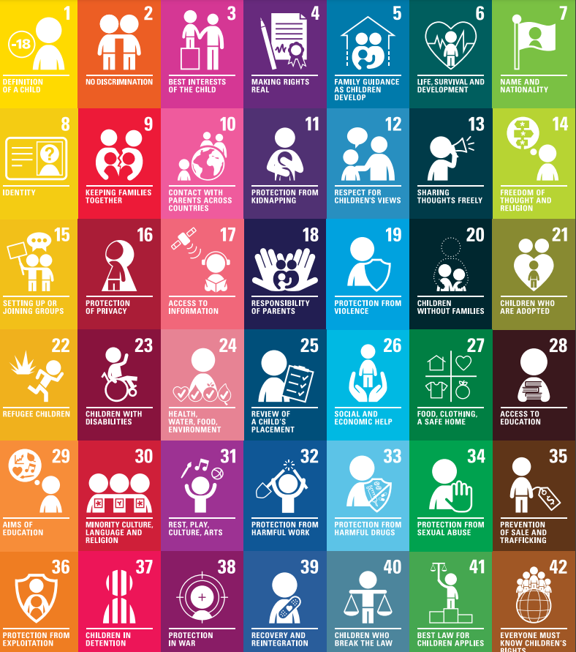
Why are we learning about this?
Local councils are a form of government so they are responsible for ensuring that any decision they make does not impact any of the rights outlined in the convention.
UN Rights
of a Child

Slide 8
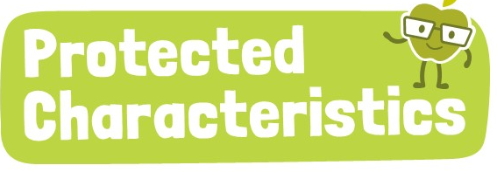
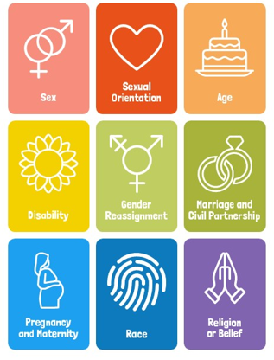
Why are we learning about this?
Any decisions made by local councils must ensure that no one is negatively impacted due to any of the protected characteristics. All decisions should ensure that all people feel safe and included.

Slide 9
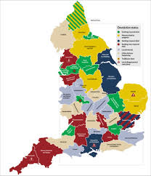

What are local councils?
Local councils are…
“the first level of government in the UK.”
Hodge Hill College is located within the Birmingham City Council area.

Slide 10
What are local councils?
Local councils…
Manage local services and facilities
Make decisions that affect daily life within a council area
Receive funding for the council area from government grants, council tax (paid by residents) and business rates (paid by businesses)

Slide 11
Key responsibilities
Key responsibilities of local councils are:
Maintain roads and street lighting
Managing rubbish and recycling collections
Running libraries, leisure centres and parks
Supporting schools and education services
Providing housing and homelessness services

Slide 12

Key responsibilities
Take out your oracy helpsheet from your learning wallet.
You have 1 minute to think about the following question:
“What responsibility do you think is most important in your local area? Why?”

Slide 13

Key responsibilities
Using your oracy helpsheet, discuss with the person next to you:
“What responsibility do you think is most important in your local area? Why?”
Remember to use the sentence starters to add, build or challenge what your partner has said.
Be ready to share your discussion with the class

Slide 14
Decision making
Councilors are elected by the public, meaning that they have to make decisions on behalf of the community.
However making these decisions can be very difficult.

Slide 15
Decision making - scenarios
Task – think about what you would do in this situation. Be ready to add, build or challenge other people’s ideas.
"Your town has a run-down park and an underfunded library. You have £50,000 to invest. What should you prioritise?"

Slide 16
Decision making - scenarios
Task – think about what you would do in this situation. Be ready to add, build or challenge other people’s ideas.
"A new housing development is planned, but it means cutting down trees in a local park. Do you cut down the trees or build the new development?”

Slide 17
Decision making - scenarios
Task – think about what you would do in this situation. Be ready to add, build or challenge other people’s ideas.
"Residents complain about potholes, but there’s also a need for more streetlights. There is only money to complete 1 complaint, what do you choose?”

