Slide 1


Remember to complete all homework tasks on SAM Learning
We still use Classcharts for announcements, surveys and revision material
Homework Club every morning in West Canteen from 8am
Library is open before school and at break times
Students on the following slides have not completed ALL tasks
Make sure you are completing the SET TASKS! These are the tasks your teachers have set.

Slide 2
Remember to complete all homework tasks on SAM Learning
We still use Classcharts for announcements, surveys and revision material
Homework Club every morning in West Canteen from 8am
Library is open before school and at break times
Students on the following slides have not completed ALL tasks
Make sure you are completing the SET TASKS! These are the tasks your teachers have set.
Notes:
Please give time for the students to produce answers for themselves before showing answers.

Slide 3
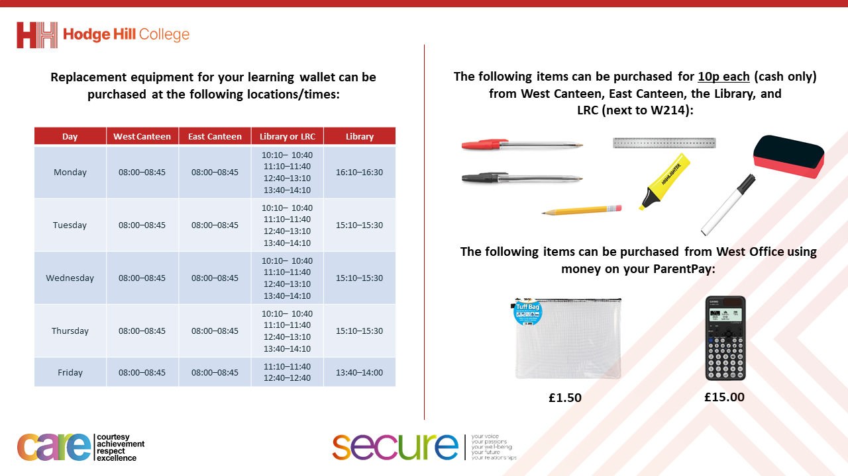

Slide 4
Thought of the Day
“A good government is one that makes the life better and fairer for all its people”
Clement Attlee (Former UK Prime Minister)

Slide 5


Secure your Future: Learning Journey
What is democracy?
What are laws?
How did the UK General Election work?
What does a MP do?
How does the UK Government work day to day?
What do local councils do?
Today we will look at:
How does the UK Government work?
This includes:
Different departments in the Government
What they do?
Please remember that during the lesson we should not be asking any pupil or teacher personal questions.
Your teacher can ask you questions but this will be to check your knowledge in the lesson.

Slide 6

Why are we learning about this?
It is important to learn about how politics works in the UK at a young age.
It is important to know who is in the government and what they do. This allows people to voice their approval or disapproval about what each government department is doing.
You will be more knowledgeable about the government so when you are old enough to vote you can make a more informed decision on who to vote for.

Slide 7

Why are we learning about this?
Democracy is a British Value that means “rule by the people”. All people within government have been elected by people living in the UK.

Slide 8

Why are we learning about this?
Article 17 states that Governments should ensure that children have a right to information. An example of this is learning about the positions of power in the UK government and understanding how they make decisions that impact your life and lives of everyone in the UK
UN Rights
of a Child

Slide 9
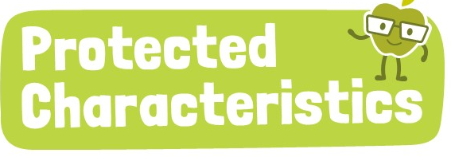
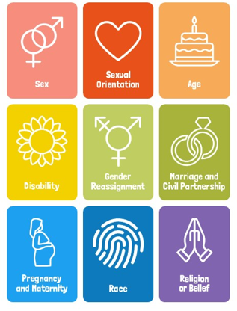
Why are we learning about this?
The decisions made by ministers in the UK Government have to ensure that none of the protected characteristics are discriminated against so everyone in the UK is treated fairly and equally

Slide 10
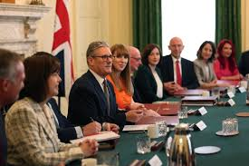
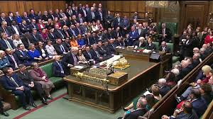
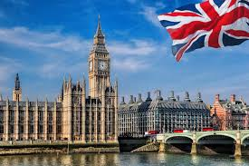
What does the UK Government do?
The UK Government is responsible for making decisions that affect everyone in the UK.
It creates and enforces law, manages public services (schools, hospitals) and ensures the safety and welfare of it’s citizens.

Slide 11
Structure of the UK Government
The UK Government achieves this through having lots of different departments.
These departments are ran by Cabinet Ministers (also known as Secretaries of State).
They are supported by ministers who will have specific roles to complete in each department

Slide 12
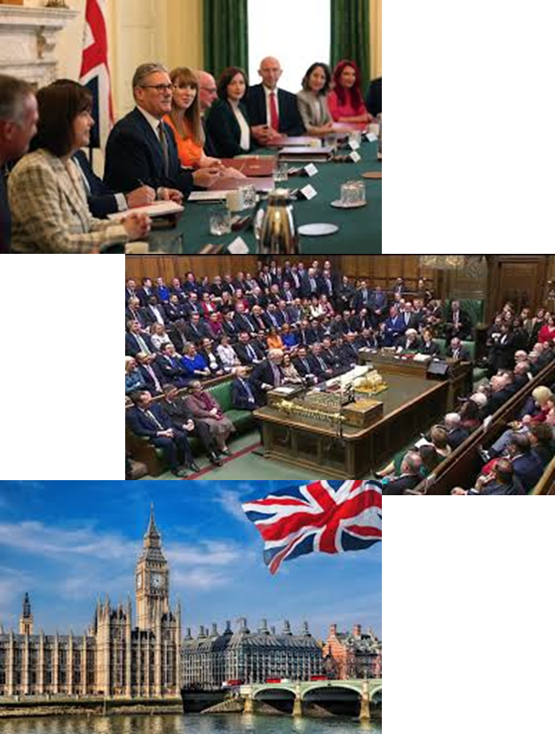
UK Government departments
Although all Government departments make decisions that will affect your lives, there are some that will have a more direct impact than others. Theses are:
Department for Education – responsible for schools
Home Office – responsible for the safety of UK citizens. They are in charge of the Police
Department for Digital, Culture, Media and Sport - in charge of anything technology based

Slide 13

UK Government departments
Take out your oracy helpsheet from your learning wallet.
You have 1 minute to think about the following question:
“If you were in charge of the Department for Education what is the first change you would make to schools?”

Slide 14

UK Government departments
Using your oracy helpsheet, discuss with the person next to you:
“If you were in charge of the Department for Education what is the first change you would make to schools?”
Remember to use the sentence starters to add, build or challenge what your partner has said.
Be ready to share your discussion with the class

Slide 15
UK Government departments
Take out your oracy helpsheet from your learning wallet.
You have 1 minute to think about the following question:
“If you were in charge of the Home Office, what is the one thing you would do to make people feel safer on the streets?”

Slide 16
UK Government departments
Using your oracy helpsheet, discuss with the person next to you:
“If you were in charge of the Home Office, what is the one thing you would do to make people feel safer on the streets?”
Remember to use the sentence starters to add, build or challenge what your partner has said.
Be ready to share your discussion with the class

Slide 17
UK Government departments
Take out your oracy helpsheet from your learning wallet.
You have 1 minute to think about the following question:
“If you worked as a minister in the Department for Digital, Culture, Media and Sport, would you support the idea of banning social media for under-16 year olds?”

Slide 18
UK Government departments
Using your oracy helpsheet, discuss with the person next to you:
“If you worked as a minister in the Department for Digital, Culture, Media and Sport, would you support the idea of banning social media for under-16 year olds?”
Remember to use the sentence starters to add, build or challenge what your partner has said.
Be ready to share your discussion with the class

