Slide 1


Remember to complete all homework tasks on SAM Learning
We still use Classcharts for announcements, surveys and revision material
Homework Club every morning in West Canteen from 8am
Library is open before school and at break times
Students on the following slides have not completed ALL tasks
Make sure you are completing the SET TASKS! These are the tasks your teachers have set.

Slide 2
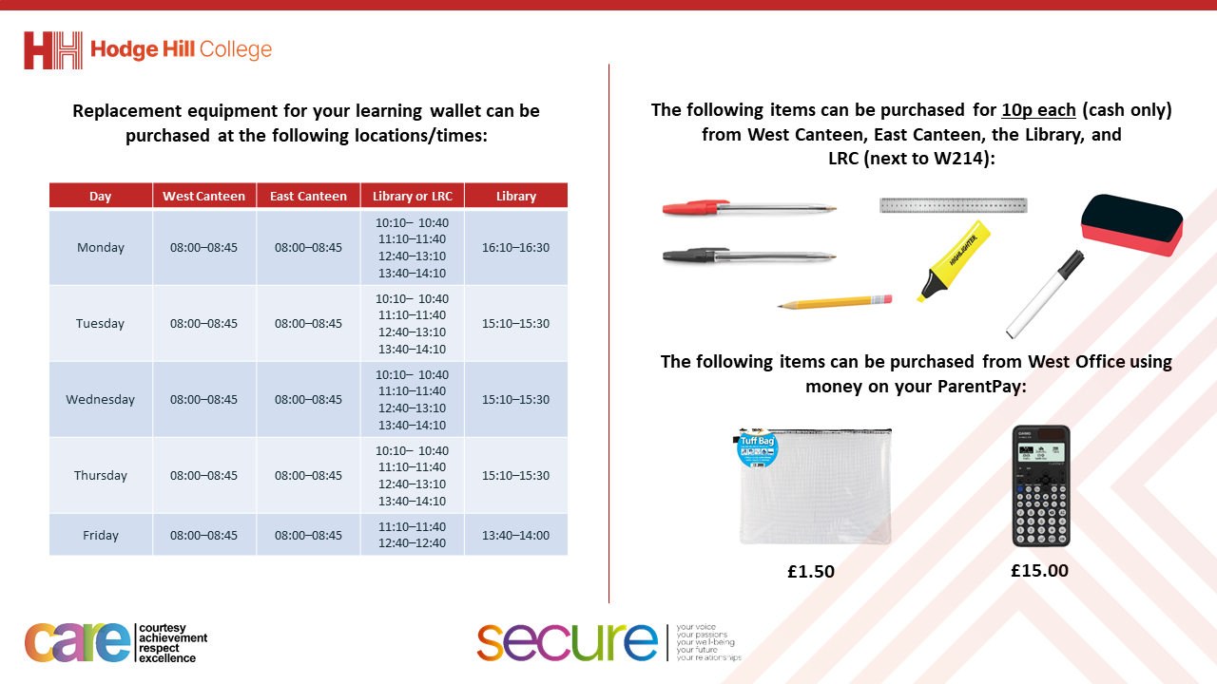

Slide 3
Thought of the Day
“Safe sex is an act of love. Love yourself enough to protect your future”

Slide 4


Secure your Relationships: Learning Journey
Risk of unprotected sex
What is intimacy without having sex?
What is sexual harassment and upskirting?
What is toxic masculinity?
Dangers of pornography
Dangers of sexting
Today we will look at:
The risks of unprotected sex
This includes:
What is unprotected sex
Risks of unprotected sex
How to reduce theses risks
Please remember that during the lesson we should not be asking any pupil or teacher personal questions.
Your teacher can ask you questions but this will be to check your knowledge in the lesson.

Slide 5
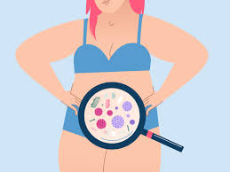
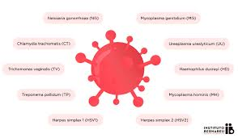

What is unprotected sex?
Unprotected sex is…
“sex without using any type of contraception.”

Slide 6




Why are we learning about this?
This links to the Golden Thread of “Secure your Relationships“
Although this may not seem relevant to you right now, it is important to know the risks of unprotected sex so you can make an informed choice when you are ready to begin having an intimate relationship with a partner. This knowledge will keep you and your partner safe.

Slide 7

Why are we learning about this?
Article 34 of the UN Rights of a Child states that governments should protect children from sexual exploitation. This is why there are laws around the legal age to have sex (16 years old). The law also states that anyone over the age of 16 is breaking the law if they have a sexual relationship with a person under 16 years old.
UN Rights
of a Child

Slide 8
Risks of unprotected sex
There are 2 main risks associated with having unprotected sex:
Unwanted pregnancy
Contracting/transmitting STI’s (sexually transmitted infections)

Slide 9
Unwanted Pregnancy
Unwanted pregnancy is…
“pregnancy that occurs without planning or intention”

Slide 10
Unwanted Pregnancy
The impacts of unwanted pregnancy are:
1. Emotional and mental health challenges – there is an increased risk of anxiety and stress of young people who have an unwanted pregnancy. One reason for this is the potential embarrassment of “bringing shame” onto the family

Slide 11
Unwanted Pregnancy
The impacts of unwanted pregnancy are:
2. Education and career impacts – due to the pressures of parenthood, people may not complete school, college or apprenticeship which can limit potential career opportunities in the future

Slide 12
Unwanted Pregnancy
The impacts of unwanted pregnancy are:
3. Financial pressures – Raising a child is expensive. For teenagers, much of this expense falls on their families who had not budgeted for raising another child.

Slide 13
Sexually Transmitted Infections
STI stands for “sexually transmitted infection”
One of the main ways that STI’s are spread is through unprotected sex.
STI’s are not just spread through vaginal sex but also through oral and anal sex.

Slide 14
Sexually Transmitted Infections
Common STIs are:
Chlamydia
Gonorrhea
HPV
Herpes
Genital warts
Syphilis

Slide 15
Sexually Transmitted Infections
Risks include:
Discomfort or pain when using the toilet or having sex
Rashes or sores appearing on genitals
Longer term risks if STIs are left untreated are infertility and chronic pain

Slide 16
How to avoid these risks
The best way for a person to protect themselves from these risk is to use contraception when having sex.
There are many types of contraception…

Slide 17
How to avoid these risks
Condoms – a barrier method of contraception that is worn over the penis. This reduces the risk of unwanted pregnancy and STIs
Contraceptive pill – a hormonal method of contraception where the female has to take a daily pill. This reduces the risk of unwanted pregnancy but not STIs
Contraceptive implant – a hormonal method of contraception where a small plastic rod is placed under the skin of the female. This reduces the risk of pregnancy but not STIs.

Slide 18



Support
Support around anything discussed today support is available:
Umbrellahealth.co.uk
This provides a safe way to find the closest sexual health in Birmingham
Themix.org.uk
You can email or have one-to-chat online.
There is also a crisis messenger which is available 24/7

