Slide 1


Remember to complete all homework tasks on SAM Learning
We still use Classcharts for announcements, surveys and revision material
Homework Club every morning in West Canteen from 8am
Library is open before school and at break times
Students on the following slides have not completed ALL tasks
Make sure you are completing the SET TASKS! These are the tasks your teachers have set.

Slide 2
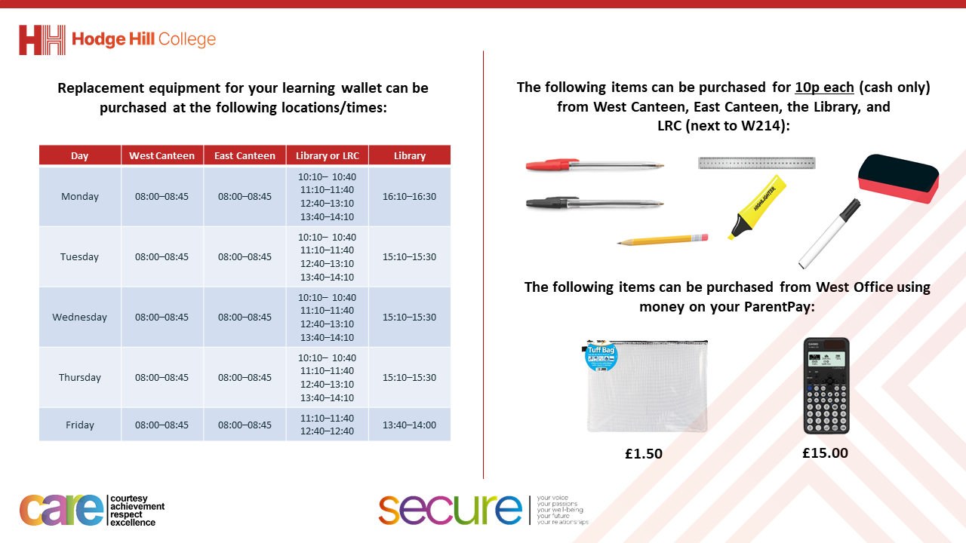

Slide 3
Thought of the Day
“Your vote is your voice”
Laung Ung

Slide 4


Secure your Future: Learning Journey
What is democracy?
What are laws?
How did the UK General Election work?
What does a MP do?
How does the UK Government work day to day?
What do local councils do?
Today we will look at:
How did the UK General Election work?
This includes:
What are constituents and constituencies
What voting system was used
Results of the General Election
Please remember that during the lesson we should not be asking any pupil or teacher personal questions.
Your teacher can ask you questions but this will be to check your knowledge in the lesson.

Slide 5

Why are we learning about this?
It is important to learn about how politics works in the UK at a young age.
Despite you not being old enough to vote, it is important to learn about this now so that when you are 18 you are equipped with the knowledge and understanding to vote for a political party that has the same beliefs and values as you

Slide 6

Why are we learning about this?
Democracy is a British Value that we learn about before half term. This mean “rule by people” as this happens by people being able to freely vote for a political party to represent them in Government

Slide 7

Why are we learning about this?
Article 12 states that Governments should have respect for children’s views. Although children cannot vote, they still have the human right to have their opinions and voices heard and taken seriously. An example of how this happens in the UK is the UK Youth Parliament which gives young people access to the policy making process to be the voice of young people in the UK.
UN Rights
of a Child

Slide 8

What can you remember?
Before the summer holidays you learnt about the General Election.
You have 1 minute to think about what you can remember about the General Election

Slide 9
What can you remember?
Using your oracy helpsheet, with the person next to you, discuss what you can remember learning about the General Election.
Remember to use the sentence starters to add, build or challenge what your partner has said.
Be ready to share your discussion with the class

Slide 10
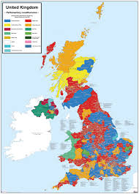
How elections work
During elections, people (known formally as constituents) vote for a person to represent their local area (known formally as a constituency) in Government.
There 650 constituencies in the UK.

Slide 11
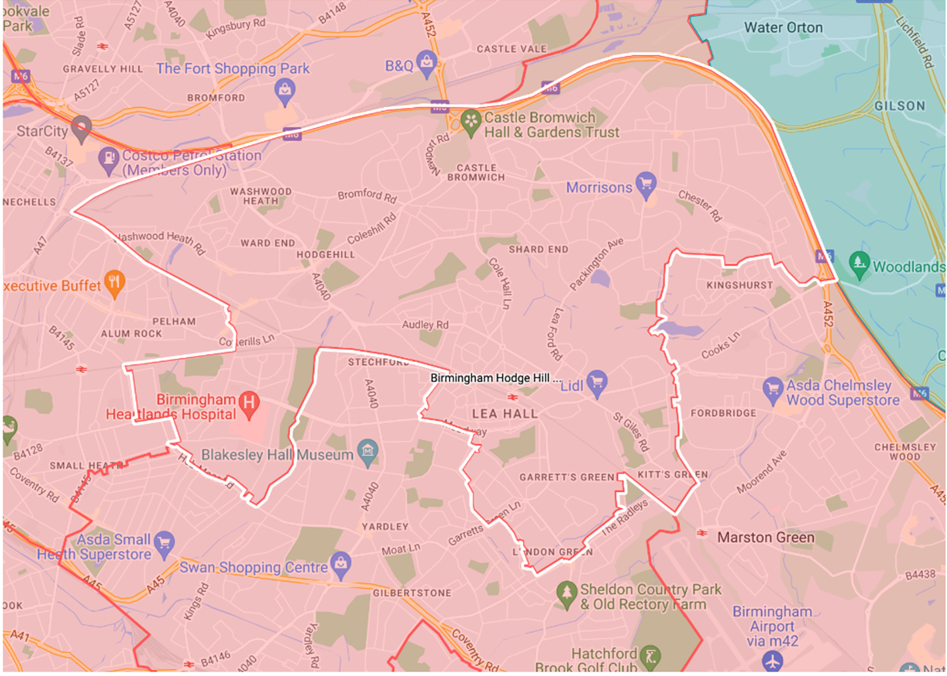
What is our constituency?
Hodge Hill College is part of the “Hodge Hill and North Solihull” constituency.
The General Election in July 2024 was the first time this constituency existed, after constituency borders were changed after the previous General Election in 2019.
The constituency borders are shown by the white line.

Slide 12
Who could people vote for?
In the Hodge Hill and North Solihull constituency people could vote for the following candidates:
Liam Byrne, Labour Party
Caroline Clapper, Conservatives
Qasim Esak, Liberal Democrats
Imran Khan, Green Party
Jamie Pullin, Reform UK
James Giles, Workers Party for Britain
The winning candidate was Liam Byrne from the Labour Party with 31.2% of the vote

Slide 13
Who won the election?
You have 1 minute to think about the following question
“who won the majority of votes in the General Election?”

Slide 14
Who won the election?
Using your oracy helpsheet, with the person next to you, discuss your response to the following question:
“who won the majority of votes in the General Election?”
Remember to use the sentence starters to add, build or challenge what your partner has said.
Be ready to share your discussion with the class

Slide 15

What were the General Election results
Labour won the vote in 412 constituencies.
This meant that they won the majority of seats available in Parliament so they now have 412 MP’s.
This also meant that the Labour Party Leader, Sir Keir Starmer, became Prime Minister and replaced Rishi Sunak.

Slide 16
What voting system was used
The voting system used in the UK is called “first past the post”
This means that people can chose their preferred candidate in their constituency. The candidate with the majority of the vote then wins.
In order to form the Government with a majority, a political party needs to win 326 constituencies. Labour won 412 constituencies which is why the could form the UK Government. The second biggest political party was the Conservatives with 121

Slide 17
What were the General Election results
If results are looked at differently, Labour won 33.7% of all votes made in the General Election.
Conservatives won 23.7% of all the votes made in the General Election.
Despite this Labour won over 3 times as many constituencies and therefore have over 3 times the amount of MP’s in Parliament

Slide 18

Election result
You now have 1 minute to think about the question:
“Do you think this is a fair system to count the votes?”

Slide 19
Election results
Using your oracy helpsheet, discuss with the person next to you the question:
“Do you think this is a fair system to count the votes?”
Remember to use the sentence starters to add, build or challenge what your partner has said.
Be ready to share your discussion with the class

