Slide 1


Remember to complete all homework tasks on SAM Learning
We still use Classcharts for announcements, surveys and revision material
Homework Club every morning in West Canteen from 8am
Library is open before school and at break times
Students on the following slides have not completed ALL tasks
Make sure you are completing the SET TASKS! These are the tasks your teachers have set.
Notes:
Please give time for the students to produce answers for themselves before showing answers.

Slide 2
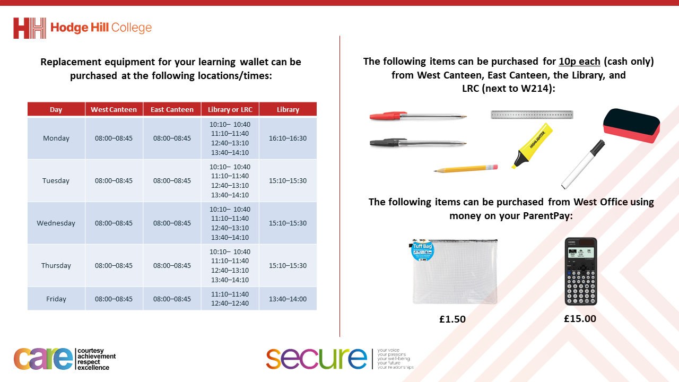

Slide 3
Thought for the Day
“The greatest public health victory of the 20th century is vaccines”
Paul Offit

Slide 4


Slide 5


Secure your Future: Learning Journey
What is mental health?
What is stress?
What influences your decisions?
What is addiction?
Why are vaccines important?
What health checks should you do?
Today we will look at:
Why vaccines are important
This includes:
What are vaccines
Why they matter
Why people might not get vaccinated
Please remember that during the lesson we should not be asking any pupil or teacher personal questions.
Your teacher can ask you questions but this will be to check your knowledge in the lesson.

Slide 6

What are vaccines?
With the person next to you discuss the following question
“What are vaccines? Do you know of any vaccines?
Be ready to share your discussion with the class

Slide 7
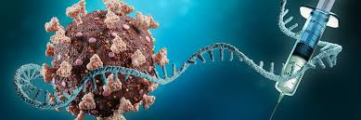
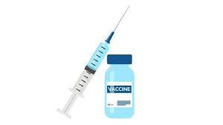
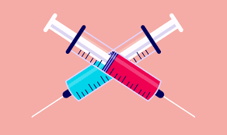
What are vaccines
The definition of vaccines is…
“a substance that helps the body’s immune system recognize and fight harmful organisms like bacteria and viruses. They help the immune system learn how to defend itself against them without causing illness”

Slide 8
Why vaccines matter
Vaccines matter because:
They prevent dangerous diseases and reduce the speed of infection, protecting both individuals and entire communities
They save lives by preventing severe diseases that might cause long term health issues or death

Slide 9

How do vaccines work?
Notes:
https://www.youtube.com/watch?v=-muIoWofsCE

Slide 10
Successful vaccines
There have been many successful vaccine roll outs in the UK and across the world.
Polio vaccine – this used to paralyse thousands of children globally. A vaccine was introduced in 1955 and since polio has been reduced by over 99%
HPV – this virus can cause cervical cancer. Since the HPV vaccine was introduced, the rates of infection have dropped significantly which will help prevent cancer developing later in life
Smallpox – this is a deadly disease which killed millions of people. A worldwide vaccination programme meant that smallpox was eradicated by 1980.

Slide 11
Why might people not get vaccinated?
With the person next to you discuss the following question
“why might people not get vaccinated?”
Be ready to share your discussion with the class

Slide 12
Why people might not get vaccinated?
Some reasons why people might not get vaccinated are:
Fear of side effects – people might worry about side effects like a mild fever or soreness at the injection site. However these are normal reactions and it is rare that severe reactions happen due to receiving a vaccine
Religious/Cultural beliefs – some communities have beliefs that discourage vaccination. These beliefs are often rooted in specific traditions or fears about how vaccines are made

Slide 13
Why people might not get vaccinated?
The other main reason is misinformation.
This is false information that has spread through media outlets (including social media). One common myth is that vaccines can cause autism.
However this has been scientifically debunked many times

Slide 14
Why people might not get vaccinated?
One vaccine that has suffered misinformation spreading and reducing vaccination numbers is the MMR (measles, mumps and rubella) vaccine. Measles in particular was a major cause of childhood death, meaning that vaccination is very important

Slide 15
Why people might not get vaccinated?
This misinformation has been so impactful that in September 2024, NHS figures showed that 1 in 6 5 year olds had not received both doses of the vaccine.
This is important as earlier in 2024, there was a reported measles outbreak in the UK with 465 cases reported.
71% of these cases were reported in the West Midlands

Slide 16
Why might people not get vaccinated?
With the person next to you discuss the following question
“why is it important to rely on scientific evidence rather than rumours or myths when it comes to health?”
Be ready to share your discussion with the class

Slide 17

Support
If you want any additional advice on vaccines, please speak to your AC/AAC or a member of SLT and they can signpost you to more advice

