Slide 1
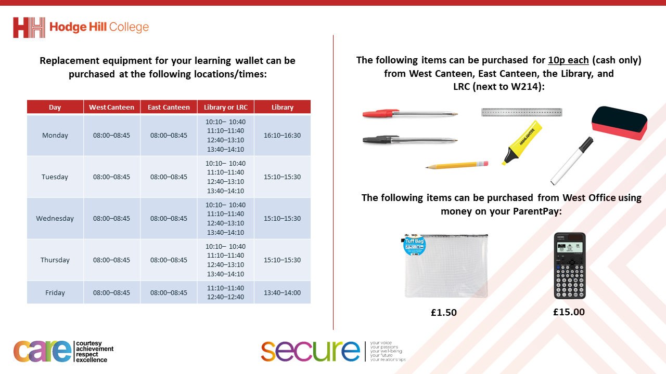

Slide 2
Thought for the Day
“Take care of your body. It’s the only place you have to live”
Jim Rohn

Slide 3


Slide 4


Secure your Future: Learning Journey
What is mental health?
What is stress?
What influences your decisions?
What is addiction?
Why are vaccines important?
What health checks should you do?
Today we will look at:
What health checks should be completed?
This includes:
Are health checks?
Examples of health checks
Advice if you think something is not right
Please remember that during the lesson we should not be asking any pupil or teacher personal questions.
Your teacher can ask you questions but this will be to check your knowledge in the lesson.

Slide 5

What are vaccines?
With the person next to you discuss the following question
“what are health checks? Do you know of any health checks?
Be ready to share your discussion with the class

Slide 6

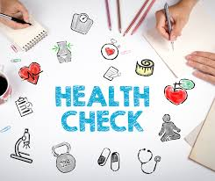
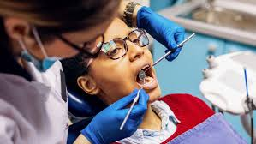
What are health checks
The definition of health checks is…
“an examination to determine whether a person is suffering from illness or injury”

Slide 7
Why are health checks important?
Health checks are important for various reasons:
Catch problem early – many health issues start small and can be easier to treat if caught early
Build healthy habits – Regular checks help people stay connected with their bodies
Feel more confident - People can gain self assurance knowing that they are taking care of their health

Slide 8
Why are health checks important?
These reasons show the importance of health checks.
It is also important to remember that if a person does find anything they find unusual to contact a doctor, GP or dentist straight away.
This will allow a medical professional to diagnose, as it could be that there is nothing wrong at all.

Slide 9
Who completes the health check?
Depending on the type of health check being completed will determine who will complete it.
The process is normally:
Complete a self check up (if possible)
If unsure about something contact a health professional (doctor, GP, dentist)
The health professional will complete the health check again

Slide 10
General Health Checks for everyone
Check your skin – look out for new moles, spots or any changes in colour (that can’t be explained by being in the sun) or texture. This is an important check as changes in skin can sometimes be a sign of a health issue like infections or skin cancer
This can be difficult so it is recommended to use a mirror or ask a parent/carer to help with hard to see areas like the back

Slide 11
General Health Checks for everyone
2. Check your teeth and gums – when brushing teeth, the person should look in the mirror at their gums and teeth to check for any redness or swelling. If there is blood in the spat out toothpaste, this could be a sign of gum disease or an infection.
To protect against this a person should visit the dentist every 6 months for a check up. It is worth remembering that children get free NHS dental treatment.

Slide 12
General Health Checks for everyone
3. Check your poo – although this sounds strange, poo can tell a person a lot about their health. Unusual changes could be a sign of problems like infections or even bowel cancer (although this is rare at a young age)
Things to look out for include:
Black or very dark stools which can indicate bleeding in the bowel
Red stools may also be a sign of blood
Long term diarrhoea or constipation
This health check can be completed very quickly by taking a quick look before flushing – it does not need a close examination!

Slide 13
General Health Checks for females
There are specific health checks for females:
Breast self-examination
  Early detection of lumps can be key in preventing breast cancer, even though this is rare at a young age
  When completing this check, a person is feeling or looking for any unusual lumps, swelling or changes in colour or shape
Skin and Hair health
  Any excessive hair loss, dry patches of skin or scalp issues can be a sign of stress, hormonal changes or nutritional deficiencies

Slide 14
General Health Checks for males
There are specific health checks for females:
Testicular self examination
  Similar to why it is important that females check their breasts, it is important that males check their testicles for any unusual lumps, swelling or changes in size and shape. Although it is rare in young people, lumps may be an early sign of testicular cancer. It is best to complete this check in the shower or bath when the skin is relaxed

Slide 15
What if you find something unusual
Don’t panic – most changes are serious, especially at a young age but…
Don’t ignore it – don’t wait to long to tell someone that you trust (parent/carer, teacher, family member) or book an appointment with the GP/dentist. Early detection is always better, even if it turns out to be nothing serious.
Keep track – write down any changes such as how long it has been happening or if it gets worse. This can help the doctor understand the situation better

Slide 16
Never be embarrassed
Although it may feel awkward, talking about the body and checking certain areas, it is important to know that this is a normal part of taking care of your health.
Health checks show you’re being responsible for your own body and well being and talking openly about health will make it easier to take action if something’s wrong.

Slide 17
Never be embarrassed
Never be embarrassed about going to see a GP/doctor/dentist. They are trained to help people with their bodies. They have seen it all before and their job is t keep people healthy, not judge them.
Ignoring something because of embarrassment can lead to bigger problems down the line, so it is better to have that chat sooner rather than later if you are worried

Slide 18

Support
If you want any additional advice on health checks, please speak to someone that you trust. This can be a parent/carer, any member of staff in school or a health professional.

