Slide 1


Homework Reminders:
We still use Classcharts for announcements, surveys and revision material
Homework Club every morning in West Canteen from 8am
Library is open before school and at break times
Make sure you are completing the SET TASKS! These are the tasks your teachers have set.
Complete all tasks with a due date of 11th November onwards first!
Notes:
Please give time for the students to produce answers for themselves before showing answers.

Slide 2


Slide 3
Thought of the Day
“The law is the framework within which all freedoms are protected”
William Blackstone

Slide 4


Secure your Future: Learning Journey
What is democracy?
What are laws?
How did the UK General Election work?
What does a MP do?
How does the UK Government work day to day?
What do local councils do?
Today we will look at:
What are laws
This includes:
Definition of laws
Examples of laws
Consequences of not following laws
Please remember that during the lesson we should not be asking any pupil or teacher personal questions.
Your teacher can ask you questions but this will be to check your knowledge in the lesson.

Slide 5

Why are we learning about this?
Rule of Law is a British Value. There are many laws in the UK. All of these laws are designed to ensure that everyone in the UK feels safe and is treated equally.

Slide 6

Why are we learning about this?
Article 41 states that the best law applies for children. This means that if the law of a country protects children’s rights better than the UN Rights of a Child, these laws should be used. This means that children rights have the highest amount of protection.
UN Rights
of a Child

Slide 7

What are laws?
Take out your oracy helpsheet from your learning wallet.
You have 1 minute to think about the following question:
“What are laws?”

Slide 8
What are laws?
Using your oracy helpsheet, with the person next to you, discuss your response to the question:
“What are laws?”
Remember to use the sentence starters to add, build or challenge what your partner has said.
Be ready to share your discussion with the class

Slide 9


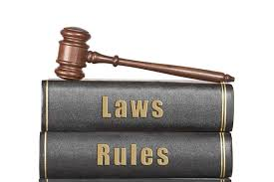
What are laws?
Laws are…
“official rules created by government to maintain order, safety and justice”
Laws help create predictability and ensure safety. They also provide a fair system where everyone knows the consequences of breaking the law.

Slide 10
Examples of laws
Take out your oracy helpsheet from your learning wallet.
You have 1 minute to think about the following question:
“What laws do you know?”

Slide 11
What are laws?
Using your oracy helpsheet, with the person next to you, discuss your response to the question:
“What laws do you know?”
Remember to use the sentence starters to add, build or challenge what your partner has said.
Be ready to share your discussion with the class

Slide 12
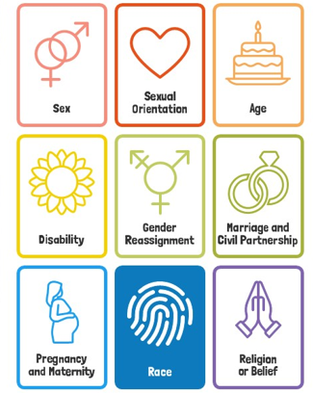
Examples of Laws
An example of the law is the Equality Act 2010.
This outlines 9 protected characteristics.
This law was created to ensure everyone is treated equally. An example of this is that employers cannot refuse to hire someone based on their background.

Slide 13
Examples of Laws
Other examples of laws are:
The malicious communications act 1988. Even though this law was designed before social media, it prevents harmful or hateful things being said online
Traffic laws – such as speed limits, following signals and what age you have to be to drive
Every child in the UK has to legally attend education until aged 18.
Age limits to buy certain products such as alcohol, vapes/cigarettes, lottery tickets

Slide 14
Consequences of not following laws
Take out your oracy helpsheet from your learning wallet.
You have 1 minute to think about the following question:
“What are the consequences of not following the law?”

Slide 15
Consequences of not following laws?
Using your oracy helpsheet, with the person next to you, discuss your response to the question:
““What are the consequences of not following the law?”
Remember to use the sentence starters to add, build or challenge what your partner has said.
Be ready to share your discussion with the class

Slide 16
Consequences of not following laws
It is important to have consequences for those who do not follow laws.
Consequences exist to prevent people from breaking the law, maintain safety and show that society values fairness
Without consequences, laws would not be respected and society would become unsafe and unfair.
This system is also followed regarding consequences of not following school rules.

Slide 17
Consequences of not following laws
Depending on how a person breaks the law depends on their consequence. Consequences include:
1. Fines – this is often for offences such as littering or speeding

Slide 18
Consequences of not following laws
Depending on how a person breaks the law depends on their consequence. Consequences include:
2. Community service – people must complete tasks that benefit the community. This is for less severe law breaking

Slide 19
Consequences of not following laws
Depending on how a person breaks the law depends on their consequence. Consequences include:
3. Probation – some people may have to report to a probation officer or wear a tracking device. This can also limit where a person can go and when they can go outside their home. This is for more severe law breaking.

Slide 20
Consequences of not following laws
Depending on how a person breaks the law depends on their consequence. Consequences include:
4. Imprisonment – This is for the most serious law breaking. This is when a person goes to prison.

Slide 21
Consequences of not following laws
Take out your oracy helpsheet from your learning wallet.
You have 1 minute to think about the following question:
“What consequence do you think is most effective? Why?”

Slide 22
Consequences of not following laws?
Using your oracy helpsheet, with the person next to you, discuss your response to the question:
“What consequence do you think is most effective? Why?”
Remember to use the sentence starters to add, build or challenge what your partner has said.
Be ready to share your discussion with the class

