Slide 1


Remember to complete all homework tasks on SAM Learning
We still use Classcharts for announcements, surveys and revision material
Homework Club every morning in West Canteen from 8am
Library is open before school and at break times
Students on the following slides have not completed ALL tasks
Make sure you are completing the SET TASKS! These are the tasks your teachers have set.
Notes:
Please give time for the students to produce answers for themselves before showing answers.

Slide 2
Nawaz, Aaila
Khalid, Abaan
Noor, Abdirahman
Ghanem, Adel
Osman, Aisha
Sheraz, Aleena
Irfan, Aleeza
Jabeen, Alishba
Kanwal, Anam
Hussain, Armaan
Manu, Christabel
Stan, Elisei
Tubb, Finlay
Muhammad, Furqan
Haroon, Hamza
Islam, Hamzah
Yousefi, Helal
Hussain, Hurais
Mumtaz, Inayah
Rivers, Jayden
Following students have not competed their MATHS Homework that was due on Monday 21st October. This needs to be completed as soon as possible and all other set tasks.
Students will be put into a detention if they continue to not complete homework and phone calls will be made to parents.
Khan, Charagh
Ursu, David
Majid, Essa
Mohamud, Fatima-Sahra
Hussain, Haris
Ahmed, Hasan
Siddique, Ibrahim
El Ghadfa, Ilyas
Hussain, Isaac
Tashfin, Maryam
Eesa, Mohammed
Hussain, Mohammed
Hussain, Mohammed
Ismail, Mohammed
Chaudhry, Noor-Ul-Huda
Yasin, Sohaib
Ali, Uzayr
Khan, Yunus
Khan, Zain
Khan, Arian
Hussain, Maleeha
Ghanem, Mahmoud
Saddique, Mariam
Lazar, Melin
Hussain, Misbah
Khan, Mohammad
Isa, Mohammed
Sami, Mohammed
Lazar, Nicoleta-Andreea
Younis, Robas
Qashif, Sabah
Hussain, Sameer
Akanji, Samira
Hussain, Taneem
Khan, Yusuf
Khan, Zayyan
Baicu, Stefania
Fatimah, Zunaira
Mitchell, Louis

Slide 3
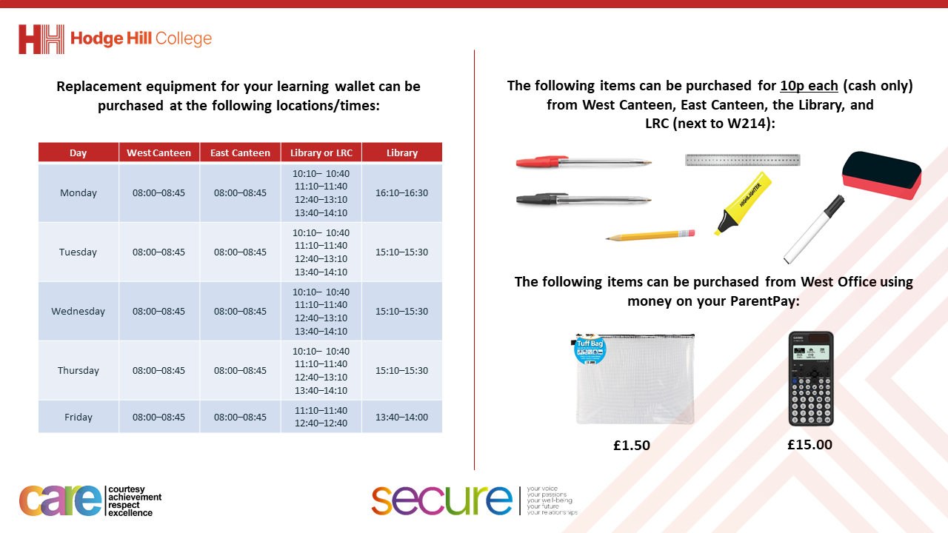

Slide 4
Thought of the Day
“We are stronger together. In a democracy, every voice matters”

Slide 5




Slide 6
Secure your Future: Learning Journey
What is democracy?
What are laws?
How did the UK General Election work?
What does a MP do?
How does the UK Government work day to day?
What do local councils do?
Today we will look at:
What is democracy?
This includes:
Definition of democracy
Democracy in the UK
Quiz
Please remember that during the lesson we should not be asking any pupil or teacher personal questions.
Your teacher can ask you questions but this will be to check your knowledge in the lesson.

Slide 7

What is democracy?
Using your oracy helpsheet, discuss with the person next to you:
“What is democracy? Where have you heard the term before?”
Remember we are sharing our ideas to the class and following all the advice on the oracy helpsheet.

Slide 8


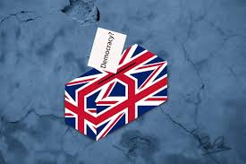
What is democracy?
Democracy is..
“rule by the people”
This means that in countries that follow democracy, the people elect the government and have a say in how the country is run.
This means that it is a fair system that ensure everyone in that country has a voice

Slide 9

What is democracy?
Watch the video to learn more about democracy
Notes:
https://www.youtube.com/watch?v=u6jgWxkbR7A

Slide 10
Democracy in the UK
Democracy is a British Value.
This means in the UK there is a culture built upon freedom and equality, where everyone is aware of their rights and responsibility.
This is why British Values, URC Children Rights and Protected Characteristics are included in our news discussions in Tutor Time.

Slide 11
Democracy in the UK
Examples of democracy in the UK:
1. Parliament – The UK has a Parliament with 2 houses – the House of Commons and the House of Lords. They are responsible for lots of things but they also help to make laws that keep everyone in the UK safe

Slide 12
Democracy in the UK
Examples of democracy in the UK:
2. Prime Minister – The leader of the Government is the Prime Minister. This is the leader of the political party that has the most Members of Parliament (MPs)

Slide 13
Democracy in the UK
Examples of democracy in the UK:
3. Members of Parliament (MP’s) – These are people elected to represent their local areas (called constituencies) in the House of Commons

Slide 14
Democracy in the UK
Examples of democracy in the UK:
4. Local Councils – In addition to national government, there are local councils that make decisions for the towns and cities within their council area. Members of the council are also elected.

Slide 15
Hinge Questions – whiteboard activity
3
Rules!
I will ask the question and give you some thinking time. (no more than 10 seconds)
Write the answer and turn your whiteboard over so nobody can see it.
When I am ready I will put on the 3 to 1 counter.
When ‘Show me’ appears on the board you must hold up your whiteboard (even if you don’t know the answer and there is nothing on your board)
2
1
Show me!
(even if your whiteboard is blank)

Slide 16
Hinge Questions – whiteboard activity
What democratic votes happened this year in the West Midlands?
Local council votes including electing the Mayor of West Midlands
General Election to vote on what political party runs the Government

Slide 17
Hinge Questions – whiteboard activity
Who is the Mayor of West Midlands?
Richard Parker

Slide 18
Hinge Questions – whiteboard activity
What political party is in charge of the government?
Labour

Slide 19
Hinge Questions – whiteboard activity
Who is the UK Prime Minister?
Sir Keir Starmer

Slide 20
Hinge Questions – whiteboard activity
Who was the previous UK Prime Minister?
Rishi Sunak

Slide 21
Hinge Questions – whiteboard activity
Where are the Houses of Parliament in the UK?
Westminister, London

Slide 22
Hinge Questions – whiteboard activity
Where does the Prime Minister live in London?
10 Downing Street

