Slide 1




Tutor Notice
Homework will start being set on Monday 9th September.
You will go on to SAM Learning and click on Set Tasks to see all your tasks.
You will receive Homework on a weekly basis so you need to log in and complete work every week.
If you need help or access to a computer/device there is:
Homework Club every morning in West Canteen from 8am onwards.
Library computers available every break time and afterschool
You still need to be logging in to Classcharts as your teachers may send announcements out on there or attach revision material for upcoming assessments.
All log in details can be found on your Attainment cards in your passports.
Any issues please come see Mrs Shaheen in W309
Notes:
https://www.youtube.com/watch?v=QYmr9pVtryo

Slide 2


Slide 3
Secure your Future: Learning Journey
What is mental health?
What stress will I have this year?
Hope to cope with stress?
What healthy habits should I have this year?
How can I manage my time effectively?
Should I have a revision timetable now?
Today we will look at:
What is mental health?
This includes:
Definition of mental health?
Difference between mental health and mental illness
Ways to improve mental health?
Please remember that during the lesson we should not be asking any pupil or teacher personal questions.
Your teacher can ask you questions but this will be to check your knowledge in the lesson.

Slide 4
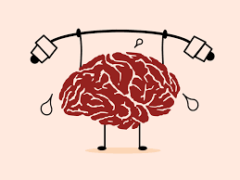
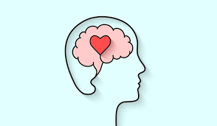

What is mental health?
With the person next to you discuss the following question
“what is mental health?”
Be ready to share your answers with the class

Slide 5
What is mental health?
The World Health Organisation (WHO) say…
“mental health is a state of mental well being that enables people to cope with the stresses of life, realise their abilities, learn well and work well and contribute to their community”

Slide 6
What is mental health?
Mental health is not just when people are feeling down. People have mental health when they are feeling good.
Mental health is something everyone has and it impacts everyone, everyday.

Slide 7

What is mental health?
Notes:
https://www.youtube.com/watch?v=DxIDKZHW3-E playing from beginning to 4.50

Slide 8
What is the difference between mental health and mental illness?
People often confuse mental health and mental illness.
Everyone has mental health but not everyone has mental illness
Mental illness can include things like depression, eating disorders, mood disorders and anxiety. These things affect a persons ability to function over a long period of time. They also need to be diagnosed by a trained professional.
When a person is suffering from poor mental health one day, it does not mean that they have a mental illness. This is because it is not over a long period of time.

Slide 9
How to have good mental health
Studies have shown that there are a number of things that can help you have good mental health.
With the person next to you discuss what these might be.

Slide 10
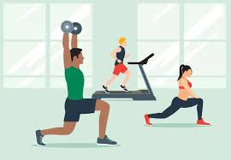
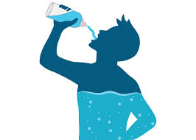
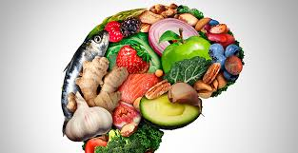


How to have good mental health
Studies have shown that there are a number of things that can help you have good mental health.
Exercise
Stay hydrated
Eat healthy food
Do things that make you happy
Speak to people in person to feel connected. Speaking online is not as effective

Slide 11



Support
If you ever need support about mental health for either yourself or a friend/family member, you can get support from the following places
Childline.org.uk
Call – 08001111
Email or chat online for support
Themix.org.uk
You can email or have one-to-chat online.
There is also a crisis messenger which is available 24/7

