Slide 2
Write the date: 15 April 2024
Write the title: What are STI’s?
Underline both!
Complete the do now task:
True or False – Consent cannot be withdrawn
2. Give an example of cyberbullying
3. What does E stand for in the BED principle?
False – consent can be withdrawn at any time
Spreading lies/rumours online, posting videos/photos of other people without their permission, sending abusive messages to people, impersonating someone online
Bedroom environment

Slide 4
Big question: How can I secure my relationship through knowing what STI’s are?
Today we will look at:
What does STI stand for?
Different types of STI’s?
How STI’s are spread
Ways of reducing the risk of contracting a STI

Slide 5
What is our starting point?
In your books, complete the following sentence
At the start of the lesson I think STI stands for…
An STI I have heard of is…

Slide 6
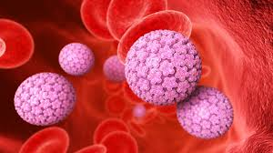
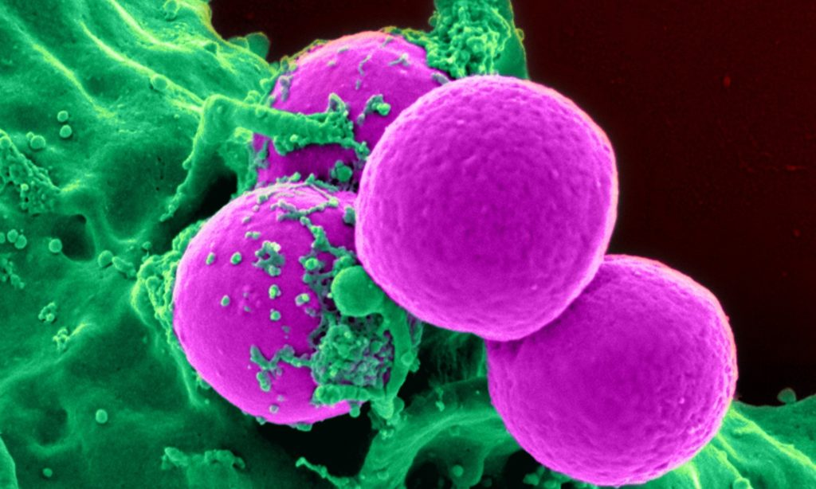
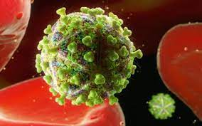
What is a STI?
STI stands for “sexually transmitted infection”

Slide 7
Important things to know about STI’s
Is normally passed from person to person when having any form of sex
You do not need to have lots of sexual partners to get a STI
Both men and women can pass on STI’s

Slide 8
What are the names of STI’s?
The World Health Organisation lists more than 30 STI’s on their guidance
Turn and Talk
What STI’s do you know?
Be ready to share your answers with the class

Slide 9
What are the names of STI’s?
The most common STI’s in the UK are:
Chlamydia – makes up 46% of infections in 2021
Genital Warts and Herpes (HPV) – makes up 15% of infections on 2021
Gonorrhea – an 11% increases of cases on 2021 compared to 2020
Syphilis – an 20% increases of cases in 2021 compared to 2020.
Another STI that is most well known in the UK is HIV/AIDS but cases are declining

Slide 10
Transmission of STIs
Transmission of STIs is how they spread from person to person.
STIs are spread through the exchange of bodily fluids, primarily through unprotected sex.
Unprotected sex is when a male or female condom has not been used.

Slide 11
Transmission of STIs - activity
To show how STIs are spread we are going to complete a class activity.
Task – move around the room with the aim of getting 3 people to sign your piece of paper. You have 3 minutes to complete this task.
At this point ignore the letter on the back

Slide 12
Transmission of STIs - activity
For the next part of the activity to work we need to use our imaginations.
Imagine that the names on your sheet have been sexual partners.
We can now learn what the letters on the back meant and how this relates to transmission of STIs

Slide 13
Transmission of STIs - activity
Can the people with “S” written on the back of their sheet please stand up
These people without knowing it have a STI
Please remaining standing

Slide 14
Transmission of STIs - activity
If the people standing up have signed their name on your piece of paper please stand up.
This potentially means that the STI of the people with “S” on the back of their sheet have been spread to everyone standing up.
If there is now someone in the room that is standing and their name is on your sheet, you must now stand up as there is a risk you may have caught the STI.
Now lets look at what other letters are on the back of other people’s sheets

Slide 15
Transmission of STIs - activity
If there is a “U” on the back of your sheet, this means that you have been having unprotected sex. This means that you must stay standing as there is a high risk you have caught the STI.
If there is a “C” on the back of your sheet, this means a condom was used. You may now sit down as the risk of you having caught the STI is low.

Slide 16
Transmission of STIs - activity
There are 2 other letters in this activity – “M” and “A”
The people with these letters should not have stood up. This is because these letters mean they are at a reduced risk or no risk at all of catching an STI

Slide 17
Transmission of STIs - activity
M stands for “Monogamy” This means that a person only has sex faithfully with one partner after both have been tested for STIs
A stands for “Abstinence” This means that a person refrains from having sexual contact with anybody. This means there is no risk of transmitting a STI.
Everyone can now sit down

Slide 18
What does this activity show?
This shows that from a small number of people having a STI, if they are having unprotected sex with multiple partners there is a high risk that a STI will be transmitted. It also shows how fast STIs can be spread
There is a reduced risk of transmitting STIs if you have protected sex (using a condom), limiting sexual partners to one at a time (monogamy) or by not taking part in any sexual activity (abstinence).

Slide 19
Recap Questions: whiteboard task – True or False
STI stands for “Sexually Transmitted Infection”
True

Slide 20
Recap Questions: whiteboard task
Write down a common STI (don’t worry about spelling at this point)
Chlamydia, Genital Warts/Herpes, Gonorrhoea, Syphilis, HIV/AIDS

Slide 21
Recap Questions: whiteboard task
STI’s are transmitted through the exchange of bodily fluids, mostly through having sex
True

Slide 22
Recap Questions: whiteboard task – True or False
STI’s are transmitted through the exchange of bodily fluids, mostly through having unprotected sex
True

Slide 23
Recap Questions: whiteboard task
What is being described?
“having sex faithfully with only one partner”
Abstinence
Monogamy
Having multiple sexual partners

Slide 24
Task
Write out the following paragraph and fill in the blanks. You will mark your answers with red pen.
STIs stands for _______________. Some common STIs are _________, __________ and _________. STIs are ________ through exchanging bodily ________. To reduce the risk of transmitting a STI, during sex a ________ should be used. Other ways of reducing the risk of transmitting STI’s it through _________ or ________. A high risk way of transmitting STIs is through having _____________. This is when a condom has ____ been used.
Word Bank
1. Chlamydia
2. Transmitted
3. Sexually Transmitted Infection
4. Gonorrhea
5. HIV/AIDS
6. Not
7. Condom
8. Fluids
9. Monogamy
10. Abstinence
11. Unprotected sex
Sexually transmitted infection
Gonorrhea
Chlamydia
HIV/AIDS
transmitted
fluids
condom
monogamy
abstinence
Unprotected sex
not

Slide 25
Reflection
In your books, complete the following sentences
One thing I now know about STIs is….
One keyword I learnt today was….
This word means….

Slide 26
Support
Below are ways you can get support regarding STIs
Umbrellahealth.co.uk
There is a postcode checker for your closest place to receive free sexual health advice
The website also offers text messaging service for help
Brook.org.uk
Information on local sexual health advice centres and an online chat option

Slide 27
Extension activity – Symptoms of STIs
While watching the video answer the following questions in your books
Does everyone experience the same symptoms?
What are some common symptoms?
Do people generally experience no symptoms, mild symptoms or extreme symptoms?

Slide 29
_________________
_________________
_________________
________________
________________
________________
________________
________________
________________
________________
________________
________________
_________________
_________________
_________________
_________________
_________________
_________________
_________________
_________________
_________________
_________________
_________________
_________________

Slide 30
A
M
M
S
S
C
C
U

Slide 31
_________________
_________________
_________________
________________
________________
________________
________________
________________
________________
________________
________________
________________
_________________
_________________
_________________
_________________
_________________
_________________
_________________
_________________
_________________
_________________
_________________
_________________

Slide 32
U
U
U
U
U
U
U
U

