Slide 2
Write the date: 10 April 2024
Write the title: What is Consent?
Underline both!
Complete the do now task:
True or False – Peer Pressure is only a negative thing
2. What type of bullying is being described – “hitting, pushing or kicking someone to cause hurt
3. True or False – Carbohydrates should make up 1/3 of your daily food intake
False – you can positively influence your peers
Physical Bullying
True

Slide 4
Big question: How can I secure my relationship through knowing what consent is?
Today we will look at:
The definition of consent
The laws around consent
How to know if consent is given

Slide 5
What is our starting point?
In your books, complete the following sentence
1. At the start of the lesson I think consent is…

Slide 6
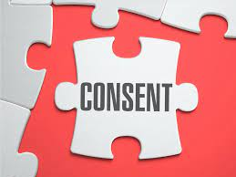
What is consent?
The definition of consent is…
“An agreement by choice made by someone with the freedom and capacity to provide consent.”
Turn and Talk
With the person next to you discuss why choice, freedom and capacity underlined in the definition?

Slide 7
Example of Consent
While watching the 2 volunteers think about the following questions:
Who had the responsibility for stopping how close the 2 people got?
How would you feel if the request was ignored?
If the volunteers did this activity again – can the person who was moving immediately go to where they stopped previously?
Notes:
For this activity you need 2 volunteers – they will stand about 3-5 meters apart. One person will move and the other will stand still. The person moving must ask “can I take a step forward?” The person standing still can say “yes” until the other person gets to close for them at this point the answer to the person moving is “no” – at this point the person moving must not move.

Slide 8
When is consent used in relationships?
Consent is normally linked to sexual relationships as consent is important when any sexual activity happens between 2 people.
Consent meant that both people agree to the sexual activity happening.

Slide 9
What is the Law around consent?
Rule of Law is a value that we follow in the UK.
The law states that if you do not gain consent for any sexual activity, this action is classed as sexual harassment all the way up to sexual assault including rape.
The charge is dependent on the sexual action that takes place.
It is also important in terms of the law to understand that consent can be withdrawn at any time. At this point all actions should stop otherwise this is nonconsensual action.

Slide 10
Recap Questions: whiteboard task – True or False
Consent is if one person says “yes” even if the other person says “no”
False – all parties involved in any sexual activity must give consent

Slide 11
Recap Questions: whiteboard task – True or False
If you continue with any sexual activity without consent you are breaking the law
True – this could be classed as sexual harassment or sexual assault (including rape)

Slide 12
How to provide consent
There are 2 main ways that consent can be given:
Verbally
Nonverbally
Turn and Talk - with your partner discuss different way that consent can be given verbally and nonverbally

Slide 13
What is verbal consent?
Verbal consent is when you actually say your decision around providing consent.
Examples of this are:
Saying no
Saying yes
A way to check for consent this way is through asking questions. An example of verbal consent was shown in the demonstration earlier this lesson

Slide 14
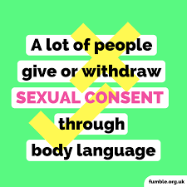
What is non verbal consent?
Non verbal consent is the use of body language and actions to convey your consent. Nonverbal consent is just as important as verbal consent. This is due to people being forced to verbally consent despite not wanting to provide consent.
A persons body language can say more about their choices than what they actually say

Slide 15
Example of non verbal consent
Lets look at different examples of non verbal actions that provide consent and examples that do not provide consent
Actions that provide consent
There is eye contact between people
The person has relaxed body language. This shows they are comfortable
The person is responsive to any questions or actions
There is touching/kissing and other actions
Actions that do not provide consent
One person is avoiding eye contact
One person is emotional. They may also have a rigid and tense body language
The person is not responsive. They are silent or display stillness
A person flinches when another person goes to touch or kiss them
Turn and Talk – with the person next to you, discuss the differences between these body language messages

Slide 16
What can impact a persons ability to provide consent?
Think – in your books write down as many things that might impact a persons ability to provide consent?
Pair – with the person next to you, discuss your ideas
Share – be ready to share your suggestions with the class

Slide 17
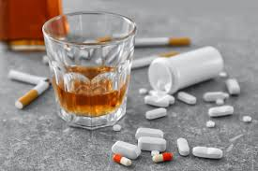
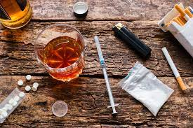
What can impact a persons ability to provide consent?
The two biggest factors that can impact a person’s ability to provide consent are:
Alcohol
Drugs
The law states that a complainant (the person who said they did not provide consent) does not need to be unconscious through alcohol or drugs to lose their capacity.
This means that a person can verbally consent but because of their intake of too much alcohol or drugs, they do not have the capacity to provide consent

Slide 18
Recap Questions: whiteboard task – True or False
Consent can only be given verbally?
False – non verbal consent through body language is just as important as verbal consent

Slide 19
Recap Questions: whiteboard task – True or False
A conscious person under the influence of drugs or alcohol may not be able to provide consent
True – they may have taken too many drugs or too much alcohol to have the capacity to make an informed decision

Slide 20
Consent – what we know
In your books write out the following paragraph and fill in the blanks. Use the Word Bank to help you.
Consent is an agreement by _______ made by someone with the freedom and _______ to do so. It is against the ______ to continue any action without consent. The legal age of sexual consent is ____. Consent can be given ________ or ________ and it can be ________ at any time. An example of verbal consent is ________. An example of non verbal consent is __________. Two things that can impair a person’s consent is _________ and ________. If a person has taken to much of these, they may not be able to ________ consent.
Word Bank
Provide
16
Choice
Capacity
withdrawn
drugs
Non verbally
Verbally
Alcohol
Law
You need to provide your own examples. Examples are not included in the word bank
choice
capacity
law
16
verbally
nonverbally
withdrawn
drugs
alcohol
provide

Slide 21
Consent - Recap
Watch the video and think about “what is consent” as you will have questions to answer on the next slide
Notes:
https://www.youtube.com/watch?v=pZwvrxVavnQ

Slide 22
Consent - Recap
In your books complete the following sentences:
At the end of the lesson I think consent is….
One important thing I have learnt about consent is…

Slide 23
Support
If you ever need support about consent for either yourself or a friend/family member you can get support from the following places
Childline.org.uk
Call – 08001111
Email or chat online for support
Themix.org.uk
You can email or have one-to-chat online.
There is also a crisis messenger which is available 24/7

Slide 24
Consent – Extension Activity
Alex was really out of it last night!
This is an example of some WhatApp message between 2 friends. Answer the questions in your books.
What do you think the friends are talking about?
Do you think Alex was able to give consent to whatever happened? Explain your answer.
What would you do if Alex was your friend?
So after you both left… did you?
Did we what?
You know… did you?
Yeah, yeah we did.
I never thought Alex would do that!
That’s what happens when you get drunk
Notes:
Key messages – Alex could have consented to whatever happened but it depends on how drunk they were. When some seeks consent they assume responsibility for ensuring the other person has the capacity to consent. Rule to live by “if in doubt, assume consent has not been given”

