Slide 2
Write the date: 10 April 2024
Write the title: What is my identity?
Underline both!
Complete the do now task:
True or False – Peer Pressure is only a negative thing
2. What type of bullying is being described – “hitting, pushing or kicking someone to cause hurt
3. True or False – Carbohydrates should make up 1/3 of your daily food intake
False – you can positively influence your peers
Physical Bullying
True

Slide 4
Big question: How can finding my identity help secure my relationships
Today we will look at:
How identity links to self worth
What makes up our identity?
How does identity link to values?
How do people express their identity?

Slide 5
What is our starting point?
In your books you are going to draw a spider diagram. In the middle of your spider diagram should be “identity” Look at the spider diagram below to add detail to your work.
Write a description or definition of identity
What words are associated with identity?
Identity
What words or objects are linked to your identity?

Slide 6
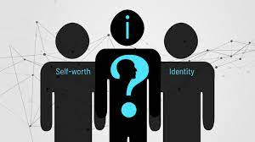
Identity and Self Worth
Self worth is the internal sense of being good enough and worthy of love and belonging from others.
A huge factor in your own self worth is understanding your identity.
Identity is summarised by “who do you think you are?” and “how do you perceive yourself?”

Slide 7
Identity
While watching the video answer the following questions:
What things can form your identity?
What is a benefit of having a strong sense of identity?
What are values? Can you give an example?
Notes:
https://www.youtube.com/watch?v=om3INBWfoxY watch from beginning to 2:12

Slide 8
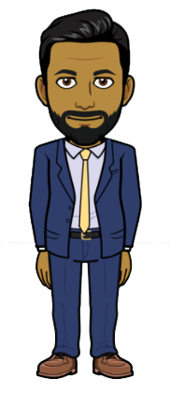
Examples of people who have a strong sense of their identity and values
Mr Patel – Deputy Head Teacher
What 3 things make up your identity?
Family. I am a son, a father, husband and uncle
Liverpool supporter
Friend

Slide 9
Examples of people who have a strong sense of their identity and values
Mr Patel – Deputy Head Teacher
What 3 values do you have?
Hard working
Resilient
Quick thinker especially in an emergency/crisis

Slide 10
Examples of people who have a strong sense of their identity and values
Mr Patel – Deputy Head Teacher
Did you always have a strong sense of identity/values or has it developed over time?
“From 6th Form onwards, I have developed the identity I have today. The values were instilled in me from a young age by my mother, father and wider family unit and I have matured over the years”

Slide 11
Recap Questions: whiteboard task –
Give one example of something that can impact your identity

Slide 12
Recap Questions: whiteboard task –
Give one example of something that can be a value

Slide 13
Recap Questions: whiteboard task – True or False
Everyone has the same identity and values?
False – everyone has their own identity and values. There might be similarities but no one is the same.

Slide 14
What does your identity look like now?
We are now going to reflect on our current identity.
Inside the body, write 5 things that make up your identity
If you feel confident enough, you will be asked to share things that make up your identity. While people are sharing their ideas, around the outline write things down suggestions that are important to you.
You can reflect on this and see how they may shape your identity in the future

Slide 15
Notes:
Pupils can share some things that make up their identity and you can write key point inside or around the outline

Slide 16
Individuality
Although we are all similar, everyone is their own individual.
Turn and Talk
Why is important that we are not all the same?
Be ready to share your ideas.

Slide 17
Individuality
People can choose to express their identity in different ways.

Slide 18
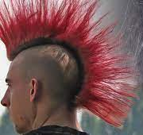
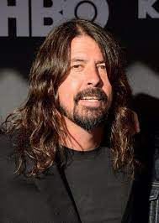
Individuality – Examples - Hairstyle
This hairstyle is traditionally a sign of showing that you listen to punk rock
Braids and the many different styles is a way that many black women show part of their identity
A lot of “rock stars” grow long hair. Listening to rock music is part of their identity especially when they head bang!

Slide 19
Individuality
Turn and Talk Task
What other ways can people express their identity?

Slide 20
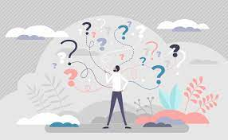
I don’t know my identity or values?
You may have been thinking throughout this lesson “I have no idea about my identity or values. Should I be worried?
ABSOLUTELY NOT!
You will continue to develop and change your identity and values as you get older.
However you will still currently have an identity and values. You just can’t quite explain them now

Slide 21
I don’t know my identity or values?
While watching the video, in your books make a list of the different things you can do to think about what makes up your identity and values.

Slide 22
Recap Questions: whiteboard task –
Give one way that people may express their identity or values?

Slide 23
Recap Questions: whiteboard task – True or False
You should already know your identity and values
False – you may have some idea but you are too young for this to be fully developed

Slide 24
Recap Questions: whiteboard task – True or False
Your identity and values will change and develop as you get older
True – as you mature your identity and values may change as you have different experiences

Slide 25
Recap Questions: whiteboard task –
What is one thing you can do to try to help you find your identity and values?

Slide 26
Identity and values reflection
In your books complete the following sentences
One part of my identity is…
This is important to me because…
I can express this by…

Slide 27
Support
Exploring your identity and values can be difficult but there is support out there for you.
Childline.org.uk
Call – 08001111
Email or chat online for support
Themix.org.uk
You can email or have one-to-chat online.
There is also a crisis messenger which is available 24/7

Slide 29
Notes:
Here use cold calling to get answers from the class about what characteristics they came up with. You can write up their ideas on the board. Pupils can continue to add to their worksheet using red pen during this activity. Pupils then stick worksheet into books.

